Slide 1




Notes:
The Office of Research and Sponsored Programs welcomes you to our overview of the Student Undergraduate Research Fellowship program also known as SURF and administered by the Arkansas Division of Higher Education (ADHE). The purpose of the grant is to support the continued development of undergraduate academic efforts at Arkansas’s public and private institutions of higher education and to provide funding to encourage students to complete in-depth projects in various fields of study under the tutelage of tenured or full-time faculty member. In this presentation, we will cover eligibility, materials you’ll need to apply, putting together a successful application, and how mentors and students will work with our office to submit SURF proposals.

Slide 2
Student Undergraduate Research Fellowship
Eligibility
Guidelines
To be eligible to apply for SURF:
3.25 GPA or higher
The SURF program provides up to $3,250 in funds to undergraduate students in any major.
Full-time student
30 hours or more of college credit by January 1
Partnership with a UCA faculty mentor
U.S. citizen or permanent resident alien
No more than 2 years previous SURF funding
Not a post-baccalaureate
Notes:
The SURF program is designed to assist all students throughout the state in any discipline. The grant provides up to $3,250 to students, depending on the project period they choose to carry out their activities, and $750 for the faculty mentor who can use funds for salary, supplies, or travel. All students who receive a SURF grant must allocate $750 for professional conference travel.
To be eligible, students must have at least 3.25 GPA, have achieved sophomore status by the time they will begin their projects in January, created a partnership with a faculty mentor, and be a US citizen or permanent resident alien. Students who have received three years of funding are no longer eligible. Students who have already earned a bachelor’s degree are not eligible.

Slide 3
Student Undergraduate Research Fellowship
Deadlines & Links
To register with ORSP, mentors should fill out the form here:
uca.edu/go/submit-my-proposal
Deadlines
Mentor Registers w/ OGSR | September 15
Optional Feedback | 2nd Wednesday of October
Completed Packets | Day before Fall Break
For optional feedback on your proposal, send documents for review to OGSR@uca.edu.
Everything you need to apply can be found here:
uca.edu/sponsoredprograms/SURF/
Notes:
To begin the application process, the mentor will register their intent to apply with the Office of Research and Sponsored Programs. Please note that ADHE will not accept applications from individuals, so you must apply through our office. To provide us ample time to process proposals, we have established some internal deadlines: one for registration, which will always fall on September 15, one for optional feedback on your proposal which will always be on the second Wednesday of October, and the deadline for completed packets which will always be the day before Fall Break.

Slide 4
Student Undergraduate Research Fellowship
SURF
Application
Activity Amounts
Activity | Spring Only | All Other Periods
Project Costs (ADHE) | $ 625 | $1250
Project Costs (UCA Match) | $ 625 | $1250
Student Travel | $ 750 | $ 750
Mentor Costs | $ 750 | $ 750
Total | $2,750 | $4,000
The total SURF award is a combination of funding from the state of Arkansas and UCA.
Remember that students are required to travel to a professional conference. Save all travel documentation: registration, mileage, airfare, meals, parking.
Notes:
This is a breakdown of the funding amounts for the different project periods. As you can see, UCA provides funds for the matching requirement; however, the Arkansas Division of Higher Education manages the program, applications, reviews, and awards. We have provided two sets of templates and tips on our website that are based on ADHE’s guidelines for completing each narrative component: one for the spring only project period and one for all other project periods. Be sure to follow the instructions for headings and page limits. For all documents.

Slide 5
Student Undergraduate Research Fellowship
Application
Checklist
What You Need to Apply
UCA Registration Form (filled out online by September 15)
ADHE Budget Form
ADHE Cover Page and Budget Justification Form (one document)
UCA Proposal Budget Form
UCA Request for Cost-Sharing Form
ADHE Mentor Form
ADHE Student Form
Mentor's vita (2-page maximum)
Student’s résumé (2-page maximum)
Current official transcript from the Registrar’s Office
Current class schedule screenshot from myUCA
One-page summary of proposed research
Description of proposed research (maximum of 5 pages, doubled spaced)
Reference list (no page limit)
Letter of support from mentor
Two letters of recommendation from faculty members
IRB or IACUC approvals
Financial Aid consultation
Notes:
As you can see from the checklist on this slide, the application packet is quite large and will require a lot of planning and time to complete. It is extremely important that you work as far in advance as you possibly can to prepare the packet. On the ORSP website, you will find all the forms listed here along with templates for the other components that contain tips and tricks for preparing a competitive proposal to lighten some of the burden of applying. We have put together two packets for students who wish to apply: one for those who intend to apply for the spring only and one for those who intend to apply for all other project periods. You can access the packets at uca.edu/sponsoredprograms/SURF.

Slide 6
Student Undergraduate Research Fellowship
Important!
If you receive state scholarships, please remember…
SURF grants apply toward Arkansas scholarship stacking limits. If you are receiving state aid that pays your full tuition, you need to speak with Financial Aid about re-arranging your aid.
This doesn’t mean you shouldn’t apply!
SURF is very prestigious and is a testament to your desire to extend your learning beyond the classroom. A SURF grant looks very good in applications for graduate school or for other grants.
Notes:
The grant professionals in ORSP find that getting the little things out of the way first helps you concentrate on the more important things, so we’ve arranged this presentation to cover forms and smaller documents first, reserving a discussion about the project description for last.
If you receive state-funded scholarships, SURF will apply to Arkansas state stacking limits, so you may want to speak with your financial aid advisor before you begin your application. This doesn’t mean you shouldn’t apply if your full cost of attending UCA is covered by state funding. SURF gives you the opportunity to manage a special project with guidance from a mentor, which can strengthen graduate or professional school applications and looks very good on your academic CV.

Slide 7
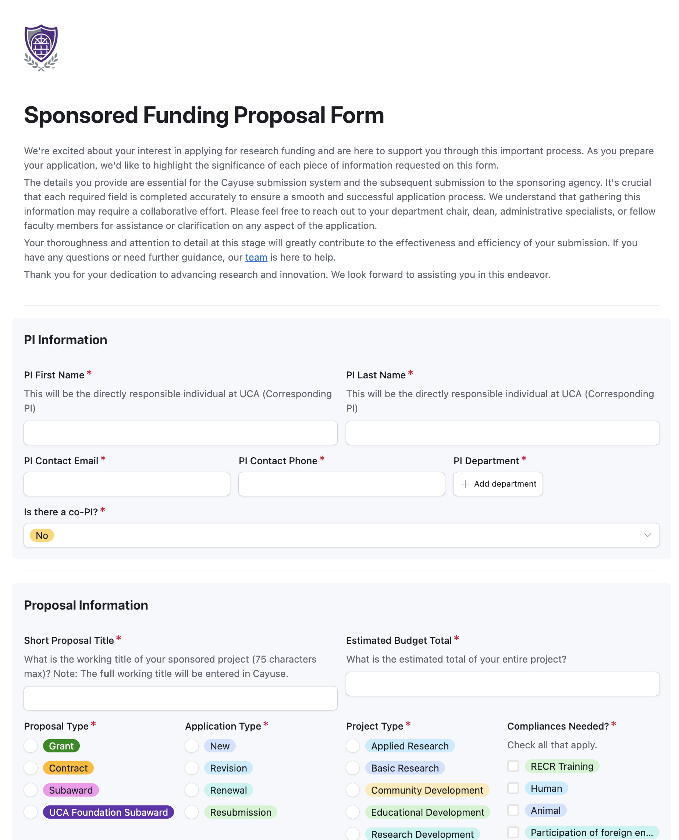
Student Undergraduate Research Fellowship
Registration
SURF Online Registration Form
Available at uca.edu/sponsoredprograms/SURF/
or uca.edu/go/submit-my-proposal.
Notes:
Remember that the first step in applying for SURF is having the faculty mentor fill out the “Intent to Apply” registration form. Students should be listed as Co-PIs on this form. The budget total for spring only is $2,750; the budget total for all other project periods is $4,000.

Slide 8
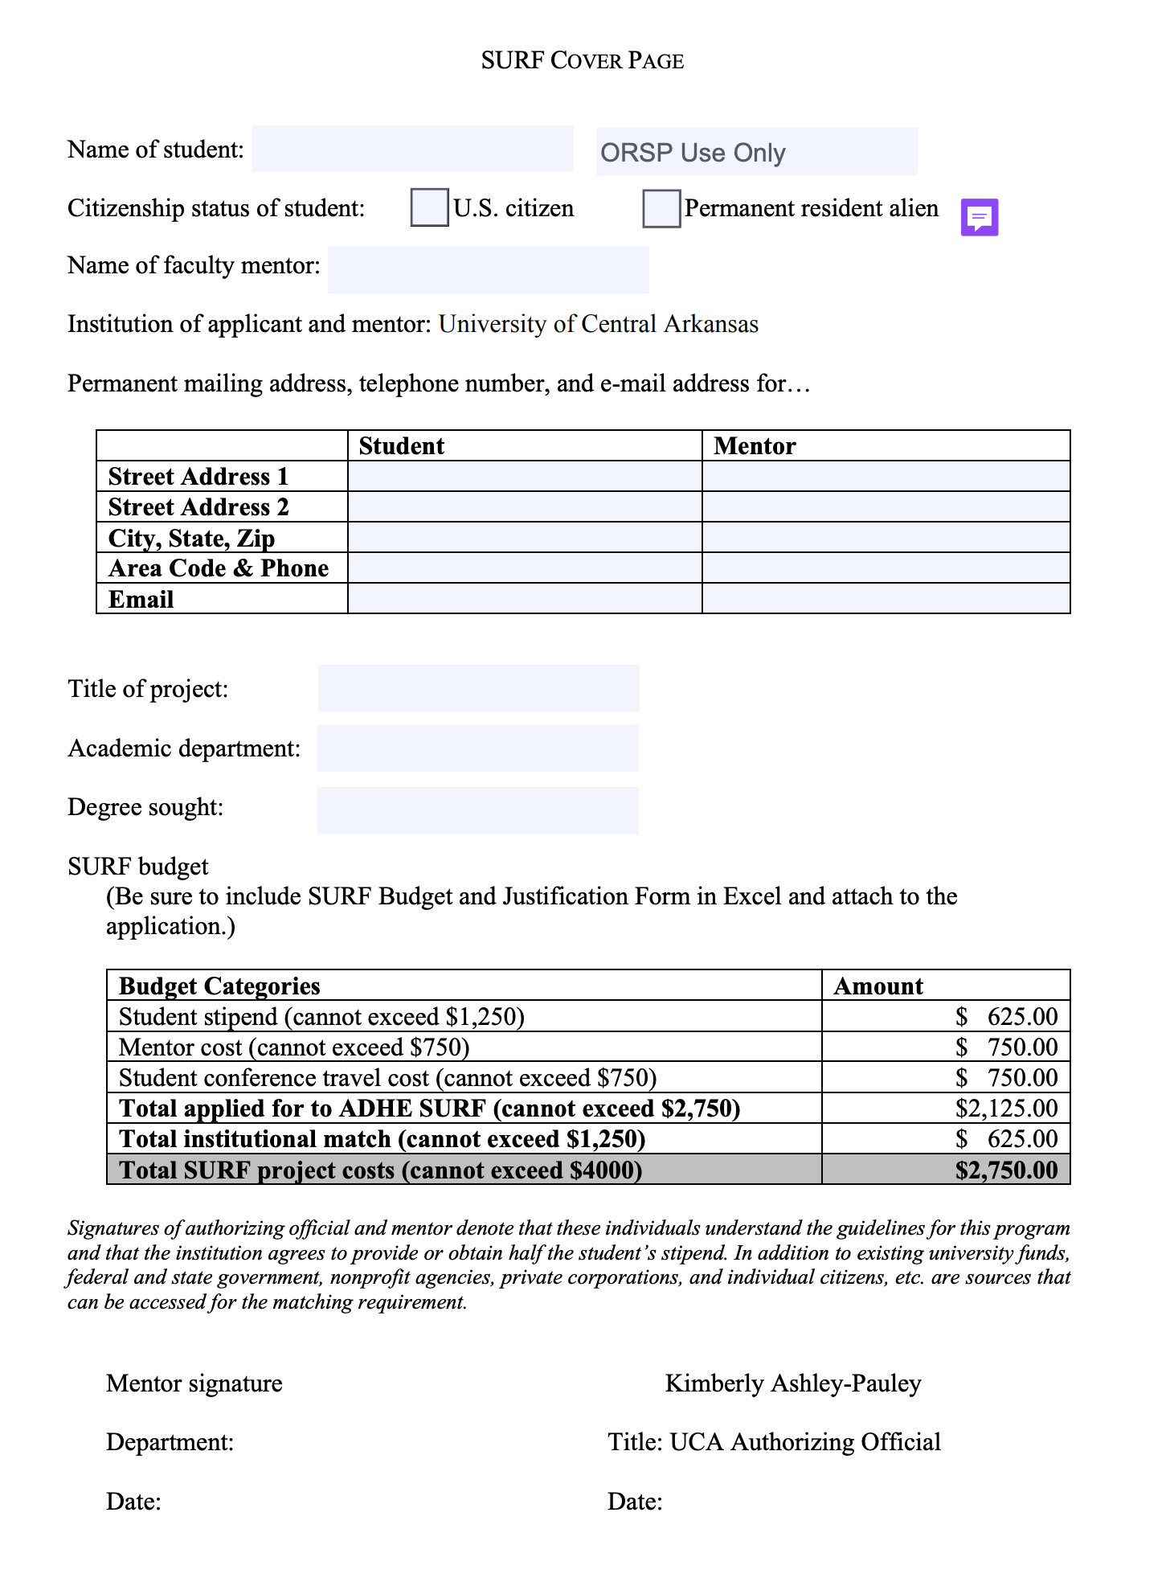
Student Undergraduate Research Fellowship
SURF
Application
SURF Cover Page:
OGSR Website
Remember!
Order an official transcript from the registrar’s office.
Screenshot a list of your current semester schedule from myUCA.
Budget information is pre-filled. Please do not make any changes.
Notes:
You will be filling out parts of your budget five times throughout the process beginning with the Cover Page. A fun fact about grants: every budget you submit for any grant is an estimate. Another fun fact is that, except for the mentor’s share and the required student travel, this budget is discretionary. You can use it to pay for your utilities, a new computer to assist you in your classwork, or even your rent if it will allow you to cut back on working hours to focus on your project. Please do not change any pre-filled numbers where you’re asked to fill out information about your budget and be sure to ask for the full amount. If you are a permanent resident alien, please bring a physical copy of your green card to our office. Do not send it via email. Don’t forget to request a transcript from the Registrar’s Office and to take a screenshot of your current class list.

Slide 9
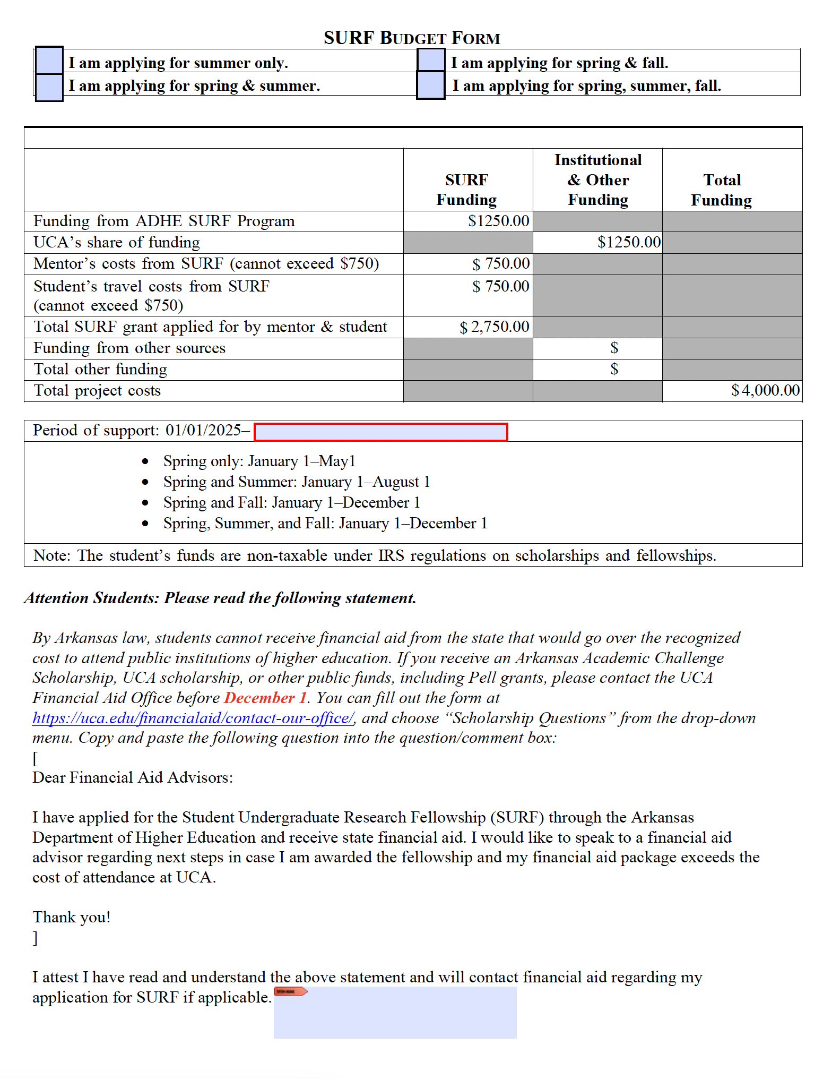
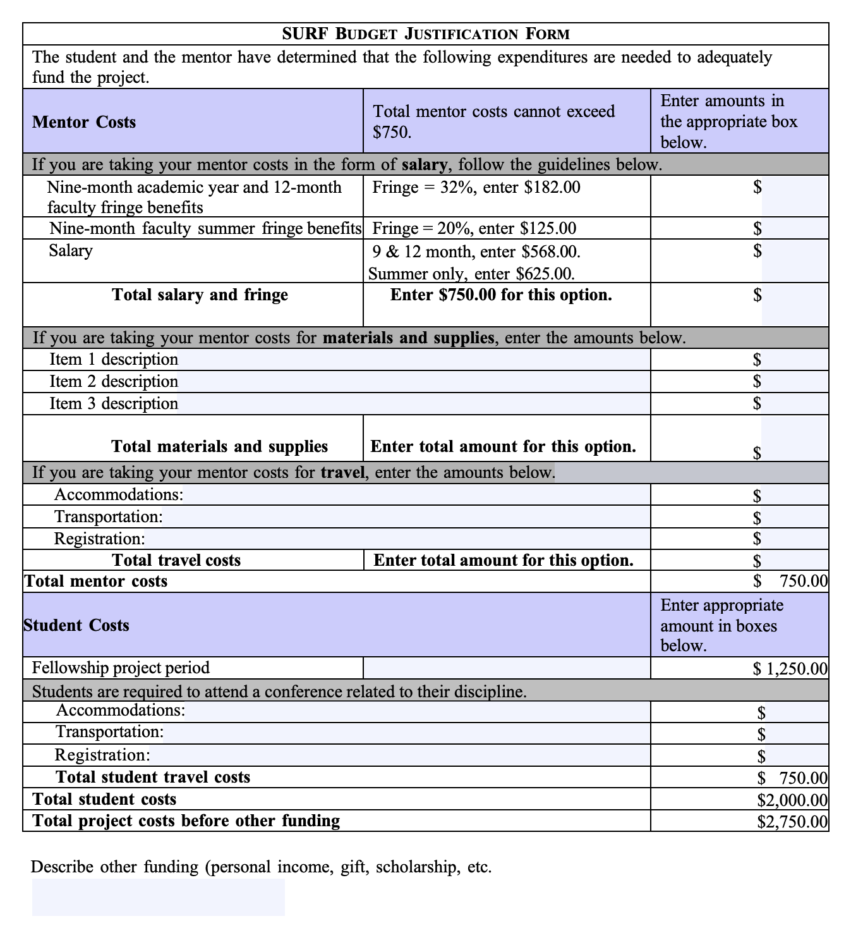
Student Undergraduate Research Fellowship
SURF
Application
ADHE’s SURF Budget and Justification
Notes:
Please fill out the ADHE Budget and Justification forms. Some amounts have been pre-filled. Just as a reminder, this is a discretionary grant, and you should request the full amount for the project period. Please do not change any amounts. Please be sure to fill out the red box, indicating your project period, on the budget form and be sure to read and sign the statement at the bottom.

Slide 10
Student Undergraduate Research Fellowship
SURF
Application
Mentor’s Letter of Support
Addressed to SURF Selection Committee
Should discuss student’s academic abilities and performance, especially as related to the project
Should outline significance of the project
Should indicate student’s ability to complete the project within the timeline
Should outline mentor’s advisory role
Printed on letterhead, digital signatures are fine
Two Letters of Recommendation
Addressed to SURF Selection Committee
Should discuss student’s academic abilities and performance
Should give specific examples of student’s merit and potential
Should be written on letterhead, digital signatures are fine
Notes:
The mentor’s letter of support is a different type of letter from the two letters of recommendation students must submit as part of their application. While all should be addressed to the selection committee and be written on letterhead, the mentor’s letter of support should focus on the project that will be completed by the mentor and mentee, the student’s ability to work in a timely manner, and the role the mentor will play in the project.

Slide 11
Student Undergraduate Research Fellowship
SURF Application
Mentor’s Vita
Mentors should include the following information in their vitae:
Name, department, institution
Brief statement of scholarly interests
List of recent publications
List of undergraduate advisees and projects directed in last five (5) years
Other relevant information as space allows.
Remember!
The CV is limited to two (2) pages.
OGSR has provided a template on the SURF webpage.
Notes:
The mentor’s vita is a 2-paged summary of their academic CV that should focus on work they’ve carried out with students that is relevant to the project and to the SURF program. We have provided a template with tips on our website.

Slide 12
Student Undergraduate Research Fellowship
SURF Application
Student Vita
It should include...
Education: GPA, degree plan, number of hours completed, class standing (sophomore, junior, senior)
Your academic résumé is an important part of your application.
Honors & Awards: scholarships, previous SURF funding, dean’s list, president’s list, other honors
Academic Experience: lab experience, scholarship, artistic activity, presentations, posters, publications, projects
OGSR has provided a template on the SURF webpage.
Employment: Title, company, city, and descriptions of duties and dates worked
Other Experience: leadership experience, volunteer work, community service, related work experience, significant hobbies
Notes:
SURF peer reviewers consider the student’s vita as one of the more important narratives included in the package, so make sure you follow the template. Do not include achievements from high school and do not use a creative résumé template as you might find on Canva or in Word. This should an academic résumé.

Slide 13
Student Undergraduate Research Fellowship
Compliance
IRB
If your research involves live human subjects, you will need to submit the appropriate form to the Research Compliance Officer by October 1. Please work with your mentor to determine what level of review your research will require.
Visit uca.edu/researchcompliance for more information.
IACUC
If your research involves live vertebrate animals, you may need Institutional Animal Care and Use Committee approval. Please contact the Research Compliance Officer by October 1.
Visit uca.edu/researchcompliance
for more information.
Notes:
If you are awarded a SURF grant, you will want to have IRB or IACUC approvals in place before January 1, which is the day your project period begins. Because IRB and IACUC meetings are scheduled years in advance, you should contact Research Compliance on or before October 1 to see if your project requires review and approval for human participants or animal subject research.

Slide 14
Student Undergraduate Research Fellowship
SURF Application
Project Description
Answer these questions:
What need will this project meet? In your field of study? In the community?
How and why will it meet this need?
In what ways will the project you are proposing prepare you for future endeavors?
What facilities and resources are available to help ensure you are successful?
Remember!
Cite your sources, including data, figures, and language you borrowed. Use the style guide specific to the discipline.
The project description should be double-spaced.
OGSR has provided a template on the SURF webpage.
Notes:
The project description is the most important part of the application package. We recommend completing the smaller tasks first so you can concentrate on writing the description. STEM applications will look very different from non-STEM applications in that they will include a discussion of the hypothesis and methodology. Students should write their own proposal descriptions, but mentors should also offer guidance and feedback. Remember that each document in your packet is an opportunity for you to demonstrate your professionalism and persuade the reviewers you are the right person to carry out the proposed project. Even the reference list, which is separately numbered from the project description, is an opportunity to persuade, so be sure your citations are consistent with the style guide of your discipline.

Slide 15
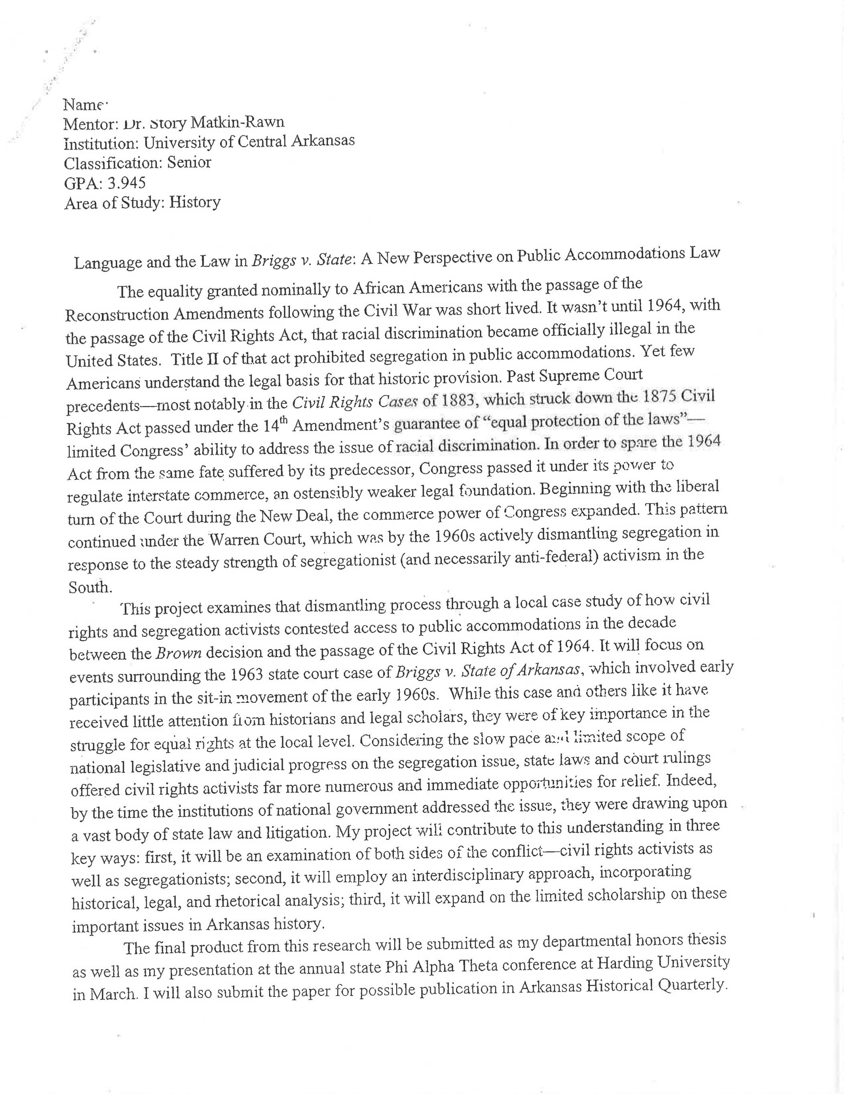
Student Undergraduate Research Fellowship
SURF Application
Summary
One Page
In the heading, include…
Your name,
Mentor’s name,
Institution,
Classification,
GPA,
Area of study,
And title of the project.
OGSR has provided a template on the SURF webpage.
Notes:
We suggest you write your summary last because it’s easier to summarize the project description once you’ve completed it. The summary can be single spaced, but remember to include the required information at the top at the top and do not use the space as a way to expand on the project description. Note the title of this awarded SURF proposal is “Language and the Law in Briggs v. State: A New Perspective on Public Accommodations Law.” The main title uses alliteration to draw the peer reviewers’ attention, while the subtitle explains what is meant by the main title. This is not a suggestion that you use alliteration in every main title, but that you be at least a little creative with other kinds of literary and rhetorical devices to stand out.

Slide 16
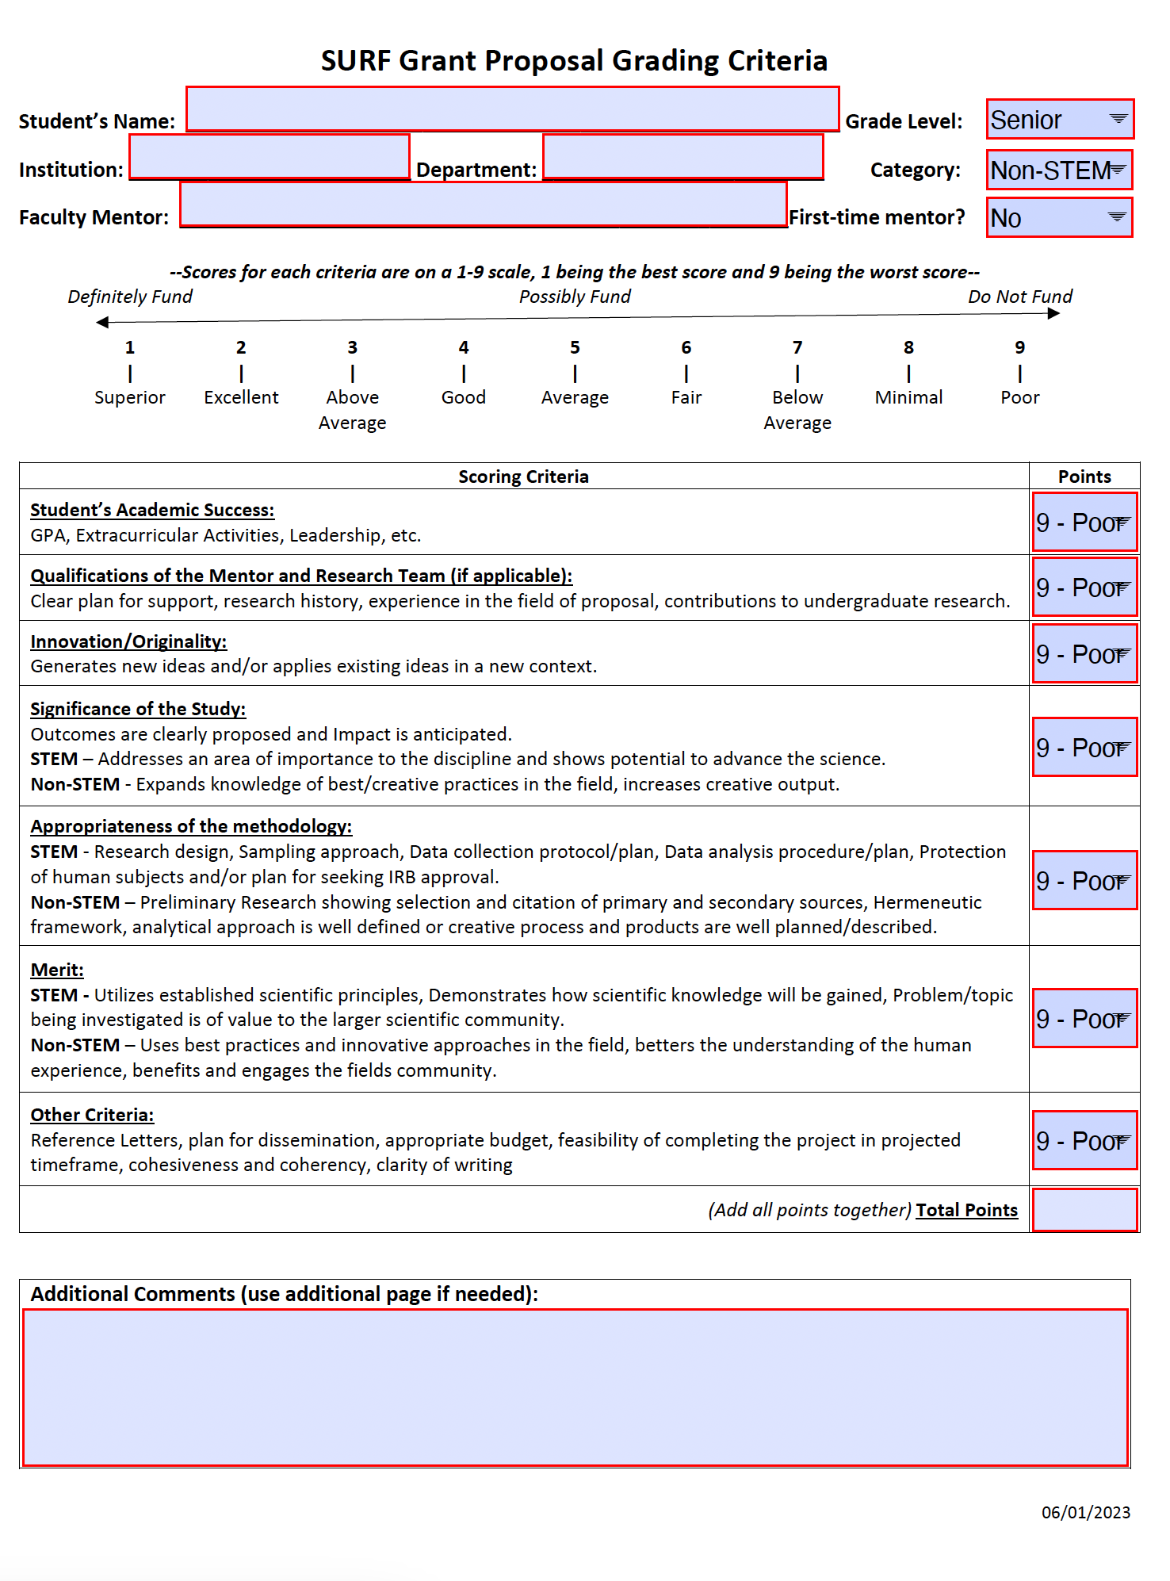
Student Undergraduate Research Fellowship
How Applications Are Reviewed
SURF Evaluation Form
Notes:
This is a copy of the evaluation form given to the reviewers who score the proposals individually first, and then meet to rank proposals from most to least competitive. This form is loosely based on NIH review criteria where lower scores are at the top. Reviewers comprise professors from all over Arkansas who volunteer for the opportunity.

Slide 17

Student Undergraduate Research Fellowship
Questions?
Research Compliance
Budget
Writing
OGSR@uca.edu
ResearchCompliance@uca.edu
Notes:
If you have any questions about budget related issues or about writing the various components of your proposal, please contact ORSP. If you have questions about research compliance, please contact the research compliance officer.

