Slide 1


Torreyson West, Ste. 328

Slide 2
Student Undergraduate Research Fellowship
Eligibility
Guidelines
To be eligible to apply for SURF:
The SURF program provides up to $3,250 in funds to undergraduate students in any major.
3.25 GPA or higher
30 hours or more of college credit by January 1 of the current year
Partnership with a UCA faculty mentor
U.S. citizen, resident alien, or national
Must NOT have previously earned a bachelor’s degree

Slide 3
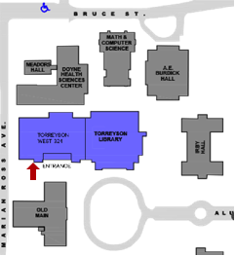
Student Undergraduate Research Fellowship
How to Apply
Deadline
Completed applications must be submitted to Sponsored Programs in Torreyson West, Ste. 328. See website for dates.
Everything you need to apply
can be found at
uca.edu/sponsoredprograms/home/surf

Slide 4
Student Undergraduate Research Fellowship
Application
Checklist
What You’ll Need to Apply
SURF registration (see the Sponsored Programs website).
SURF cover page
Mentor form and mentor's vita (2 page maximum)
Student form and student résumé (2 page maximum)
Current sealed, official transcript from the Registrar's office
Listing of current semester classes printed out from myUCA
One-page summary of proposed research
Description of proposed research (maximum of 5 pages, doubled spaced)
Reference list (no page limit)
Budget and budget justification forms from ADHE SURF application package
UCA Budget Spreadsheet
Letter of support from mentor
Two letters of recommendation from faculty members

Slide 5
Student Undergraduate Research Fellowship
Important!
If you’re on a “full ride,” consider your financial aid!
SURF grants apply toward Arkansas scholarship stacking limits.
If you are receiving state aid that pays your full tuition, you will have to drop a scholarship if you are awarded a SURF.
This doesn’t mean you shouldn’t apply.
SURF is very prestigious and is a testament to your desire to extend your learning beyond the classroom.
A SURF grant looks very good in applications for graduate school or for other grants.
If you win a SURF, work with Financial Aid to determine the best route for financing your education.

Slide 6
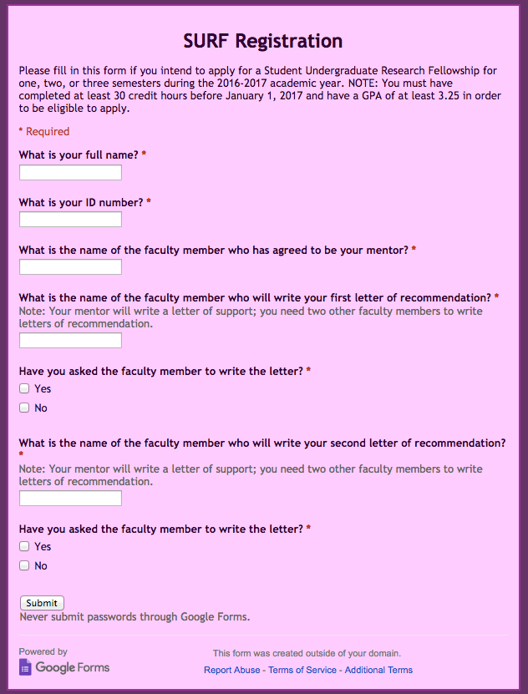
Student Undergraduate Research Fellowship
SURF
Application
SURF Online Registration Form
Available at uca.edu/sponsoredprograms/home/surf

Slide 7
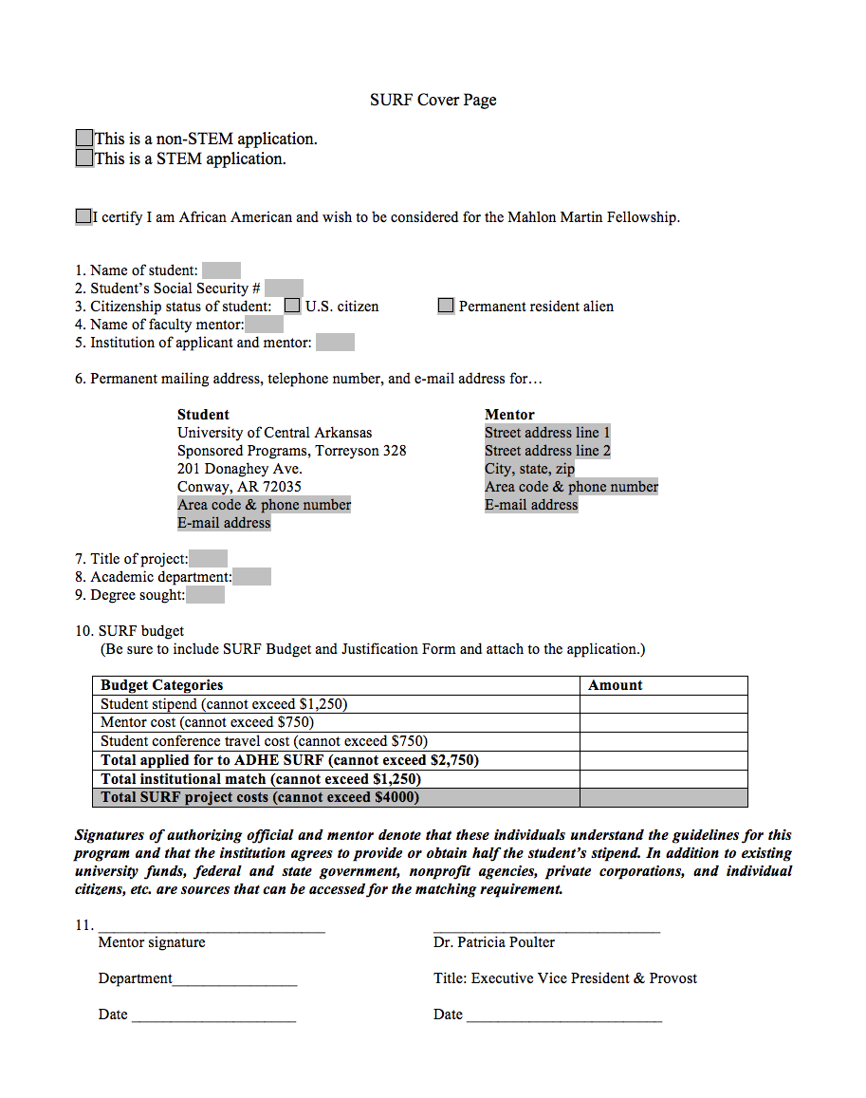
Student Undergraduate Research Fellowship
SURF
Application
SURF Cover Page:
Sponsored Programs Website
Remember!
Order an official transcript from the registrar’s office.
Print out a list of your current semester courses from myUCA.
Please type inside the form rather than printing out and handwriting.

Slide 8
Student Undergraduate Research Fellowship
SURF Application
Mentor’s CV
Mentors should include the following information in their CVs:
Name, department, institution
Brief statement of scholarly interests
List of recent publications
List of undergraduate advisees and projects directed in last five (5) years
Other relevant information as space allows.
Remember!
The CV is limited to two (2) pages.

Slide 9
Student Undergraduate Research Fellowship
SURF Application
Student Résumé
It should include...
Education: GPA, degree plan, number of hours completed, class standing (sophomore, junior, senior)
Your academic résumé is an important part of your application.
Experience: lab experience, scholarship, artistic activity, presentations, posters, publications, projects
Honors & Awards: scholarships, previous SURF funding, dean’s list, president’s list, other honors
Other Experience: leadership experience, volunteer work, community service, related work experience, significant hobbies

Slide 10
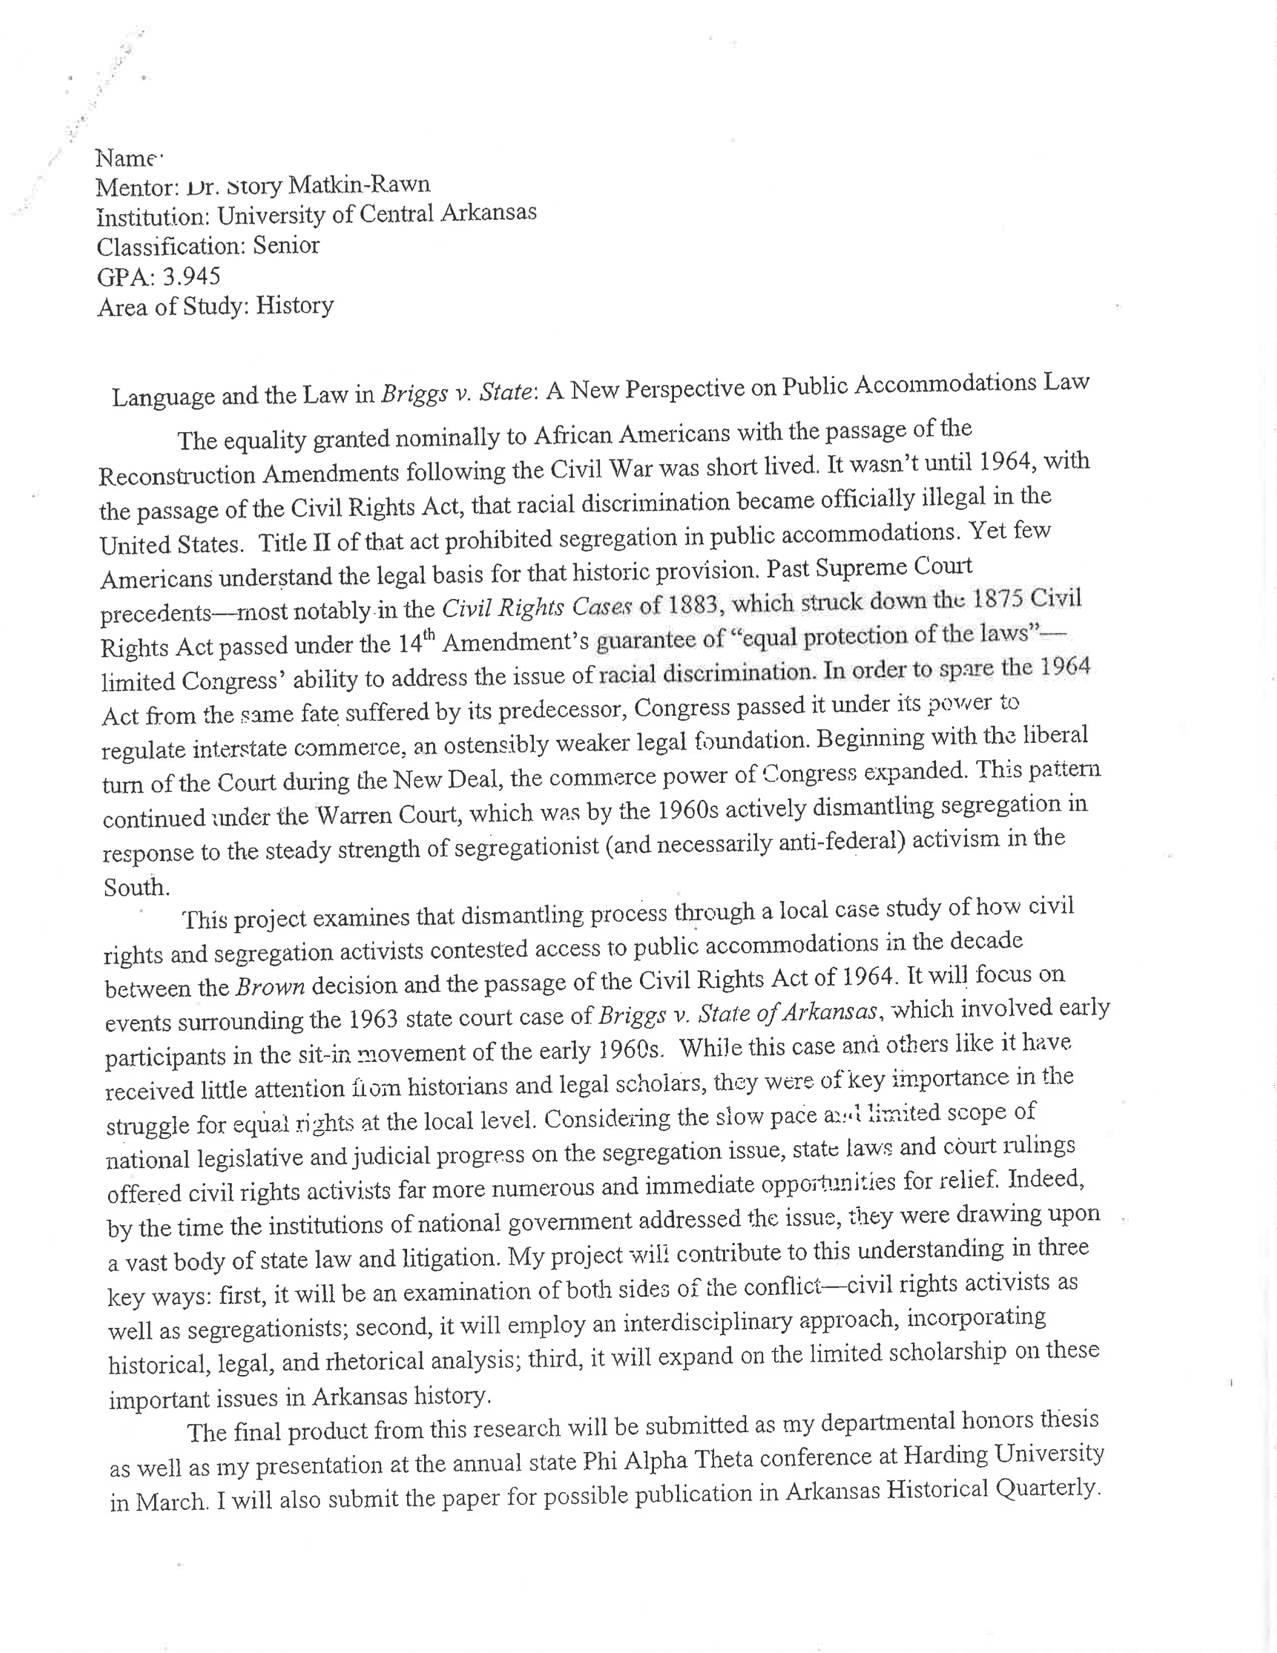
Student Undergraduate Research Fellowship
SURF Application
Summary
ONE page
In a heading, include…
Your name,
Mentor’s name,
Institution,
Classification,
GPA,
Area of study,
And title of the project.

Slide 11
Student Undergraduate Research Fellowship
SURF Application
Proposal Narrative
Answer these questions:
What need will this project meet? In your field of study? And in the wider scheme of things?
How and why will it meet this need?
In what ways will the project you are proposing prepare you for future endeavors?
What facilities and resources are available to help ensure you are successful?
Remember!
Cite your sources, including data, figures, and language you borrowed. Use the style guide specific to the discipline.

Slide 12
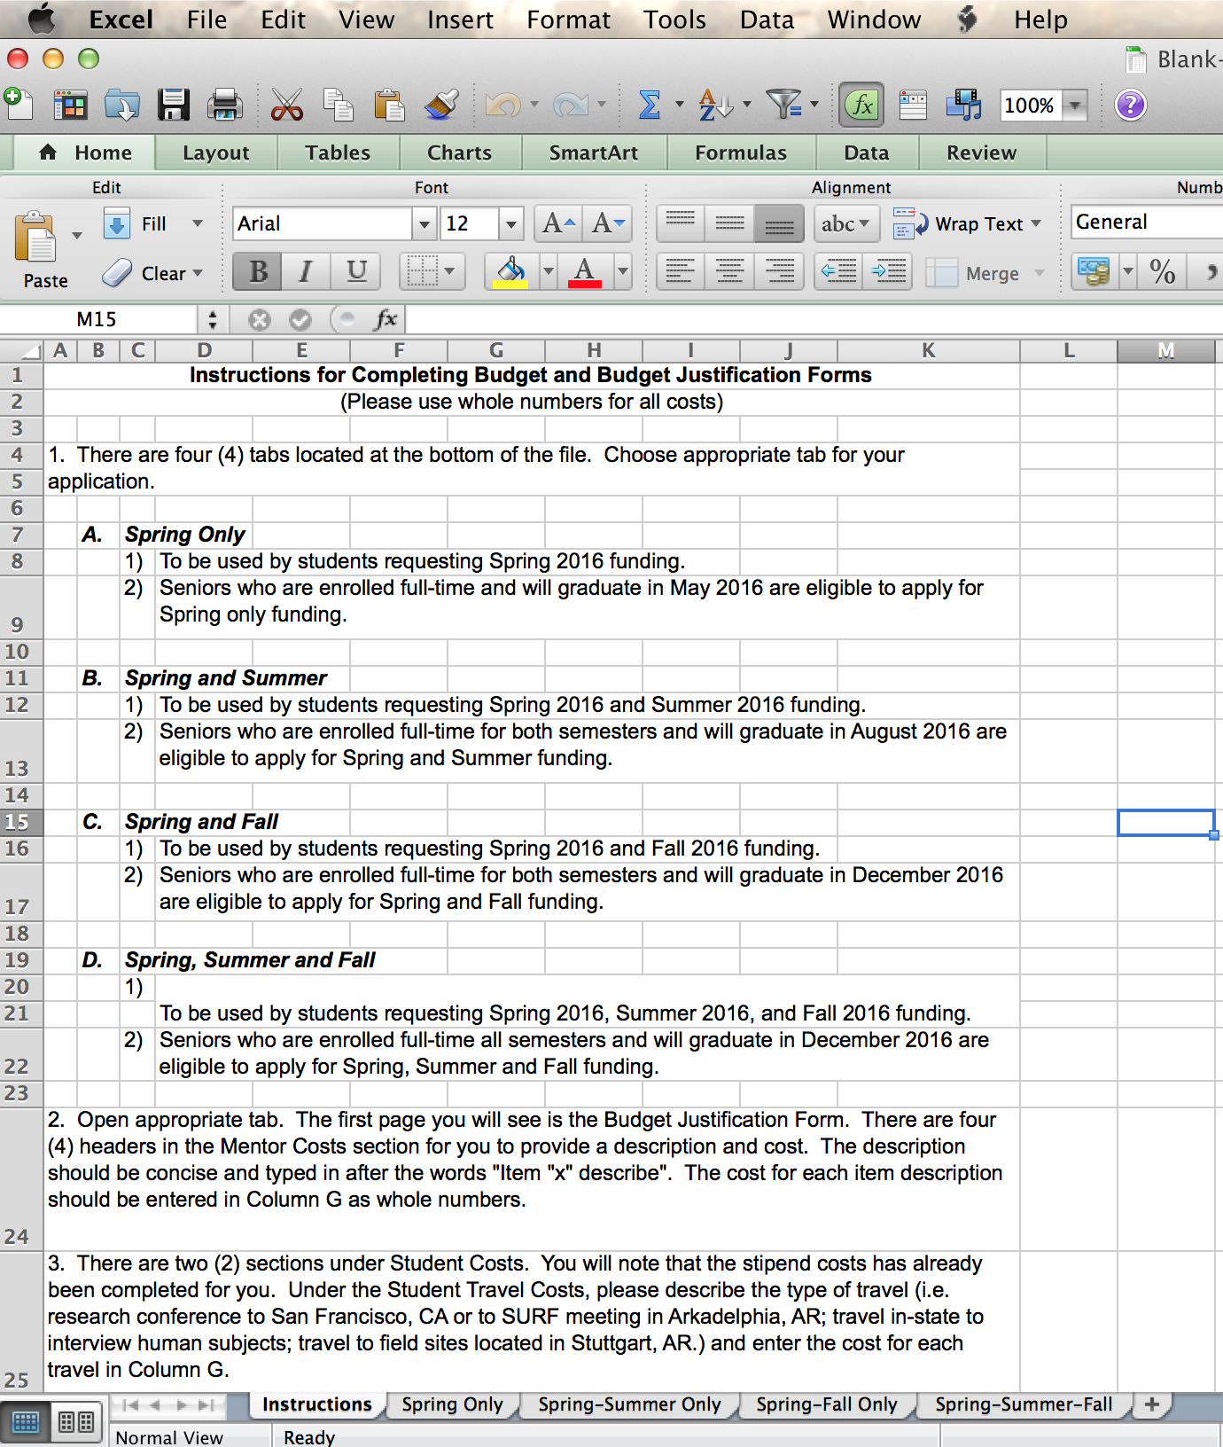
Student Undergraduate Research Fellowship
SURF
Application
ADHE’s SURF Budget and Justification

Slide 13
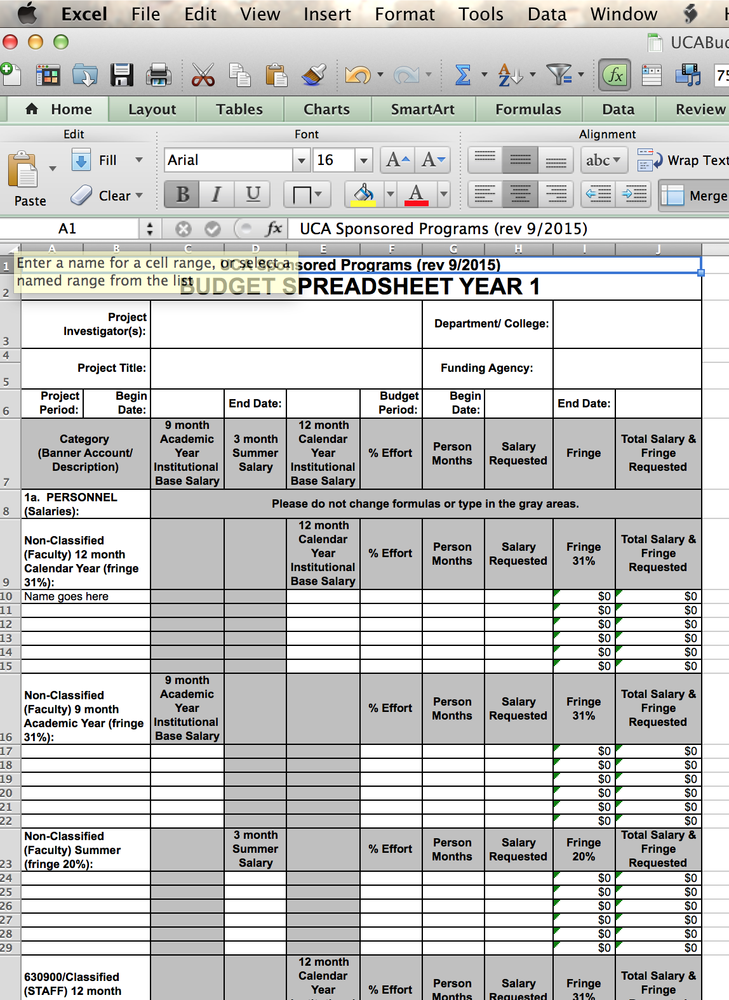
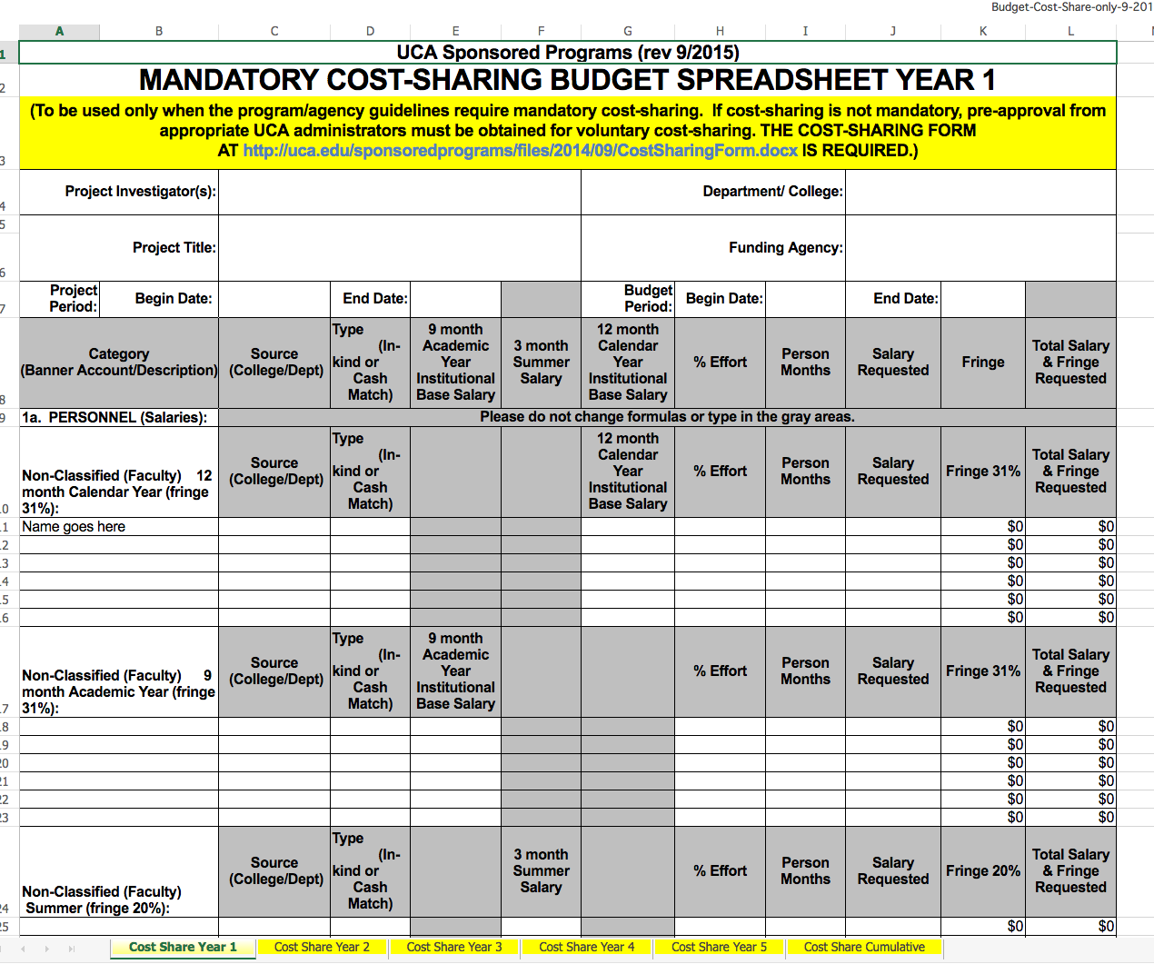
Student Undergraduate Research Fellowship
SURF
Application
UCA Budget Spreadsheet
UCA Budget
Spreadsheet for Matching Funds
Both forms must be filled out to help our administrators process your budgets in a timely manner.

Slide 14
Student Undergraduate Research Fellowship
SURF
Application
SURF Funding Amounts
Project Funding Amounts
$625 for projects completed within the spring semester from ADHE
The total SURF award is a combination of funding from the state of Arkansas and UCA.
If you have a question about your budget, please contact a research administrator at 450-3451 or SponsoredPrograms@uca.edu.
$1250 for projects requiring two or more semesters to complete from ADHE
$625 or $1250 matching grant from UCA
$750 for student conference travel from ADHE
$750 for mentor costs from ADHE
$4000 total available for SURF award

Slide 15
Student Undergraduate Research Fellowship
SURF
Application
Mentor’s Letter of Support
Two Letters of Recommendation
Addressed to SURF Selection Committee
Should discuss student’s academic abilities and performance, especially as related to the project
Should outline significance of the project
Should indicate student’s ability to complete the project within the timeline
Should outline mentor’s advisory role
Printed on letterhead, signed and delivered with signature across the seal
Addressed to SURF Selection Committee
Should discuss student’s academic abilities and performance,
Should give specific examples of student’s merit and potential
Printed on letterhead, delivered in an envelope signed across the seal

Slide 16
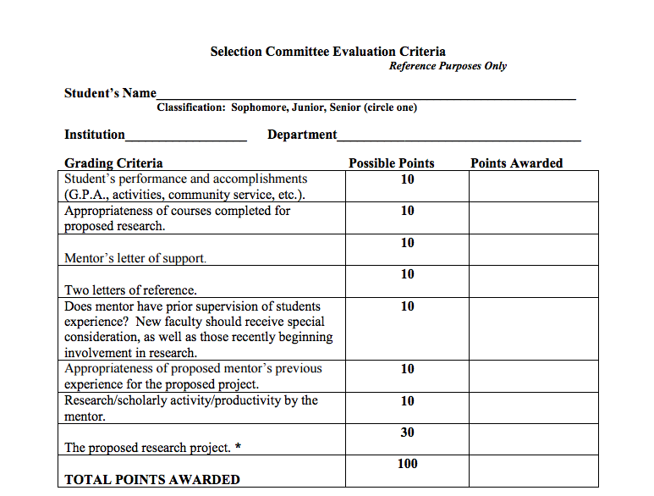
Student Undergraduate Research Fellowship
How Applications Are Reviewed
SURF Evaluation Form

Slide 17
Student Undergraduate Research Fellowship
Additional
Opportunities
Mahlon Martin Fellowship
The Mahlon Martin Fellowship is awarded to two to four African-American students annually. Eligible African-American students should check the Mahlon Martin box at the top of the SURF cover page if they wish to apply for this opportunity, which will enable awardees to be paid for additional time on the project as well as provide an expanded travel budget.
The fellowship was named in honor of Mahlon Martin, a dedicated council member who contributed valuable knowledge and insight into the SURF program. Mr. Martin died in 1995.

Slide 18
Student Undergraduate Research Fellowship
SURF
Application
IRB
IACUC
If your research involves live human subjects, you may need Institutional Review Board approval before beginning your project.
Please visit
uca.edu/researchcomplicance for more information.
If your research involves live vertebrate animals, you may need Institutional Animal Care and Use Committee approval before proceeding.
Please visit
uca.edu/researchcompliance for more information.

Slide 19

Student Undergraduate Research Fellowship
Questions?
Matthew Smith
Research Administrator
dsmith91@uca.edu
Budget
Suzanne Wiltgen
Research Administrator
swiltgen@uca.edu
Research Compliance
Kim Ashley-Pauley
Research Administrator
kashley@uca.edu
Jennifer Deering
Grant Writer
jdeering@uca.edu
Writing
Josh Markham
Grant Writer
joshm@uca.edu

