Slide 1










Registration Form
RtS!
Read to Succeed!
Executive Functioning Practice
Summer 2026
The cost for Read to Succeed! is $120. Children will attend one day a week for 2.0 hours a day
Read to Succeed!
for grade 3 or higher
Enrollment Deadline: May 15, 2026
Student's Name: ________________
Parent’s Name: _________________
Address: ______________________
Telephone #: __________________
Cell Phone #: __________________
Email: ________________________
Name of School and Grade Level: ____________________________
Describe the problems that your child is having with reading: ______________ ________________________________________________________
*If your child has had any testing or diagnostic evaluation, please bring a copy of this information to the first session.
We Hope to See you There!
The University of
Central Arkansas
Summer 2026
“Don’t miss it! We teach reading using a multisensory approach. Students can feel, taste, and smell to reinforce optimal learning.”
Questions?
If you have any questions, please contact:
Dr. Sun Kim Thao
Phone: (501)-852-0850
Email: skim@uca.edu
Please return the form to Amanda Rhem
UCA Speech Language Hearing Center
201 Donaghey Avenue, UCA Box 4985
Conway, AR 72035
501-450-3176 | arehm@uca.edu
Fax: 501-450-5474

Slide 2
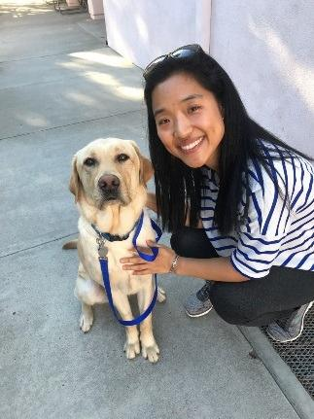


WHO?
Children, entering third through sixth grade, who are experiencing difficulties with reading and/or spelling or diagnosed with dyslexia.
Does your child have difficulty with reading?
Program Overview
Executive Functioning Practice
(9:30-10:00)
(no extra fee charged)
  Executive function helps students focus, plan, periodize, work toward goals, and self-regulate behaviors.
  Units will provide basics about cognitive abilities needed to control thoughts, emotions, and actions. We will integrate these activities to reading and writing practices.
WHEN?
Tuesday OR Thursday
from 9:30 to 11:30 a.m.
June 9-July 30
(16 hours of intervention)
Read to Succeed + Executive Function Practice is designed to help students feel successful and proud of their accomplishments.
WHERE?
UCA Speech-Language-Hearing Center
Integrated Health Science Building
2200 Bruce Street
Literacy Intervention
(10:00-11:30)
Using evidence-based intervention founded upon the principles of Orton-Gillingham, Read to Succeed! will provide training in:
  Sound Syllable Associate
  Phonological Awareness
  Syllable Instruction
  Oral Reading Fluency
  Written Text Comprehension
Meet Dr. Thao & Camo!
Camo, Canine Companions for Independence certified facility dog, will assist with our activities.

