Slide 1
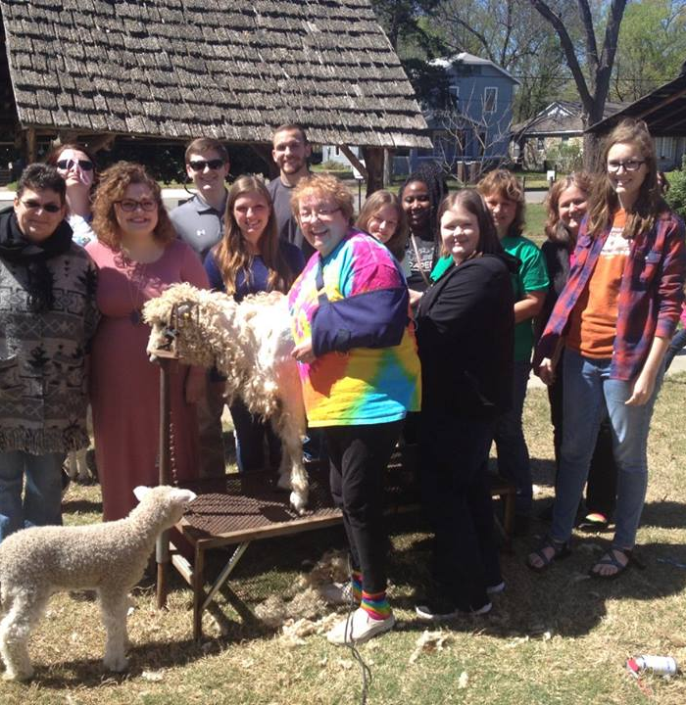
History
Kim Little’s history students host a sheep to shawl event at the Faulkner County Museum

Slide 2
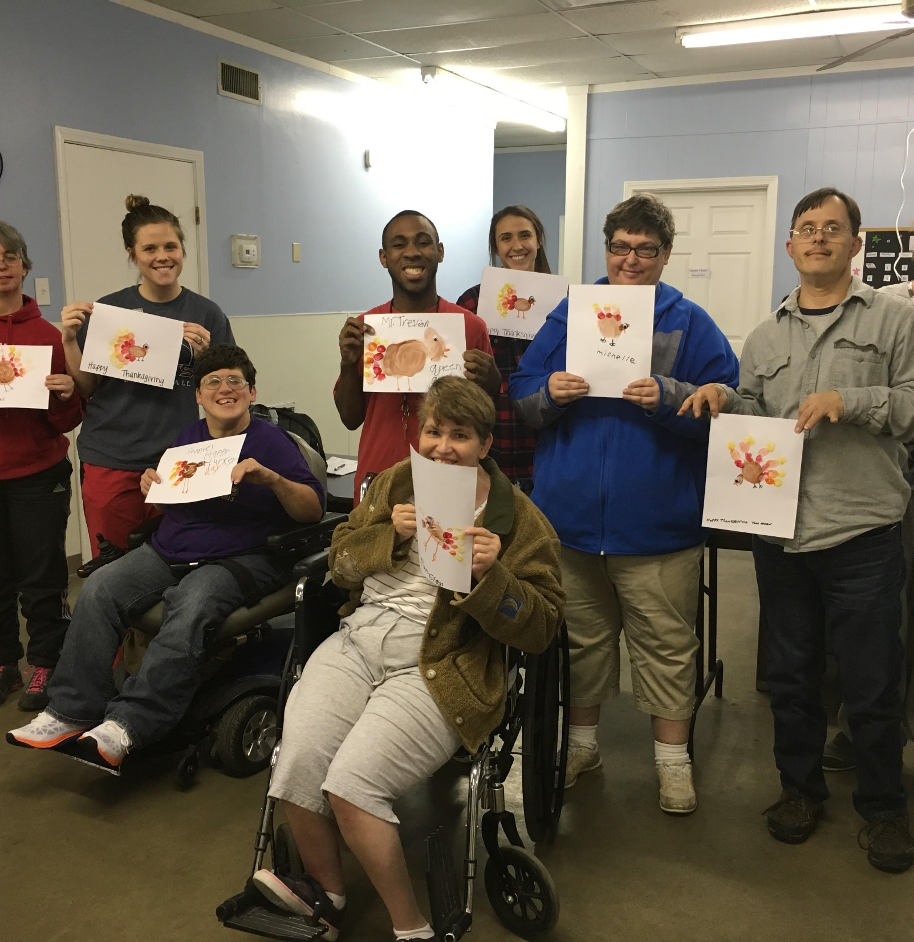
Occupational Therapy
Brittany Saviers’ occupational therapy students work on art projects with patrons at Faulkner County Day School – Work Force

Slide 3
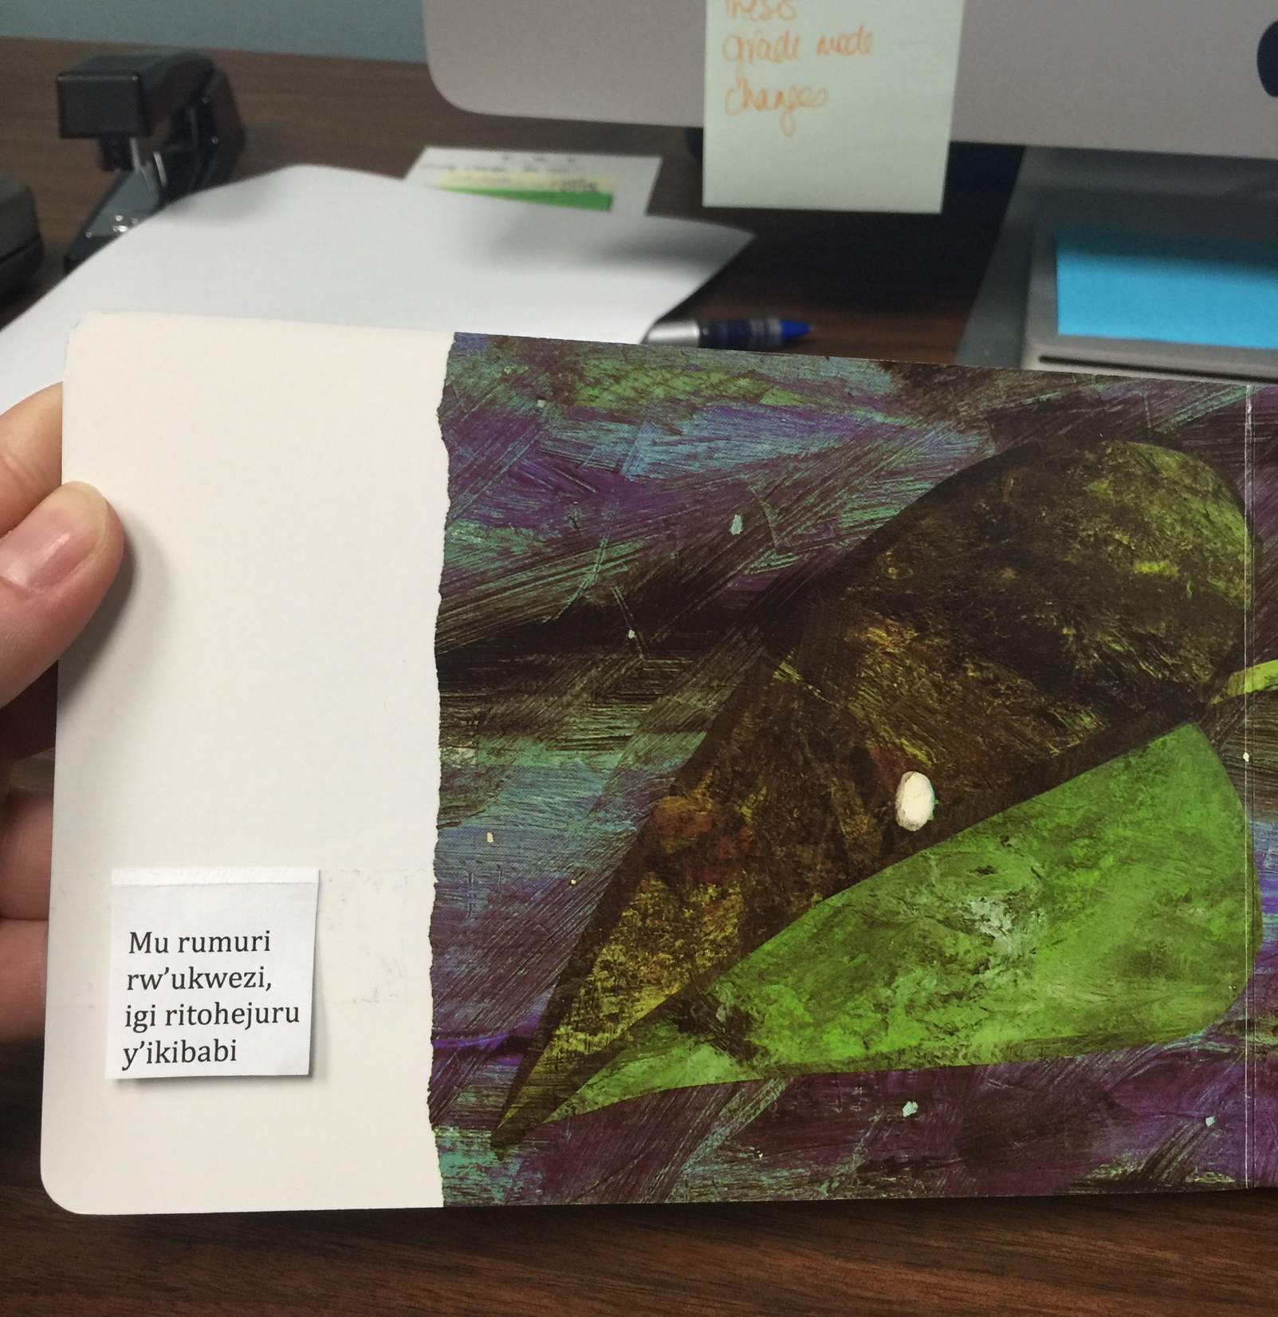
Honors
Leah Horton’s Honors seminar students translate The Very Hungry Caterpillar into kinyarwanda

Slide 4
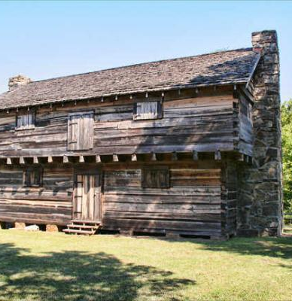
Anthropology
Duncan McKinnon’s archaeology students examined artifacts from the Cadron Settlement.
"Being in the museum to get experience doing what we talked about all semester really allowed me to learn the processes of archaeology“
–Student Evaluation Survey

Slide 5
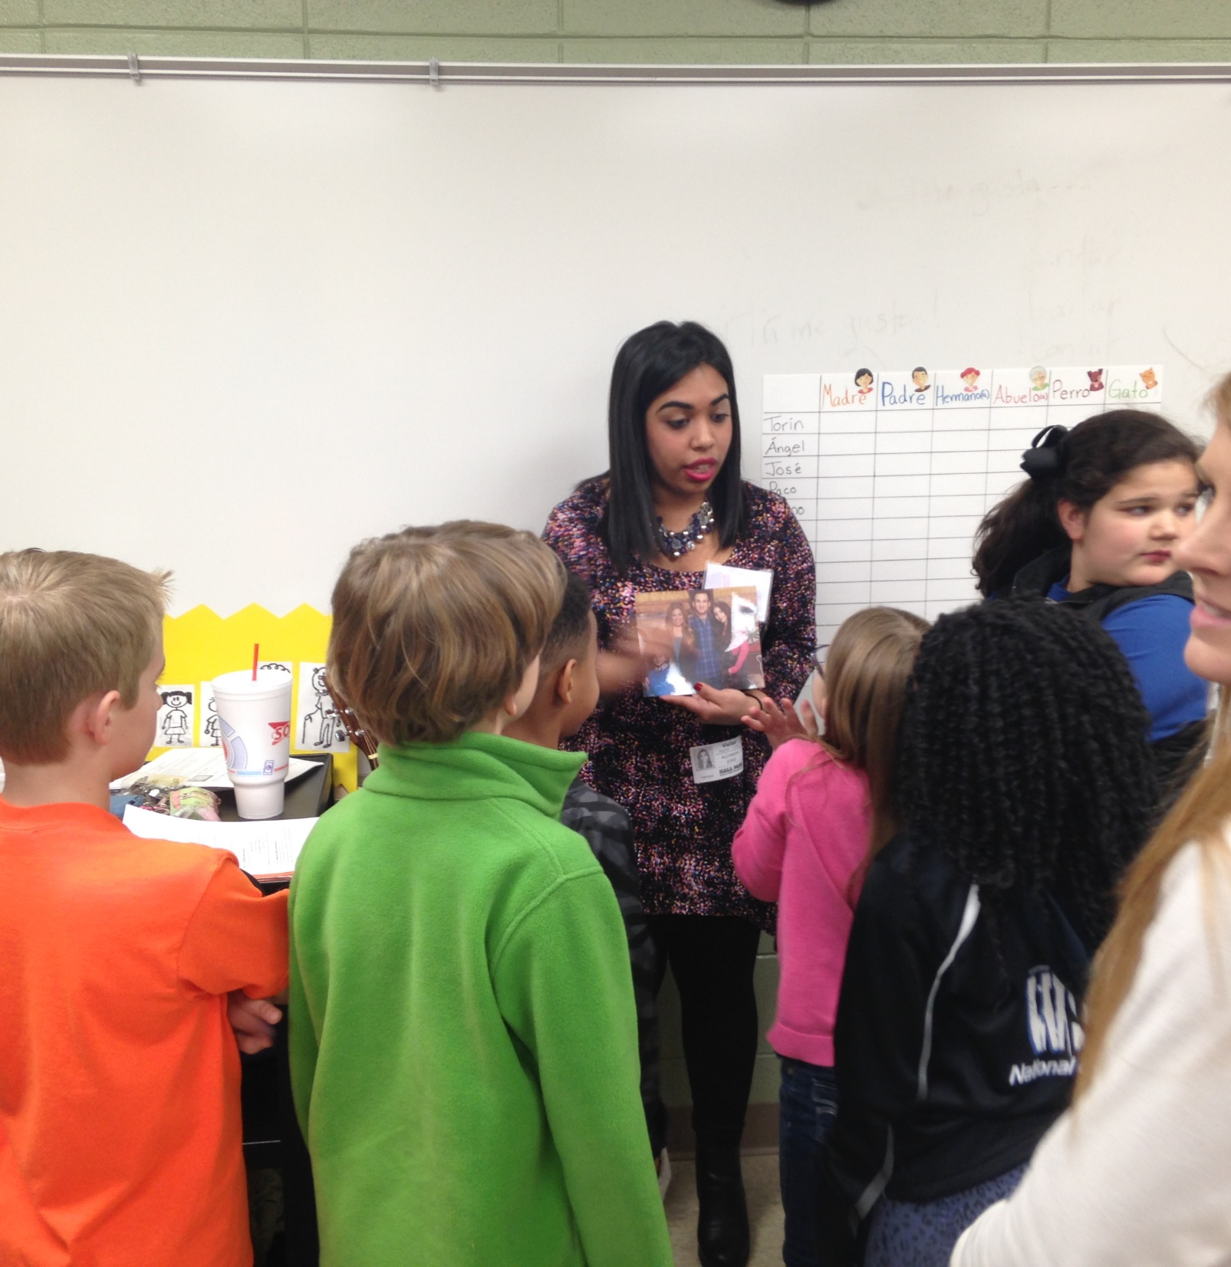
Spanish
Jennifer Parrack’s Spanish students teach Spanish to students at Julia Lee Moore Elementary

Slide 6
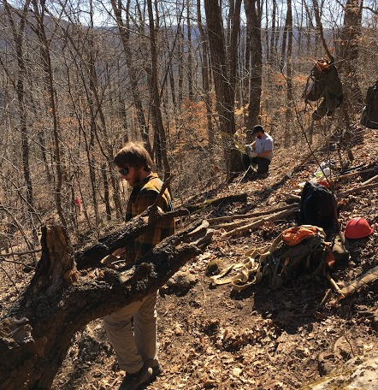
History
Kim Little’s history students work on trail building and maintenance at the Buffalo National River

Slide 7
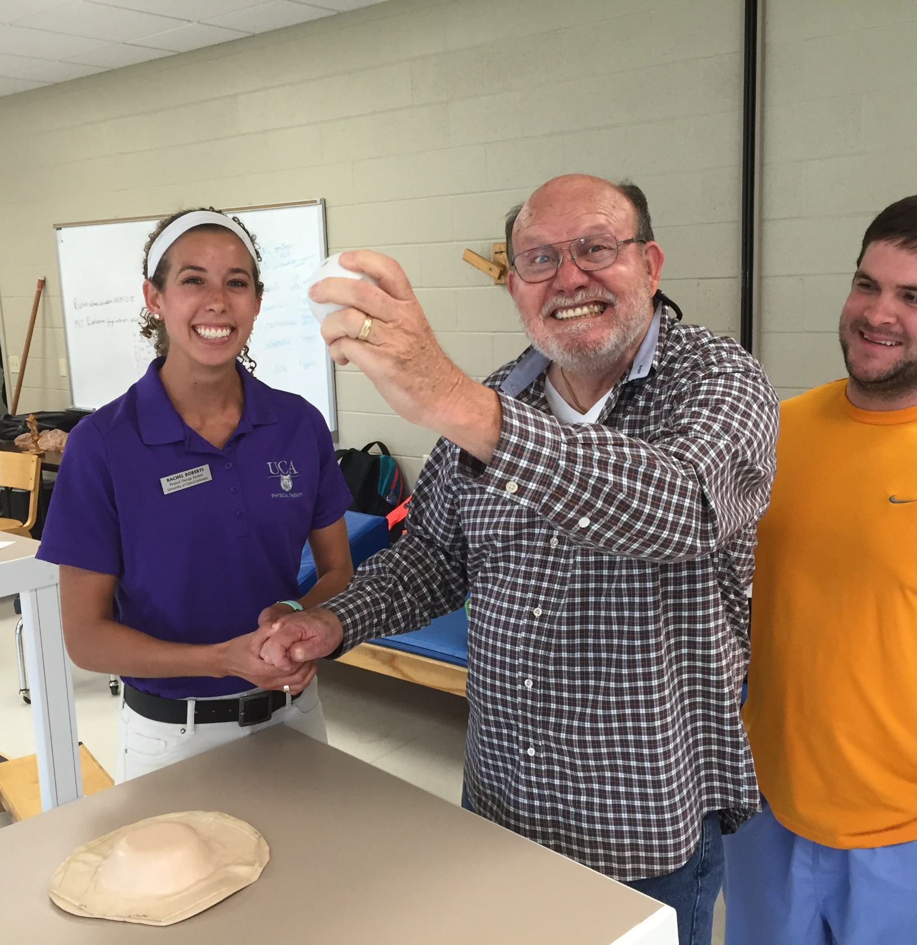
Physical Therapy
Chad Lairamore’s physical therapy students provide therapy services in UCA’s on-campus clinic

Slide 8
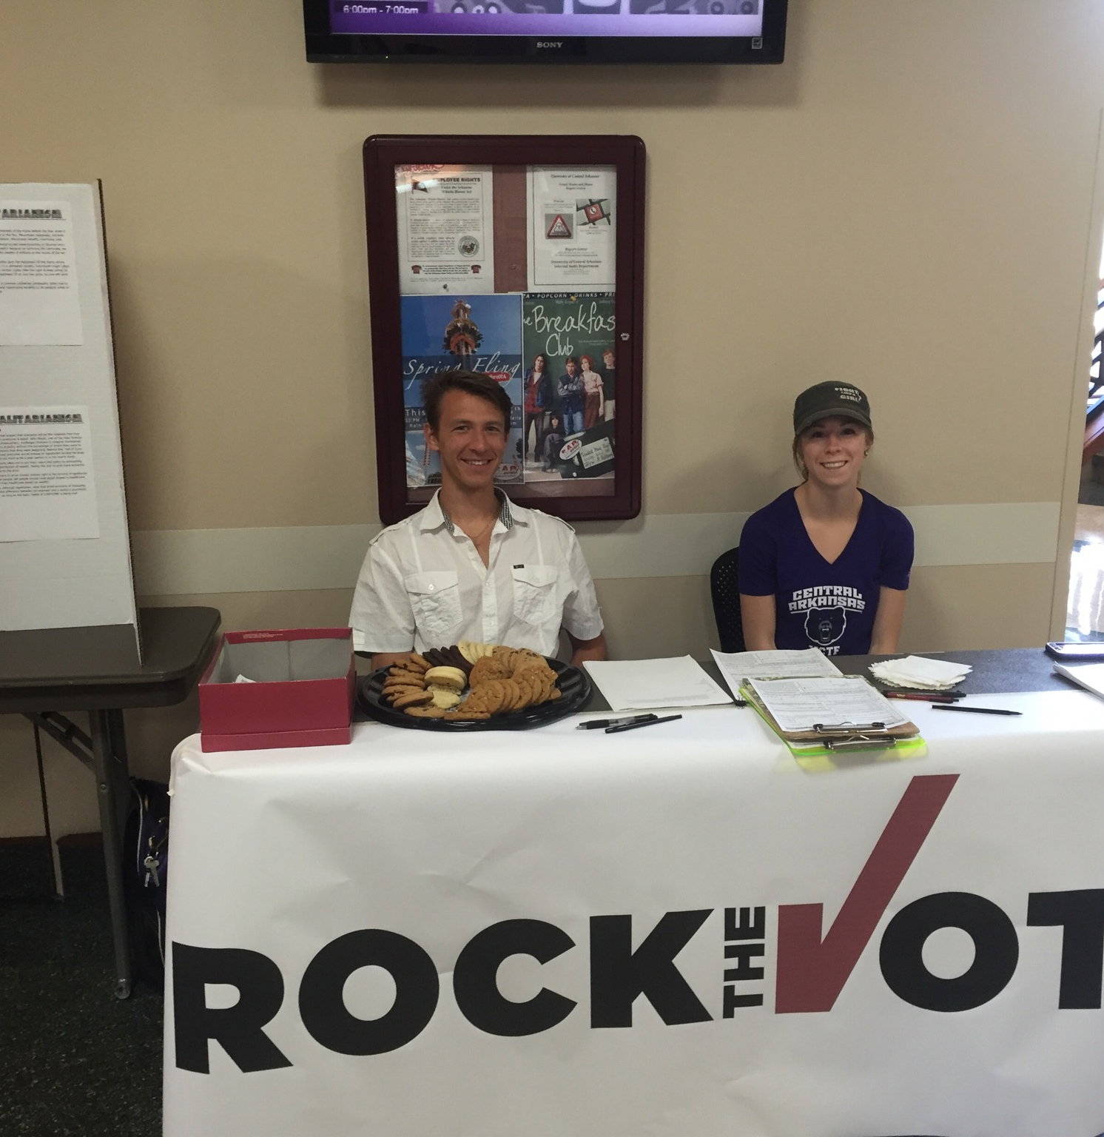
Honors
Peter Mehl’s honors students lead a voter registration drive on campus

Slide 9
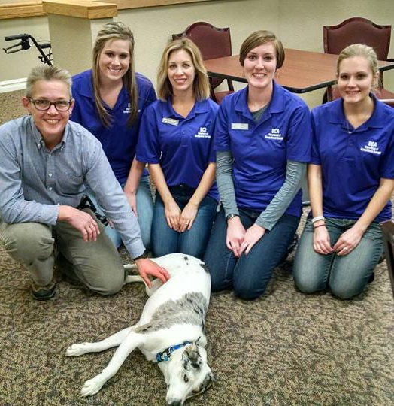
Occupational Therapy
Brittany Saviers’ occupational therapy students work with residents at Chenal Memory Care

Slide 10
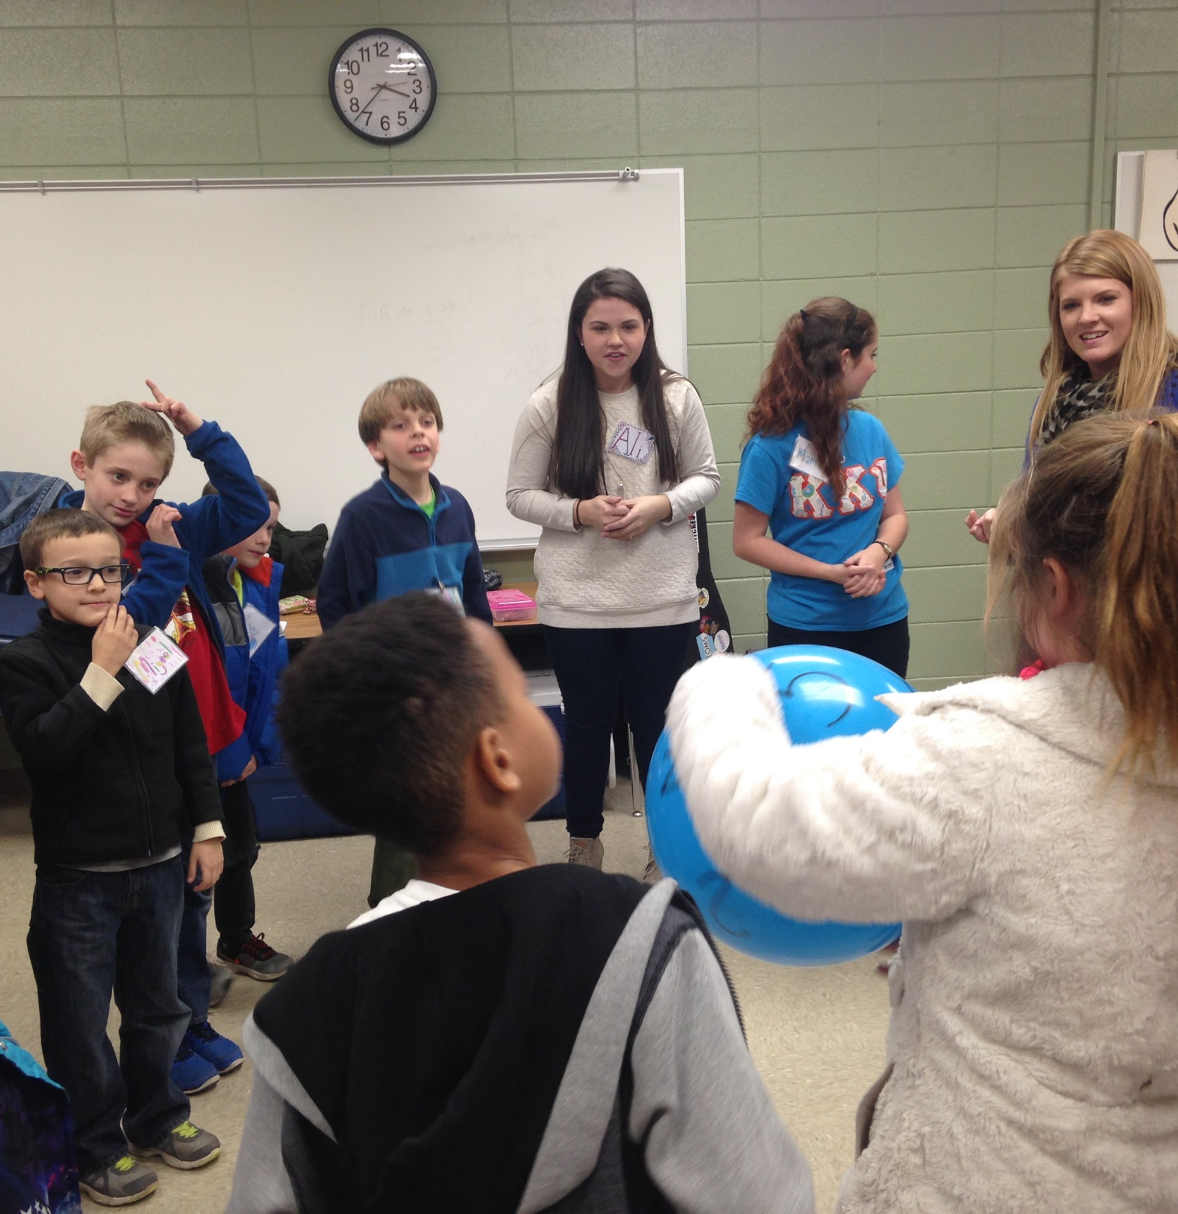
Spanish
Jennifer Parrack’s Spanish students teach Spanish to students at Julia Lee Moore Elementary

Slide 11
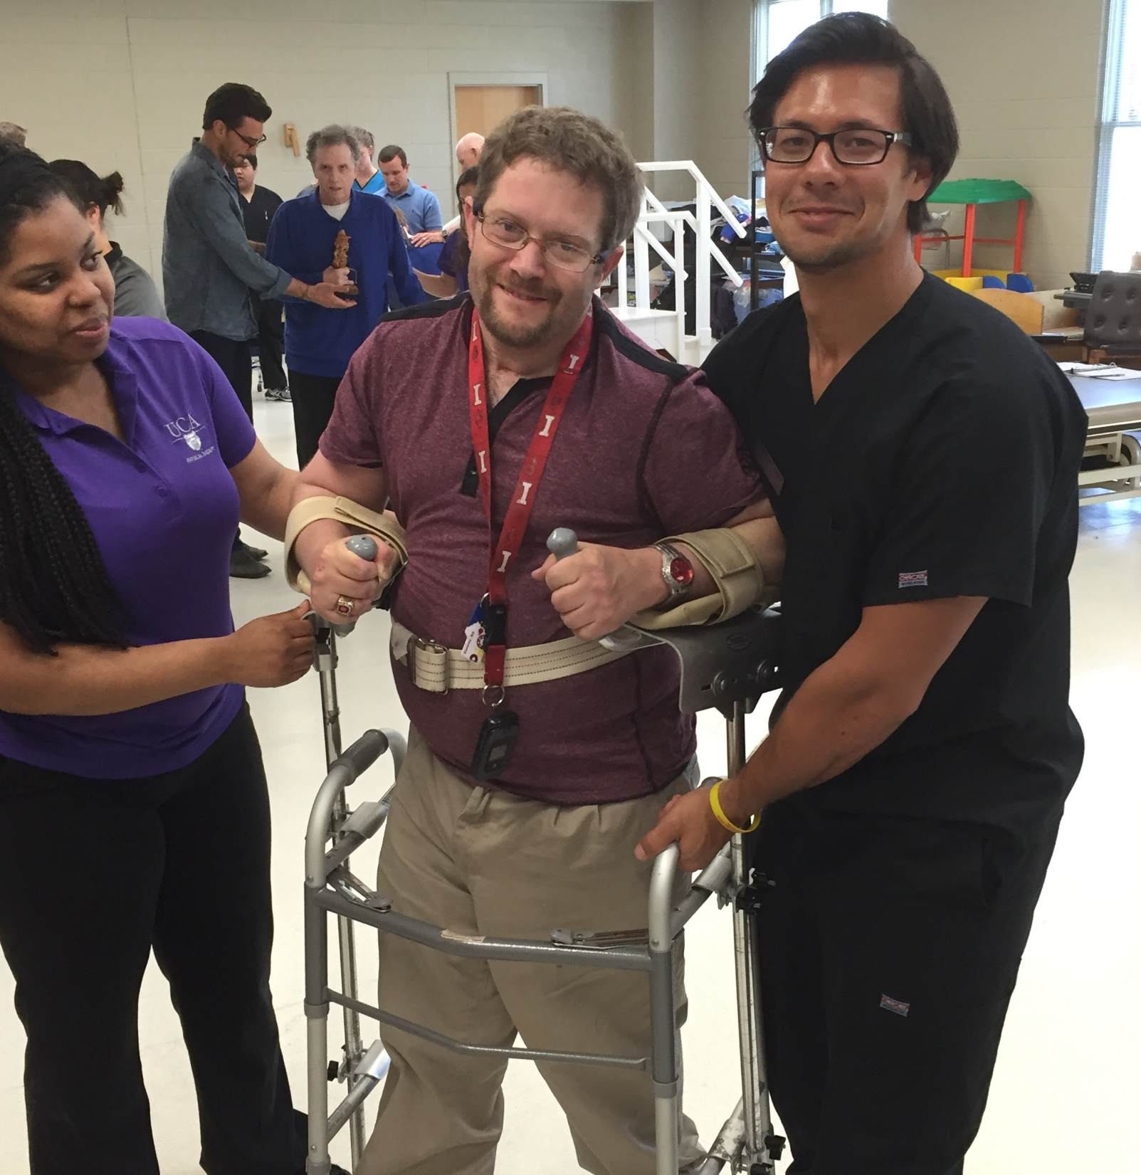
Physical Therapy
Chad Lairamore’s physical therapy students provide therapy services in UCA’s on-campus clinic

Slide 12
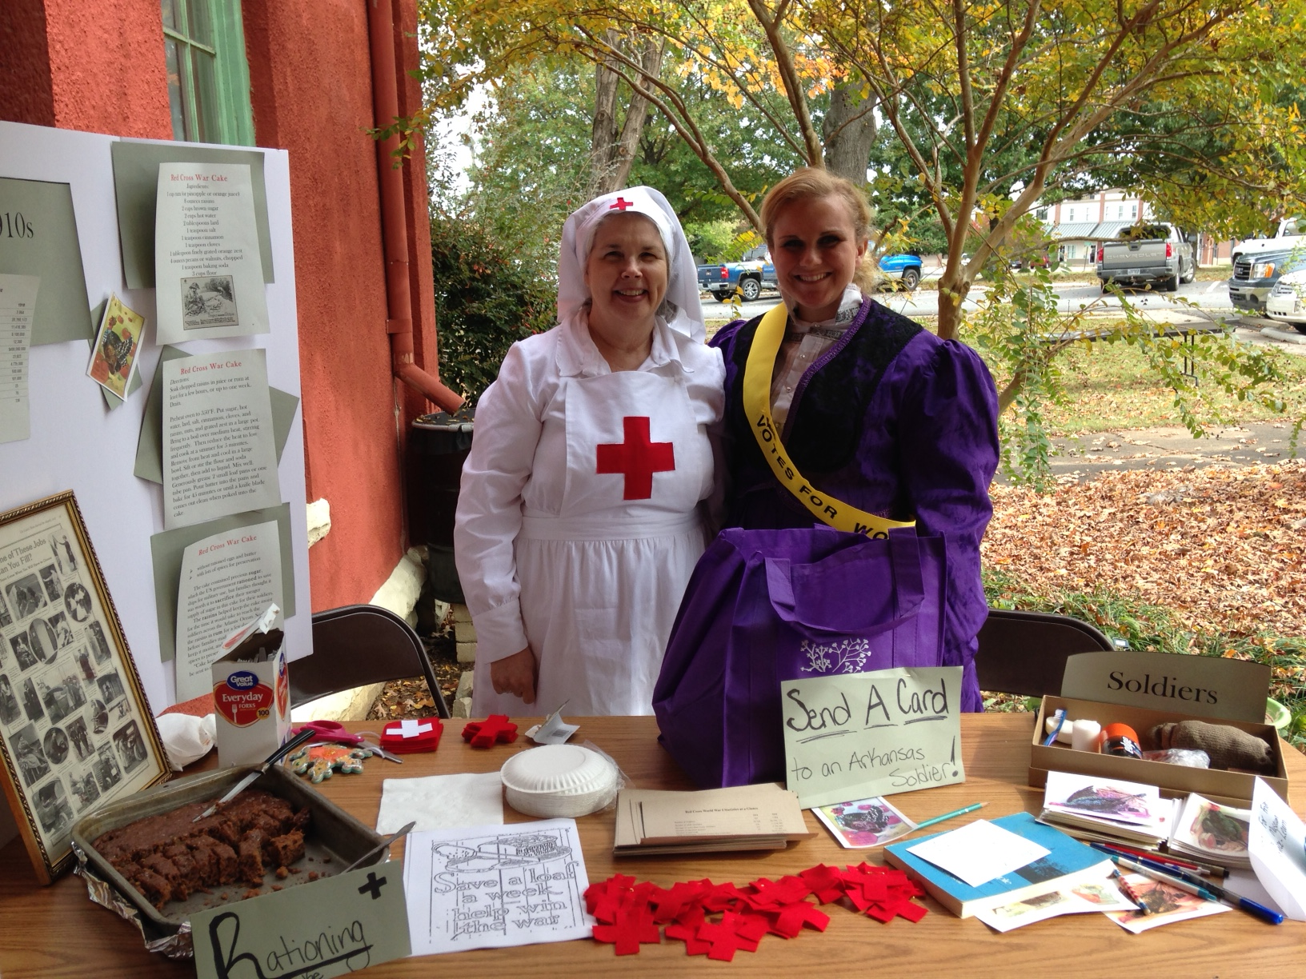
History
Kim Little’s history students lead activities at the Faulkner County Museum open house

Slide 13
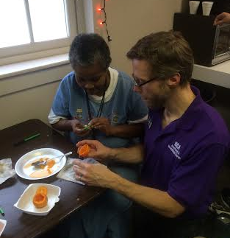
Occupational Therapy
Brittany Saviers’ occupational therapy students do a pumpkin carving activity at ARC Arkansas

Slide 14
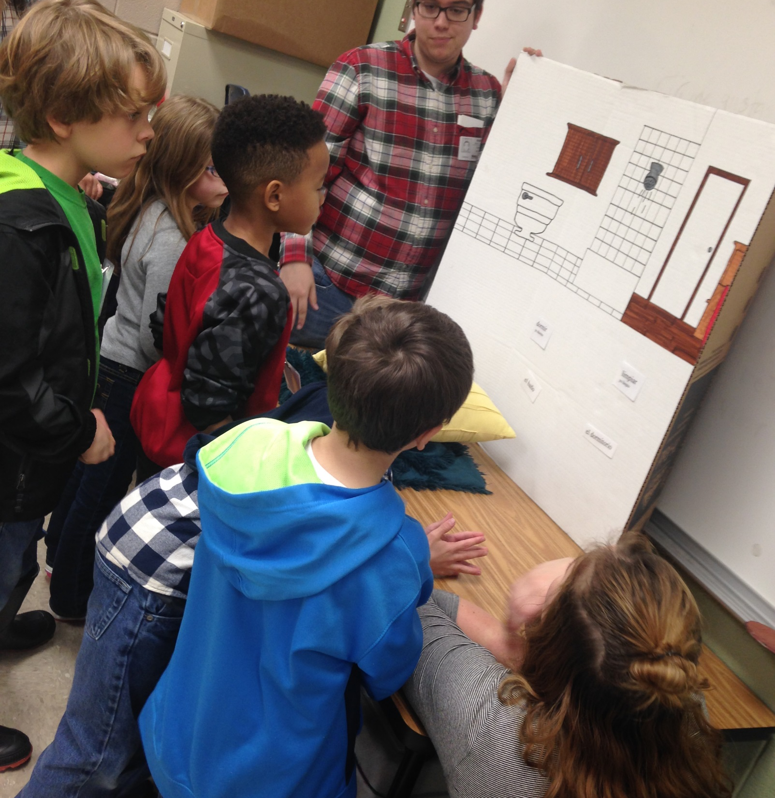
Spanish
Jennifer Parrack’s Spanish students teach Spanish to students at Julia Lee Moore Elementary

Slide 15
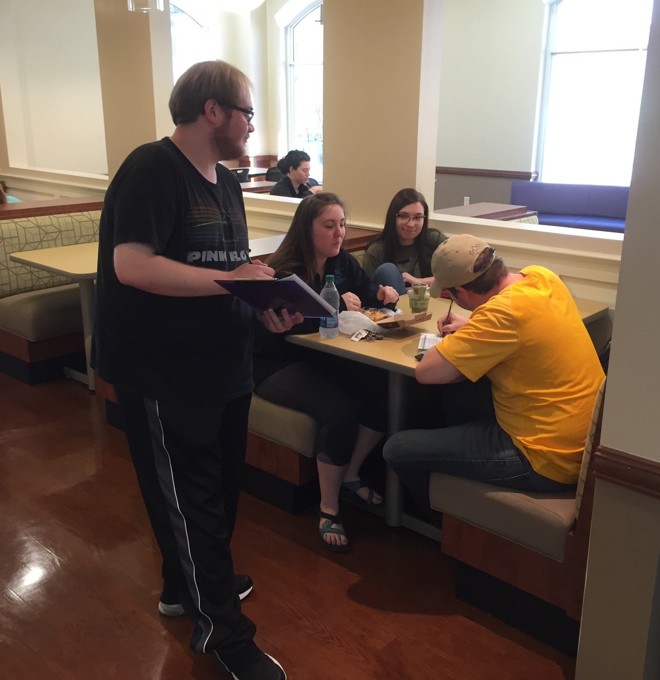
Honors
Peter Mehl’s honors students lead a voter registration drive on campus

Slide 16
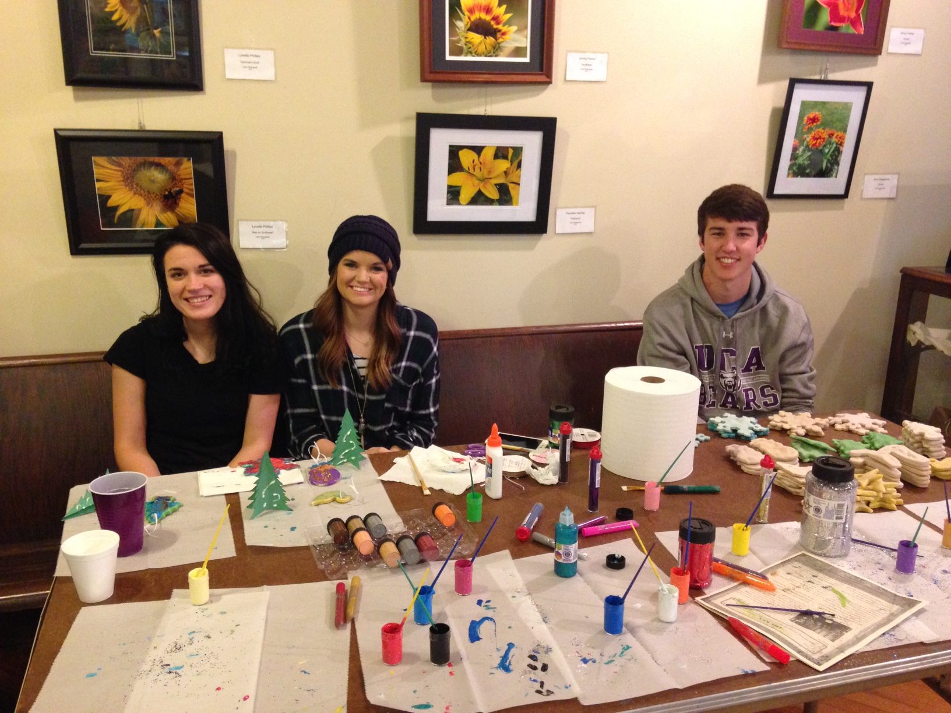
History
Kim Little’s history students lead activities at the Faulkner County Museum open house

