Slide 1
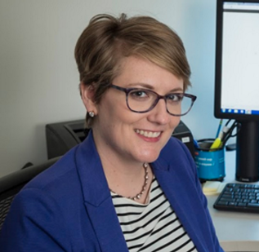
Dissertation Defense
Communication
Sciences & Disorders
Graduate Program
Major Advisor:
Samuel R. Atcherson, Ph.D.
Associate Professor, Audiology
Wednesday, April 26, 2017
3:00 PM
Sarah E.W. Kennett, Au.D.
Doctor of Philosophy Candidate
Identification and Deactivation of Cochlear Implant Electrodes with Poor Electrode-Neural Interface: Clinical Practice and Outcomes
Audiology and Speech
Pathology Department
UALR, University Plaza
Room 669

