Slide 1
Transforming Higher Education Thoughtfully
Making a Case for AI

Slide 2
I don’t trust people who say they’ve read a book if they only listened to it.

Slide 3
It is best to think about AI as a very untrustworthy friend.

Slide 4
There is headwork, “heartwork,” and busywork. AI is for the busywork.

Slide 5
Never use AI on something you would be embarrassed to say you’ve used AI on. Similarly, stop being embarrassed about using AI.

Slide 6
AI will not replace you, but people who can use AI may.

Slide 7
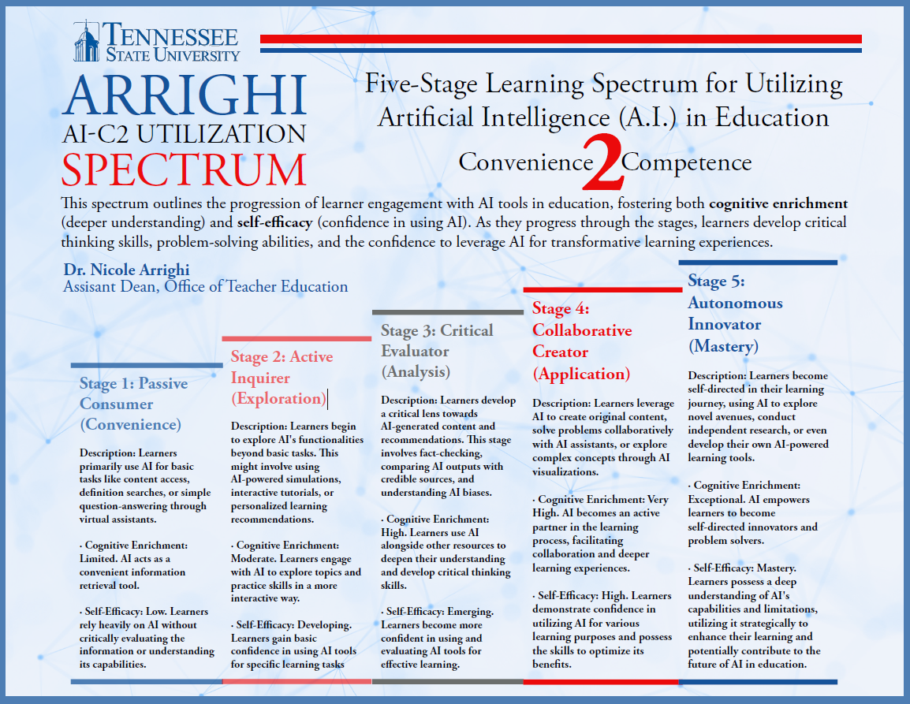
Glenn

Slide 8
poe.com

Slide 9
Tennessee State University

