Slide 1
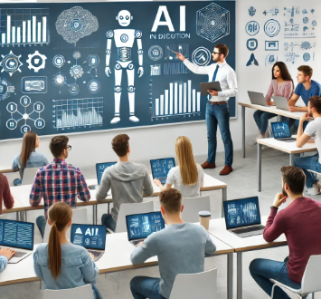
Preparing Students for AI in the Workforce
Strategies for College Professors
K. Mike Casey, Ph.D.
Computer Information Systems and Analytics
College of Business, University of Central Arkansas

Slide 2
Introduction
Overview
The importance of AI in industry is emphasized by its ability to revolutionize operations, enhance decision-making, and drive innovation across sectors such as healthcare, finance, retail, manufacturing, transportation, energy, and education.
Scope
The importance of AI Literacy
Integrating AI into the Curriculum
Ethical Considerations
Tools and Resources

Slide 3
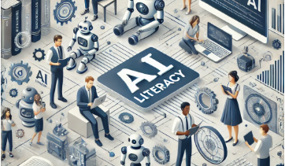
The importance of AI Literacy
AI Literacy
AI literacy refers to the understanding and ability to use artificial intelligence technologies effectively and ethically, encompassing knowledge of core AI concepts, practical applications, and the societal and ethical implications of AI.
AI is increasingly prevalent across various industries, driving advancements and efficiencies in sectors such as healthcare, finance, retail, manufacturing, transportation, energy, and education.
Incorporating AI into the curriculum will increase AI literacy in students.

Slide 4
The importance of AI Literacy
The data is in: 2024 is the year AI at work gets real. Use of generative AI has nearly doubled in the last six months,1 with 75% of global knowledge workers using it. And employees, struggling under the pace and volume of work, are bringing their own AI to work.
Microsoft. "AI at Work Is Here—Now Comes the Hard Part." WorkLab, 8 June 2023, https://www.microsoft.com/en-us/worklab/work-trend-index/ai-at-work-is-here-now-comes-the-hard-part.
The top three skills that CTOs are looking for when they’re hiring software engineers are the ability to learn, the ability to problem solve, and the ability to collaborate, according to Wöhle.
“As we move towards a world where we have all of these [AI] tools, those are some of the core skills that will enable you to differentiate yourself in the workplace,” he said.
Mader, Jackie. "What Skills Should Students Learn in an AI-Powered World?" Education Week, 3 April 2023, https://www.edweek.org/technology/what-skills-should-students-learn-in-an-ai-powered-world/2023/04.

Slide 5
The importance of AI Literacy
Healthcare
Enhanced Diagnostics: AI algorithms can analyze medical images (e.g., X-rays, MRIs) with high accuracy, helping detect diseases like cancer at early stages.
Personalized Medicine: AI can analyze patient data to provide customized treatment plans, improving patient outcomes.
Operational Efficiency: AI streamlines administrative tasks like scheduling, billing, and patient records management, allowing healthcare professionals to focus more on patient care.
Predictive Analytics: AI models predict disease outbreaks, patient admissions, and treatment outcomes, enabling proactive measures and better resource allocation.
Theator. "The Role of Artificial Intelligence in Healthcare." Theator Blog, https://theator.io/blog/the-role-of-artificial-intelligence-in-healthcare/.

Slide 6
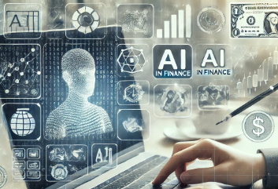
The importance of AI Literacy
Finance
Fraud Detection: AI systems identify fraudulent transactions in real-time, protecting consumers and financial institutions.
Risk Management: AI analyzes large datasets to assess risks and make informed decisions, improving investment strategies and credit scoring.
Automated Trading: AI-driven algorithms execute trades at optimal times, increasing profitability and market efficiency.
Customer Service: AI chatbots provide 24/7 customer support, handling inquiries and transactions quickly and efficiently.
Google Cloud. "How Is AI Used in Financial Services?" https://cloud.google.com/discover/finance-ai.

Slide 7
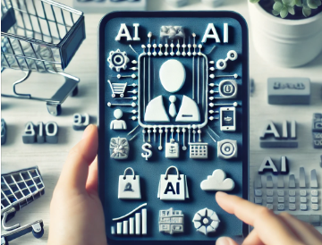
The importance of AI Literacy
Retail
Personalized Shopping Experiences: AI analyzes customer behavior and preferences to recommend products, increasing sales and customer satisfaction.
Inventory Management: AI predicts demand and optimizes inventory levels, reducing costs and minimizing stockouts or overstock situations.
Pricing Strategies: AI helps set dynamic pricing based on market trends, competition, and customer data, maximizing revenue.
Customer Insights: AI provides deep insights into customer behavior and trends, enabling targeted marketing and improved customer retention.
Intel. "AI in Retail." https://www.intel.com/content/www/us/en/retail/solutions/ai-in-retail.html.

Slide 8
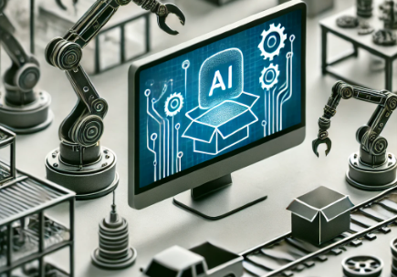
The importance of AI Literacy
Manufacturing
Predictive Maintenance: AI predicts equipment failures before they occur, reducing downtime and maintenance costs.
Quality Control: AI systems inspect products for defects, ensuring high-quality output and reducing waste.
Supply Chain Optimization: AI optimizes supply chain operations, improving efficiency and reducing costs through better demand forecasting and logistics management.
Automation: AI-driven robots and automation systems increase production efficiency, reduce labor costs, and enhance safety.
World Economic Forum. "How We Can Unleash the Power of AI in Manufacturing." World Economic Forum, January 2024, https://www.weforum.org/agenda/2024/01/how-we-can-unleash-the-power-of-ai-in-manufacturing/.

Slide 9
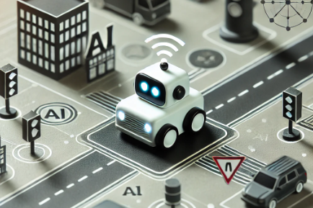
The importance of AI Literacy
Transportation
Autonomous Vehicles: AI powers self-driving cars, trucks, and drones, improving safety and efficiency in transportation and logistics.
Traffic Management: AI analyzes traffic patterns and optimizes traffic flow, reducing congestion and travel time.
Predictive Maintenance: AI predicts maintenance needs for vehicles and infrastructure, enhancing safety and reducing operational costs.
Route Optimization: AI optimizes delivery routes, reducing fuel consumption and delivery times.
Columbus, Louis. "How AI Can Transform the Transportation Industry." Forbes, 26 July 2019, https://www.forbes.com/sites/cognitiveworld/2019/07/26/how-ai-can-transform-the-transportation-industry/.

Slide 10
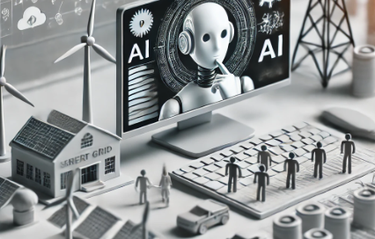
The importance of AI Literacy
Energy
Smart Grids: AI optimizes energy distribution and consumption, improving efficiency and reliability in power grids.
Renewable Energy: AI enhances the efficiency of renewable energy sources like wind and solar by predicting weather patterns and optimizing energy capture.
Predictive Maintenance: AI predicts equipment failures in power plants and distribution networks, reducing downtime and maintenance costs.
Energy Management: AI systems optimize energy use in buildings and industrial processes, reducing costs and environmental impact.
International Energy Agency. "Why AI and Energy Are the New Power Couple." IEA, 10 June 2020, https://www.iea.org/commentaries/why-ai-and-energy-are-the-new-power-couple.

Slide 11
The importance of AI Literacy
Education
Personalized Learning: AI customizes educational content to meet individual student needs, improving learning outcomes.
Administrative Efficiency: AI streamlines administrative tasks such as enrollment, scheduling, and grading, allowing educators to focus more on teaching.
Early Intervention: AI identifies students at risk of falling behind, enabling timely interventions and support.
Content Creation: AI assists in creating educational materials and assessments, enhancing the quality and accessibility of learning resources.
National Science Foundation. "AI in Education: AI for Education." NSF Science Matters, 18 May 2023, https://new.nsf.gov/science-matters/ai-education-ai-education.

Slide 12
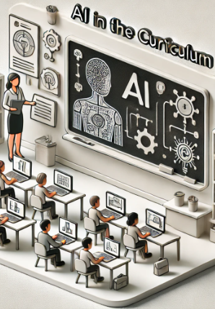
Integrating AI into Curriculum
Course Content: Incorporating AI topics in existing courses
Dedicated Courses: Developing specific AI-related courses
Interdisciplinary Approach: Combining AI with other fields of study

Slide 13
Are my students using AI?

Slide 14
Are my students using AI?

Slide 15
Are my students using AI?

Slide 16
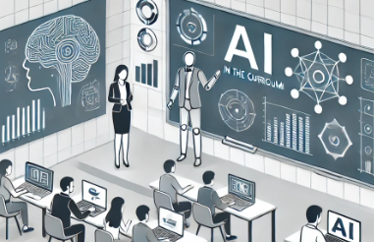
Integrating AI into Curriculum
Incorporating AI topics in existing courses: First Step (the lowest hanging fruit)
Survey your students: What AI tools do they use?
Review your course assessments: Use popular AI tools to complete your own assignments, and find the good and the bad.
Adjust your assignments: Find places you can modify assignment requirements that do not allow AI to complete it at a high level.
Use the AI tools in class: Show students how to use AI for support on assignments and discuss the use-case ethics.

Slide 17
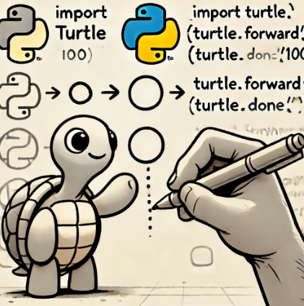
How do my assignments hold up?
Course: Introduction to Programming in Python
Major Deliverables: Programming Assignments using Python (specifically turtle graphics)
Students use the Turtle graphics module to create programs that generate a visible output.
Students showcase their understanding of introductory programming concepts with each assignment
Each assignment builds in complexity

Slide 18
Overall Grading

Slide 19
ChatGPT v. Programming Assignments
Spotting the AI on HW 2 was easy!
Expected output
ChatGPT output

Slide 20
Results – HW 5 Modular Stop Sign

Slide 21
Suggestions for Instructors
Modify the written assignment prompt to be less specific.
Require robust comments throughout the program.
Use ChatGPT to generate sample responses.
Limit students to techniques covered in class.

Slide 22
Suggestions from Other Sources
Students required to use AI to generate first draft.
They have to correct/polish it.
Turn in both versions.
Every couple of weeks have students do a video response to questions without using a computer.
In quantitative classes, process is often more important than the answer.

Slide 23
How do my assignments hold up?
Course: Systems Analysis and Design
Major Deliverables: Students Plan, Analyze and Design an information system in 3 stages.
The goal is to create a University Social Network that encompasses all activities relevant to students interactions with classes, professors, other students and the university.

Slide 24
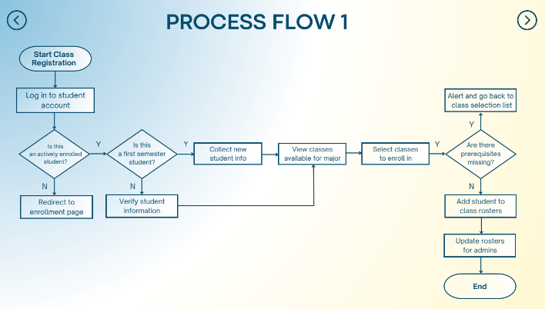
The good, bad, and the helpful (Process flow diagram)
A+

Slide 25
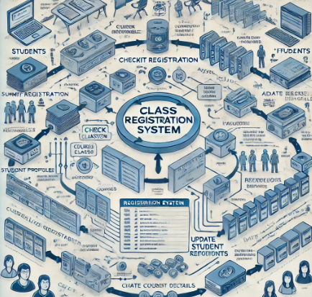
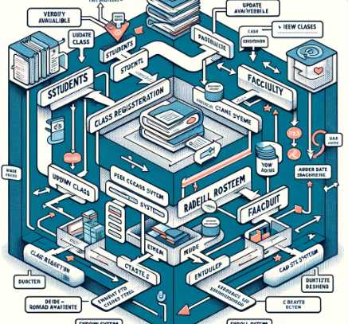
The good, bad, and the helpful (Process flow diagram)

Slide 26
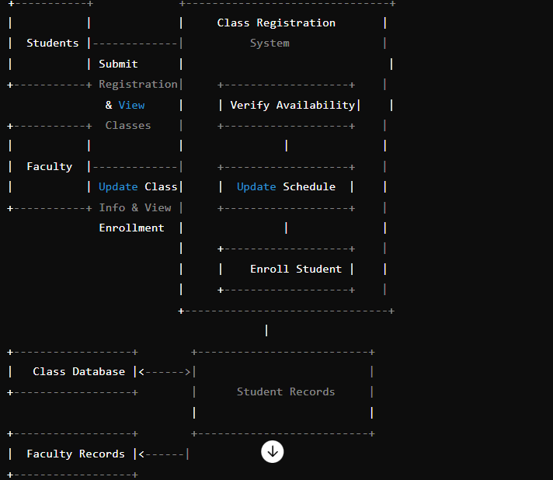
The good, bad, and the helpful (Process flow diagram)

Slide 27
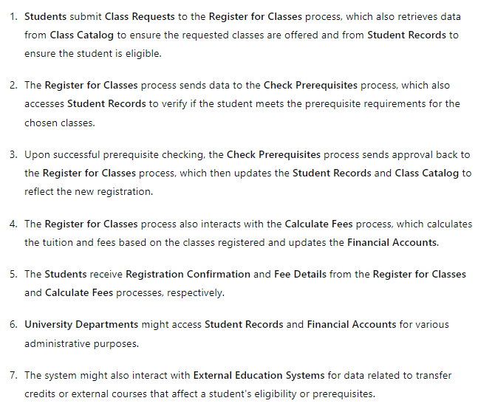
The good, bad, and the helpful (Process flow diagram)

Slide 28
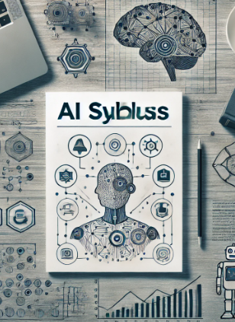
Integrating AI into Curriculum
Incorporating AI topics in existing courses: Next Steps
Consider an AI Syllabus Statement: Having an “Ethical Use of AI” statement in your syllabus sets the tone for the semester by acknowledging that there are correct and incorrect ways to use AI in your course. This will also give you a template to use in the event you believe a student has misused AI on an assignment.
Example on next slide

Slide 29
Integrating AI into Curriculum
Ethical Use of AI Syllabus Statement
Purpose: This statement aims to guide students in the responsible use of AI tools like ChatGPT in our programming courses. Violations of the following rules will be viewed as a violation of academic integrity.
1. Honesty and Integrity: Students are expected to use ChatGPT as a supplementary tool, not a replacement for their own understanding and skills. Work submitted must be primarily the product of a student's own efforts. Using ChatGPT to complete assignments without understanding the underlying concepts contravenes our commitment to academic integrity.
2. Collaboration and Attribution: When ChatGPT is used for brainstorming or problem-solving in collaborative projects, its use should be clearly disclosed. Students must also acknowledge the assistance received from AI tools in their submissions.
3. Learning and Comprehension: Students are encouraged to use ChatGPT for enhancing their learning, such as clarifying concepts, exploring different coding approaches, and debugging. However, they should first attempt to solve problems independently before seeking AI assistance.
4. Prohibited Uses: Directly submitting code or solutions generated by ChatGPT without significant modification or understanding is strictly prohibited. This use case will result in an academic integrity violation form submitted to the university, and could result in being dropped from the course at the discretion of the instructor.

Slide 30
Integrating AI into Curriculum
Incorporating AI topics in existing courses: Next Steps
Develop Assignments that mimic AI use in the workplace: Hands-on experience with AI tools and projects prepares students for real-world scenarios. They can demonstrate their practical knowledge and problem-solving abilities to potential employers through portfolios of AI-related work.
As AI continues to shape the future of work, students with AI expertise are more likely to thrive in their careers. Professors play a critical role in future-proofing students' careers by equipping them with the knowledge and skills needed to succeed in an AI-driven world.

Slide 31
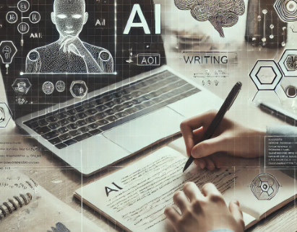
Integrating AI into Curriculum
Incorporating AI topics in existing courses: Writing Assignment Example
Assignment Title: AI in Society: Ethical Implications and Future Directions
Instructions:
Research Phase:
Use AI tools like ChatGPT to gather information on the ethical implications of AI in society.
Explore topics such as bias in AI algorithms, privacy concerns, and the impact of AI on employment.
Writing Phase:
Write a 1500-word essay discussing the ethical implications of AI.
Provide a balanced view by presenting both the benefits and potential harms of AI.
Include at least three case studies where AI has had a significant social impact.
Interactive Feedback:
Submit your draft to an AI tool for initial feedback on grammar, structure, and clarity.
Revise your essay based on the AI feedback and submit the final version.

Slide 32
Integrating AI into Curriculum
Incorporating AI topics in existing courses: Writing Assignment Example
Assignment Title: The Impact of Climate Change on Coastal Ecosystems
Instructions:
Research Phase:
Use AI tools like ChatGPT or other AI-driven research assistants to gather information on the impact of climate change on coastal ecosystems.
Explore topics such as rising sea levels, changes in biodiversity, and the effects on local communities and economies.
Writing Phase:
Write a 1500-word essay discussing the impact of climate change on coastal ecosystems.
Provide a comprehensive overview by covering both the scientific aspects (e.g., data on rising sea levels and temperature changes) and the socio-economic implications (e.g., effects on fisheries and tourism).
Data Analysis:
Utilize AI tools to analyze relevant datasets (e.g., temperature records, sea level measurements, and species population trends) to support your arguments.
Include visual aids such as graphs and charts generated by AI tools to illustrate key points.
Interactive Feedback:
Submit your draft to an AI tool for initial feedback on grammar, structure, and clarity.
Revise your essay based on the AI feedback and submit the final version.
Conclusion:
Summarize your findings and suggest potential mitigation strategies or areas for further research.
Reflect on how AI tools helped in gathering and analyzing information for your essay.

Slide 33
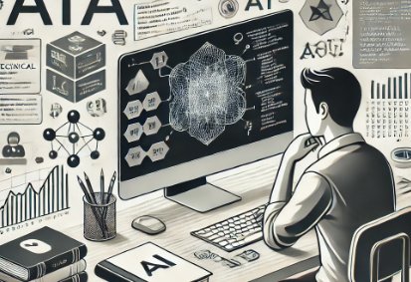
Integrating AI into Curriculum
Incorporating AI topics in existing courses: Technical Assignment Example
Assignment Title: Building a Machine Learning Model for Predictive Analytics
Instructions:
Dataset Selection:
Choose a dataset relevant to your field of study (e.g., finance, healthcare, marketing).
Examples of datasets can be found on platforms like Kaggle.
Model Development:
Use Python and a machine learning library such as scikit-learn to build a predictive model.
Preprocess the data, split it into training and testing sets, and select an appropriate algorithm (e.g., linear regression, decision tree, or random forest).
Model Evaluation:
Evaluate the model's performance using metrics like accuracy, precision, recall, or mean squared error.
Use AI tools to visualize the results and interpret the model's performance.
Report:
Write a technical report (1000-1200 words) detailing the process of building the model, the results, and your interpretation.
Include code snippets, charts, and graphs generated during the model development and evaluation phases.

Slide 34
Integrating AI into Curriculum
Incorporating AI topics in existing courses: Capstone Project
Project Title: AI-Driven Chatbot for Student Support
Instructions:
Project Planning:
Define the scope and objectives of the chatbot (e.g., answering FAQs, providing study tips, assisting with course material).
Outline the features and functionalities you want the chatbot to have.
Development Phase:
Use a platform like IBM Watson, Microsoft Azure Bot Service, or Dialogflow to develop the chatbot.
Train the chatbot with a dataset of frequently asked questions and answers related to the course.
Implementation:
Integrate the chatbot into a platform accessible to students (e.g., the course website or a messaging app like Slack).
Test the chatbot with a group of students to gather feedback and make necessary adjustments.
Documentation and Presentation:
Prepare a comprehensive project report (2000-2500 words) covering the planning, development, and implementation phases.
Include screenshots, code snippets, and any challenges faced during the project.
Present your chatbot to the class, demonstrating its functionalities and discussing its potential impact on student support.

Slide 35
Ethical Considerations
Bias and Fairness:
AI systems can inherit and amplify biases present in their training data, leading to unfair outcomes. It's crucial to educate students about recognizing and mitigating bias in AI models to ensure fairness and equity in AI applications.
Privacy and Data Security:
The use of AI often involves handling large amounts of data, which can include sensitive information. Teaching students about the importance of data privacy, secure data handling practices, and complying with legal and ethical standards is essential.
Transparency and Accountability:
AI systems can be complex and opaque, making it difficult to understand how decisions are made. Emphasizing the importance of transparency in AI processes and the need for accountability helps students develop responsible AI solutions.
Ethical Use of AI:
It's important to instill a sense of ethical responsibility in students regarding how AI is used. This includes considering the potential societal impact of AI applications and striving to use AI for the greater good, avoiding harm and misuse.
Inclusivity:
Ensuring that AI education is accessible to all students, regardless of background, promotes inclusivity. Providing equal opportunities to learn about AI can help bridge the digital divide and ensure diverse perspectives in AI development.

