Slide 1

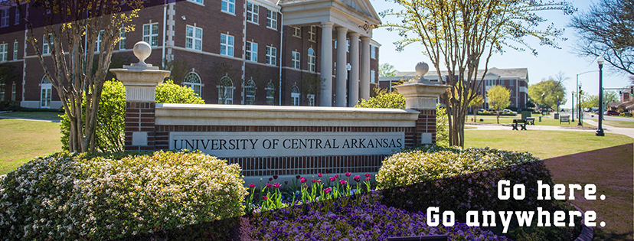

School Counseling Practicum
SCCN 6390
What you need to know before enrolling in…

Slide 2

Prerequisite Courses
SCCN 6320 Foundations of School Counseling
LEAD 6330 Individual and Group Counseling
SCCN 6380 Interventions for School Counselors

Slide 3
Important Information
Please do not contact Conway School District directly.
If you want a placement in CSD, you need to let us know and we need to contact Dr. Gary Bunn as he is the UCA contact person for these districts.

Slide 4

Other Requirements
*Finger Print/Background Check
Locate a site and obtain permission from the principal to complete your practicum there
Find a school counselor (licensed, with a minimum of two years’ experience) willing to serve as your site supervisor
Download a copy of the Practicum Manual from the UCA School Counseling webpage and complete ALL paperwork (DEADLINES MATTER!)
Attend all synchronous classes and complete all assignments

Slide 5

DEADLINES:
OCTOBER 31 for students who wish to enroll in Spring Practicum (SCCN 6390)
MARCH 31 for students who wish to enroll in Fall Practicum (SCCN 6390)

Slide 6

Questions?
If you still have questions after reading the Practicum Manual, please contact the Practicum Coordinator, Dr. Valerie Couture, at vcouture@uca.edu.

