Slide 1
Assessment in P.E?? Plickers makes it easy!
Jana McCollum
7/10/15

Slide 2
Sign Up at plickers.com

Slide 3
Put that information in!

Slide 4
You are all signed up. Easy, huh?

Slide 5
How to add a class
Select Add New Class
Fill in Class Information

Slide 6
Add those students!
Two ways to add students!
Manually
Copy and Paste Roster (Much more time efficient)

Slide 7
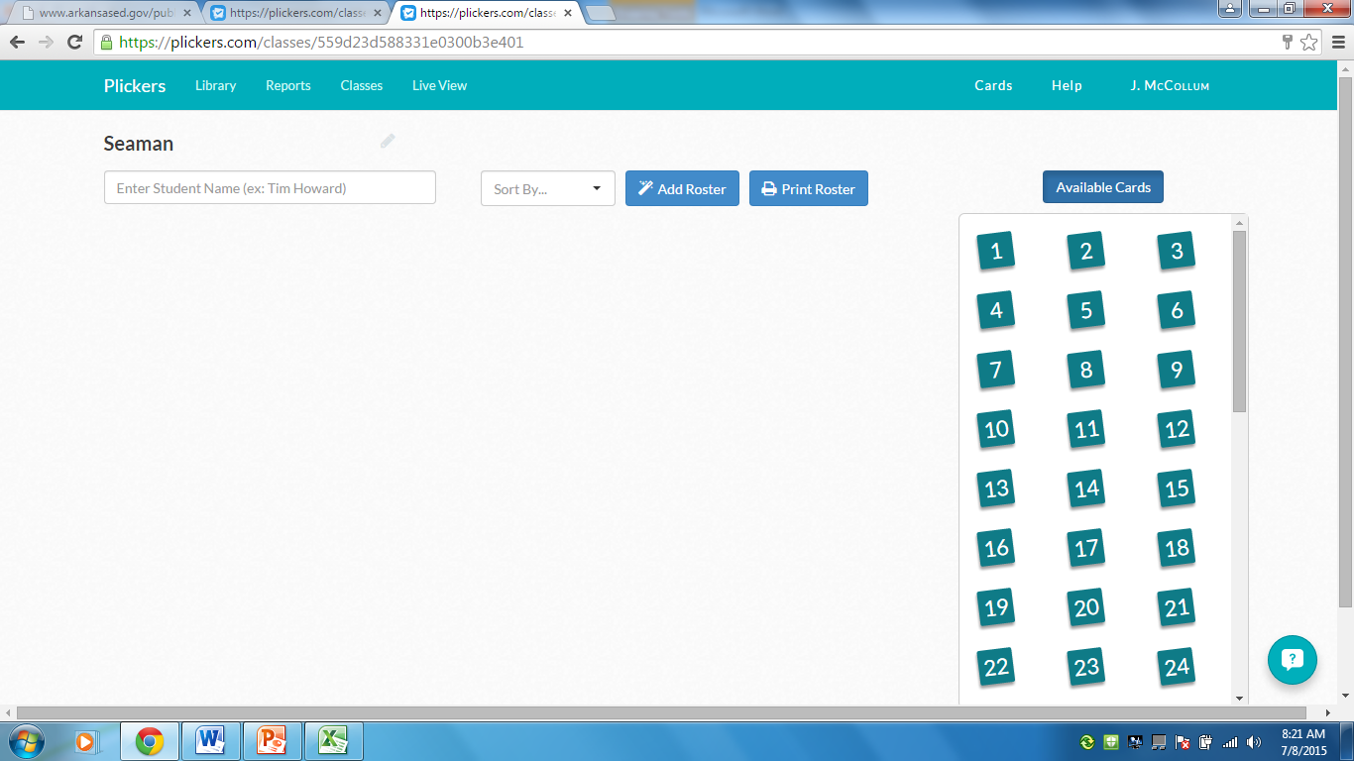
Manually enter names here
Copy and paste roster here

Slide 8
Looks like this when finished ☺

Slide 9
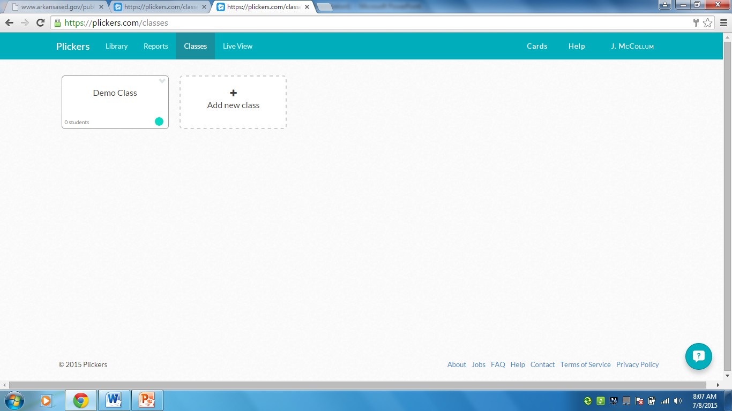
Now to add those questions!

Slide 11
Setting up a multiple choice question

Slide 12
Steps
Type in question and answers
Mark which answers are correct (you can choose more than one)
Save the question

Slide 13
Once saved, add classes to the plan

Slide 14
More Options!
Edit questions- fix any problems
Archive question- saving it for later
Delete question- this question has got to go!

Slide 15
Live View

Slide 16
Scan Cards
Using the Plickers app, you will scan the room for plicker cards.
The app is found on the Apple App Store or Google Play.
Student responses are able to be seen in Live View. No more time wasted to see who has turn in the work!

Slide 17
Real Time Responses

Slide 18
Graph Option

Slide 19
Documented Reports
Reports can be archived to save for documentation just like in the library section

Slide 20
Perks of Plickers
Cost effective
Quick question design
Track student responses
Technology implementation
Faster than the paper and pencil approach
DOCUMENTATION!

Slide 21
Feedback Time!
Putting plickers to the test!

Slide 22
If you need help, contact me!
mccollumj@conwayschools.net

