Slide 1
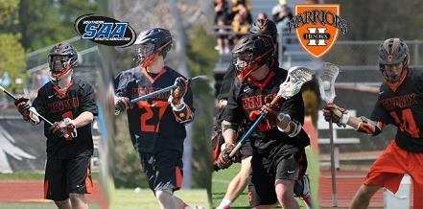
LACROSSE
Branden Harbaugh
HENDRIX COLLEGE
THE FASTEST GAME ON TWO FEET

Slide 2
History—the one true American sport.

Slide 3
HISTORY OF LACROSSE
1636 - Jesuit Missionary Jean de Brebeuf is the first to document the game of lacrosse
1794 - A match between the Seneca and Mohawks results in the creating of basic rules.
1834 - Caughnawaga Indians demonstrate the sport in Montreal.
1876 - Queen Victoria watched and "endorses" a lacrosse game in Windsor, England. New York University is the first college in the United States to establish a lacrosse team.
1881 - The first intercollegiate tournament is held at Westchester Polo Grounds in New York.
1890 - The first women's lacrosse game is played at St. Leonard's School in St. Andrew's, Scotland.
1904 - Lacrosse is first played as an actual event in the Olympics in St. Louis, with Canada winning the gold medal
2001 - Major League Lacrosse, a professional league for field lacrosse, makes its debut.
2010 - A record 29 nations participate in the FIL Men's World Championship.

Slide 4
EQUIPMENT
Ball
Stick—attack/middie—defensemen--goalies
Gloves
Helmet
Elbow pads
Shoulder pads

Slide 5
STICKS: pre-history to 1970’s

Slide 6
STICKS—2013: engineered for speed and durability
Titanium shaft
Die cast plastic heads
Mesh pocket
Channel built for high speed shooting
Different sized heads/shafts for specialized positions

Slide 7
HEADS: evolution in speed

Slide 8
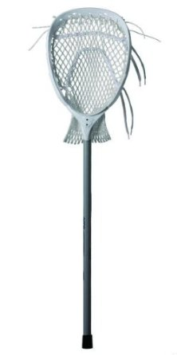

Slide 9
OFFENSE/DEFENSE STICKS
Defense 72 inches
Attack/middies 42 inches

Slide 10
BALL—solid rubber, 5 ounces, 8 inch circumference

Slide 11
MEN’S EQUIPMENT

Slide 12
WOMEN’S EQUIPMENT

Slide 13
BENEFITS
Peak physical fitness—most games are 60 minutes of sprinting, each practice and game averages 4-8 miles of sprinting.
Hand/eye coordination and focus—ball travels 40-80 mph on passes, 80-110 mph on shots.
Teamwork—offensive and defensive schemes, total team transition plus specialized units—defensive midfield, long stick middies, face-off middies, man down, man up units, goalies, attack, middies and defensemen.
Strength training and conditioning, change of direction agilities, flexibility.

Slide 14
FIELD DIMENSIONS

Slide 15
POSITIONS
ATTACKMEN—three designated offensive players on one end of the field, pitted against the opposing team’s defensemen and goalie.
MIDFIELDERS—play the entire field, and carry the ball way from the defense and toward the attack. Also play defense, take face-offs. Play offense and also score
DEFENSEMEN—carry longer poles for the purpose of playing against the opponent’s attackmen, and dislodging the ball from them.
GOALIE– stands in a 6 x 6 goal, protecting it from a 5oz, 8 inch ball.

Slide 16
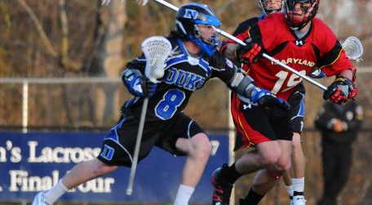
ATTACKMEN
Great change of direction
Physical toughness
Intelligent players
Highly skilled players on the field
Passing catching shooting dodging
Go against defensemen who have longer poles (6 feet) and are traditionally larger
quarterbacks

Slide 17
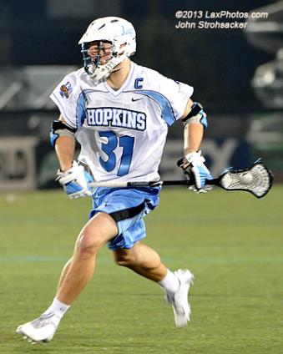
MIDDIES
Workhorses
Fast and north south dodgers
Able to shoot on the run
Must play physical defense and run the whole game in a sprint.
FACE-OFFS
Toughness
Running backs/defensive backs/safeties

Slide 18
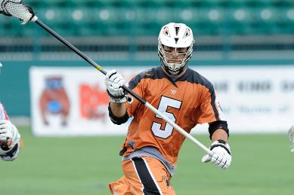
DEFENSE
Best all around athletes, very fast also
Bigger than others, generally speaking
Very physical and aggressive
Great change of direction and also all directional speed
Linebackers, defensive ends

Slide 19
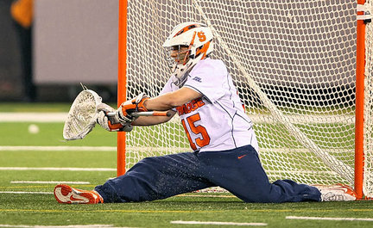
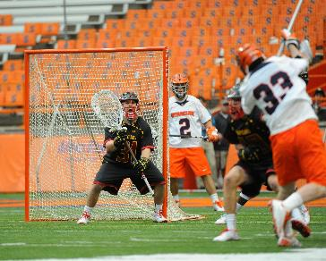
GOALIES
All shapes and sizes, large, athletic.
Hand eye coordination—shots are 80-110 MPH (11% faster than a baseball pitch) and taken at 2-12 yards (60% closer than a pitcher to batter)
Once they have the ball they become the quarterback
Without the ball they conduct the defense
Good save percentage at NCAA level is 60%

Slide 20
SIMPLIFIED RULES
Face-offs on the ground for possession after each goal, and at the beginning of each quarter.
15 minute quarters (2 timeouts each half)
Sudden death overtime
No ties
10 student athletes on the field at all times from each team (3 attack, 3 defensemen, 3 middies, and 1 goalie)
Only six offensive players and seven defensive players (goalie) over the midline at once.

Slide 21
Rules Continued… and Concepts
6 on 6 same concepts as basketball. IE—pick and roll, pick and slip, drive to the cage and move the ball twice. Inside shots outside shots.
Defensively similar to basketball—man defense, zone defense, lock off certain players, like adjacent, top player, etc.
Clearing the ball similar to basketball, “RIDING” is the concept of a basketball press.
Penalties for cross checking, helmet to helmet hits, slashing, pushing with possession, tripping, going offsides.
https://www.youtube.com/watch?v=fwrVye6QSiA

Slide 22
SITUATIONS
MAN UP/MAN DOWN (power play in hockey)
Penalized team may have one or more players sit out for a fixed period of time. This gives the offensive team a 6 on 5 or less advantage
Ground balls
Face-offs
Clears/rides

Slide 23
Face-off
https://www.youtube.com/watch?v=PLnvXXp5CJo

Slide 24
BOX/INDOOR LACROSSE
https://www.youtube.com/watch?v=1KDTQ9Z-jVQ

Slide 25
BOX LACROSSE
Larger goalie pads
Much smaller net
Traditionally played in colder areas—Canada, Czech Republic, northern areas.
Requires tremendous skill in shooting, pinpoint feeding in assists, and very physical
All sticks are SHORT STICKS
Canadian players tend to stick with their strong hand and are not as ambidextrous or confident with both as Americans

Slide 26
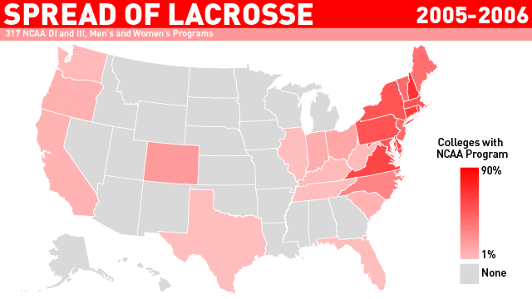
NCAA MEN’S LACROSSE Growth

Slide 27
NCAA GRADUATION RATES
Men's Sports Women's Sports
Sport NCAA GSR Federal Rate Sport NCAA GSR Federal Rate
Lacrosse 88% 75% Skiing 95% 79%
Gymnastics 88%72% Gymnastics 94% 85%
Fencing 88% 70% Lacrosse 94% 83%
Water Polo85% 69% Field Hockey 94% 82%
Ice Hockey84% 68% Fencing 93% 83%
Swimming 82% 68% Swimming 91% 75%
Tennis 82% 63% Ice Hockey 90% 74%
Golf 79% 60% Crew/Rowing 90% 73%
Volleyball 78% 65% Soccer 89% 71%
Rifle 78% 62% Volleyball 88% 71%
Soccer 77% 58% Tennis 88% 70%
CC/Track 74% 60% Golf 87% 69%
Skiing 73% 60% Water Polo 85% 77%
Wrestling 70% 53% Softball 85% 70%
Football 66% 55% CC/Track 83% 68%
Baseball 66% 45% Basketball 81% 64%
Basketball 61% 45% Rifle 77% 68%
Bowling 68% 59%
Average 77.6% 61.6% 87.3% 73.4%

Slide 28
GROWTH IN HS BOYS’ SPONSORSHIP and PARTICIPATION
2006 2007 2008 2009 2010 2011 2012 01-12
1,395 1,588 1,815 1,984 2,068 2,192 2,338 149.3%
SCHOOLS
#’s in 1,000’s
2006 2007 2008 2009 2010 2011 2012 01-12
65.0 71.5 82.9 88.5 90.7 95.7 100.6 140.6%

Slide 29
NCAA STUDENT ATHLETE #’s

Slide 30
MEN’S TEAMS by DIVISION

Slide 31
HIGH SCHOOL TEAMS

Slide 32
HIGH SCHOOL STUDENT ATHLETE #’s

Slide 33
Highlight Reel
https://www.youtube.com/watch?v=IkRuWFY5M1U

Slide 34
GETTING INVOLVED
www.uslacrosse.org
www.littlerocklacrosse.com
www.hendrixwarriors.edu
www.Laxpower.com
Boys and girls ages 6-18, mens leagues and women’s leagues, high school, NCAA professional indoor and outdoor, amateur international and national teams.

