Slide 1
CAEP Annual Report
September 1, 2022 - August 31, 2023
University of Central Arkansas

Slide 2
Overview
CAEP (Council for the Accreditation of Educator Preparation) requires the EPP to publicly share data against four annual reporting measures. These measures are used to provide information to the public on both program outcome and program impact on both initial and advanced programs.
These data are for the UCA COE in alignment with CAEP annual reporting expectations.

Slide 3
8 Annual Reporting Measures
Measure 1 (Initial programs only): Completer effectiveness. Data must address: (a) completer impact in contributing to P-12 student-learning growth AND (b) completer effectiveness in applying professional knowledge, skills, and dispositions.
Measure 2: Satisfaction of employers; stakeholder involvement
Measure 3: Candidate competency at completion
Measure 4: Ability of completers to be hired.

Slide 4
Program Completer Data
Academic Year | Initial Programs (combined UG and MAT) | Advanced Programs
2022-2023 | 233 | 205
2021-2022 | 233 | 199
2020-2021 | 288 | 141
2019-2020 | 257 | 124

Slide 5
INITIAL PROGRAMS | 2020-2021 | 2021-2022 | 2022-2023
K-6 Elementary | 117 | 78 | 93
4-8 Middle Level | 30 | 26 | 35
4-12 Business | 2 | 6 | 1
4-12 Computer Science | 1 | 0 | 1
7-12 Chemistry | * | * | 3
7-12 English | 15 | 16 | 7
7-12 FACS | 7 | 11 | 11
7-12 Life Science | 8 | 3 | 2
7-12 Math | 5 | 12 | 7
7-12 Physical Science | 1 | 4 | 1
7-12 Social Studies | 14 | 9 | 10
7-12 Speech / Drama | 2 | 0 | 0
K-12 Art | 10 | 9 | 9
K-12 Music | 23 | 10 | 10
K-12 PE/Health | 28 | 22 | 19
K-12 Chinese | 0 | 1 | 0
K-12 French | 0 | 0 | 1
K-12 Spanish | 5 | 1 | 3
K-12 SPED | 20 | 25 | 20
TOTAL | 288 | 233 | 233

Slide 6
ADVANCED PROGRAMS | 2020-2021 | 2021-2022 | 2022-2023
Building Level Admin | 16 | 22 | 9
District Level Admin | 0 | 6 | 2
Curriculum Specialist | 1 | 2 | 4
Program Specialist - SPED | 0 | 3 | 0
Library Media | 34 | 22 | 28
Library Media (Ancillary) | * | * | 2
Reading | 3 | 2 | 2
Dyslexia | 4 | 6 | 2
Reading + Dyslexia | 16 | 12 | 6
School Counseling | 26 | 21 | 15
Gifted | 8 | 6 | 5
Instructional Facilitator | 3 | 6 | 2
ESOL |  | 46 | 55
Online Teaching and Learning | 5 | 31 | 29
Career Development | 5 | 2 | 0
Driver’s Education | 0 | 0 | 1
B-K | 1 | 3 | 0
Special Education | 16 | 8 | 8
Special Education Resource | 3 | 1 | 35
TOTAL | 141 | 199 | 205

Slide 7
Measure 1: Completer Effectiveness
Completer effectiveness. Data must address: (a) completer impact in contributing to P-12 student-learning growth AND (b) completer effectiveness in applying professional knowledge, skills, and dispositions.
INITIAL PROGRAMS ONLY

Slide 8
Measure 1a: Completers’ Impact on P-12 Learning (AF)
Data presented here were secured through partnership with Arch Ford (AF) Novice Teacher (NT) Mentoring Program begun in summer 2017. The AFNT program supports UCA graduates in induction for 3-years post graduation. Districts in the AFNT region support 30-40% of UCA prepared teacher candidates representing all programs across the EPP. All novice teachers in the AFNT program complete an Impact on Student Learning project each March and report data to AF. Data for UCA prepared teachers are compared to the AF aggregate for completers from all other institutions as a benchmark.
In 2022-2023, 235 UCA completers in their first three years of service completed the project (Year 1 = 78; Year 2 = 90; Year 3 = 67). Data were representative of all UCA preparation programs with data combined into 5 categories for analysis (Elementary, Middle Level, Secondary, Special Education, MAT). Programs received their data separately.
Trend data reflect natural variability in the population and consistent performance relative to the comparative benchmark. UCA prepared completers perform as well as completers prepared at other institutions with no statistical difference noted between groups. The UCA aggregate population scaled score gain x̄=15.26 compared to the AF aggregate gain of x̄=15.87.
Disaggregated data for completers indicated UCA graduates outperformed their peers in 3 categories: SecED x̄=15.7, SPED x̄=14.04 & MAT x̄=18.84 (p>.05). Completers in 2 categories scored lower than the comparative benchmark: Elem x̄=15.24; Middle Level x̄=15.8. Three year trend data indicate MAT candidates prepared at UCA consistently report high student performance scores than their peers prepared at other institutions at a level of statistical significance (UCA x̄=18.84; AF x̄=14.17). While differences in elementary, middle level, SecED, and SPED scores compared to their peers is not statistically significant, continued trends around elementary completer performance are persistent and will be a focus of continued analysis.
Note: Initial Programs Only
Notes:
Data from the pre/post-test reporting were manipulated by the EPP to ease analysis and interpretation of data. Novice teachers report their pre/post-test class averages based on ranges provided to them on the reporting form.
Data were then staged to calculate gain/loss from pre to post based on the conversion chart to a scaled score. For example, if a class pre-performance mean was 75-79%, and the class post-performance mean was 85-89%, calculate difference between “75” and “85” to be a gain of “10”. Again, the “Below 60” response just pegged at “60” in order not to overinflate the numbers. The GPA conversion was seen as another method to stage the data for ease of analysis by faculty and stakeholders.
The fact that the data are self-reported by the novice teachers should be considered a limitation of the study; however, given the variability in reported data, it appears novice teachers reported their data with fidelity.
Finally, the EPP examines data on a case-by-case basis to look for trends and patterns tied to licensure program preparation. Qualitative data resulting from the final prompts provided for the novice teachers are slated for program coordinator analysis in January 2020 after the submission of the self-study. Results and are linked here - http://bit.ly/2NSSp6D.

Slide 9
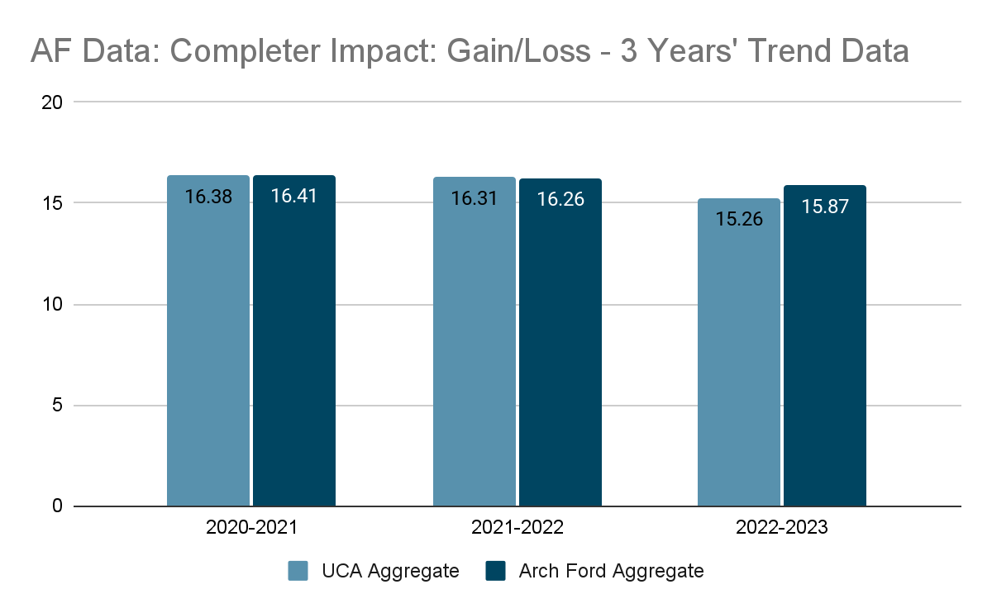

Slide 10
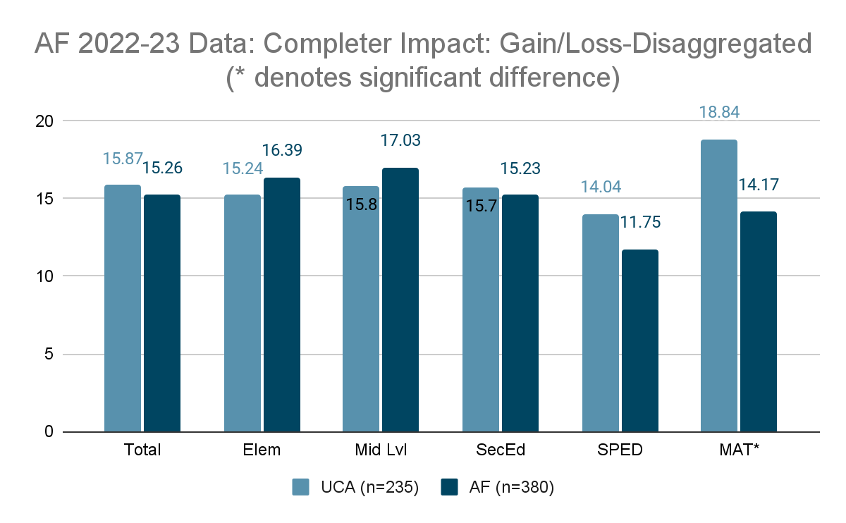

Slide 11
Measure 1b: Completers’ Teaching Effectiveness (AF)
Data presented here were secured through partnership with Arch Ford (AF) Novice Teacher (NT) Mentoring Program begun in summer 2017. The AFNT program supports UCA graduates in induction for 3-years post graduation. Districts in the AFNT region support 30-40% of UCA prepared teacher candidates representing all programs across the EPP. All novice teachers in the AFNT program are observed by their principal and scored on the state-mandated performance observation rubric (Danielson, 2007). Data for UCA prepared teachers is compared to the AF aggregate as a benchmark. Data reported here reflect year 1 novice teachers only. Data were collected in spring/summer 2023. Trends remain consistent for those in the Year 2 and Year 3 cohorts.
Domain 1. UCA completers’ data (x̄=3.11) were slightly lower than their data for their peers prepared at other institutions (x̄=3.26). This is not consistent with trends in the previous two years. Differences in data were not statistically significant.
Domain 2. UCA completers’ data (x̄=3.17) were slightly lower than their data for their peers prepared at other institutions (x̄=3.29). This is not consistent with trends in the previous two years. Differences in data were not statistically significant.
Domain 3. UCA completers’ data (x̄=3.11) were slightly lower than their data for their peers prepared at other institutions (x̄=3.28). This is not consistent with trends in the previous two years. Differences in data were not statistically significant.
Domain 4. UCA completers’ data (x̄=3.25) were slightly lower than their data for their peers prepared at other institutions (x̄=3.37). Differences in data were not statistically significant.
Note: Initial Programs Only

Slide 12
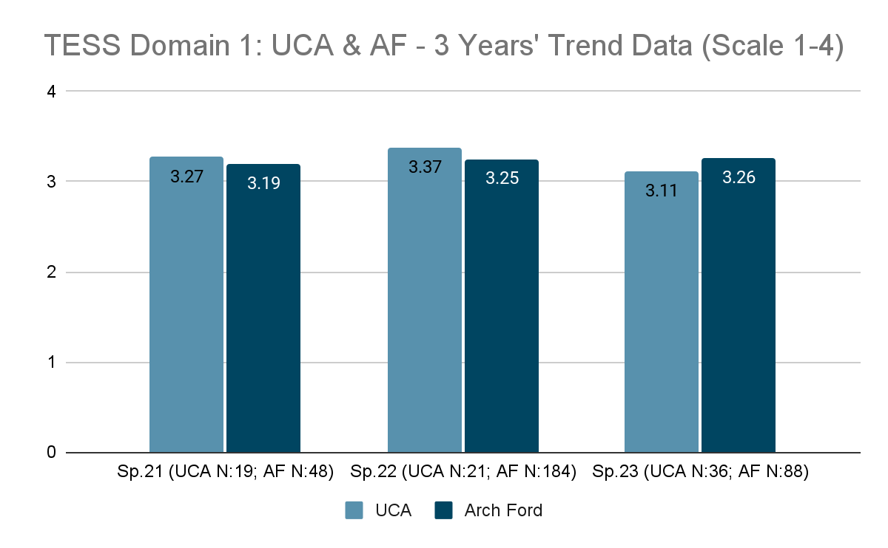

Slide 13
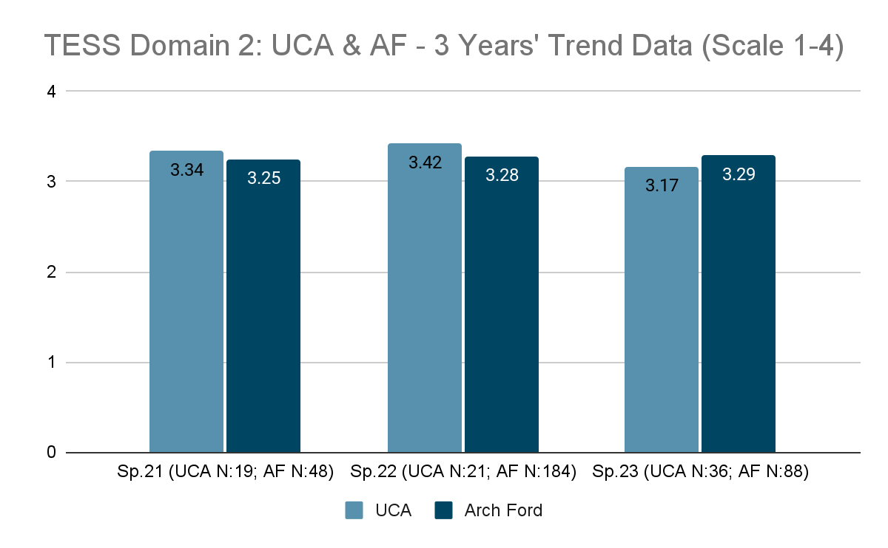

Slide 14
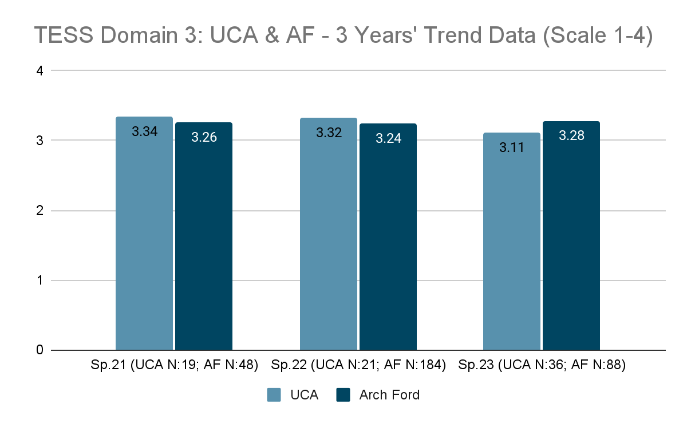

Slide 15
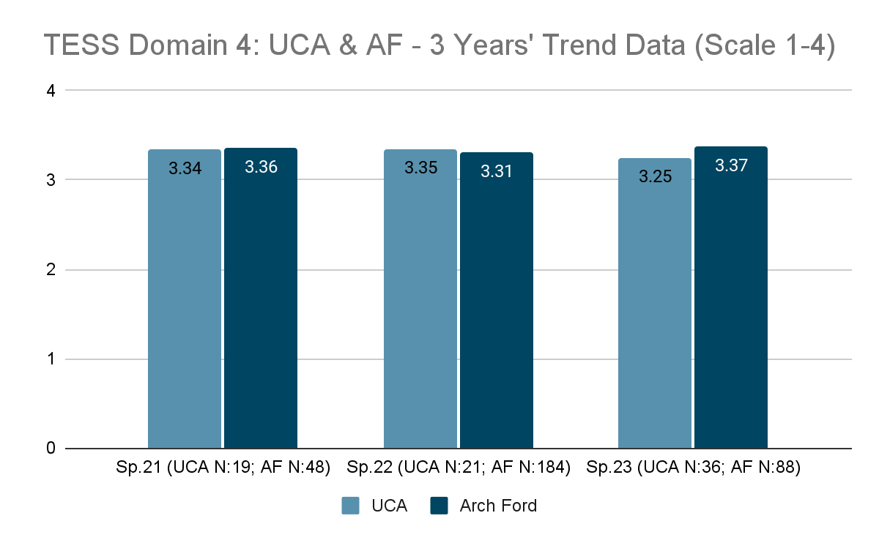

Slide 16
Measure 2: Satisfaction of Employers
UCA Employer Survey - Initial Programs
UCA Employer Survey - Advanced Programs

Slide 17
Measure 2: Employer Satisfaction (initial)
UCA measures employer satisfaction of program completers through multiple measures including a UCA survey, Arch Ford partner employee survey, and ADE/DESE measure of employer satisfaction. The data presented here were collected through a UCA principal survey aligned to the expectations of the Interstate Teacher Assessment and Support Consortium (InTASC) standards. All data included in the data set were scored on a scale of 1-4 (1 = not prepared, 2 = inadequately prepared, 3 = adequately prepared, 4 = well prepared) with a target score of “3.” Faculty in the CAEP Standard 4 committee noted the redesigned survey allowed us to more clearly see a need to support candidates in supporting diverse student populations.
Overall trends in Spring 2023 indicate that the EPP is doing well in preparing candidates to for the field with all scores falling in the upper range of the survey (levels 3-4) and exceeding scores from Spring 2022.
Relative high points in the data include candidate ability to collaborate with colleagues (x̄=3.6), ability to align instruction to the Arkansas standards (x̄=3.58), engagement in ongoing professional learning (x̄=3.57), ability to meet students’ needs (x̄=3.57), technology integration (x̄=3.56), and content knowledge (x̄=3.55). These findings are consistent with data from Spring 2022.
Relative low points in the data include candidate ability to manage student behavior (x̄=3.33), multiple methods of assessment (x̄=3.41), and differentiating instruction (x̄=3.42).
Improvements in data were noted for engaging students in multiple perspectives (x̄=3.47) and creating inclusive learning environments (x̄=3.44).

Slide 18
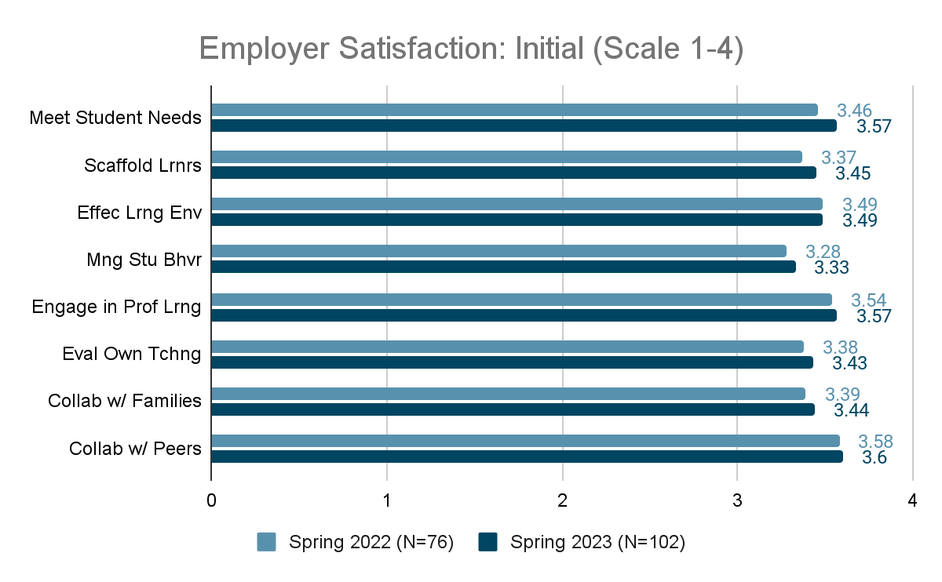

Slide 19
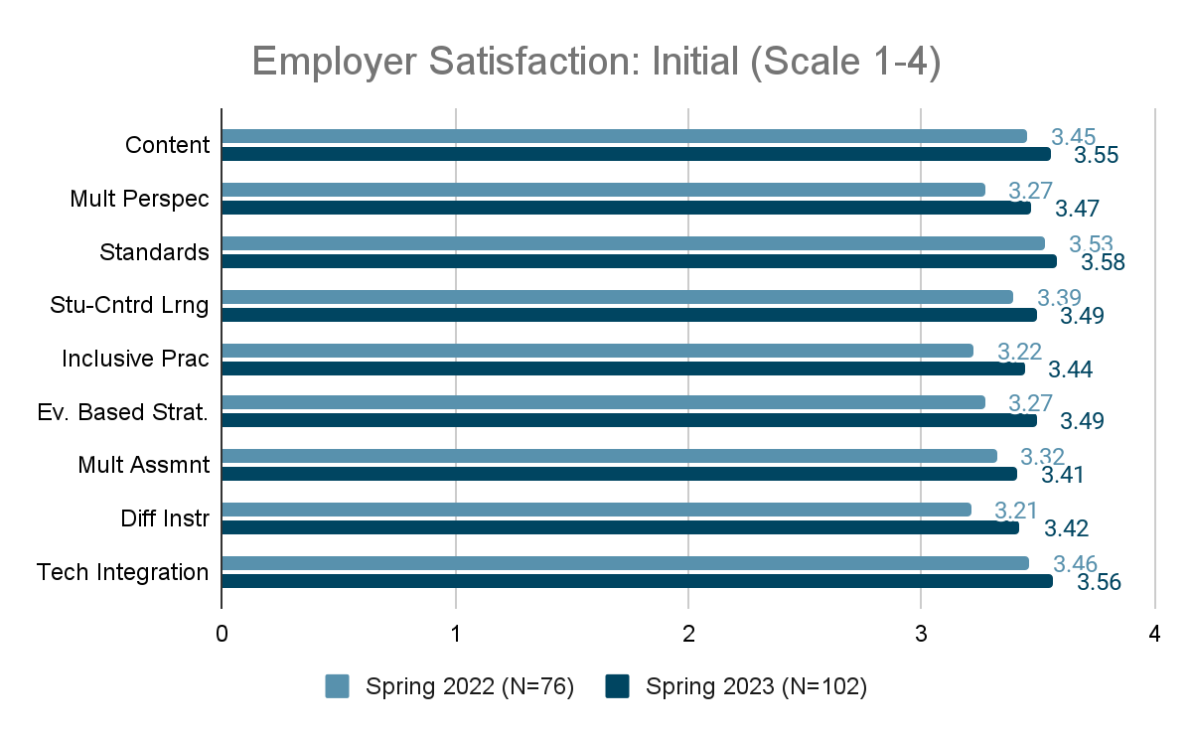

Slide 20
Measure 2: Employer Satisfaction and Milestones (advanced)
The data presented here were collected through an employer survey aligned to the expectations of the Council for the Accreditation of Educator Preparation (CAEP) (Standard A.1.1). All data included in the data set were scored on a scale of 1-4 (1 = not prepared, 2 = inadequately prepared, 3 = adequately prepared, 4 = well prepared) with a target score of “3.”
Overall trends in Spring 2023 indicate that the EPP is doing well in preparing candidates to for the field with all scores falling in the upper range of the survey (levels 3-4) and exceeding scores from Spring 2022 in many criteria.
Relative high points in the data included employer ratings around use of technology to support professional practice (x̄ = 3.94), professional skills and content knowledge specific to the professional role (x̄ = 3.78) and professional dispositions (x̄ = 3.76).
Relative low points in the data included supporting diverse stakeholders (x̄ = 3.61) which contradicts findings from Spring 2022. Again, while these data points are the relative low spots in the data, all far exceed the benchmark and lie near the “well prepared” indicator.

Slide 21
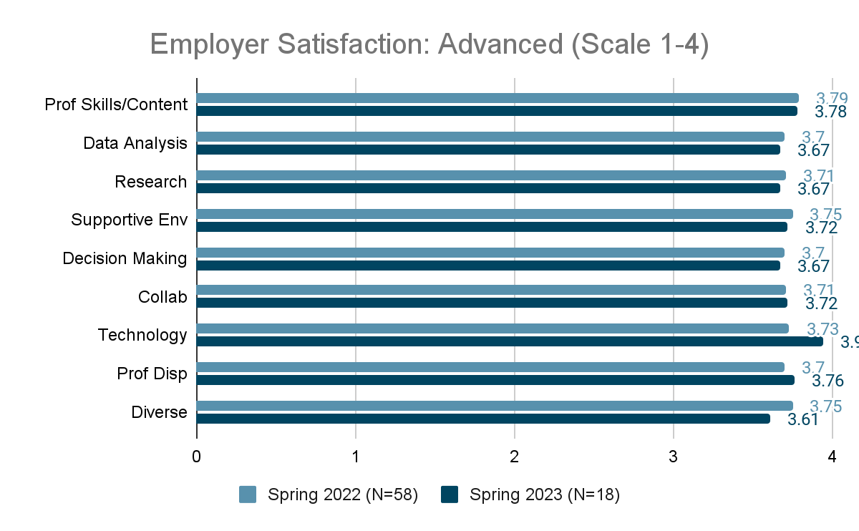

Slide 22
Measure 3: Candidate Competency at Completion
Praxis Data - Initial Programs
Praxis Data - Advanced Programs

Slide 23
Measure 3: Ability of Completers to Meet Requirements
Candidate pass rate on required content Praxis exams is tracked across programs by the Office of Candidate Services (OCS). Disaggregated program data are tracked for pass rates, mean score, standard deviation, and range
Both initial and advanced programs report overall success in candidate ability to pass the required Praxis content exam(s) with many programs yielding pass rates at 90% and higher. For initial programs, changes to policy for “Gate 3” (admission to internship 2) have resulted in higher pass rates, notably for the K6 program. Candidates must now meet the ADE/AAP score for admission to Gate 3 (https://uca.edu/ocs/aap-provisional/). Additionally, the EPP has created several support and remediation structures for students struggling to pass their required exam(s) successfully, including: 240 Tutoring, Praxis Boot Camps (DESE grant), and state resources/tutoring programs. Undergraduate K6 Social Studies continues to be an area of focus for continuous improvement.
Access to full reports - https://uca.edu/panda/panda-reports/title-ii-reports/

Slide 24
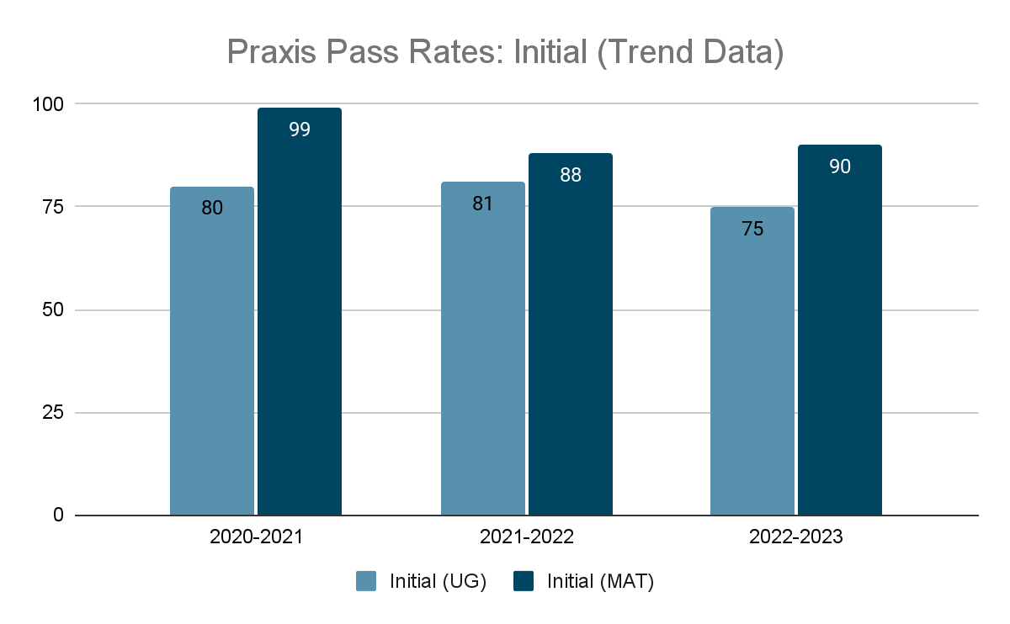

Slide 25
INITIAL UNDERGRADUATE PROGRAMS | # Taking | # Passing | Program Pass Rate | State Pass Rate
K-6 Elementary: Reading & LA | 58 | 50 | 86 | 92
K-6 Elementary: Mathematics | 58 | 53 | 91 | 91
K-6 Elementary: Social Studies | 58 | 41 | 71 | 85
K-6 Elementary: Science | 58 | 47 | 81 | 89
4-8 Middle Level: ELA | 6 | * | * | 51
4-8 Middle Level: Math (5164) | 5 | * | * | 94
4-8 Middle Level: Math (5169) | 6 | * | * | 95
4-8 Middle Level: Science | 6 | * | * | 87
4-8 Middle Level: Social Studies | 11 | 10 | 91 | 82
7-12 English | 4 | * | * | 100
7-12 FACS | 10 | 6 | 60 | 72
7-12 Math | 3 | * | * | 86
7-12 Social Studies (5086) | 2 | * | * | 100
7-12 Social Studies (5081) | 3 | * | * | 83
K-12 Art | 5 | * | * | 93
K-12 Music | 8 | * | * | 97
K-12 PE/Health | 16 | 10 | 63 | 87
K-12 Spanish | 2 | * | * | 80
K-12 SPED Fundamental Subjects | 11 | 11 | 100 | 91
K-12 SPED Knowledge and Applications | 11 | 11 | 100 | 98
Foundations of Reading (SEP0190) | 55 | 46 | 84 | 85

Slide 26
INITIAL MAT PROGRAMS | # Taking | # Passing | Program Pass Rate | State Pass Rate
K-6 Elementary: Reading and Language Arts | 32 | 32 | 100 | 93
K-6 Elementary: Mathematics | 33 | 32 | 97 | 90
K-6 Elementary: Social Studies | 33 | 31 | 94 | 82
K-6 Elementary: Science | 33 | 31 | 94 | 86
4-8 Middle Level: ELA | 5 | * | * | 67
4-8 Middle Level: Math (5134) | 2 | * | * | 50
4-8 Middle Level: Math (5169) | 5 | * | * | 81
4-8 Middle Level: Science | 5 | * | * | 83
4-8 Middle Level: Social Studies | 2 | * | * | 81
7-12 English | 3 | * | * | 95
7-12 FACS | 2 | * | * | *
7-12 Life Science / Biology | 5 | * | * | 95
7-12 Math | 4 | * | * | 69
7-12 Chemistry | 2 | * | * | *
7-12 Social Studies | 2 | * | * | 86
K-12 Art | 4 | * | * | 93
K-12 Music | 1 | * | * | *
K-12 PE/Health | 1 | * | * | 89
K-12 French | 1 | * | * | *
K-12 Spanish | 1 | * | * | *
K-12 Special Education Fundamental Subjects | 10 | 10 | 100 | 97
K-12 Special Education Knowledge and Applications | 10 | 10 | 100 | 99
Foundations of Reading (ESP0190) | 29 | 27 | 93 | 86

Slide 27
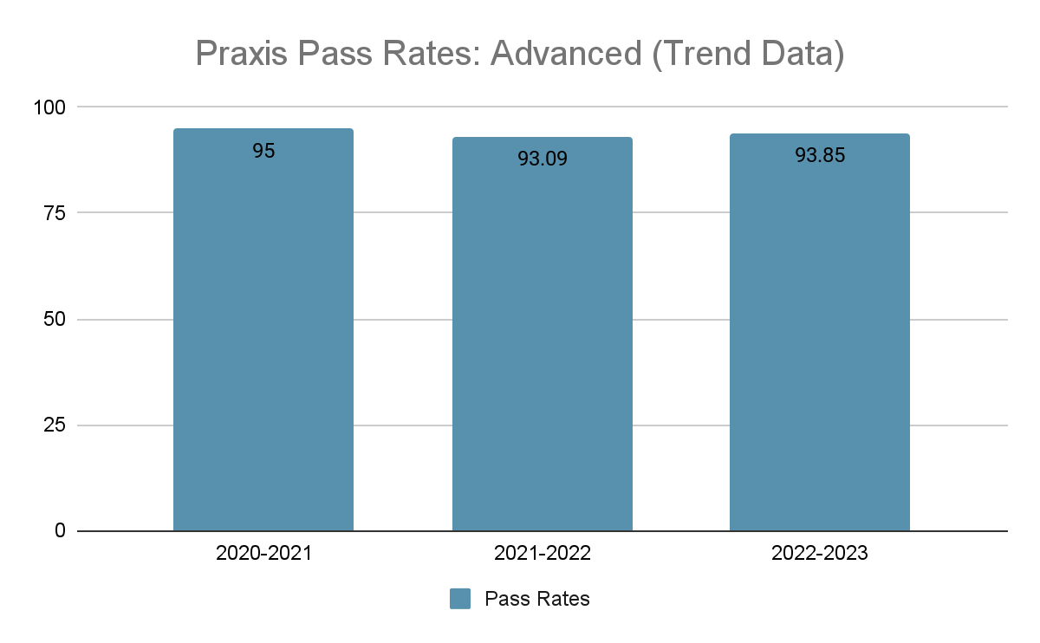

Slide 28
ADVANCED PROGRAMS | # Taking | # Passing | Program Pass Rate | State Pass Rate
Building Level Administrator (6990) | 12 | 11 | 91.67 | 93.04
District Level Administrator (6991) | 1 | * | * | 88.89
Library Media (5311) | 36 | 34 | 94.44 | 92.50
Reading (5302) | 20 | 15 | 75 | 81.25
School Counseling (5421) | 22 | 22 | 100 | 93.72
Gifted (5358) | 10 | 9 | 90 | 85.88
ESOL (5362) | 60 | 60 | 100 | 98.29
Special Education (5354) | 9 | * | * | 96.24
Special Education (5511) | 7 | * | * | 87.14

Slide 29
Measure 4: Ability of Completers to be Hired
ADE Data - Initial Programs
Employment Milestones - Advanced Programs

Slide 30
Measure 4: Ability of Completers to be Hired (initial)
EPP gathers data on initial program completers’ employment and retention milestones in partnership with UCA Office of Institutional Research and in partnership with Arkansas Division of Elementary and Secondary Education.
 | Spring 2019 | Spring 2020 | Spring 2021 | Spring 2022 | Spring 2023
Completers currently teaching in Arkansas Public Schools | 63% | 64% | 67% | 67% | 76%
Notes:
https://eis.ade.arkansas.gov/eppr/docs/State/StatewideReportSeptember2022.pdf

Slide 31
Measure 4: Ability of Completers to be Hired (advanced)
EPP gathers data on advanced program completers employment and retention milestones in partnership with UCA Office of Institutional Research
 | 2018-2019 | 2019-2020 | 2020-2021 | 2021-2022 | 2022-2023
Completers currently holding a position in Arkansas Public Schools aligned with their advanced degree obtained | 67% | 66% | 62% | 72% | 81%

