Slide 1
CAEP Annual Report
September 1, 2021 - August 31, 2022
University of Central Arkansas

Slide 2
Overview
CAEP (Council for the Accreditation of Educator Preparation) requires the EPP to publicly share data against four annual reporting measures. These measures are used to provide information to the public on both program outcome and program impact on both initial and advanced programs.
These data are for the UCA COE in alignment with CAEP annual reporting expectations.

Slide 3
8 Annual Reporting Measures
Measure 1 (Initial only): Completer effectiveness. Data must address: (a) completer impact in contributing to P-12 student-learning growth AND (b) completer effectiveness in applying professional knowledge, skills, and dispositions.
Measure 2: Satisfaction of employers and stakeholder involvement
Measure 3: Candidate competency at completion
Measure 4: Ability of completers to be hired.

Slide 4
Program Completer Data
Academic Year | Initial Combined UG and MAT | Advanced Programs
2021-2022 | 233 | 199
2020-2021 | 288 | 141
2019-2020 | 257 | 124

Slide 5
INITIAL PROGRAMS | 2019-2020 | 2020-2021 | 2021-2022
K-6 Elementary | 96 | 117 | 78
4-8 Middle Level | 21 | 30 | 26
4-12 Business | 1 | 2 | 6
4-12 Computer Science | 0 | 1 | 0
7-12 English | 9 | 15 | 16
7-12 FACS | 10 | 7 | 11
7-12 Life Science | 11 | 8 | 3
7-12 Math | 9 | 5 | 12
7-12 Physical Science | 3 | 1 | 4
7-12 Social Studies | 9 | 14 | 9
7-12 Speech / Drama | 2 | 2 | 0
K-12 Art | 9 | 10 | 9
K-12 Music | 19 | 23 | 10
K-12 PE/Health | 25 | 28 | 22
K-12 Chinese | 0 | 0 | 1
K-12 Spanish | 2 | 5 | 1
K-12 SPED | 31 | 20 | 25
TOTAL | 257 | 288 | 233

Slide 6
ADVANCED PROGRAMS | 2019-2020 | 2020-2021 | 2021-2022
Building Level Admin | 12 | 16 | 22
District Level Admin | 1 | 0 | 6
Curriculum Specialist | 3 | 1 | 2
Program Specialist - SPED | 0 | 0 | 3
Library Media | 22 | 34 | 22
Reading | 5 | 3 | 2
Dyslexia | 9 | 4 | 6
Reading + Dyslexia | 11 | 16 | 12
School Counseling | 37 | 26 | 21
Gifted | 5 | 8 | 6
Instructional Facilitator | 0 | 3 | 6
ESOL |  |  | 46
Online Teaching and Learning | 0 | 5 | 31
Career Development | 0 | 5 | 2
B-K | 4 | 1 | 3
Special Education | 11 | 16 | 8
Special Education Resource | 4 | 3 | 1
TOTAL | 124 | 141 | 199

Slide 7
Measure 1: Completer Effectiveness
Completer effectiveness. Data must address: (a) completer impact in contributing to P-12 student-learning growth AND (b) completer effectiveness in applying professional knowledge, skills, and dispositions.
INITIAL PROGRAMS ONLY

Slide 8
Measure 1a: Completers’ Impact on P-12 Learning (AF)
Data presented here were secured through partnership with Arch Ford (AF) Novice Teacher (NT) Mentoring Program begun in summer 2017. The AFNT program supports UCA graduates in induction for 3-years post graduation. Districts in the AFNT region support 30% of UCA prepared teacher candidates representing all programs across the EPP. All novice teachers in the AFNT program complete an Impact on Student Learning project each March and report data to AF. Data for UCA prepared teachers is compared to the AF aggregate as a benchmark.
In 2021-2022, 102 UCA completers in their first three years of service completed the project. Data were representative of all UCA preparation programs with data combined into 5 categories for analysis. Trend data reflect natural variability in the population and consistent performance relative to the comparative benchmark. Two year trend data around elementary completer performance are of concern and will be a focus of continued analysis. The UCA aggregate population scaled score gain x̄=16.31 compared to the AF aggregate gain of x̄=16.26. UCA graduates in 3 categories outperformed completers from other EPPs (SecEd x̄=18.33, SPED x̄=13.08, & MAT x̄=17.05 (p>.05). Completers in 2 categories scored lower than the comparative benchmark (Elem x̄=15.9; Middle Level x̄=16.43.
Note: Initial Programs Only
Notes:
Data from the pre/post-test reporting were manipulated by the EPP to ease analysis and interpretation of data. Novice teachers report their pre/post-test class averages based on ranges provided to them on the reporting form.
Data were then staged to calculate gain/loss from pre to post based on the conversion chart to a scaled score. For example, if a class pre-performance mean was 75-79%, and the class post-performance mean was 85-89%, calculate difference between “75” and “85” to be a gain of “10”. Again, the “Below 60” response just pegged at “60” in order not to overinflate the numbers. The GPA conversion was seen as another method to stage the data for ease of analysis by faculty and stakeholders.
The fact that the data are self-reported by the novice teachers should be considered a limitation of the study; however, given the variability in reported data, it appears novice teachers reported their data with fidelity.
Finally, the EPP examines data on a case-by-case basis to look for trends and patterns tied to licensure program preparation. Qualitative data resulting from the final prompts provided for the novice teachers are slated for program coordinator analysis in January 2020 after the submission of the self-study. Results and are linked here - http://bit.ly/2NSSp6D.

Slide 9
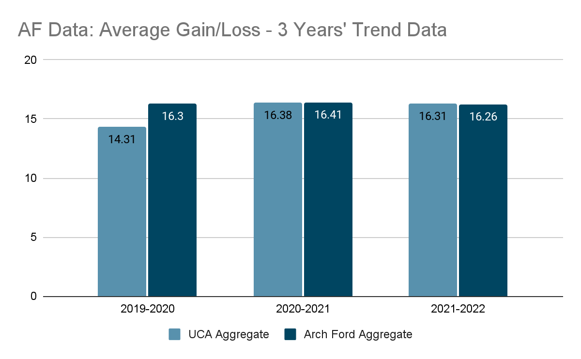

Slide 10
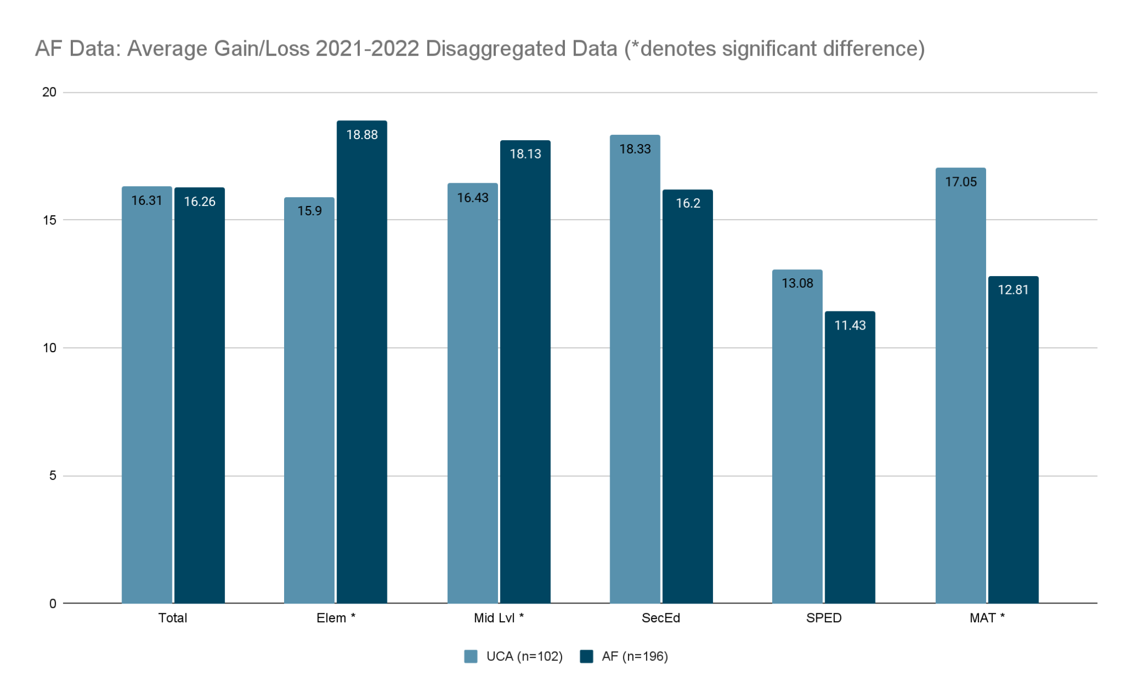

Slide 11
Measure 1b: Completers’ Teaching Effectiveness (AF)
Data presented here were secured through partnership with Arch Ford (AF) Novice Teacher (NT) Mentoring Program begun in summer 2017. The AFNT program supports UCA graduates in induction for 3-years post graduation. Districts in the AFNT region support 30% of UCA prepared teacher candidates representing all programs across the EPP. All novice teachers in the AFNT program are observed by their principal and scored on the state-mandated performance observation rubric (Danielson, 2007). Data for UCA prepared teachers is compared to the AF aggregate as a benchmark.
In AY 2022-2023, UCA completers had stronger data than their colleagues prepared at other EPPs and in other pathways in all domains. Trends noted earlier continued with strengths noted in all domains. No relative low points were noted. Data reported here reflect year 1 novice teachers only. Trends remain consistent for those in the Year 2 and Year 3 cohorts.
Note: Initial Programs Only

Slide 12
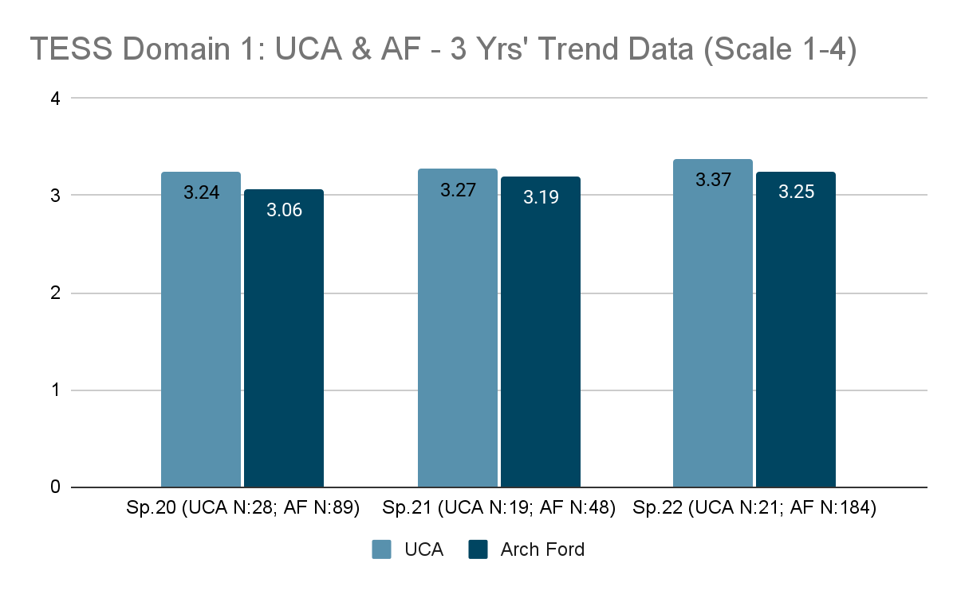

Slide 13
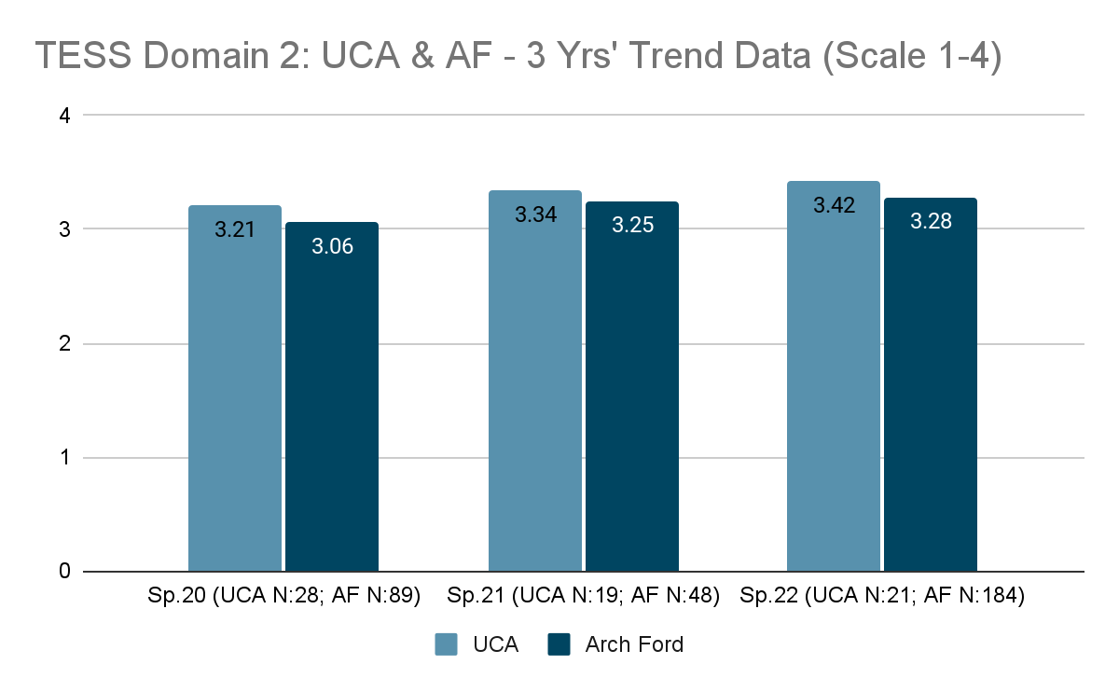

Slide 14
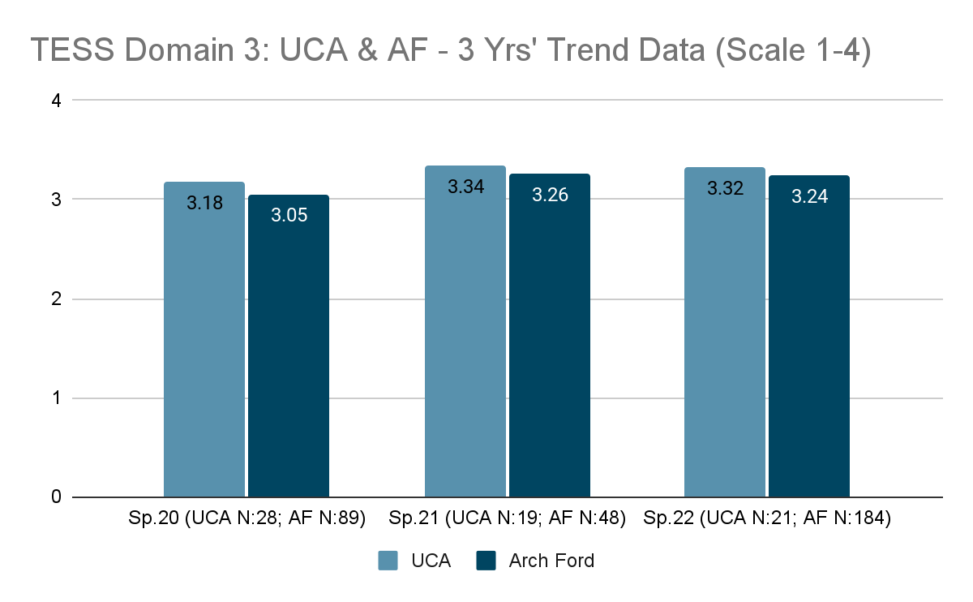

Slide 15
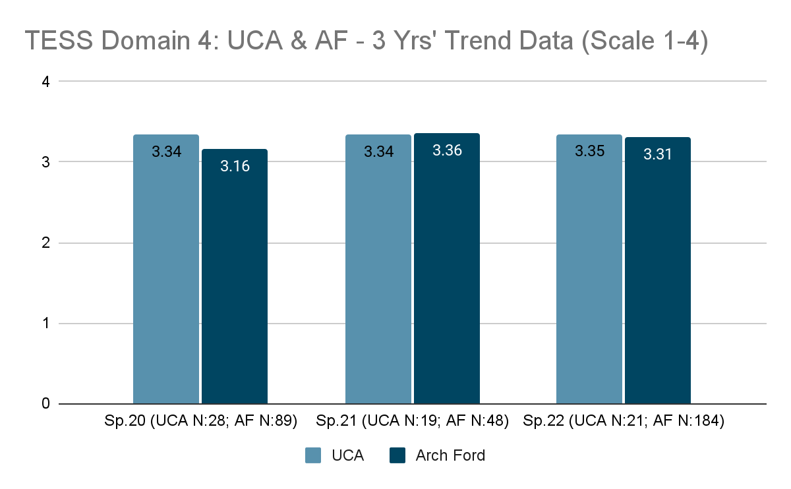

Slide 16
Measure 3: Satisfaction of Employers
UCA Employer Survey - Initial Programs
UCA Employer Survey - Advanced Programs

Slide 17
Measure 3: Employer Satisfaction (initial)
UCA measures employer satisfaction of program completers through multiple measures including a UCA survey, Arch Ford partner employee survey, and ADE/DESE measure of employer satisfaction. The data presented here were collected through a UCA principal survey aligned to the expectations of the Interstate Teacher Assessment and Support Consortium (InTASC) standards. All data included in the data set were scored on a scale of 1-4 (1 = not prepared, 2 = inadequately prepared, 3 = adequately prepared, 4 = well prepared) with a target score of “3.”
Overall trends in Spring 2022 indicate that the EPP is doing well in preparing candidates to for the field with all scores falling in the upper range of the survey (levels 3-4). Relative high points in the data include candidate ability to align instruction to the Arkansas standards (x̄=3.53), engagement in ongoing professional learning (x̄=3.54), and collaboration with colleagues (x̄=3.58). Relative low points in the data were designing inclusive curriculum (x̄=3.22) and differentiating instruction (x̄=3.21). Faculty in the CAEP Standard 4 committee noted the redesigned survey allowed us to more clearly see a need to support candidates in supporting diverse student populations.

Slide 18
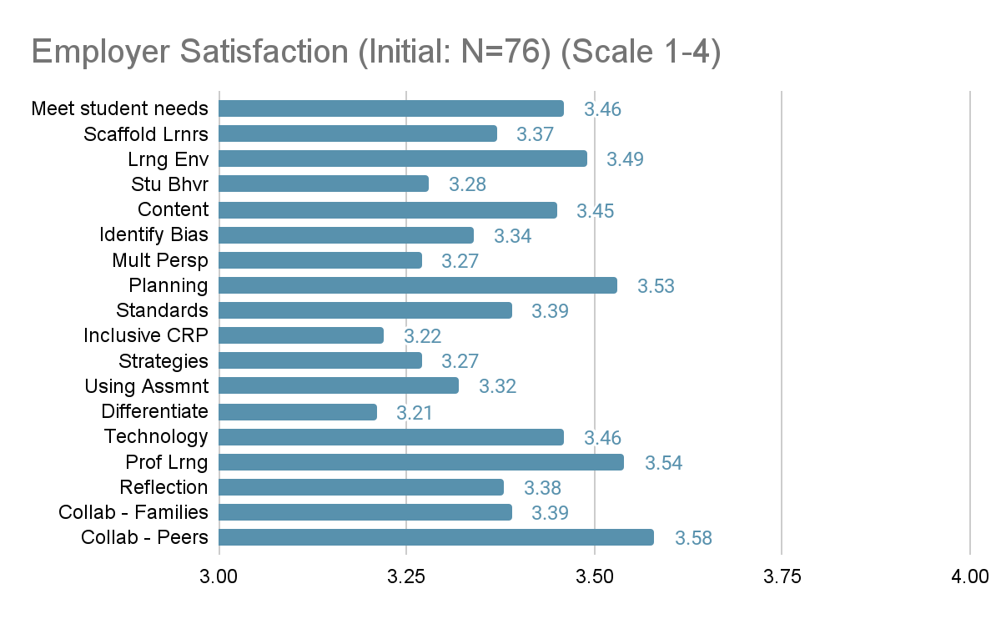

Slide 19
Measure 3: Employer Satisfaction and Milestones (advanced)
The data presented here were collected through an employer survey aligned to the expectations of the Council for the Accreditation of Educator Preparation (CAEP) (Standard A.1.1). All data included in the data set were scored on a scale of 1-4 (1 = not prepared, 2 = inadequately prepared, 3 = adequately prepared, 4 = well prepared) with a target score of “3.”
Relative high points in the data included employer ratings around completer skills and content specific to the professional role (x̄ = 3.64, 3.82, 3.79) and ability to respond to the needs of diverse stakeholders (x̄ = 3.52, 3.82, 3.75). Consistently lower points in the data included understand/use of data to support professional role (x̄ = 3.64, 3.82, 3.7) and professional dispositions (x̄ = 3.4, 3.68, 3.7). Again, while these data points are the relative low spots in the data, all far exceed the benchmark and lie near the “well prepared” indicator.

Slide 20
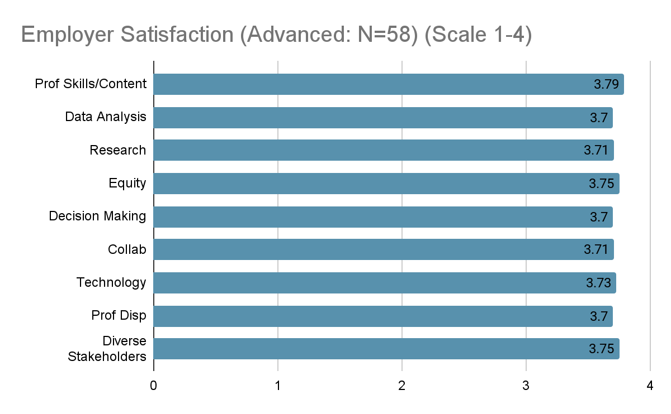
Notes:
Note: Data are AY 2020-2021. Employer data for advanced programs collected every 2 years.

Slide 21
Measure 3: Candidate Competency at Completion
Praxis Data - Initial Programs
Praxis Data - Advanced Programs

Slide 22
Measure 6: Ability of Completers to Meet Requirements
Candidate pass rate on required content Praxis exams is tracked across programs by the Office of Candidate Services (OCS). Disaggregated program data are tracked for pass rates, mean score, standard deviation, and range
Both initial and advanced programs report overall success in candidate ability to pass the required Praxis content exam(s) with many programs yielding pass rates at 90% and higher. Changes to policy for “Gate 3” (admission to internship 2) have resulted in higher pass rates, notably for the K6 program. Candidates must now meet the ADE/AAP score for admission to Gate 3 (https://uca.edu/ocs/aap-provisional/). Additionally, the EPP has created several support and remediation structures for students struggling to pass their required exam(s) successfully, including: 240 Tutoring, Praxis Boot Camps (DESE grant), and state resources/tutoring programs. Undergraduate K6 Social Studies continues to be an area of focus for continuous improvement.
Access to full reports - https://uca.edu/panda/panda-reports/title-ii-reports/

Slide 23
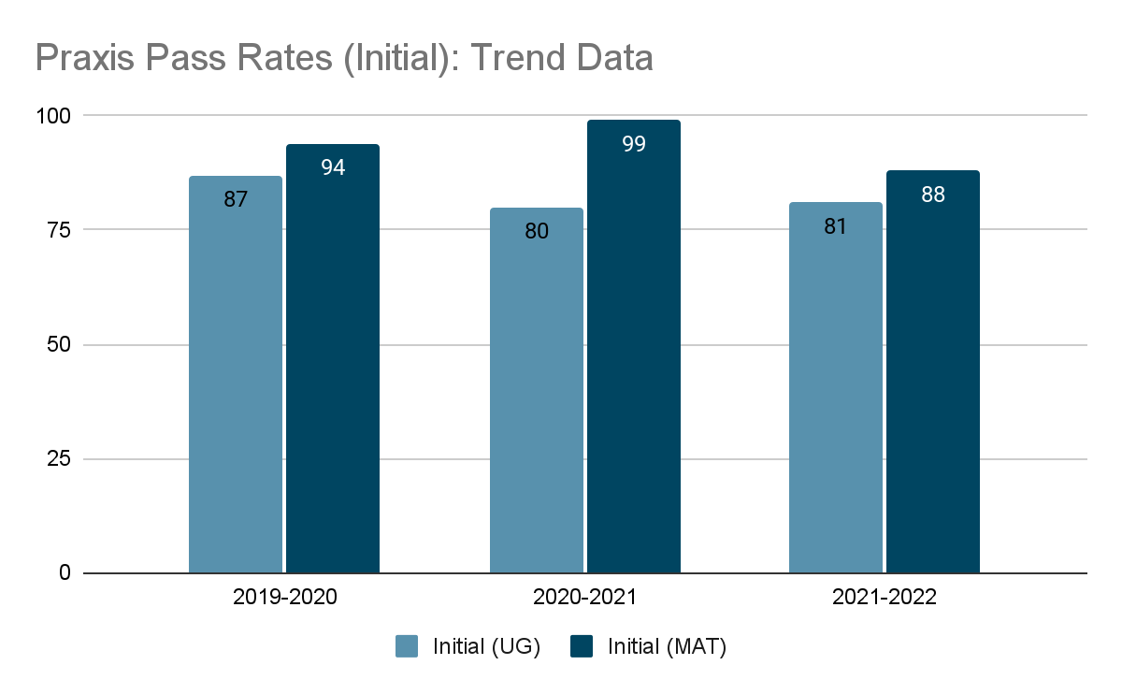

Slide 24
INITIAL UNDERGRADUATE PROGRAMS | # Taking | # Passing | Program Pass Rate | State Pass Rate
K-6 Elementary: Reading and Language Arts | 55 | 53 | 96 | 94
K-6 Elementary: Mathematics | 55 | 51 | 93 | 90
K-6 Elementary: Social Studies | 55 | 44 | 80 | 86
K-6 Elementary: Science | 55 | 51 | 93 | 89
4-8 Middle Level: English Language Arts | 9 | * | * | 46
4-8 Middle Level: Math | 8 | * | * | 68
4-8 Middle Level: Science | 5 | * | * | 78
4-8 Middle Level: Social Studies | 8 | * | * | 77
7-12 English | 9 | * | * | 89
7-12 FACS | 7 | * | * | 82
7-12 Life Science | 2 | * | * | 92
7-12 Math | 7 | * | * | 82
7-12 Physical Science | 2 | * | * | *
7-12 Social Studies | 5 | * | * | 82
K-12 Art | 4 | * | * | 90
K-12 Music | 9 | * | * | 88
K-12 PE/Health | 19 | 17 | 89 | 91
K-12 Special Education Fundamental Subjects | 11 | 11 | 100 | 98
K-12 Special Education Knowledge and Applications | 13 | 13 | 100 | 98
Foundations of Reading (ESP0090) | 12 | 12 | 100 | 95
Foundations of Reading (SEP0190) | 50 | 43 | 86 | 87

Slide 25
INITIAL MAT PROGRAMS | # Taking | # Passing | Program Pass Rate | State Pass Rate
K-6 Elementary: Reading and Language Arts | 21 | 21 | 100 | 97
K-6 Elementary: Mathematics | 21 | 21 | 100 | 95
K-6 Elementary: Social Studies | 21 | 21 | 100 | 92
K-6 Elementary: Science | 26 | 26 | 100 | 97
4-8 Middle Level: Math | 5 | * | * | 74
4-8 Middle Level: Science | 2 | * | * | 81
4-8 Middle Level: Social Studies | 3 | * | * | 95
4-12 Business | 5 | * | * | 100
7-12 English | 6 | * | * | 79
7-12 FACS | 3 | * | * | 91
7-12 Life Science | 3 | * | * | 100
7-12 Math | 2 | * | * | 80
7-12 Physical Science | 2 | * | *
7-12 Social Studies | 7 | * | * | 79
K-12 Art | 3 | * | * | 92
K-12 PE/Health | 1 | * | * | 81
K-12 Special Education Fundamental Subjects | 12 | 12 | 100 | 99
K-12 Special Education Knowledge and Applications | 12 | 12 | 100 | 100
Foundations of Reading (ESP0090) | 6 | * | * | 78
Foundations of Reading (ESP0190) | 24 | 19 | 79 | 82

Slide 26
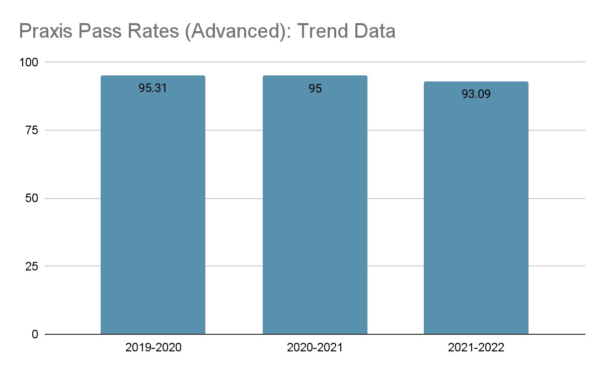

Slide 27
ADVANCED PROGRAMS | # Taking | # Passing | Program Pass Rate | State Pass Rate
Building Level Administrator (6990) | 18 | 18 | 100 | 93.39
District Level Administrator (6991) | 5 | 5 | 100 | 86.27
Library Media (5311) | 22 | 22 | 100 | 90.62
Reading (5302) | 20 | 17 | 85 | 82.42
School Counseling (5421) | 28 | 26 | 92.86 | 92.43
Gifted (5358) | 8 | 6 | 75 | 81.58
B-K (5024) | 2 | * | * | 47.37
ESOL (5362) | 51 | 50 | 98.04 | 98.97
Special Education (5354) | 27 | 25 | 92.59 | 94.62
Special Education (5511) | 7 | 6 | 85.71 | 84.71

Slide 28
Measure 7: Ability of Completers to be Hired
ADE Data - Initial Programs
Employment Milestones - Advanced Programs

Slide 29
Measure 4: Ability of Completers to be Hired (initial)
EPP gathers data on initial program completers’ employment and retention milestones in partnership with UCA Office of Institutional Research and in partnership with Arkansas Division of Elementary and Secondary Education.
 | Spring 2019 | Spring 2020 | Spring 2021 | Spring 2022
Completers currently teaching in Arkansas Public Schools | 63% | 64% | 67% | 67%
Notes:
https://eis.ade.arkansas.gov/eppr/docs/State/StatewideReportSeptember2022.pdf

Slide 30
Measure 7: Ability of Completers to be Hired (advanced)
EPP gathers data on advanced program completers employment and retention milestones in partnership with UCA Office of Institutional Research
 | 2018-2019 | 2019-2020 | 2020-2021 | 2021-2022
Completers currently holding a position in Arkansas Public Schools aligned with their advanced degree obtained | 67% | 66% | 62% | 72%

