Slide 1
Effective Communication
Pre-Assessment Cycle Information Session
Goal B (Written)

Slide 2
In this Session we will:
Refresh our understanding of the Effective Communication Goal B (Written) Rubric
Discuss expectations regarding student learning
Discuss assignment selection and design
Learn about the assessment process
Ask questions, raise concerns

Slide 3
The Assessment Cycle
A four year cycle.
Each year we will focus on one aspect of each competency.
The first four year cycle provides initial data. A second four year cycle allows for an assessment of the process as a whole. A full programmatic assessment is recommended every 10 years.
Academic Year | 16-17 | 17-18 | 18-19 | 19-20 | 20-21
Assess | RL | D | C | CI | RL
Evaluate |  | RL | D | C | CI
Train |  |  | RL | D | C
Implement |  |  |  | RL | D

Slide 4
The Assessment Process
Collect Artifacts
Score Artifacts
Collect and Process Data
Improvement Teams
Interventions
Faculty Development

Slide 5
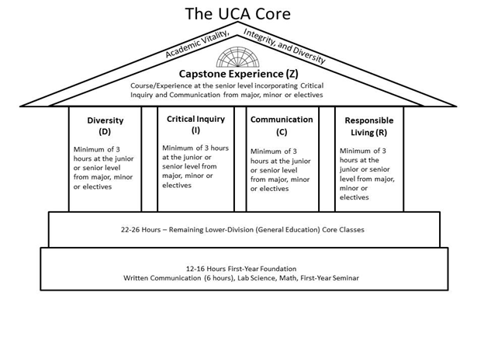
The Competencies and Scaffolding
Lower Division: Introduce and Develop
Upper Division: Reinforce, and Demonstrate Mastery
Capstone: Culminating Educational Experience

Slide 6
The Goal is Student Learning
The goal of the UCA Core is to provide a common, foundational educational experience to all UCA undergraduate students. We chose these outcomes as the essential skills all UCA students should develop.
We can only achieve this goal if we continuously evaluate the UCA Core curriculum and assess it for programmatic cohesion and effectiveness. Assessment is crucial for improvement!
We all must do our part in our respective roles to provide our students the best education possible at UCA.
Remember: This is about student learning.

Slide 7
The Goal of Assessment
Assure integrity in the UCA Core as an academic program.
Verify that best practices are being used consistently across campus.
Optimize student learning across the competencies at both the Lower and Upper Division.
Identify areas for improvement, and design and implement improvement measures.
It’s our curriculum. They’re our students. Their education is our responsibility.

Slide 8
The Requirements of Assessment
Representative sampling. Need all sections to participate.
Work that exemplifies students’ actual skills along each of the outcomes. Need representative student work.
Artifacts that are useable. Faculty scorers need to be able to evaluate the work you provide.

Slide 9
What is “Effective Communication” in the UCA Core?
Effective Communication: “the ability to develop and present ideas logically and effectively in order to enhance communication and collaboration with diverse individuals and groups.”
No Disciplinary Bias: Applicable to all disciplines. Does not mandate any particular content.
A Demonstrable Skill: Each of the outcomes focuses on a discrete skill that is assessable on a deliverable artifact.
A Federalist Approach: Academic freedom and experimentation under a universal rule or guideline with oversight for compliance. Content is not mandated.
See https://uca.edu/core/for-faculty/effective-communication-assessment/

Slide 10
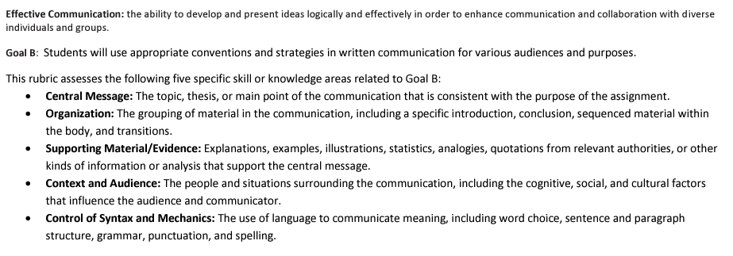
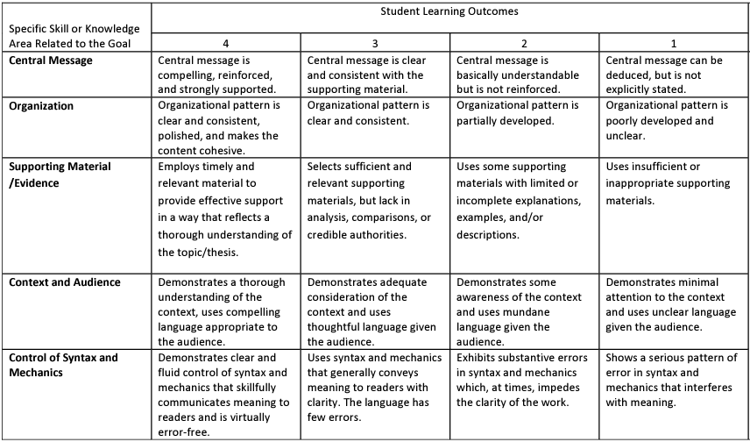
Effective Communication Rubric B: Written
Written Communication

Slide 11
Effective Communication resources https://uca.edu/core/for-faculty/effective-communication-assessment/
Expectations at all levels: From Lower to Upper Division courses, our expectations of students vary. But we should make sure to afford all students the opportunity to demonstrate the full range of their abilities.
No discipline has a monopoly on promoting or developing this skill in our students. All faculty who teach courses under this rubric, are teaching writing. (As such, make sure to make use of resources on campus, especially Jen Talbot and the WAC/WID program.)
We’re training our students to be effective rhetoricians. This is an area where our past assessment cycle showed we had room for growth.

Slide 12
Areas for Improvement
Last assessment cycle we saw that our students underperformed on “Supporting Material/Evidence” and “Context and Audience”
Are these areas you focus on? Do you discuss these with your students? Do you evaluate it?
Written Communication is in the UCA Core because it is a foundational skill in a liberal education.
Our students performed well on the technical components of writing. But were lacking in the rhetorical components, namely, Ethos (Credibility).

Slide 13
Context, Audience, and Evidence
Context and Audience
Compelling language
Sensitive to audience
Appreciates the cultural, social factors of the discourse
Avoids unnecessary jargon, as well as condescending or overly aggressive/agonistic language
Supporting Material/Evidence
Uses credible sources
Uses ample sources
Sources are relevant
Sources are aptly used
Avoids fallacious/misleading use of evidence, statistics, or information.

Slide 14
Assignment Choice and Design
Your course aligns to the Core rubric. It went through curriculum review to be so classified, and in that process affirmed your program’s commitment that the course would reinforce these student learning outcomes. As such, there should be an assignment that intentionally aligns to these outcomes and can function as your assessment artifact.
Choose or craft an assignment wisely: 1) Near the end of the semester, 2) One that aligns well to the Core outcomes and prompts students to present performances that demonstrate their skills across the learning outcomes of the rubric, 3) Provides ample opportunity for students to demonstrate the full range of their abilities.

Slide 15
Lower Division Artifacts
What are expectations in terms of: Central Message, Organization, Supporting Material/Evidence, Context and Audience, Syntax and Mechanics?
Are your writing assignments clear in their prompts and expectations? Do your students know what a good paper looks like?
Opportunity to demonstrate full range of skills: Chances are you’re not requiring lengthy research papers in a 1000, 2000 level course. (The grading would be a nightmare!) So what is a good writing assignment to see where students are in terms of all 5 outcomes?

Slide 16
Upper Division Artifact
What are expectations in terms of: Central Message, Organization, Supporting Material/Evidence, Context and Audience, Syntax and Mechanics?
Are your writing assignments clear in their prompts and expectations? Do your students know what a good paper looks like?
Opportunity to demonstrate full range of skills: At the upper level, especially in a Capstone course, students should be doing substantive writing and research. So what is a good writing assignment to see where students are in terms of all 5 outcomes? At the upper level it should be substantive and will need to be sizable.
Is your assignment significantly important so students will produce quality work?

Slide 17
Preparatory Work is Crucial
For assessment to be meaningful we need the best information we can get on student ability. We need an accurate picture of our students.
We need the data we receive to accurately depict our students’ skill levels across all the learning outcomes.
These data will be used to evaluate and improve the general education program at UCA.
Help us deliver to our students the best education we can; the education they deserve.

Slide 18
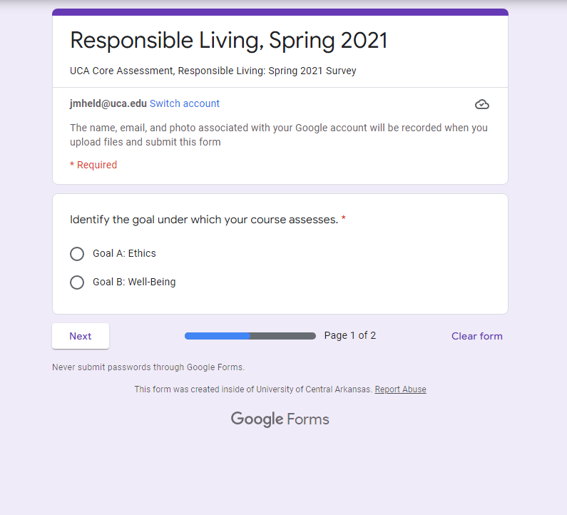
Artifact Collection: The Survey
Fall and Spring of assessment year, a survey is sent out from the office of assessment.
What will you use for assessment?
When will it be used?
How will it be delivered? Electronic is preferred – Consider using Blackboard.

Slide 19
Additional Info: When you submit your artifacts…
Assignment instructions
Assignment expectations
A grading rubric
The scorers will be scoring the student’s performance according to the Core rubric. They only have this single performance to evaluate a student’s competency. This is why assignment design and choice is crucial.

Slide 20
Looking ahead to Fall 2022
Please Participate
Complete the survey
Communicate with the Office of Assessment
Deliver your artifacts (student work)
Consider serving as a scorer
Questions: Contact Jake Held at jmheld@uca.edu or Alyson McEntire at amcentire@uca.edu

Slide 21
Questions?
Comments?

Slide 22
Jake Held, PhD
Professor of Philosophy
Assistant Provost for Academic Assessment
and General Education
Wingo Hall 215
501-450-5307
jmheld@uca.edu

