Slide 1
Effective Communication
Pre-Assessment Cycle Information Session
Goal A (Oral)

Slide 2
In this Session we will:
Refresh our understanding of the Effective Communication Goal A (Oral) Rubric
Discuss expectations regarding student learning
Discuss assignment selection and design
Learn about the assessment process
Ask questions, raise concerns

Slide 3
The Assessment Cycle
A four year cycle.
Each year we will focus on one aspect of each competency.
The first four year cycle provides initial data. A second four year cycle allows for an assessment of the process as a whole. A full programmatic assessment is recommended every 10 years.
Academic Year | 16-17 | 17-18 | 18-19 | 19-20 | 20-21
Assess | RL | D | C | CI | RL
Evaluate |  | RL | D | C | CI
Train |  |  | RL | D | C
Implement |  |  |  | RL | D

Slide 4
The Assessment Process
Collect Artifacts
Score Artifacts
Collect and Process Data
Improvement Teams
Interventions
Faculty Development

Slide 5
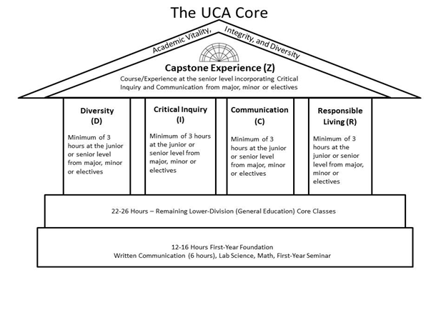
The Competencies and Scaffolding
Lower Division: Introduce and Develop
Upper Division: Reinforce and Demonstrate Mastery
Capstone: Culminating Educational Experience

Slide 6
The Goal is Student Learning
The goal of the UCA Core is to provide a common, foundational educational experience to all UCA undergraduate students. We chose these outcomes as the essential skills all UCA students should develop.
We can only achieve this goal if we continuously evaluate the UCA Core curriculum and assess it for programmatic cohesion and effectiveness. Assessment is crucial for improvement!
We all must do our part in our respective roles to provide our students the best education possible at UCA.
Remember: This is about student learning.

Slide 7
The Goal of Assessment
Assure integrity in the UCA Core as an academic program.
Verify that best practices are being used consistently across campus.
Optimize student learning across the competencies at both the Lower and Upper Division.
Identify areas for improvement, and design and implement improvement measures.
It’s our curriculum. They’re our students. Their education is our responsibility.

Slide 8
The Requirements of Assessment
Representative sampling. Need all sections to participate.
Work that exemplifies students’ actual skills along each of the outcomes. Need representative student work.
Artifacts that are useable. Faculty scorers need to be able to evaluate the work you provide.

Slide 9
What is “Effective Communication” in the UCA Core?
Effective Communication: “the ability to develop and present ideas logically and effectively in order to enhance communication and collaboration with diverse individuals and groups.”
No Disciplinary Bias: Applicable to all disciplines. Does not mandate any particular content.
A Demonstrable Skill: Each of the outcomes focuses on a discrete skill that is assessable on a deliverable artifact.
A Federalist Approach: Academic freedom and experimentation under a universal rule or guideline with oversight for compliance. Content is not mandated.
See https://uca.edu/core/for-faculty/effective-communication-assessment/

Slide 10
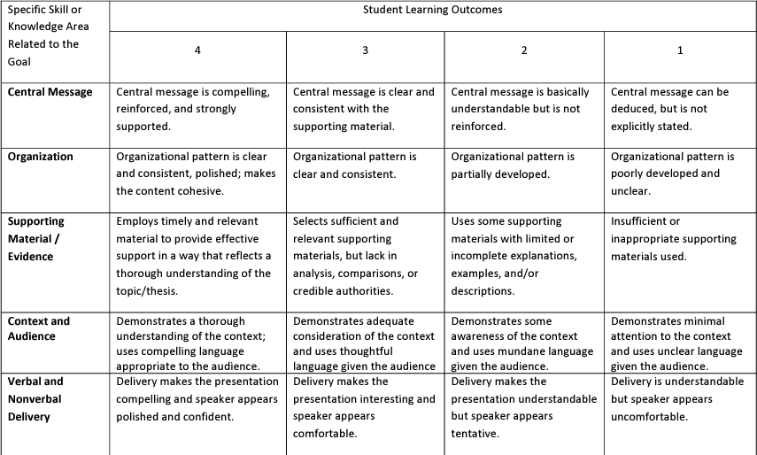
Effective Communication Rubric A: Oral
Oral Communication

Slide 11
Effective Communication resources https://uca.edu/core/for-faculty/effective-communication-assessment/
Expectations at all levels: From Lower to Upper Division courses, our expectations of students vary. But we should make sure to afford all students the opportunity to demonstrate the full range of their abilities. That’s how we learn where they are, so we can meet them there and promote growth.
No discipline has a monopoly on promoting or developing this skill in our students. All faculty who teach courses under this goal, are teaching oral communication.
We’re training our students to be effective rhetoricians. This is an area where our past assessment cycle showed we had room for growth.

Slide 12
Areas for Improvement
Last assessment cycle we saw that our students underperformed on “Delivery”
No growth demonstrated from lower division to upper division course work
Is this an area you focus on? Do you discuss this with your students? Do you evaluate it? Do you value it?
Oral Communication is in the UCA Core as a result of surveying both best practices in general education and employer needs.
In order for students to be effective public speakers, orators, or simply competent communicators, we need to focus on all facets of Oral Communication.

Slide 13
Verbal and Nonverbal Delivery
Verbal
Conversational tone
Well-paced
Proper grammar
Clear articulation
No distracting filler (umm, uhh, like, you know, right…)
Nonverbal
Appropriate dress
Purposeful movement
Eye contact
Gestures reinforce verbal message
No distractors (swaying, pacing, fidgeting, bouncing…)
* This slide is a revised version of a previous version authored by Nelle Bedner and Staci Fritzges.

Slide 14
Assignment Choice and Design
Your course aligns to the Core rubric. It went through curriculum review to be so classified, and in that process affirmed your program’s commitment that the course would reinforce these student learning outcomes. As such, there should be an assignment that intentionally aligns to these outcomes and can function as your assessment artifact.
Choose or craft an assignment wisely: 1) Near the end of the semester, 2) One that aligns well to the Core outcomes and prompts students to present performances that demonstrate their skills across the learning outcomes of the rubric, 3) Provides ample opportunity for students to demonstrate the full range of their abilities.

Slide 15
Lower Division Artifacts
What are expectations in terms of: Central Message, Organization, Supporting Material/Evidence, Context and Audience, Verbal and Nonverbal delivery?
Are your assignments clear in their prompts and expectations? Do your students know what a good presentation looks like?
Opportunity to demonstrate full range of skills: What is a good assignment to see where students are in terms of all 5 outcomes?

Slide 16
Upper Division Artifacts
What are expectations in terms of: Central Message, Organization, Supporting Material/Evidence, Context and Audience, Verbal and Nonverbal delivery?
Are your assignments clear in their prompts and expectations? Do your students know what a good presentation looks like?
Opportunity to demonstrate full range of skills: At the upper level, especially in a Capstone course, students should be doing substantive research. Expectations for an effective presentation should be high.
Is your assignment significantly important so students will produce quality work?

Slide 17
Preparatory Work is Crucial
For assessment to be meaningful we need the best information we can get on student ability. We need an accurate picture of our students.
We need the data we receive to accurately depict our students’ skill levels across all the learning outcomes.
These data will be used to evaluate and improve the general education program at UCA.
Help us deliver to our students the best education we can; the education they deserve.

Slide 18
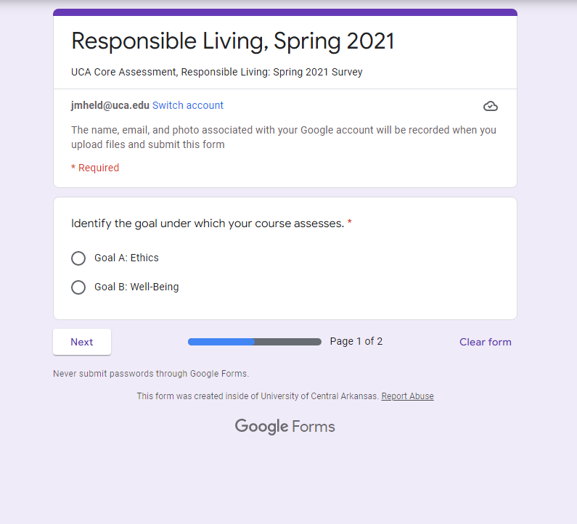
Artifact Collection: The Survey
Fall and Spring of assessment year, a survey is sent out from the office of assessment.
What will you use for assessment?
When will it be used?
How will it be delivered?

Slide 19
Recording Presentations
We will accept a sample from your courses: 20% or at least 5 artifacts.
Samples should be random
This will only work if we have general compliance from all relevant sections. Please participate.
All recordings will be deleted one year after the conclusion of assessment.
How to record:
Use classroom webcam: zoom, kaltura…
Portable video camera. Office of Assessment has some we can lend.
Office of Assessment staff can record presentations.
iPhone, iPad, alternative device…
*Make sure recording quality is consistent with clear visual and audio.

Slide 20
Submitting Recordings
Each student’s presentation should be a separate file.
Each file should be identified by student name.
Follow the usual directions provided with the survey. Upload files to the Office of Assessment.
If you have difficulty uploading files, you can email them, share them via google drive, or deliver them on a thumb drive, among various alternatives. But don’t give up! We’re here to help and will assist in any way we can.

Slide 21
Additional Info: When you submit your artifacts…
Assignment instructions
Assignment expectations
A grading rubric
The scorers will be scoring the student’s performance according to the Core rubric. They only have this single performance to evaluate a student’s competency. This is why assignment design and choice is crucial.

Slide 22
Looking ahead to Fall 2022
Please Participate
Complete the survey
Communicate with the Office of Assessment
Deliver your artifacts (student work)
Consider serving as a scorer
Questions: Contact Jake Held at jmheld@uca.edu or Alyson McEntire at amcentire@uca.edu

Slide 23
Questions?
Comments?

Slide 24
Jake Held, PhD
Professor of Philosophy
Assistant Provost for Academic Assessment
and General Education
Wingo Hall 215
501-450-5307
jmheld@uca.edu

