Slide 1
A Federalist Model of General Education
Assessment and Improvement
Jacob M. Held, PhD
University of Central Arkansas

Slide 2
Today’s Presentation
Key Concepts: Standards, Trust, Respect, Humility, Experimentation, Autonomy, and Accountability
Key Takeaways:
  Federalism – A theory of curricular development, assessment, and improvement.
  Process is improvement – Implementing an assessment process is in-itself improvement.
  A value of assessment is the conversation it provokes. Improvement follows naturally afterward.

Slide 3
Part I:
Building an Analogy: Federalism in Higher Education

Slide 4
What is “Federalism” in
Higher Education
Federalism: “mode of political organization that unites separate states or other polities within an overarching political system in a way that allows each to maintain its own integrity. … The political principles that animate federal systems … stress the virtues of dispersed power centres as a means for safeguarding individual and local liberties. (from Brittanica.com)
Departmental/College integrity
General Education standards
Academic Freedom and Experimentation
“Certitude is not the test of certainty. We have been cocksure of many things that were not so.”
(Oliver Wendell Holmes, Jr. “Natural Law”)

Slide 5
The UCA Core Council: The Judiciary
Articulated standards: UCA Core Competencies, Goals, Outcomes. Adopted by Faculty Senate
Applied to the curriculum and implemented by the departments and colleges
Oversight and Review: The role of assessment
Restraint: Motivated by humility, respect for integrity, and experimentation.

Slide 6
Part II:
Assessment of General Education at the University of Central Arkansas: A Brief Overview

Slide 7
The UCA Core: General Education
The UCA Core is a comprehensive, scaffolded, general education curriculum that introduces, develops, and reinforces core competencies.
Faculty developed and adopted
Fully assessable and routinely assessed
Governed by the UCA Core Council, a representative body of faculty from all colleges across campus
Administered by the Assistant Provost for Academic Assessment and General Education
  UCA Core Handbook and Assessment Plan at http://uca.edu/core/for-faculty/

Slide 8
General Education needs to be
Assessable and Assessed
We value Gen Ed because we value the outcome: informed, engaged citizens.
We should be able to articulate these student learning outcomes in terms of a coherent pedagogical theory and practice.
We should be able to articulate how we promote student learning and thereby what added value our students receive from our programming.
We need to make informed decisions about best practices and improve based on relevant information.

Slide 9
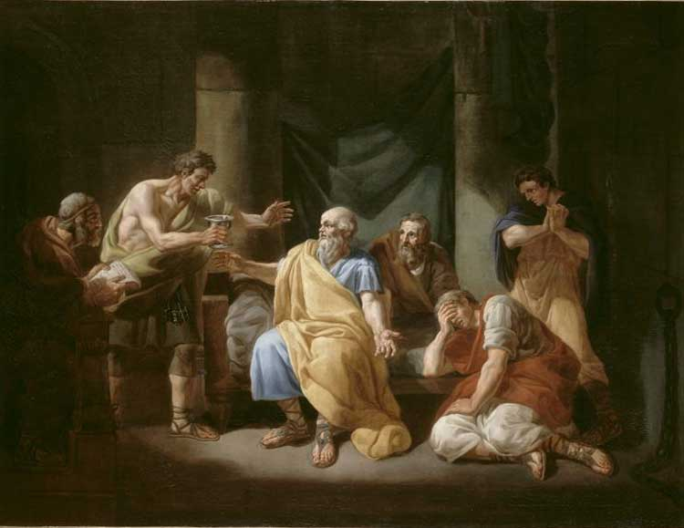
Against the Sophists
Notes:
Socrates hated the sophists, not just because they charged for education, but because they couldn’t show that they did anything. If education is not assessable, then we are frauds, we are selling a product that we expect the consumers to take the value of on blind faith. The attack on assessment is a faith based approached to higher education, and given crippling student loan debt, it’s infelicitous, and downright insulting, to claim that we can’t articulate what we are providing students with when they spend 4-6 years and 10s of thousands of dollars with us, “but trust us, it’s worthwhile!” Likewise, quasi-experimental model designs in assessing learning in higher education are good enough for our purposes. We needn’t have “research” level data, nor could we get it if we wanted. (Ethics and complexity would get in the way.) Need to assess and figure out how to talk about assessment. Need a productive relationship. We have to be open about why we assess, and what we can and can’t tell from the data, how we’ll use the data and make sure the end result is seen to promote the overall goal, student learning in these Core areas. This is how to frame the conversation!

Slide 10
The UCA Core Basic Structure
The UCA Core is a comprehensive course of study comprised of a lower (LD) and upper (UD) core curriuclum, and carried through the student’s entire undergraduate career. The Core introduces, develops, and applies fundamental competencies around four knowledge and skill areas:
Critical Inquiry (I) – The ability to analyze new problems and situations to formulate informed opinions and conclusions;
Effective Communication (C) – The ability to develop and present ideas logically and effectively in order to enhance communication and collaboration with diverse individuals and groups;
Responsible Living (R) – The ability to address real-world problems and find ethical solutions for individuals and society;
Diversity (D) – The ability to analyze familiar cultural assumptions in the context of the world’s diverse values, traditions, and belief systems as well as to analyze the major ideas, techniques, and processes that inform creative works within different cultural and historical contexts.

Slide 11
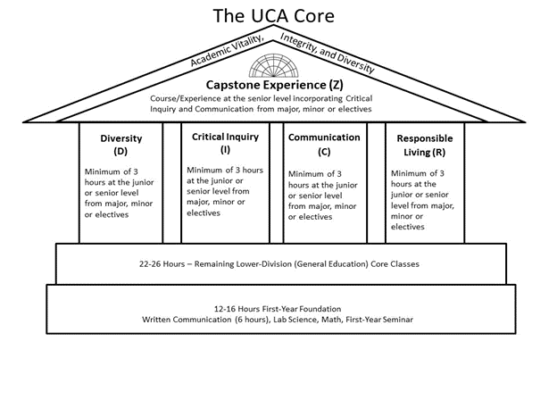
Scaffolding
Lower Division: Introduce and Develop Skills
Upper Division: Reinforce and Demonstrate Mastery
Capstone: Culminating Educational Experience

Slide 12
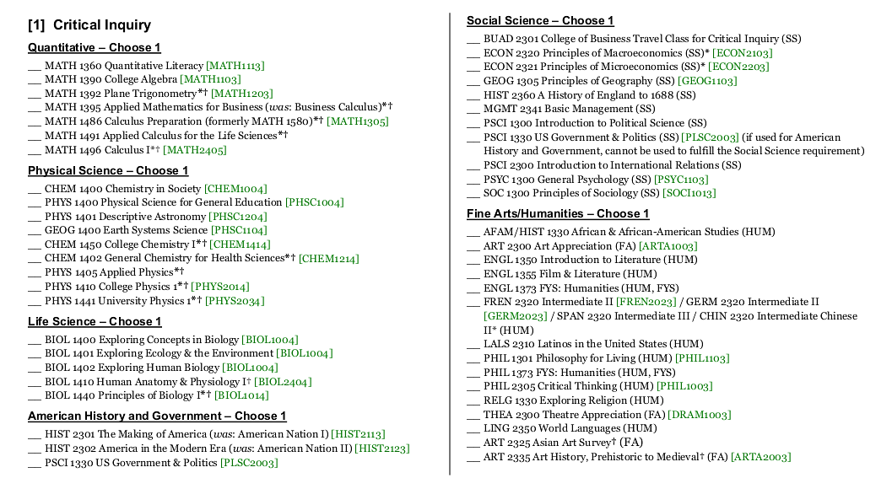
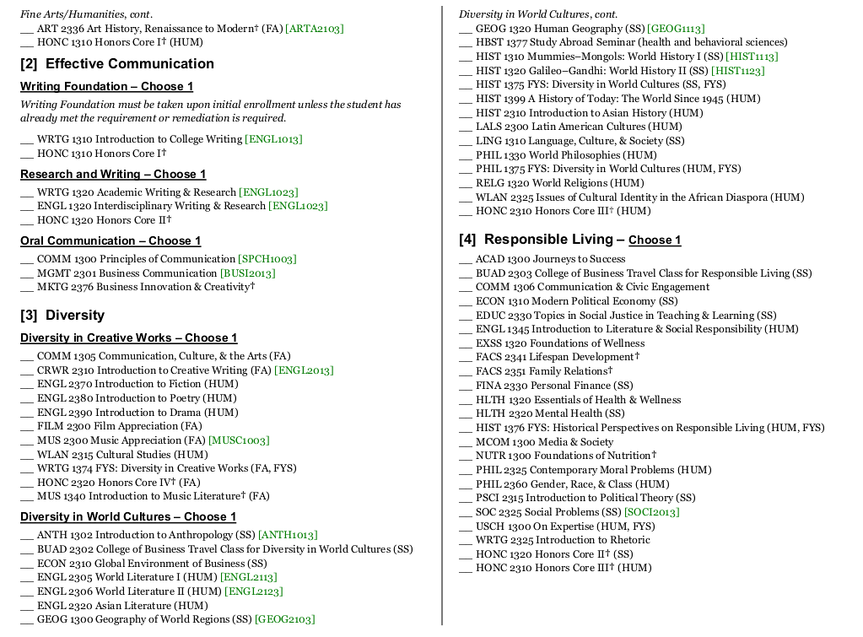
In Practice: The Lower Division Checksheet

Slide 13
The Assessment Cycle
Assessment of the UCA Core proceeds on a 4 year cycle.
Each year a single competency, with all of its associated goals, is assessed.
The first four year cycle provides initial data. A second four cycle provides an additional data set. A full programmatic assessment is scheduled after 10 years.
Academic Year | 16-17 | 17-18 | 18-19 | 19-20 | 20-21
Assess | RL | D | C | CI | RL
Evaluate |  | RL | D | C | CI
Train |  |  | RL | D | C
Implement |  |  |  | RL | D
Notes:
Briefly

Slide 14
The Assessment Process
Collect Artifacts
Score Artifacts
Collect and Process Data
Improvement Teams
Interventions
Faculty Development

Slide 15
Diversity Cycle
Pre-Cycle Training: Facilitated in coordination with the Office of Diversity and Inclusion
Artifact Scoring: Faculty scorers from across the campus score artifacts from all Diversity courses
Results: Lack of substantive growth from lower to upper division. Lack of clarity on the rubrics and expectations.
Improvement: Among other measures, decided to do a full review of all lower level diversity courses.

Slide 16
The LD Core Review Process
  Review all courses falling under the Diversity competency of the Lower Division Core.
    Assurance of quality
    Continued conversations about expectations
  Request materials for all extant sections of courses that fall under “Diversity”
  Reviewed by a sub-committee of the Core Council
  Report to Core Council and Departments providing “Diversity” courses.

Slide 17
Part III:
LD Core Review Process
Federalism in Practice

Slide 18
The Goal of the Review
Assure integrity in the UCA Core as an academic program: Curricular coherence, consistency of standards, shared student learning experiences
Review newer courses as well as “grandfathered” courses as we have learned what the core actually is/means.
Continue/Perpetuate the conversation about core learning outcomes, student learning, and expectations.
Notes:
Think about gen ed like a major, and the director as the chair. Then we’re all faculty and we need to talk about the curriculum ,best practices, and student learning. All faculty should want students to excel in gen ed for the same reason they want them to excel If they are majors. They want them to be better and see excellence in a discipline as assisting them in bettering their positions as humans.

Slide 19
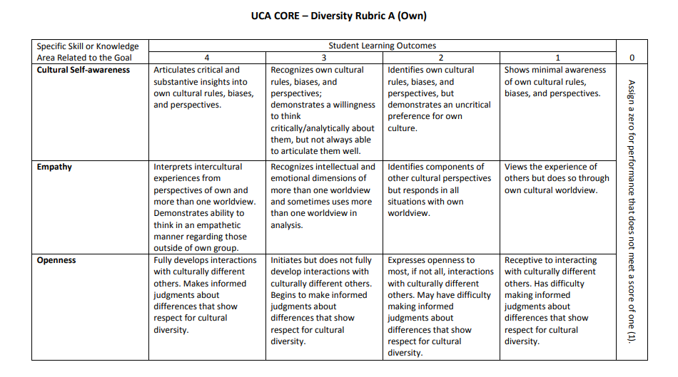
Core standards: The Principle
When the UCA Core Council considers proposals to add a course to the LD Core, considerations include: 1) Does the majority of course content in the proposed course explicitly address the outcomes of the competency and corresponding goal under which the course would be designated; 2) does the course curriculum, as a whole, address the competency in question; 3) Is the assignment (or assignments) designated as assessing for the learning outcomes well-designed.

Slide 20
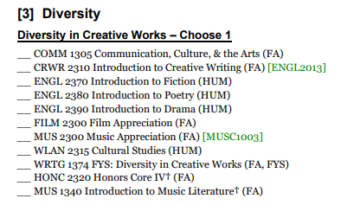
LD Core Review Process: Diversity
All courses in all Diversity areas of LD Core reviewed.
Evaluated by whichever rubric they fall under. Diversity in Creative Works falls under Diversity Goal C
Review extant course offerings by reviewing material from all regularly offered sections:
  Consistent with standards
  Consistent with outcomes
Should offer a consistent academic experience. (Family resemblance of courses)

Slide 21
Diversity Review Process
Review course materials
Determination: Course meets core standards
Send to Core Council for affirmation. No further action required. Informational report sent to department
Review Course materials
Determination: Course fails to meet core standards
Contact department: Provide report. Ask for assurance argument.
Assurance argument reviewed by Core Council.

Slide 22
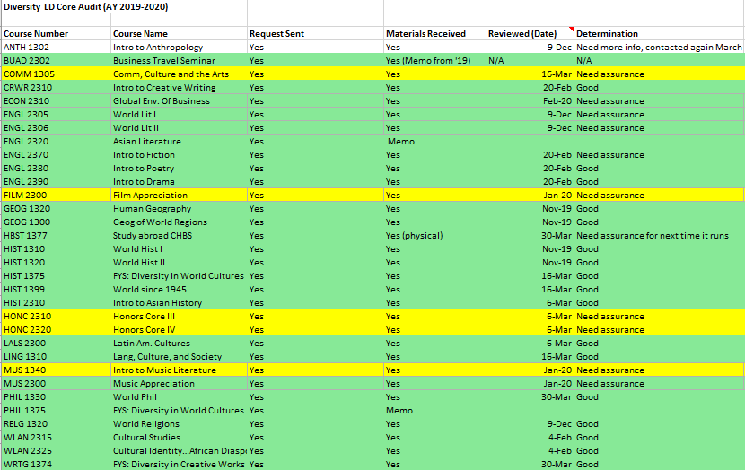
Results for Diversity
33 courses evaluated
11 courses required assurance arguments
5 assurance arguments received to date (COVID!)
All assurance arguments accepted by UCA Core Council
Notes:
Full compliance, all gave the full amount of requested information.

Slide 23
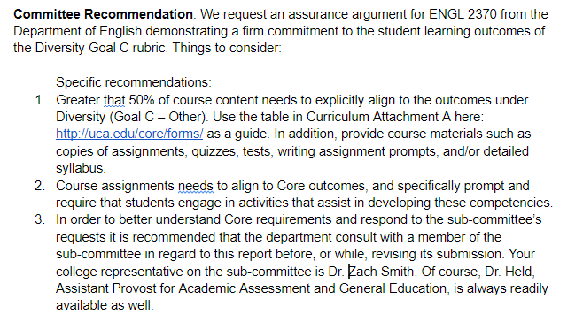
Sample Departmental Report
From the report on ENGL 2370: Intro to Fiction:
“In general, given that Intro to Fiction, as a UCA course, falls under the Diversity in Creative Works category of the UCA Core, and thus is intended to align to and promote learning outcomes promoting appreciation of diverse viewpoints, UCA’s intro to fiction should look distinctively different from an intro to fiction course you might see at another university. It should demonstrate a devotion to the diversity outcomes. This is where the committee struggled. Dr. [X’s] course looked like a fascinating intro to fiction course, but didn’t look like it took diversity to heart in its course offerings and assignments. Ms. [Y’s] came much closer. However, all sections of the course should be as committed and explicit in their engagement with the rubric.”

Slide 24
The Benefits of the Process
Builds shared understanding of expectations
Reinforces quality of all course offerings.
Politically disarms critics by reaffirming shared commitment to student learning outcomes
Perpetuates constructive conversations.
Notes:
This is all bottom up. Begin with faculty and departments, they implement the program.

Slide 25
A Greater Conversation
What does teaching Diversity mean?
Can learning in Diversity be assessed?
Is what we’re doing enough?

Slide 26
Part IV:
Diversity and General Education at UCA

Slide 27
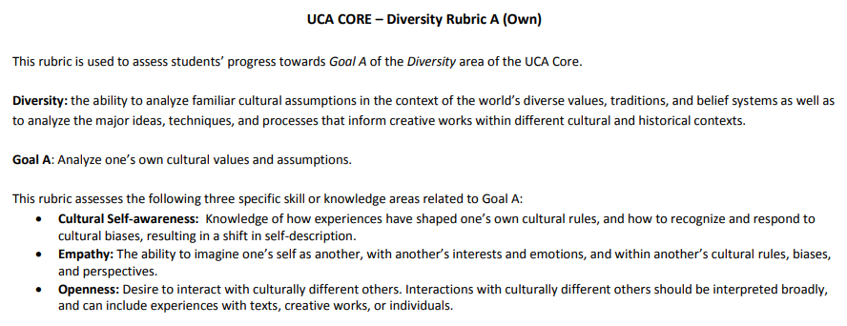
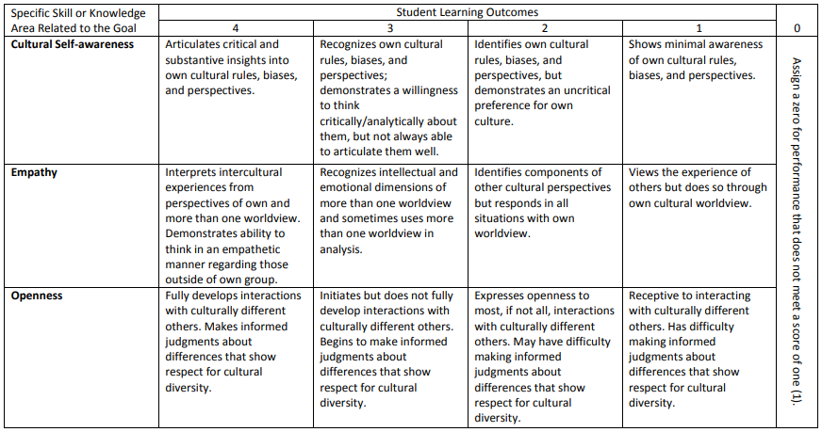

Slide 28
Issues with the diversity standard
The standard is unclear: What does “diversity” mean? Ideological diversity, racial diversity, gender…? What does this look like in a course? How is it reflected in course work? Authors from “diverse” backgrounds, or substantively diverse perspectives?
Can these outcomes be assessed? How do you measure or verify “empathy” or “openness”? Scorer feedback reinforces these difficulties.
Is this enough when it comes to promoting diversity? Some think we ought to be doing more with respect to “social justice”

Slide 29
Is it enough?
Some desire that campus do more; require the curriculum to promote “social justice” or “anti-racist pedagogies.”
But that fails to appreciate the role of general education, the holistic nature of education.
  Our Diversity standard is the required minimum, like a Federal statute. It is not exhaustive of what can be done, nor does it prohibit greater engagement.
  Our standard and process respects academic freedom and autonomy, given the amorphous nature of “diversity”
  Offers the freedom to experiment, be creative within departments
  Avoids the mortal sin of bad administrations: micro managing and top down “pet” projects

Slide 30
Can these outcomes be assessed?
Like any grader, we can only see outputs; we aren’t telepaths
We can discuss intentions but only measure outputs
Plus, assessment data in higher education is fundamentally flawed. We measure indiscreet data using interval or ratio variables. We can’t meet most assumptions for proper statistical analyses. Nor can we reproduce results or guarantee anything like clinical conditions. So all data needs to be interpreted in this context.
“Is there no virtue among us? If there be not, we are in a wretched situation. No theoretical checks—no form of government can render us secure.” (James Madison)

Slide 31
The standard is unclear
But do we know it when we see it? This is rhetorical, but “Yes” we do. The standards are not insufferably vague.
We can afford to be vague since we are not draconian in our enforcement mechanisms.
Need to avoid disciplinary biases. There are no real experts in “diversity” unlike quantitative literacy, written communication…
“Some play must be allowed in the joints if the machine is to work.” (Oliver Wendell Holmes, Jr.)

Slide 32
Conclusions
There is no way to build a perfect system
There is a way to conduct a viable, constructive process
  Procedures are crucial : oversight, compliance, engagement.
  Need a clear, fair, predictable, and stable process
  Predicated on humility, perspective, and restraint and thereby builds trust and cooperation.

Slide 33
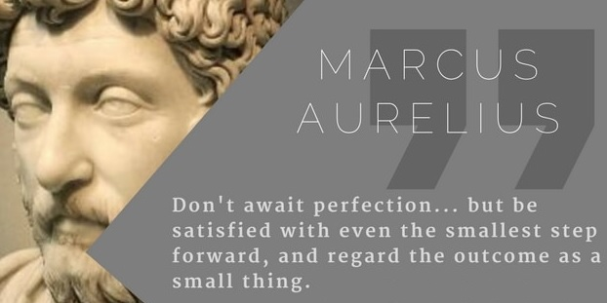
Notes:
Perspective in Higher education

Slide 34
Contact Information
Jacob Held, PhD
Assistant Provost for Academic Assessment and General Education
Professor of Philosophy
University of Central Arkansas
501-450-5307
jmheld@uca.edu

