Slide 1
Diversity Core Competency
Pre-Assessment Cycle
Information Session

Slide 2
In this Session we will:
Refresh our understanding of the Diversity Rubrics
Discuss expectations regarding student learning
Discuss assignment selection and design
Learn about the assessment process
Ask questions, raise concerns

Slide 3
The Assessment Cycle
A four year cycle.
Each year we will focus on one aspect of each competency.
The first four year cycle provides initial data. A second four cycle allows for an assessment of the process as a whole. A full programmatic assessment is recommended every 10 years.
Academic Year | 16-17 | 17-18 | 18-19 | 19-20 | 20-21
Assess | RL | D | C | CI | RL
Evaluate |  | RL | D | C | CI
Train |  |  | RL | D | C
Implement |  |  |  | RL | D

Slide 4
The Assessment Process
Collect Artifacts
Score Artifacts
Collect and Process Data
Improvement Teams
Interventions
Faculty Development

Slide 5
The Competencies and Scaffolding
Lower Division: Introduce and Develop
Upper Division: Reinforce, and Demonstrate Mastery
Capstone: Culminating Educational Experience

Slide 6
The Goal is Student Learning
The goal of the UCA Core is to provide a common, foundational educational experience to all UCA undergraduate students. We chose these outcomes as the essential skills all UCA students should develop.
We can only achieve this goal if we continuously evaluate the UCA Core curriculum and assess it for programmatic cohesion and effectiveness. Assessment is crucial for improvement!
We all must do our part in our respective roles to provide our students the best education possible at UCA.
Remember: This is about student learning.

Slide 7
The Goal of Assessment
Assure integrity in the UCA Core as an academic program.
Verify that best practices are being used consistently across campus.
Optimize student learning across the competencies at both the Lower and Upper Division.
Identify areas for improvement, and design and implement improvement measures.

Slide 8
What is “Diversity” in the UCA Core?
Diversity: “the ability to analyze familiar cultural assumptions in the context of the world’s diverse values, traditions, and belief systems as well as to analyze the major ideas, techniques, and processes that inform creative works within different cultural and historical contexts.”
Intentionally vague: Applicable to all disciplines. Does not mandate any particular content. It’s about perspectival diversity.
An Intellectual Virtue: Communicates an expectation about fostering an intellectual disposition and experience in the learner.
Minimal requirement: Faculty are free to do more, but courses designated as “Diversity” courses must at least align to one of the three rubrics under this competency.
A Federalist Approach: Academic freedom and experimentation under a universal rule or guideline with oversight for compliance.
See https://uca.edu/core/for-faculty/diversity-assessment/

Slide 9
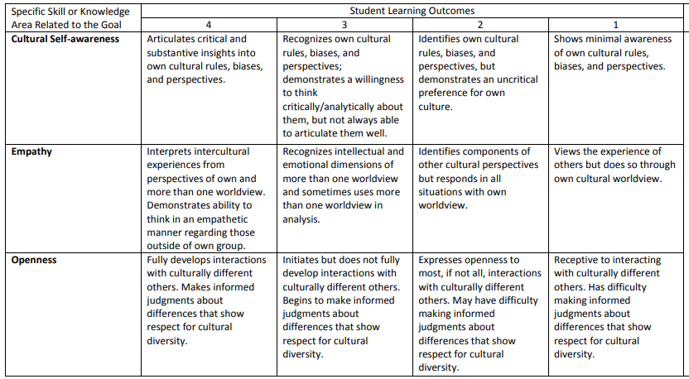
Diversity Rubric A: Own
One’s own values and assumptions
Direct versus Indirect Measures

Slide 10
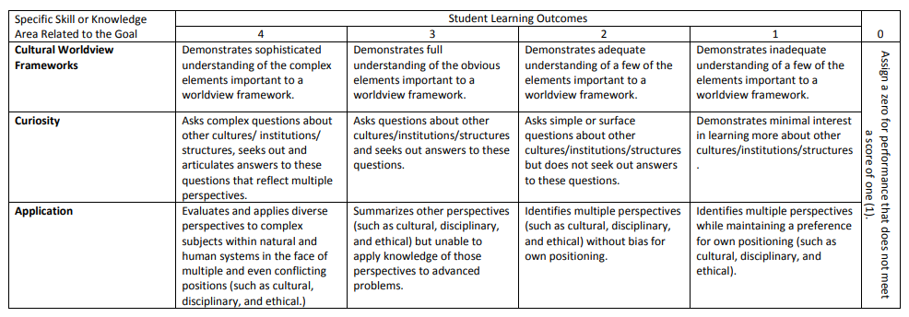
Diversity Rubric B: Other
Analyze or compare diverse perspectives
Asks questions…evaluates…applies

Slide 11
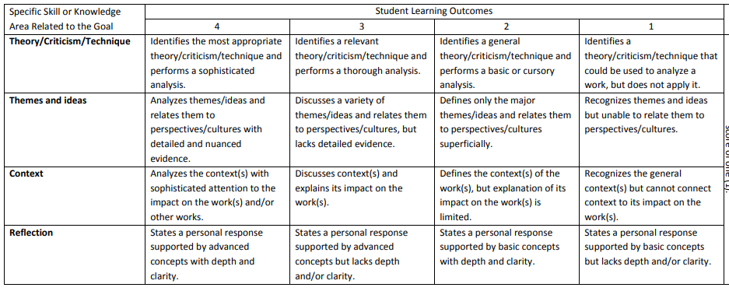
Diversity Rubric C: Creative Works
Analyze works within diverse contexts
Theory, themes, contexts, and personal response

Slide 12
Expectations at all levels: From Lower to Upper Division courses, our expectations of students vary. But we should make sure to afford all students the opportunity to demonstrate excellence. That’s how we learn where they are, so we can meet them there and promote growth.
Diversity it broadly defined. No discipline owns it. No discipline is uniquely qualified.
All measures that assess outcomes like “empathy” or “curiosity” are probably indirect measures. We can’t know attitudes or mindsets, only outputs.
It’s about authentic experiences.

Slide 13
Assignment Choice and Design
Your course aligns to the Core rubric. Your assignment should reflect this.
Choose or craft an assignment wisely: 1) Near the end of the semester, 2) One that aligns well to the Core outcomes and prompts students to present performances that demonstrate their skills across the learning outcomes of the rubric.
Questions to ask yourself: 1) Does your assignment explicitly prompt a student to demonstrate the skills your course develops and for which we are assessing? 2) Does your assignment provide an appropriate opportunity to demonstrate the student’s skill level across the Core outcomes?

Slide 14
Lower Division Diversity (Example)
Assesses under Goal A (Own)
Self-Awareness, Empathy, Openness
Length, prompts, description…
Opportunity to demonstrate full range of skills
Provided by Dr. Donna Bowman

Slide 15
Upper Division Diversity (Example)
Assesses under Goal B (Other)
Cultural Worldview, Curiosity, Application
Size/importance of assignment
Scope and Expectation
Provided by Dr. Thomas Snyder

Slide 16
Preparatory Work is Crucial
For assessment to be meaningful we need the best information we can get. We need an accurate picture of your students.
We need you to participate so we get representative data of the student population.
We need the data we receive to accurately depict our students skill levels across the Core outcomes.
This data will be used to evaluate and improve the general education program at UCA.
Help us deliver to our students the best education we can; the education they deserve.
QUESTIONS ?

Slide 17
Artifact Collection: The Survey
Fall and Spring of assessment year, a survey is sent out from the office of assessment.
What will you use for assessment?
When will it be used?
How will it be delivered?
All artifacts entered into AQUA

Slide 18
Additional Info for the Survey
Provide a syllabus
Assignment instructions?
Assignment expectations?
A grading rubric?
The scorers will be scoring the student’s performance according to the Core rubric. They only have this singular performance to evaluate a student’s competency. This is why assignment design and choice is crucial.

Slide 19
Looking ahead to Fall 2021
Please Participate
Complete the survey
Communicate with the Office of Assessment
Deliver your artifacts (student work)
Consider serving as a scorer!
Questions: Contact Jake Held at jmheld@uca.edu or Alyson McEntire at amcentire@uca.edu

Slide 20
Questions?
Comments?

Slide 21
Jake Held, PhD
Professor of Philosophy
Assistant Provost for Academic Assessment
and General Education
Wingo Hall 215
501-450-5307
jmheld@uca.edu

