Slide 1
Critical Inquiry (Goal A):
Inquiry and Analysis
Pre-Assessment Informational Session

Slide 2
In this Session we will:
Refresh our understanding of the Critical Inquiry (Goal A) Rubric
Discuss expectations regarding student learning
Learn about the assessment process
Discuss assignment selection and design
Ask questions

Slide 3
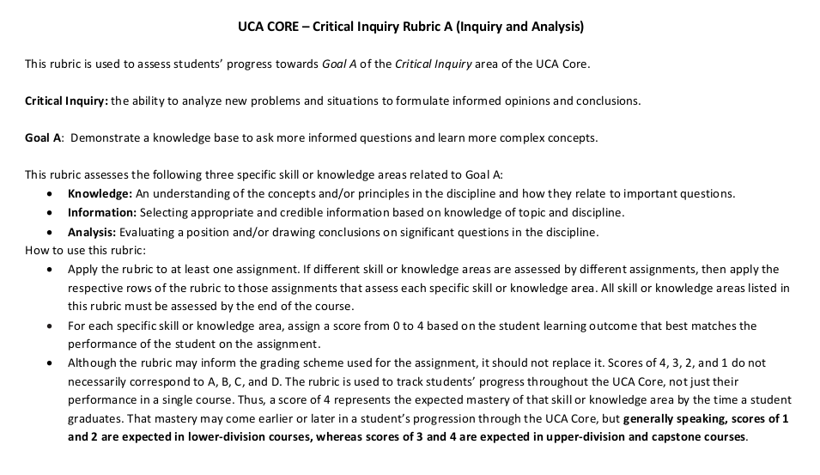
The Rubric

Slide 4
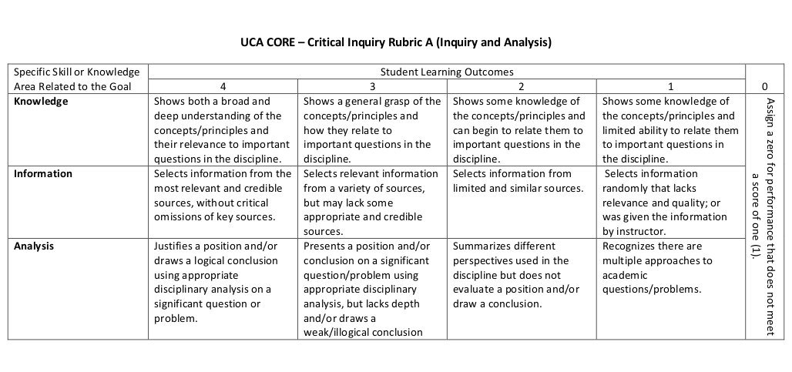
The Rubric

Slide 5
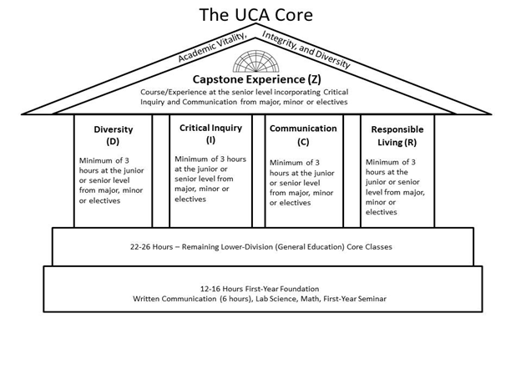
The Competencies and Scaffolding
Lower Division: Introduce and Develop
Upper Division: Reinforce, and Demonstrate Mastery
Capstone: Culminating Educational Experience

Slide 6
The Goal is Student Learning
The goal of the UCA Core is to provide a common, foundational educational experience to all UCA undergraduate students. We chose these outcomes as the essential skills all UCA students should develop.
We can only achieve this goal if we continuously evaluate the UCA Core curriculum and assess it for programmatic cohesion and effectiveness. Assessment is crucial for improvement!
We all must do our bona fide best in our respective roles to provide our students the best education possible at UCA.
Remember: This is about the students!

Slide 7
The Goal of Assessment
Assure integrity in the UCA Core as an academic program
Verify that best practices are being used consistently across campus
Optimize student learning across the 4 competencies at both the Lower and Upper Division
Identify areas for improvement and design and implement improvement measures

Slide 8
The Assessment Cycle
A four year cycle.
Each year we will focus on one aspect of each competency.
The first four year cycle provides initial data. A second four cycle allows for an assessment of the process as a whole. A full programmatic assessment is recommended every 10 years.
Academic Year | 16-17 | 17-18 | 18-19 | 19-20 | 20-21
Assess | RL | D | C | CI | RL
Evaluate |  | RL | D | C | CI
Train |  |  | RL | D | C
Implement |  |  |  | RL | D

Slide 9
The Assessment Process
Collect Artifacts
Score Artifacts
Collect and Process Data
Improvement Teams
Interventions
Faculty Development

Slide 10
Artifact Collection: The Survey
Fall and Spring of assessment year, a survey is sent out from the office of assessment.
What will you use for assessment?
When will it be used?
How will it be delivered?
All artifacts entered into AQUA

Slide 11
Additional Info for the Survey
Provide a syllabus
Assignment instructions?
Assignment expectations?
A grading rubric?
The scorers will be scoring the student’s performance according to the Core rubric. They only have this singular performance to evaluate a student’s competency. This is why assignment design and choice is crucial.

Slide 12
Assignment Choice and Design
Your course aligns to the Core rubric; Your assignments should reflect this
Choose or craft an assignment wisely
Near the end of the semester
One that aligns well to the Core outcomes
Questions to ask yourself
Does your assignment explicitly prompt a student to demonstrate the skills your course develops and we are assessing for?
Does your assignment provide an appropriate opportunity to demonstrate the student’s skill level across the Core outcomes?

Slide 13
Preparatory Work is Crucial
For assessment to be meaningful we need the best information we can get. We need an accurate picture of your students
We need you to participate so we get representative data of the student population
We need the data we receive to accurately depict our students skill levels across the Core outcomes
This data will be used to evaluate and improve the general education program at UCA
Help us deliver to our students the best education we can; the education they deserve

Slide 14
Looking ahead to Fall 2019
Please Participate
Complete the survey
Communicate with the Office of Assessment
Deliver your artifacts (student work)
Consider serving as a scorer!
Questions: Contact Jake Held at jmheld@uca.edu or Alyson McEntire at amcentire@uca.edu

Slide 15
Dr. Jake Held
Director of the UCA Core
Torreyson West 346
501-450-5307
jmheld@uca.edu

