Slide 1
Assessment of the UCA Core
Annual Brief (AY ‘18-19)
Diversity

Slide 2
The UCA Core
The UCA Core is a comprehensive academic program of study designed to develop and reinforce students’ knowledge and skills of critical inquiry and effective communication, as well as the knowledge and skills necessary for living responsible, ethical lives in a diverse and changing world.
The overarching goal of the program is to facilitate the development of thoughtful, knowledgeable, articulate, and ethical citizens.

Slide 3
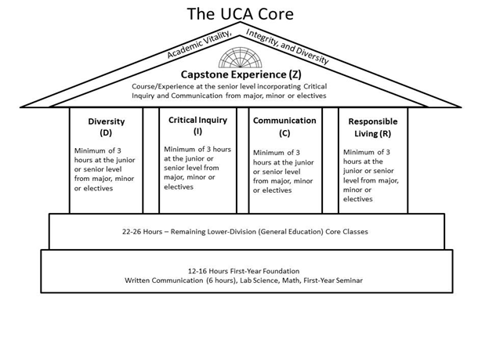
The Competencies and Scaffolding
Lower Division: Introduce and Develop
Upper Division: Reinforce, and Demonstrate Mastery
Capstone: Culminating Educational Experience

Slide 4
Improving Student Learning
The UCA Core is a comprehensive four-year program that introduces, develops, and reinforces core competencies.
The UCA Core Council in part functions as a curriculum review body whose primary duty in this regard is to review undergraduate courses proposed for or in the UCA Core to assure they are consistent with and exemplify the educational goals of the UCA Core.
UCA Core Handbook and Assessment Plan at http://uca.edu/core/for-faculty/

Slide 5
The Goal of Assessment
Assure integrity in the UCA Core as an academic program
Verify that best practices are being used consistently across campus
Optimize student learning across the 4 competencies at both the Lower and Upper Division
Identify areas for improvement and design and implement improvement measures

Slide 6
The Assessment Cycle
A four year cycle.
Each year we will focus on one aspect of each competency.
The first four year cycle provides initial data. A second four cycle allows for an assessment of the process as a whole. A full programmatic assessment is recommended every 10 years.
Academic Year | 16-17 | 17-18 | 18-19 | 19-20 | 20-21
Assess | RL | D | C | CI | RL
Evaluate |  | RL | D | C | CI
Train |  |  | RL | D | C
Implement |  |  |  | RL | D

Slide 7
The Assessment Process
Collect Artifacts
Score Artifacts
Collect and Process Data
Improvement Teams
Interventions
Faculty Development

Slide 8
Artifact Collection: The Survey
Fall and Spring of assessment year, a survey is sent out from the office of assessment.
What will you use for assessment?
When will it be used?
How will it be delivered?
All artifacts entered into AQUA

Slide 9
Artifact Scoring
The summer after artifacts have been collected:
Recruit a team of “scorers” from faculty area experts across campus (Reimbursed at $250.00 per day (3 day commitment))
Meet in August for scoring session:
Calibrate the team using anchor samples
Provide each scorer with AQUA profile
Score, score, score

Slide 10
Diversity: Scoring
Evaluation of the artifacts took place August 2018. The evaluation team included:
Rubric A (Own)
Riva Brown, Assistant Professor, School of Communication
Yuen Chan, Assistant Professor, Marketing and Management
John Gale, Associate Professor, Film, Theatre, and Creative Writing
Rubric B (Other)
John Parrack, Professor, Language, Linguistics, Literatures & Cultures
Zachary Smith, Assistant Professor, History
Thomas Snyder, Associate Professor, Economics, Finance, and Insurance & Risk Management
Rubric C (Creative Works)
Gilbert Baker, Assistant Professor, Music
Sonya Fritz, Associate Professor, English
Kyle Mattson, Associate Professor, School of Communication
Stephanie Vanderslice, Professor, Film, Theatre, and Creative Writing

Slide 11
Using the Data
The Office of Assessment provides an Evaluative Brief.
The Assessment Sub-Committee of the UCA Core Council convenes to review the brief.
Assessment Sub-Committee charged with evaluating data, requesting additional data as needed, and making recommendations on improvement measures to the UCA Core Council.
Interventions/Developmental Opportunities are designed and implemented the following academic year.

Slide 12
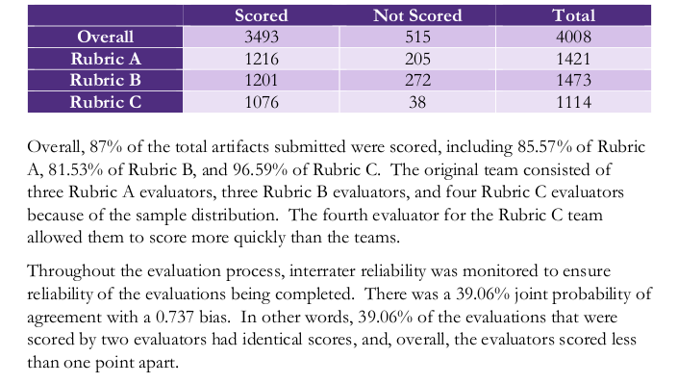

Slide 13
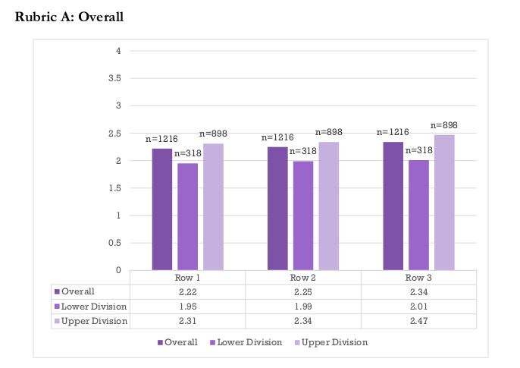

Slide 14
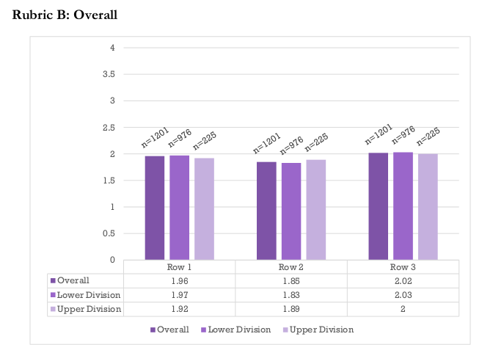

Slide 15
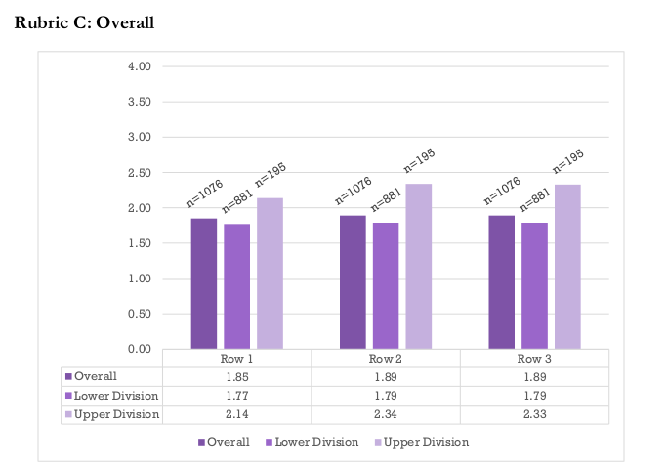

Slide 16
Observations and Recommendations from the Evaluative Brief
Scores did not advance as expected, especially for Rubric B which showed virtually no growth.
There were a considerable number of artifacts marked “N/A” by evaluators.
Participation for 2017-2018 dropped from 77% to 41%.
Overall, there was a high level of inter-rater reliability.
Explore assignment design/choice training.
Explore curriculum scaffolding of the UCA Core.
Work with faculty to ensure course content aligns to Core outcomes.
Continue to work with faculty, chairs, and deans to ensure compliance in the assessment process.

Slide 17
Next Steps
Faculty Development
Identify the top CRNS for Goals A, B, and C.
Contact faculty and work in consultation to develop programming for AY 19-20.
We can learn a great deal from each other. We need to leverage our best practices for our students’ benefit.
UCA Core Diversity programming. Sessions to promote/discuss:
Rubrics, assessment, and student learning
Assignment design and selection
Diversity education best practices on campus

Slide 18
Additional Actions: The LD Core Review Process
The Core Curriculum
The Core is a developmental program. It is paramount that LD and UD Core courses be placed intentionally throughout a student’s curriculum.
Review all courses falling under the Diversity competency of the Lower Division Core.
Assurance of Quality
Make curricular recommendations to reflect the nature of the UCA Core as a scaffolded program.

Slide 19
The Goal is Student Learning
The goal of the UCA Core is to provide a common, foundational educational experience to all UCA undergraduate students. We chose these outcomes as the essential skills all UCA students should develop.
We can only achieve this goal if we continuously evaluate the UCA Core curriculum and assess it for programmatic cohesion and effectiveness. Assessment is crucial for improvement!
We all must do our bona fide best in our respective roles to provide our students the best education possible at UCA.
Remember: This is about the students!

Slide 20
Dr. Jake Held
Director of the UCA Core
Torreyson West 346
501-450-5307
jmheld@uca.edu

