Slide 1
Responsible Living
Being Prepared for AY 20-21

Slide 2
Why assessment matters
Develop well-aligned assignments
How to participate during AY 20-21

Slide 3
Why does assessment matter?

Slide 4
We value the Responsible Living competency
Goal A: Ethics
Apply Ethical Principles to Solve problems
Goal B: Well-Being
Make appropriate recommendations …to address an issue …and evaluate the effect …on … well‐being …
Ethical Awareness
Ethical Issue Recognition
Ethical Application
https://uca.edu/core/assessment/
Issue Recognition
Analysis of Knowledge
Impact of Decisions

Slide 5
Meeting our obligation to our students
We are committed to offering our students a quality liberal education, our general education program, the UCA Core
Part of the UCA Core is Responsible Living, educating our students to be engaged, ethical, socially aware and responsible actors
In order to assure we are providing them a quality education we need to assess our efforts
Is our curriculum well designed and delivered to provide a quality educational experience?
We need to measure student ability, assess their learning, and evaluate their educational experiences

Slide 6
Educating our students: Measurement, Assessment, Evaluation
Where are our students when they begin?
Where are our students when they end?

Slide 7
Scaffolding: From Introductions to Mastery
Lower Division courses: Introduce and develop foundational skills
Upper Division courses: Reinforce skills and provide students opportunities to apply skills and demonstrate mastery

Slide 8
Measurement Good Assignment Design and Getting Useful Information
Does the assignment:
Align to the learning outcomes of the rubric? (Does it require the performance of tasks that will demonstrate the skills we’re assessing?)
Explicitly prompt students to perform in a way that demonstrates the skills we’re assessing?
Offer ample opportunity to demonstrate a student’s level of competency?

Slide 9
Example 1 A Problematic Assignment

Slide 10
Example 1 A Problematic Assignment
Since I don’t explicitly prompt my students:
They don’t know what my expectations are (Do I know what they are?)
If they meet my expectations, it’s by pure luck
This assignment is not a good measurement. It does not prompt the performances I want to see. It won’t be a reliable measure or window onto their abilities. I can’t learn much about their skill from this assignment. I won’t be able to assess their learning, or evaluate my teaching, curriculum or class experiences.
The next slide will remind you of the rubric I’m using and what the assignment should be aligned to.

Slide 11
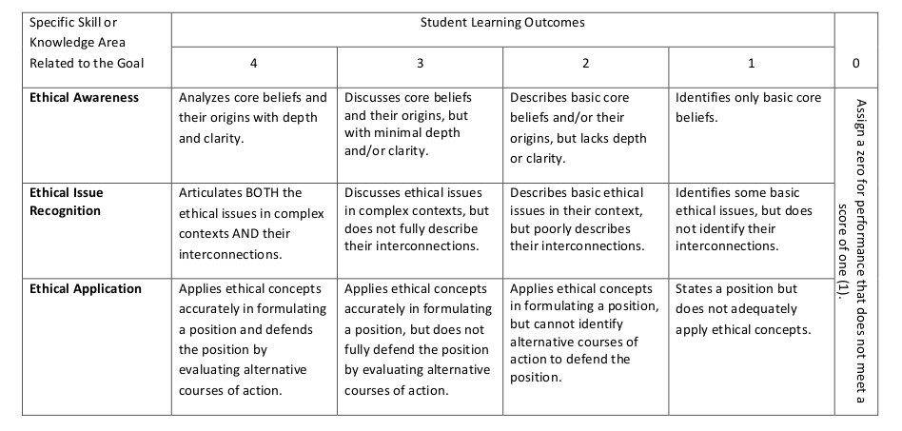
Goal A- Ethics and a sample assignment

Slide 12
Example 2 A Much Better Assignment

Slide 13
Example 2 A Much Better Assignment
Since I explicitly prompt my students:
They know what my expectations are. I’ve set clear goals.
If they meet my expectations, it’s because they had the capacity to respond well to my prompt. I didn’t “teach to the test.” I asked them clearly for a demonstration of their philosophical acumen, and then gave them a chance to perform.
This assignment is a good measurement. It provides my students a chance to demonstrate skills I value as a philosophy professor, and which are useful for them in critically engaging ethical issues in the world. I will learn what they know, what they can and can’t do, and can respond to improve their learning through course development.

Slide 14
Expectations The Lower and Upper Division
The lower division Core is about introducing ideas and providing a foundation to our students’ education
The upper division Core is about applying those skills, reinforcing them, and an opportunity to demonstrate mastery
Whereever you are teaching in the Core, make sure you are setting reasonable, yet rigorous, expectations for your students and providing them a chance to excel. Meet them where they are and assist them in growing to their full potential.
The next slide has a Bloom’s taxonomy picture as a helpful guide for crafting assignments and understanding assessment rubrics (millions of these live on the internet. Find the one you prefer.)

Slide 15
Bloom’s Taxonomy

Slide 16
What to do from here?
Review your course assignments
Which one(s) do you plan to use for Core assessment?
Are prompts present and clear? Will they be good measures?
Does the assignment provide ample opportunity to perform the skills you’re prompting?
Make sure it’s being given near the end of the semester, so it reflects your students’ performance as a result of your course
So now you have a great assignment. How is it used in Core assessment?

Slide 17
Participation in Core Assessment AY 20-21 Responsible Living
Complete the Office of Assessment survey in early Fall
Submit your student artifacts (work)
Ask questions
*Participation is crucial. We can only know where our students are, how they’re doing, and what’s working if we can review their work.

Slide 18
The Survey (yours will be for Responsible Living, Fall 2020) Answer all relevant questions

Slide 19
Attach a syllabus

Slide 20
When will you give the assignment, and how will you deliver it to the Office of Assessment?

Slide 21
Follow the link for resources on electronic submission, our preferred method

Slide 22
Important Details
Ideally student work should not be graded. We’d prefer clean copies. Seeing grades and marks may bias the scorer when it’s time to assess your students’ artifacts
Student names should be present on each artifact. It allows us to properly categorize the artifact and analyze data by any demographic material collected by the university

Slide 23
Key points
Align an assignment to the learning outcomes for which your course is assessed
Complete the survey from the Office of Assessment when you receive it in early Fall
Deliver your students’ completed assignments to the Office of Assessment
If you have any questions or concerns, please let us know

Slide 24
Office of Assessment
Dr. Jake Held
Assistant Provost for Academic Assessment and General Education
Professor of Philosophy
Wingo 215
450-5307
jmheld@uca.edu
Alyson McEntire
Assessment Research Associate
Wingo 215
450-5086
amcentire@uca.edu

