Slide 1
Accounting and Investments
Jing (Bob) Fang

Slide 2
Two Streams of Thoughts on Investments
“Among connoisseurs, Robert C. Merton is known as an expert among experts, a giant who stands on the shoulders of such giants as Louis Bachelier, John Burr Williams, George Terborgh, Keynes, James Tobin and Harry Markowitz, Kenneth Arrow and Gerard Debreu, John Lintner and William Sharpe, Eugene Fama, Benoit Mandelbrot, and the ubiquitous Black-Scholes. (Benjamin Graham occupies another part of the forest.)”
  Foreword by Paul A. Samuelson to Robert C. Merton’s book on “Continuous-Time Finance”

Slide 3
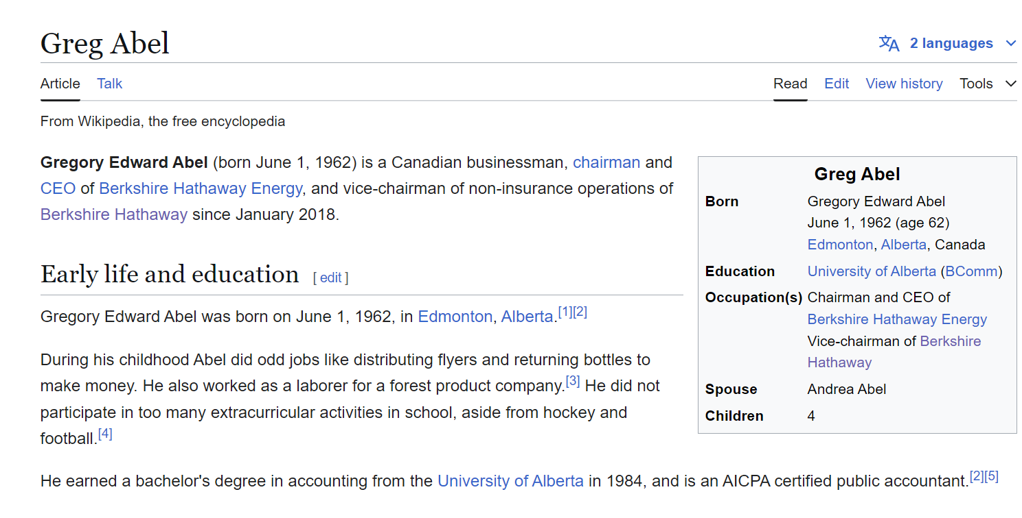
Warren Buffett: The Great Student of Benjamin Graham
Warrant Buffett’s Advice on Young Investors
  https://www.youtube.com/watch?v=8FN5CpDR97s
Host: What advice would you give to a young investor today?
Warren Buffett: Well, you've got to understand accounting.

Slide 4
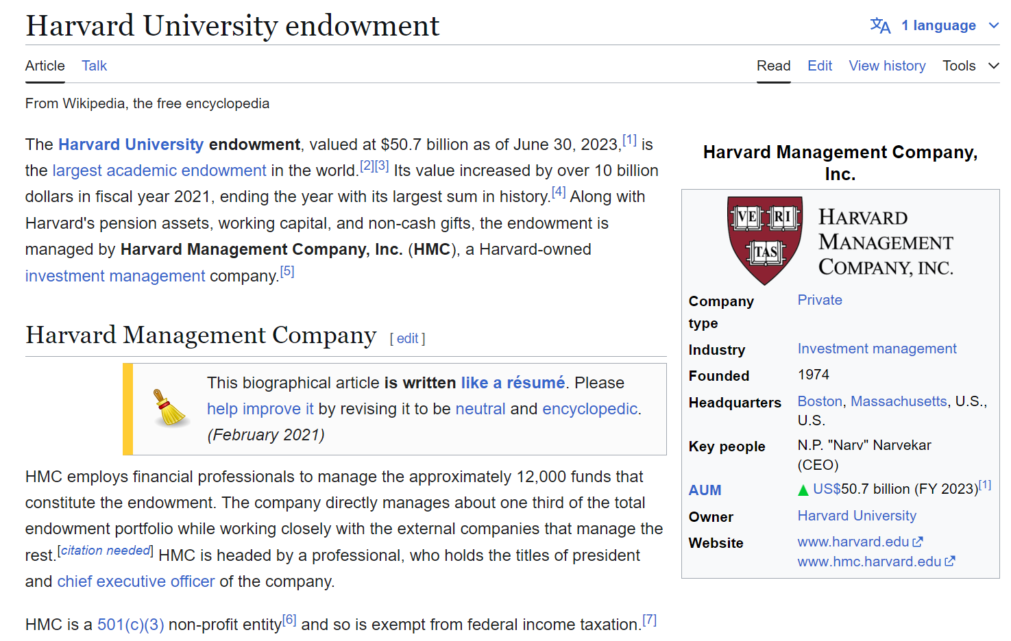
As an investment manager, you can earn a lot of money!

Slide 5
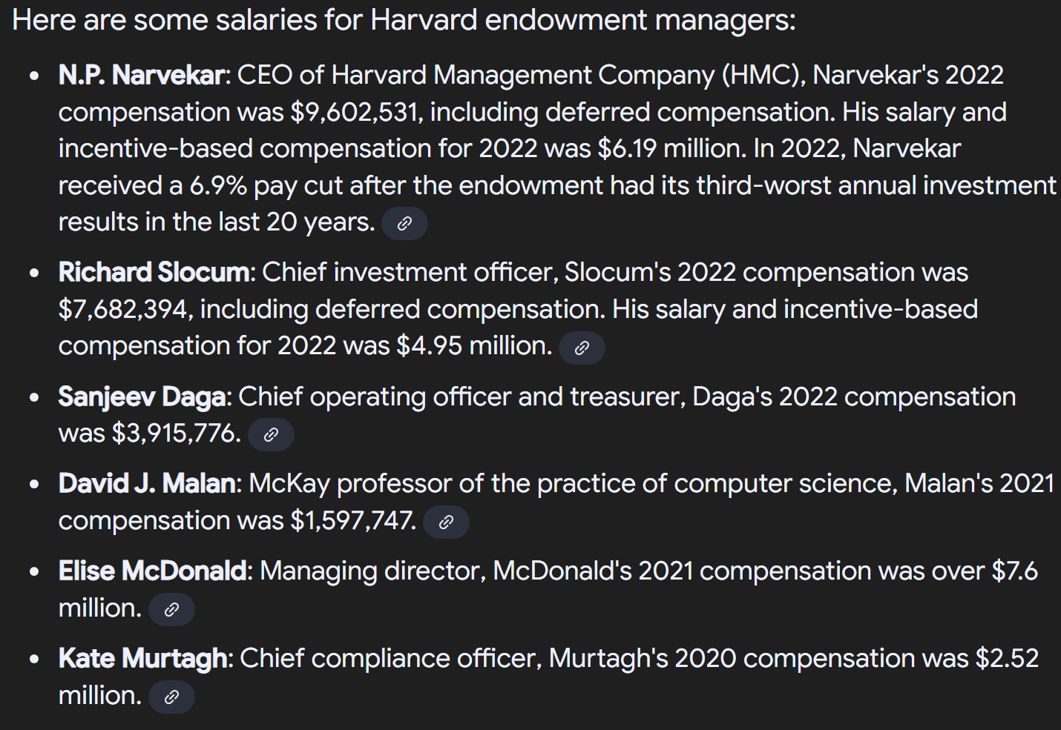
As an investment managers, you can earn a lot of money!

Slide 6
Warren Buffett vs. Modern Finance Theorists

Slide 7
Warren Buffett’s Berkshire Hathaway has realized a Sharpe ratio of 0.79 with significant alpha to traditional risk factors. The alpha became insignificant, however, when we controlled for exposure to the factors “betting against beta” and “quality minus junk.” Furthermore, we estimate that Buffett’s leverage is about 1.7 to 1, on average. Therefore, Buffett’s returns appear to be neither luck nor magic but, rather, a reward for leveraging cheap, safe, high-quality stocks. Decomposing Berkshire’s portfolio into publicly traded stocks and wholly owned private companies, we found that the public stocks have performed the best, which suggests that Buffett’s returns are more the result of stock selection than of his effect on management.

Slide 8
My own investment experience
  I am a believer and follower of Buffet’s investment philosophy.

Slide 9
Two other successful investors
George Soros
  MS in Economics for LSE
  “His early studies of philosophy led him to develop and apply Karl Popper's General Theory of Reflexivity to capital markets, which he claims renders him a clear picture of asset bubbles and fundamental/market value of securities, as well as value discrepancies used for shorting and swapping stocks”
James Harris Simons
  An American mathematician, hedge fund manager, and philanthropist
  “Renaissance employs specialists with non-financial backgrounds, including mathematicians, physicists, signal processing experts and statisticians”

Slide 10
It seems that there is a gap between the general public’s belief regarding what need to be learned to develop a career in equity investment and what the successful equity investors want us to learn

Slide 11
An Example
What drives the success of Apple Inc. During 1997–2012:
innovation vs. operating efficiency?

Slide 12
Background on Apple Inc.
In 1997, Apple Inc. nearly went bankruptcy and was not in the list of world-wide top 500 firms
In 1997, Steve Jobs rejoined Apple Inc.
Right after rejoining Apple Inc. Steve Jobs recruited Tim Cook, who is an operations guru
Tim Cook reestablished the whole operations system of Apple Inc.
Tim Cook served as temporary CEO when Steve Jobs was sick
Time Cook became the current CEO after Steve Jobs died
In the investment world, there is a debate over what contributes to the recent success of Apple Inc.: innovation or operation efficiency or both?

Slide 13
Some preliminary findings:
Recent Trend of Apple Inc.’s Market value
$2,257,837
$10,000

Slide 14
Some preliminary findings:
(R&D Expenses / Net Sales) vs. Market value

Slide 15
Some preliminary findings:
(Advertising Expenses / Net Sales) vs. Market value

Slide 16
Some preliminary findings:
(Gross Profit / Net Sales) vs. Market value

Slide 17
Some preliminary findings:
(Net Income / Assets (ROA)) vs. Market value

Slide 18
Some preliminary findings:
(Days’ Sales in Inventory) vs. Market value

Slide 19
What is your conclusion on the basis of the preliminary findings?

Slide 20
Apple under Tim Cook

Slide 21
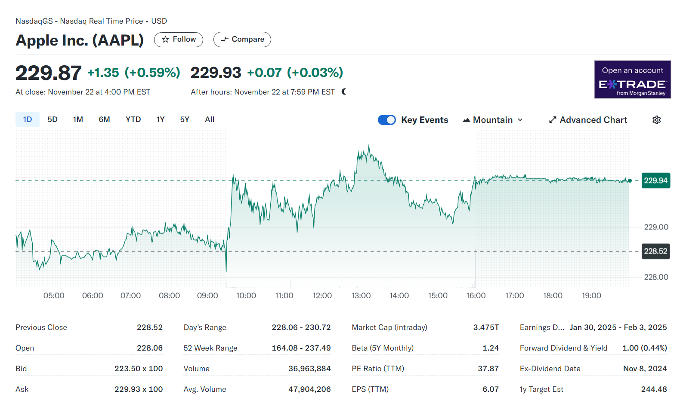
Apple Today!

