Slide 1
Artificial Intelligence* in Accounting *and other useful technologies UCA Accounting Department CPE Event December 6, 2024

Slide 2
Agenda
Speaker introduction
GenAI vs. analytical AI vs. other technology
Practitioners’ views
Regulators’ views
Recap of key takeaways
Q&A

Slide 3
Speaker Introduction
CPA (Texas)
Former auditor (KPMG)
Intensely inquisitive
Coauthor of award-winning research

Slide 4
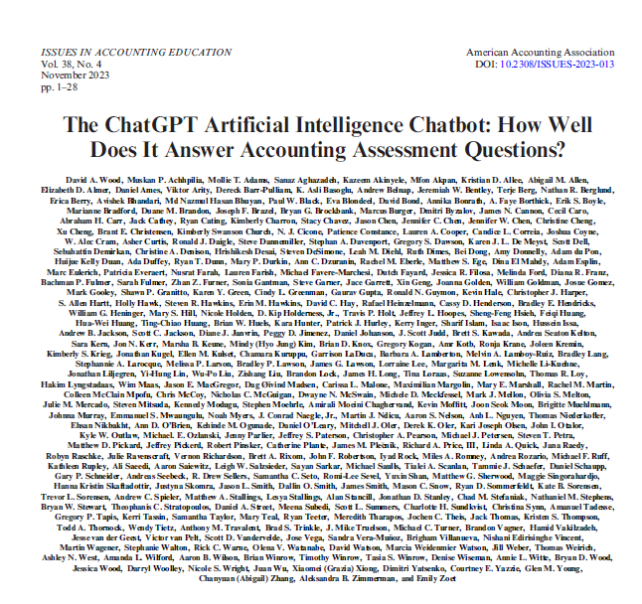
AI Research
28,000+ questions
327 authors
186 institutions
14 countries
3 months from start to publication
ChatGPT: 47.5%
Actual humans: 76.7%
2024 Notable Contribution to the Literature Award – AAA AIS Section

Slide 5
GenAI vs. analytical AI vs. other technology

Slide 6
GenAI
Analytical AI
Generates new output based on training data (text or images)
Designed to respond in a human-like manner
Typically use a transformer model
Analyzes data to generate predictions based on training data (numbers or text)
Does not create new content
Underlying models typically rely on machine learning methods (supervised, unsupervised, and deep learning)
Other technologies
Robotic process automation (RPA)
Data visualization
Data processing/cleaning/ analysis

Slide 7
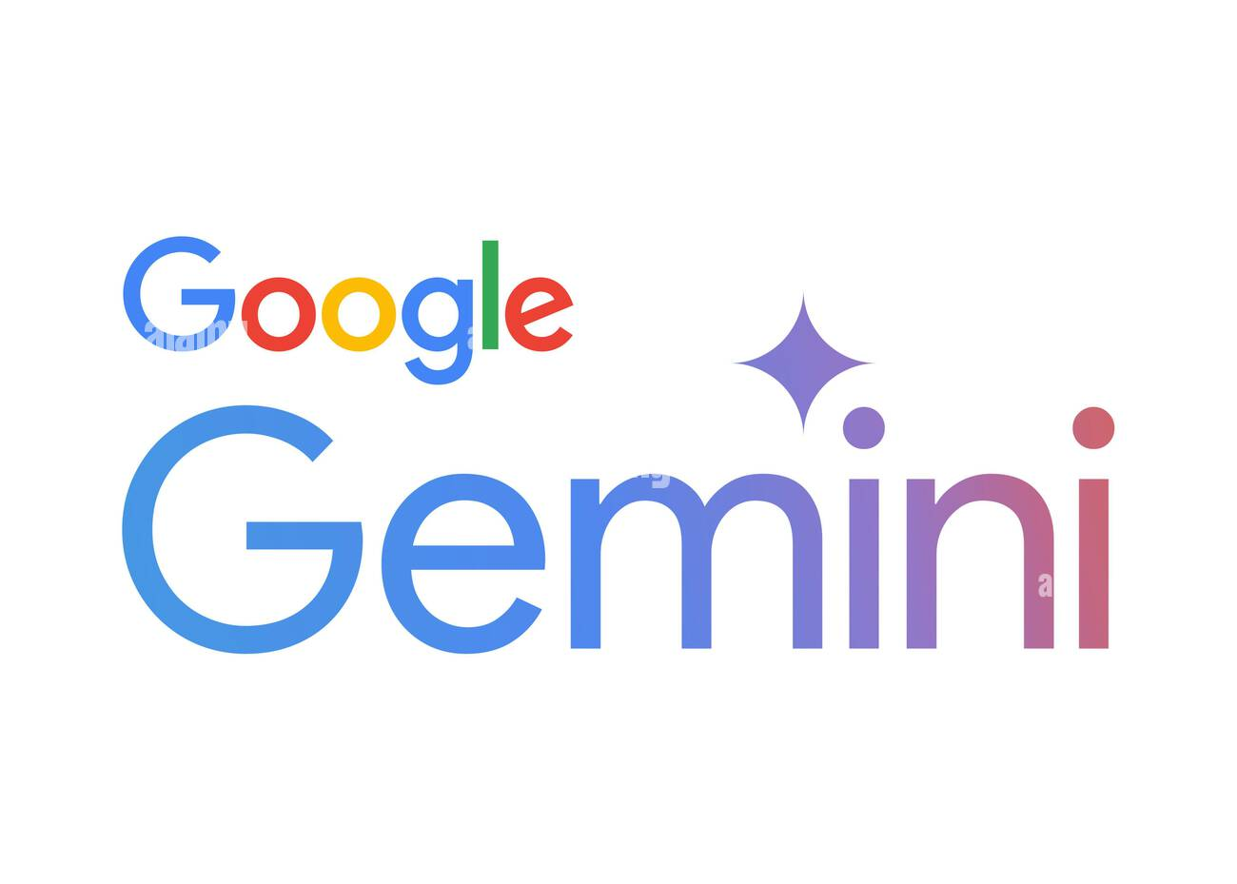
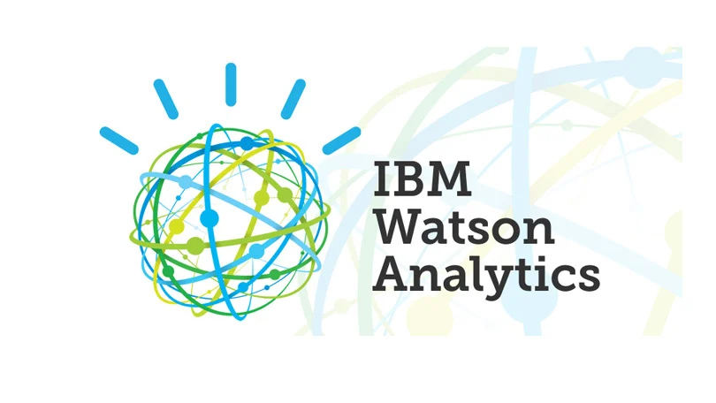
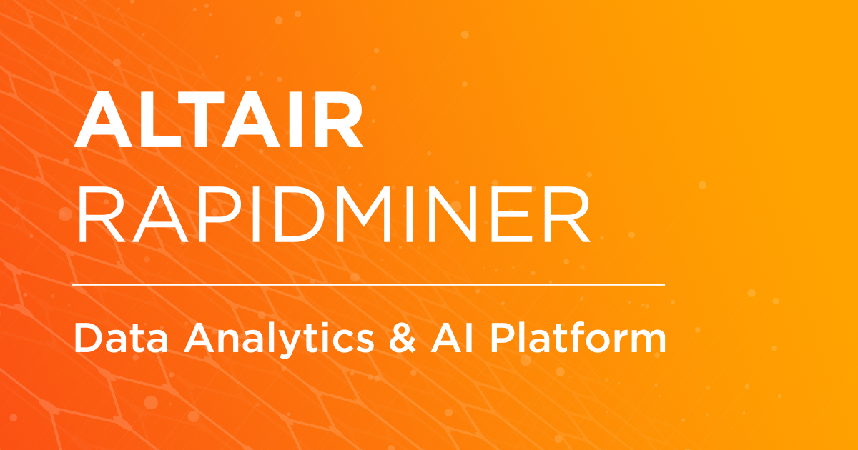
GenAI
Analytical AI
Other technologies

Slide 8
Conversations with practitioners

Slide 9
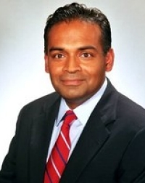
Kazi Islam
PwC Global Assurance Strategy & Growth Leader
George Fackler
Deloitte Audit & Assurance Chief Operating Officer
Brian Wolohan
Grant Thornton National PIC Audit Innovation

Slide 10
Most frequent use cases by firms
Biggest drawbacks
Knowledge management
Back office
Quality control
Cost
Client confidentiality
Regulatory concerns
Consistent use by staff
Availability of structured, relational databases
Integrating/cleaning data types from different databases
Most frequent use cases by issuers
Accounting memos/rollforwards
Intelligent automation
Customer analysis

Slide 11
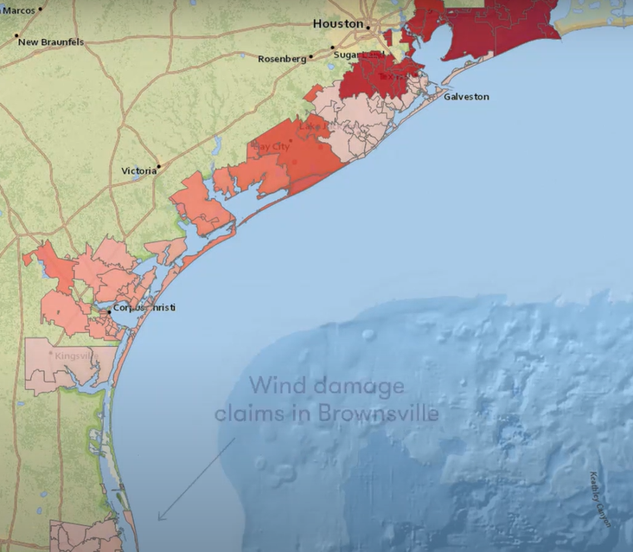

Slide 12
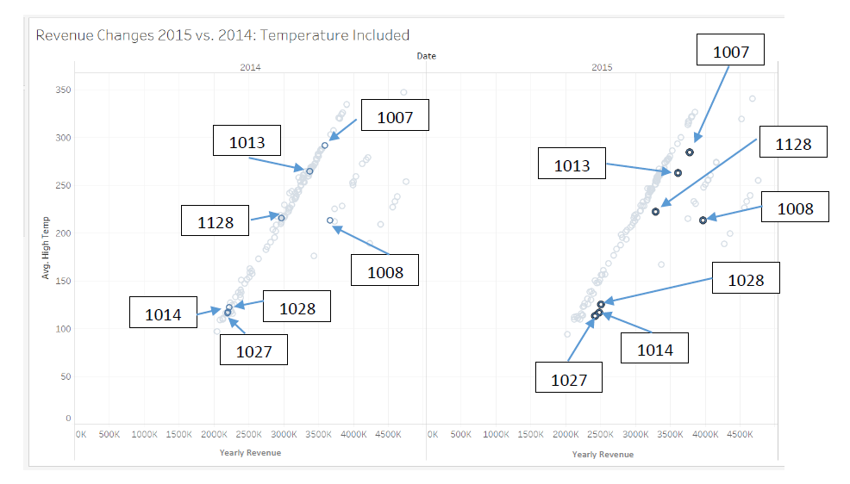
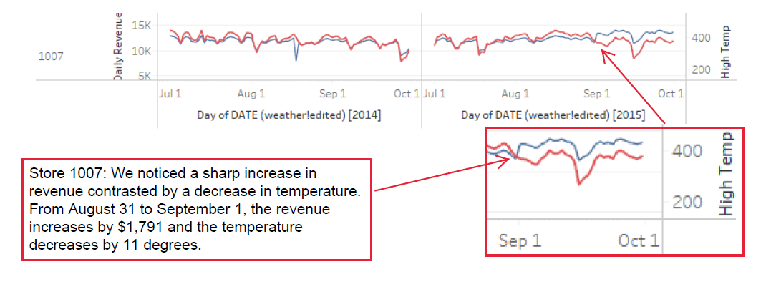

Slide 13
Conversations with regulators

Slide 14
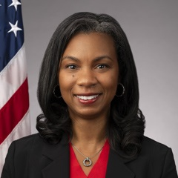
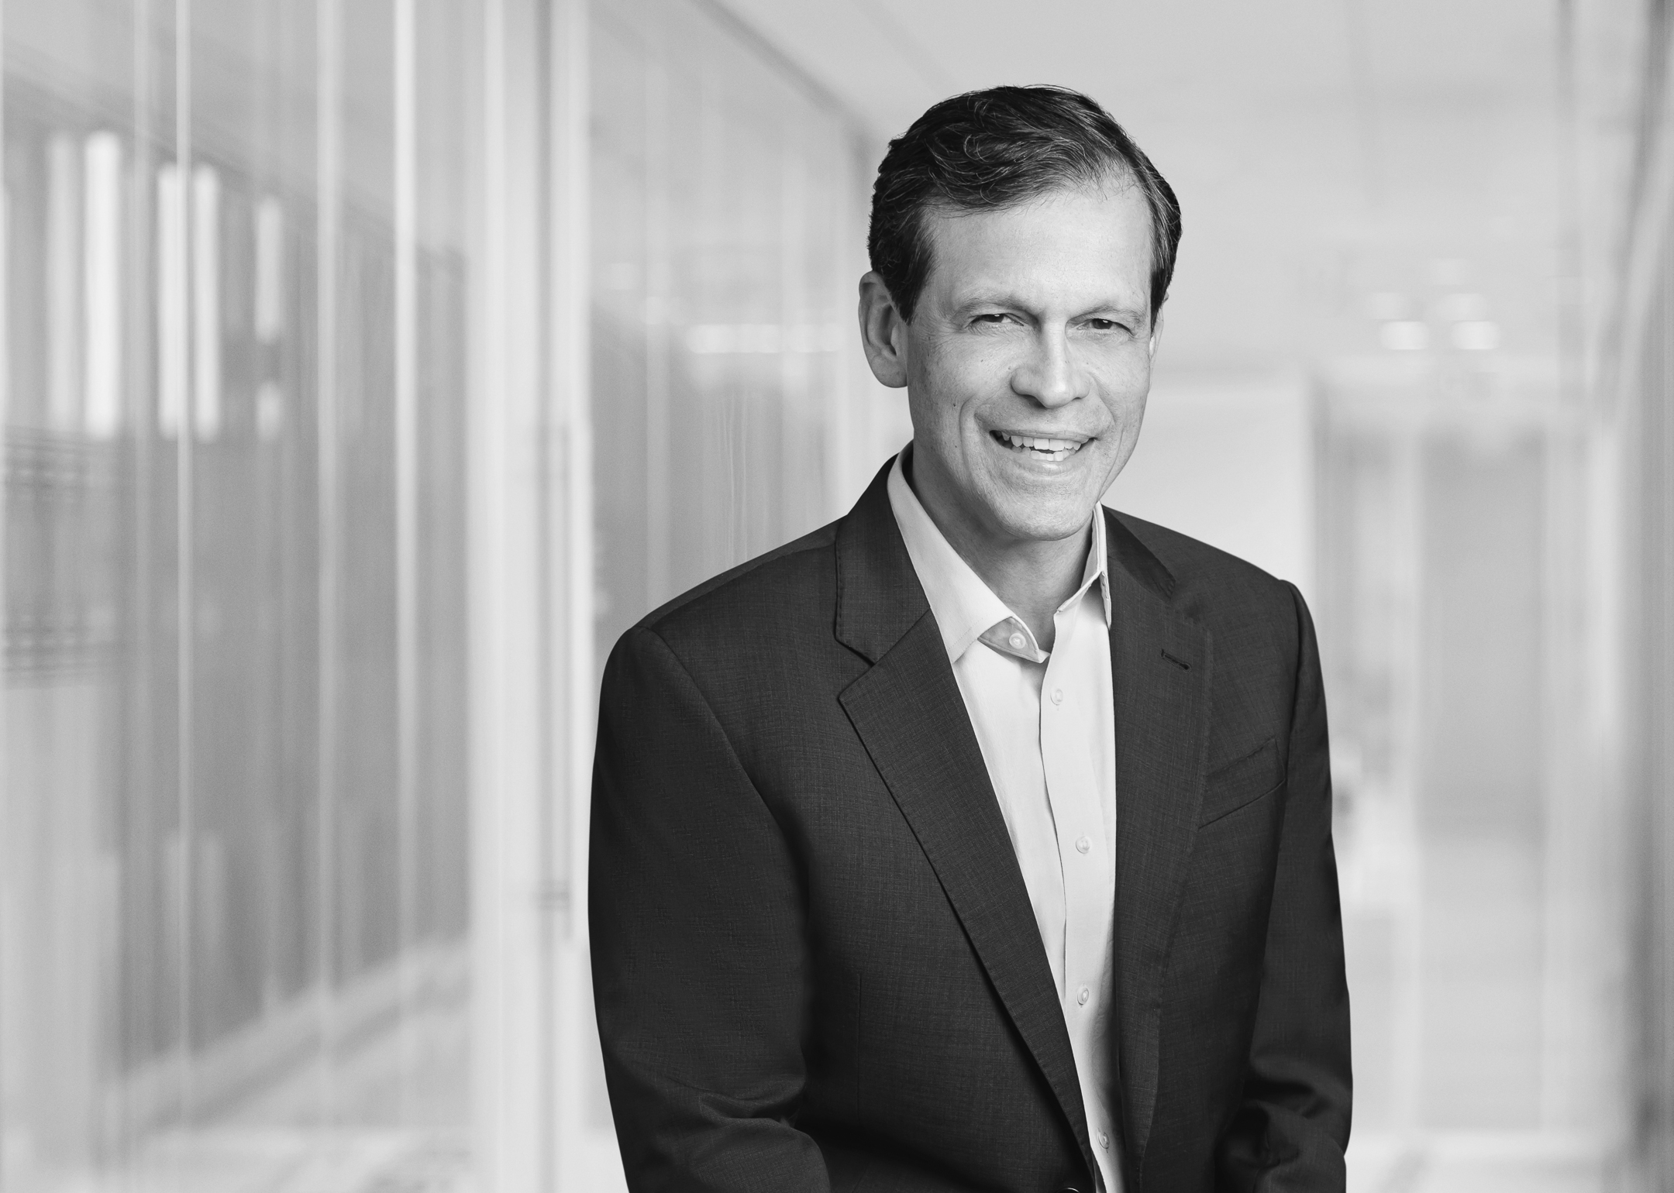
Claudius Modesti
Partner - Akin Gump Former PCAOB Director of Enforcement
(2004-2018)
Erica Williams
PCAOB Chair

Slide 15
Biggest drawbacks
Overreliance on genAI
Attribution of error
Lack of standardization in documentation
Lack of standards around the use of genAI as audit evidence
Client confidentiality

Slide 16
Quotes
“GenAI is like an eager intern: it will always give you a confident answer. It’s up to you to determine what you do with that answer.” – David Heaney, CISO Mass General – Brigham
“The best or worst thing to happen to humanity.” – Stephen Hawking

Slide 17
Final takeaways
AI tools are here to stay
Whether you like it or not
Iteration is important
More art than science
Underlying data is key
Completeness and accuracy matter
User training is costly, but worth it
Educating on attribution and proper use
Critical thinking isn’t going away
Technology simply frees up time for higher-order tasks
Be careful what you feed it
Client confidentiality concerns
User training is costly, but worth it
Educating on attribution and proper use
Critical thinking isn’t going away
Technology simply frees up time for higher-order tasks

Slide 18
Q&A Session
What’s on your mind?

Slide 19
Thank you
Ryan Cating, Ph.D., CPA
501-852-0203
rcating@uca.edu

