Slide 1
2024 Continuing Professional Education in Accounting
From Data Visualizations to Data Governance:
Illustrations for CPAs
Joe Thomas
Associate Professor
CISA Department
College of Business
joethomas@uca.edu
Your Questions First
1
My turn – Time for a Quiz!
2
Storytelling with Data
3
Excel Vs Tableau Vs Power BI
4
Data Governance
5
Takeaways
6

Slide 2

First Your Questions
Do you have a burning question about data analytics, data visualization, data prep, or data governance?
I’ll do my best to answer your questions during the presentation or I will follow up via email afterwards.

Slide 3
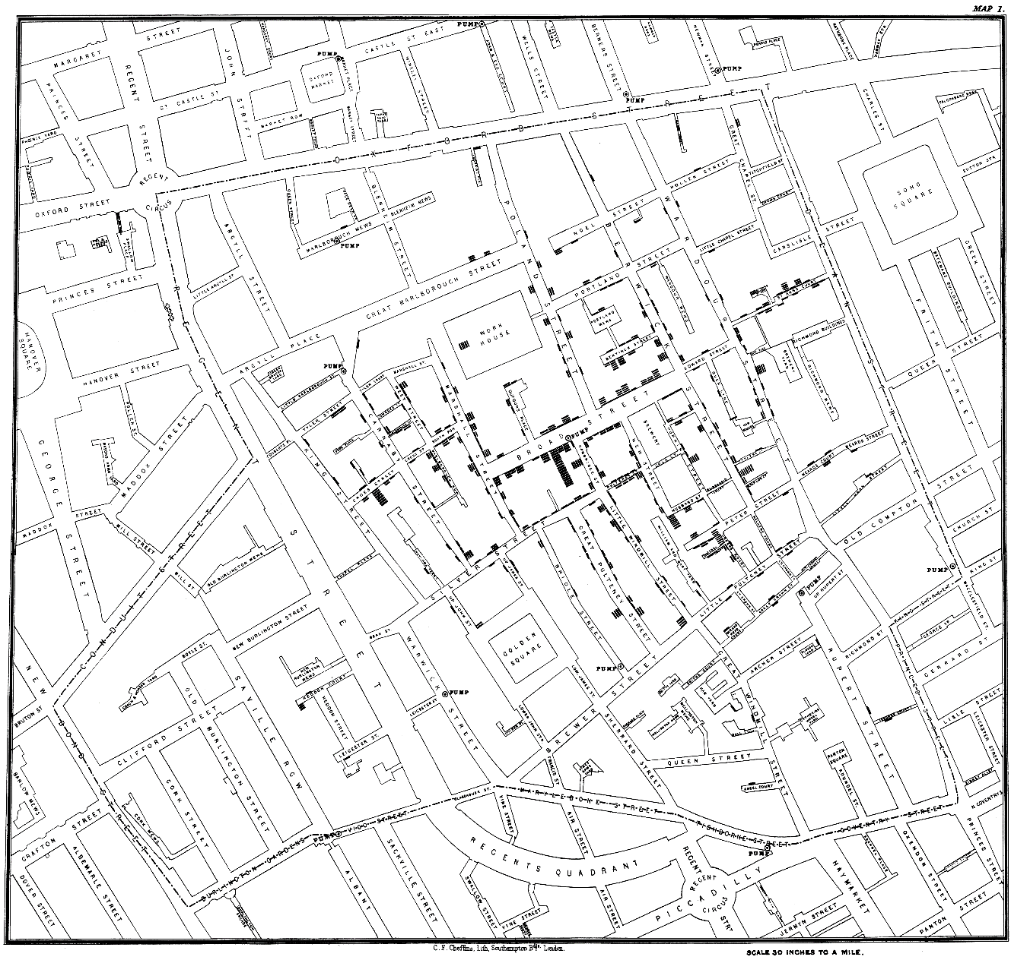
My turn! - Time for a Data Visualization Quiz!
What is this a map of?

Slide 4
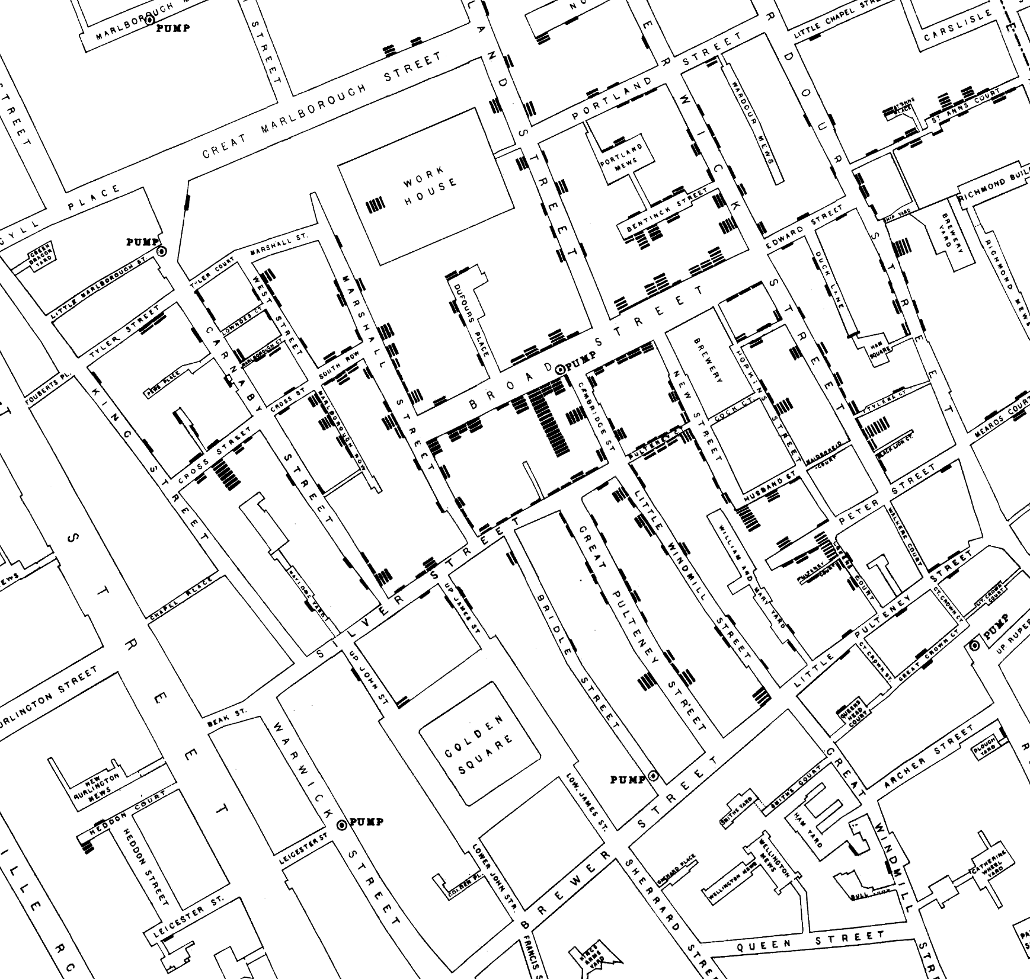
What is this a map of?

Slide 5
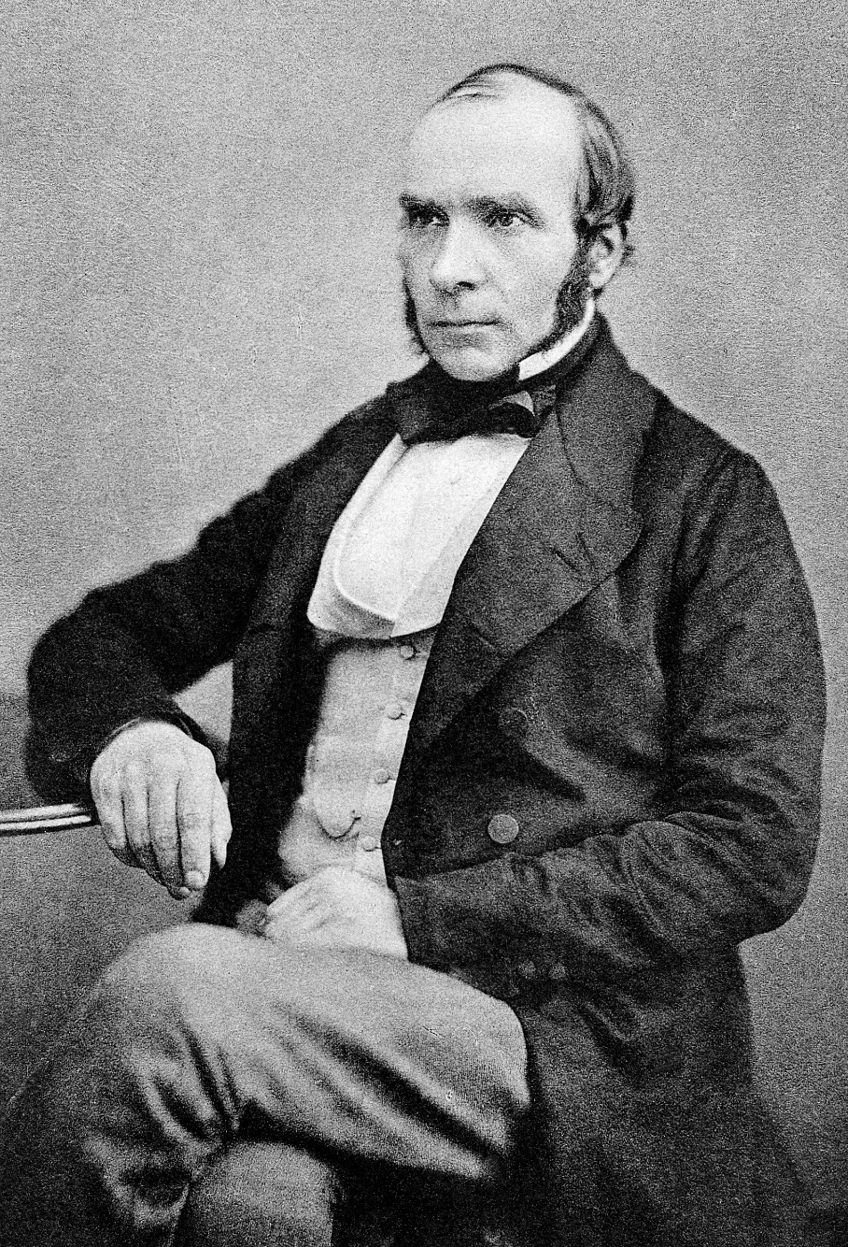


Data Viz Pioneer: John Snow
London, 1854
  Cholera outbreak in Soho – over 120 deaths in just 3 days.
  We did not yet understand how the disease was spread.
  Snow’s big advance: he mapped the addresses of victims.
  The map shows deaths clustered around one public well on Broad Street.

Slide 6
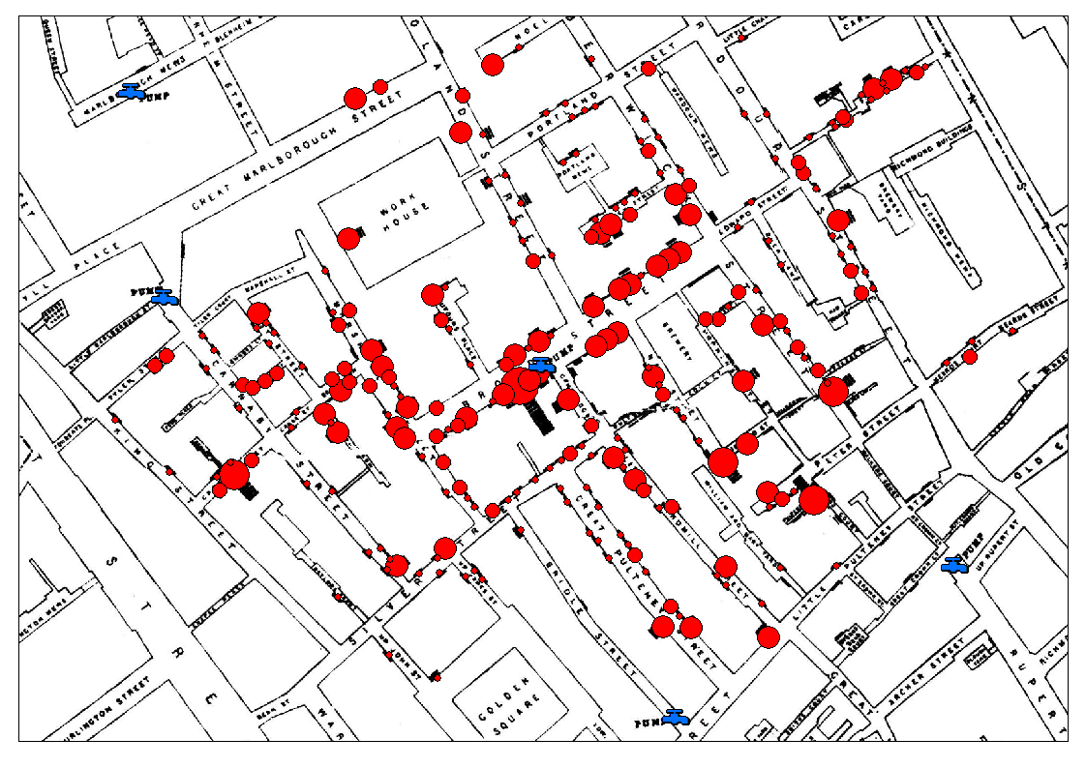

Slide 7
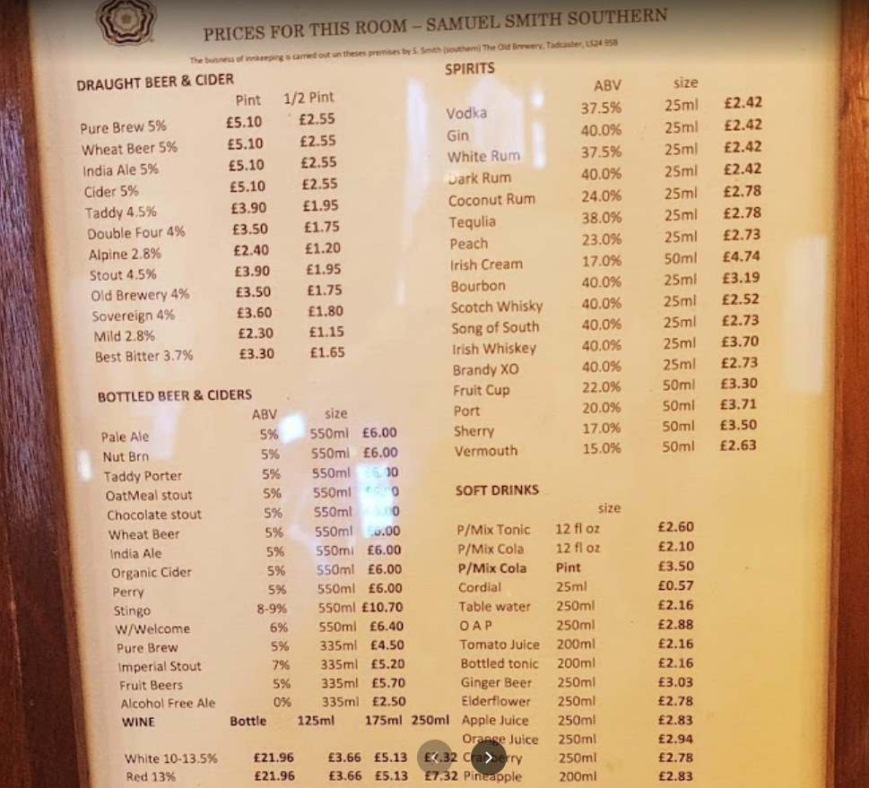

Where Are They Now?:
The Broad Street Pump
Speaking of stories…

Slide 8
Storytelling With Data
Six Key Lessons for Good Visualizations
Understand the context.
Choose an appropriate visual display.
Eliminate clutter.
Focus attention where you want it.
Think like a designer.
Tell a story.

Slide 9
1. Understand the context
Who is your audience?
What do you want your audience to know or do?
  The “big idea”
  The 3-minute elevator pitch
How will you be communicating with your audience?
  Live talks and written work have different levels of control.
    What does this mean “levels of control”?
Now you can start to create your visualization.
  Your visuals become the supporting evidence for your story.

Slide 10
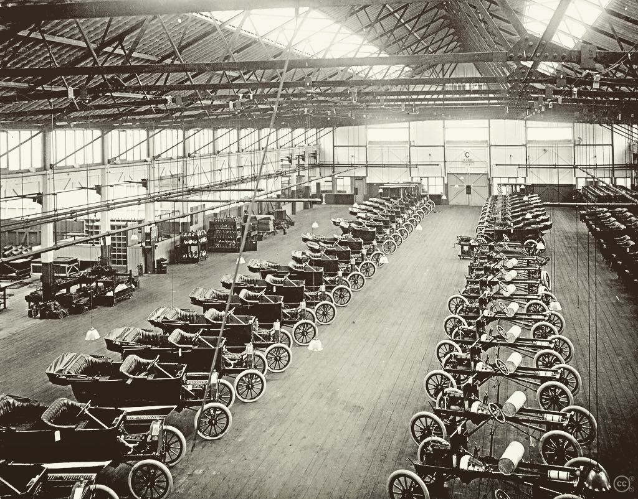
2. Choose an appropriate visual display
Which visual is best for telling my story?
  Text taps into the verbal system of the audience.
  Pictures use the visual system, which is faster.
But, pictures aren’t automatically always better, though.
  If you have just a number or two you want to emphasize, use them with a little explanatory text to get your point across.
Story time:
Henry Ford motivates with a single number.

Slide 11
2. Choose an appropriate visual display
Tables
  Rarely a good idea in a live presentation
  but can be good in a written communication.
  Let the design fade into the background so the data isn’t overshadowed.

Slide 12
3. Eliminate clutter
Cognitive load
  the mental effort required to learn new information.
  What is really important is the perceived cognitive load of the audience – try to minimize it while still getting your point across.
Clutter is the visual elements that take up space but don’t add anything to the audience’s understanding.
We want to distinguish between signal and noise.
  Signal is what we want to communicate, noise is what gets in the way of that communication, aka clutter.

Slide 13
3. Eliminate clutter
Apply six Gestalt Principles of Visual Perception to reduce noise.
Proximity
Similarity
Enclosure
Closure
Continuity
Connection
The Gestalt Principles are a set of laws arising from 1920s’ psychology, describing how humans typically see objects by grouping similar elements, recognizing patterns and simplifying complex images.

Slide 14
Proximity
Objects that are physically close together are seen to belong to the same group.
We can use this to guide how people read tables.

Slide 15
Similarity
Objects of similar color, shape, size, or orientation are seen to belong to the same group.

Slide 16
Enclosure
Objects that are physically enclosed are seen to belong to the same group.

Slide 17
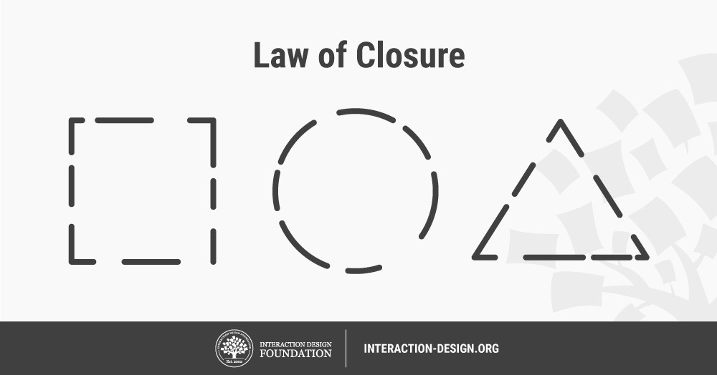
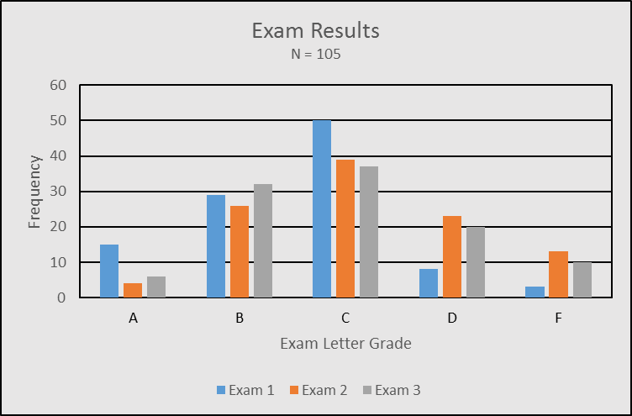
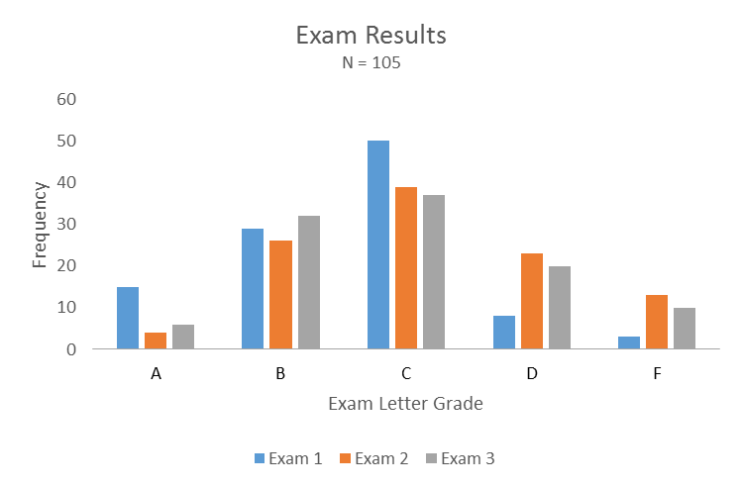
Closure
People will fill-in the gaps left by missing elements so what they see matches what they’ve seen before.
Because of this principle we can omit elements like chart borders and background shading.

Slide 18

Continuity
Our eyes look for the smoothest path and create continuity where it may not exist.

Slide 19

Connection
Objects that are physically connected are seen as part of a group.
  Typically, is stronger than color or size.
We use this when we connect points in line graphs to imply a relationship.

Slide 20
4. Focus attention where you want it
With a chart, graph, or web page the audience will typically start at the top-left and work down in a “Z” pattern.
  (put important stuff at the top left.)
To direct their attention, use preattentive attributes.
  Preattentive attributes: are visual properties that we notice without using conscious effort to do so
  They tell the audience where to look.
  They enable the audience to see what we want them to see before they even know they are seeing it.
  We can utilize differences in: orientation, shape, line length, line width, size, curvature, extra marks or enclosure, color, intensity, or position in space.
  It also creates a visual hierarchy, an order for when items should be seen.

Slide 21
Lets Play a Game - Preattentive Attributes
Count the 3s

Slide 22

Using Color
Use color sparingly.
  The use of many different colors causes the data to get lost. Use differing shades of a single color when possible.
  See the heatmap slide for an example.
Colorblindness - Roughly 8% of men (and 0.5% of women) are colorblind and usually have a hard time with shades of red and green.
  It is best to avoid those colors.
  Tableau defaults to orange and blue instead.
Colors also invoke emotions so watch which colors you use. Some colors can have different meanings between cultures.

Slide 23
5. Think like a designer
Have a plan!
Keep It Simple S_ _ _ _ _. (aka the KISS principle)
Using text wisely can have a big impact (Ford example).
Be smart with color and white space.
Make sure the design of your visualization will be accepted by your audience.

Slide 24
6. Tell a story
Why? People remember stories.
Stories express how and why life changes.
  They start with balance, then something upsets the balance.
  They have a beginning, a middle, and an end.
The point is not to tell a story.
Tell a story to make a point.
  ~ Dr T.

Slide 25
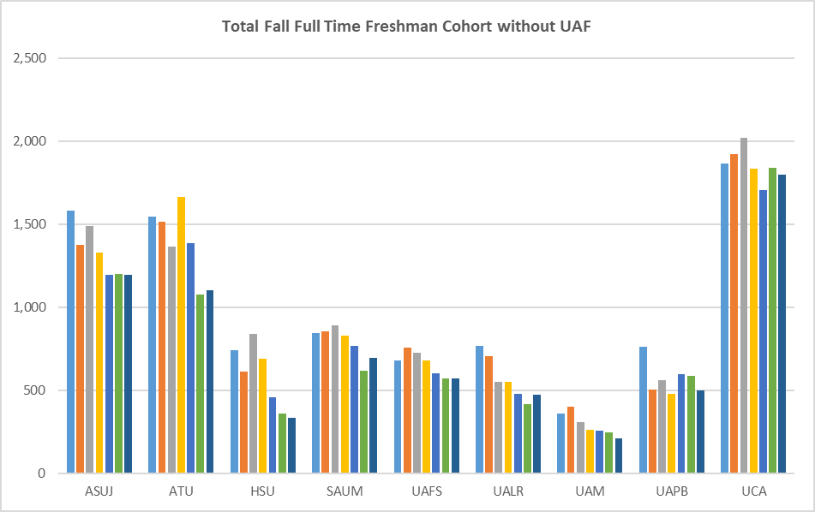
Original Graph
If focus is on UCA then colors are a distraction.
Font too small for auditorium
  Ok for paper handout

Slide 26
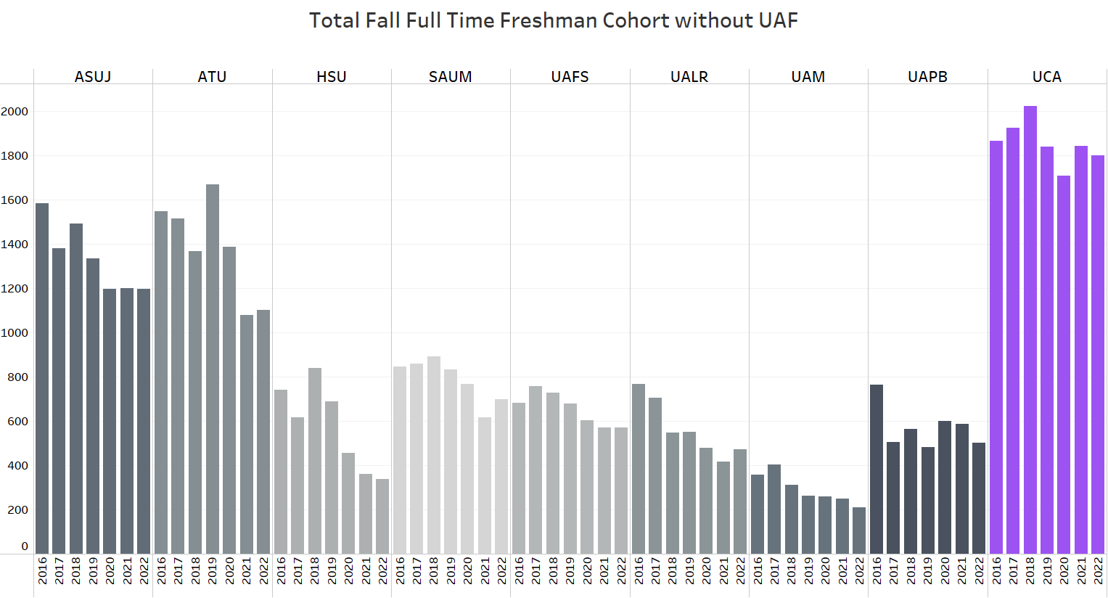
By University

Slide 27
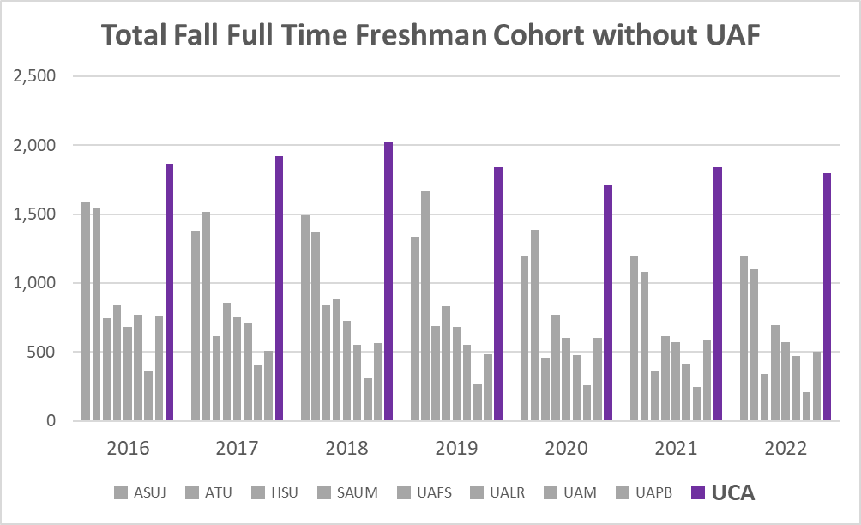
By Year

Slide 28
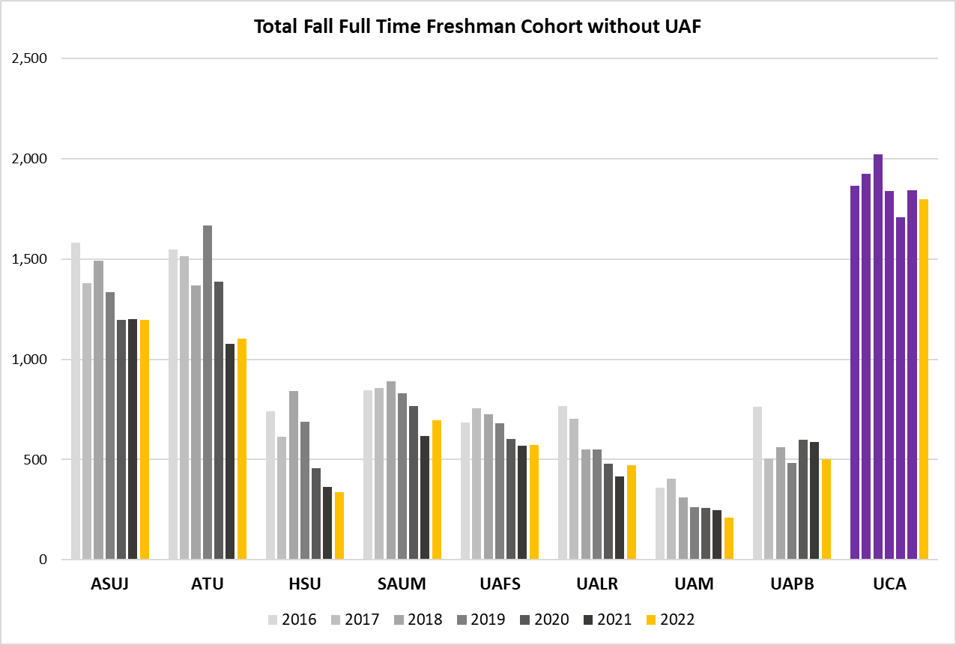
By University focus on Latest Year

Slide 29
“So what?” – Takeaways from today’s session
Data visualizations are a powerful decision making tool!
  Know how the human brain “sees” data
If you’re only using Excel you are falling behind.
  Learn Tableau or Power BI
Next up, Data Governance!

Slide 30
Data Governance
Importance of data governance (DG) in the financial sector
DG Program
DG Policy Framework Components
Policies vs Standards (Programs) vs Procedures
Key Principles in HBI DG Policy:
  Data classification
  Data handling

Slide 31
Imagine that your bank no Internet use policy.
You can use the Internet and company-owed PCs in whatever way they want.
Could this cause problems for the organization?
Would your customers feel safe banking online with you?
What if there were no rules regarding how your credit card information was stored at Centennial Bank online app?

Slide 32
Definition and Importance of Data Governance
Data Governance: everything you do to ensure data is secure, private, accurate, available, and usable.
DG means managing your data lifecycle
  Establishing internal policies that apply to how data is gathered, stored, processed, and disposed of.
DG is at both the macro and micro levels
  From protecting stakeholder interests to who can access what kinds of data and data use policies.
DG is also external and internal
  Internally DG can lower risk, lower data mgmt. costs, improve data quality, and enables innovation.
  Externally DG involves complying with standards set by industry associations, government agencies, and stakeholders.

Slide 33
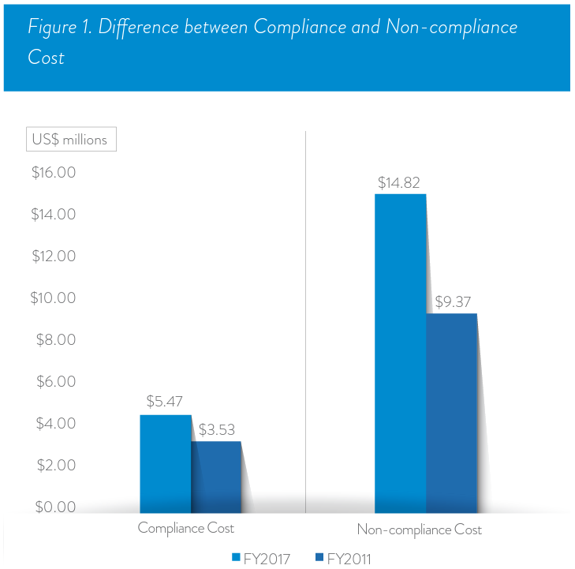
Definition and Importance of Data Governance
Human Error is Responsible for 82% of Data Breaches
  Skill-based errors & decision-based errors
  $5.01 per record stolen
Data Breaches That Have Happened in 2022 and 2023 So Far
  T-Mobile - $350M, Sony - 6k files, Forever 21 - 500k records ….
  Ontario birth registry - 3.4M people, MOVEit file transfer tool
The True Cost of Non-Compliance
  Avg $5.87M per non-compliance event
  Fines and sanctions + business disruption and lost productivity = $14M
The avoidance approach is far more costly in the end
  The average cost of compliance came in at $5.47M
  The average cost of non-compliance came in at $14.82M
110 “reported”
Difference between Compliance and Non-compliance Cost

Slide 34
Why Is Governance Important?
Provides assurance and confidence that rules are being followed
Senior management
  needs to know business objectives are being met
  needs to know that the investment the organization has made is being properly managed
  If rules are being followed, there is some assurance the value promised to the business is being delivered
Regulators (recent audit Arkansas State Bank Dept & Federal Reserve Bank)
  Look at governance structure for assurance that risks to shareholders, customers, and the public are being properly managed
Stakeholders
  Builds confidence and trust

Slide 35
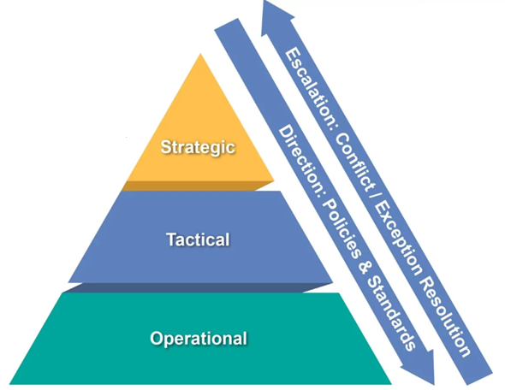
DG Program
Executive Level – drives, directs, and steers priorities and the Data Governance Goals. Has overall accountability for the success of Data Governance
Strategic Level - The Data Governance Committee, the departmental sponsor of Data Governance, considers the Financial and Human Resource implication of Data Governance and Management
IT Subject Matter Experts
Tactical Level – Data Owners and Data Stewards, assigned at a Data Domain level, ultimately accountable for the effective execution of Data Governance for the data within their domain. Participate in Data Working Group.
Data Governance Committee
Operational Level – Data Custodians, assigned by the Data Owners, these are the people that regularly process data within their Data Owner’s domain, and have a vested interest in how the data is managed. This includes Data Subject Matter Experts.

Slide 36
DG Policy Framework Components
Principle
Policy
Standards
(Programs)
Procedures
Guidelines
Definitions

Slide 37
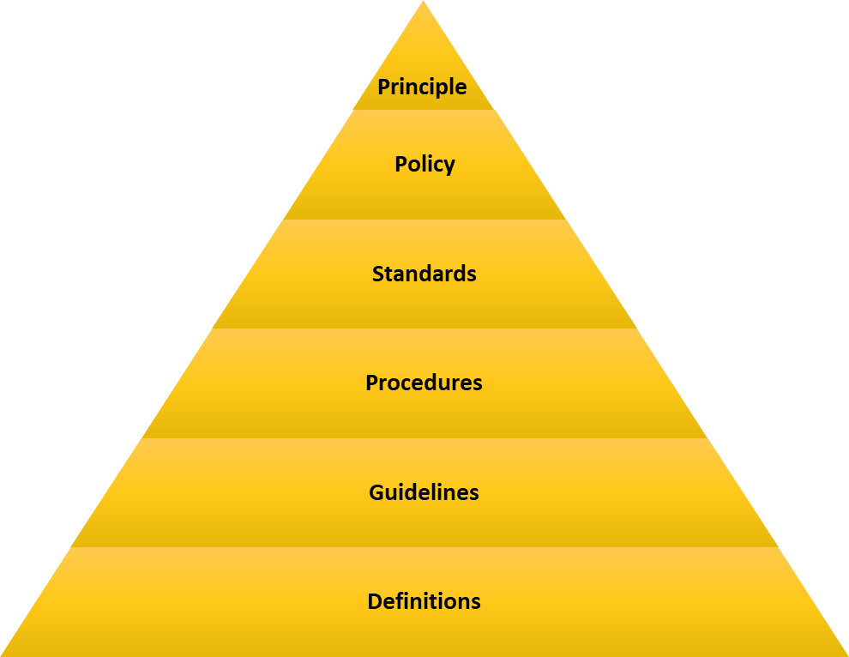
DG Policy Framework Components
Principles
  Establish tone at the top and authority by which policies are enforced
Policies
  Define how an organization performs and conducts business functions and transactions with a desired outcome
Programs
(Standards)
  Established methods implemented organization-wide

Slide 38
DG Policy Framework Components
Procedures
  The Detailed steps required to implement a process
Guidelines
  Parameters within which a policy, standard, or procedure is suggested
Definitions
  Statements that define terms used in policy documents and set context in which policy documents are interpreted (consistency)

Slide 39
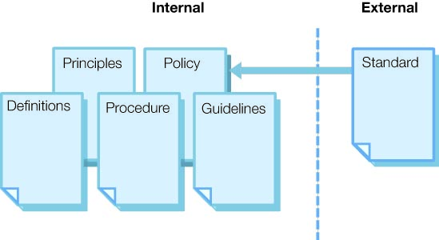
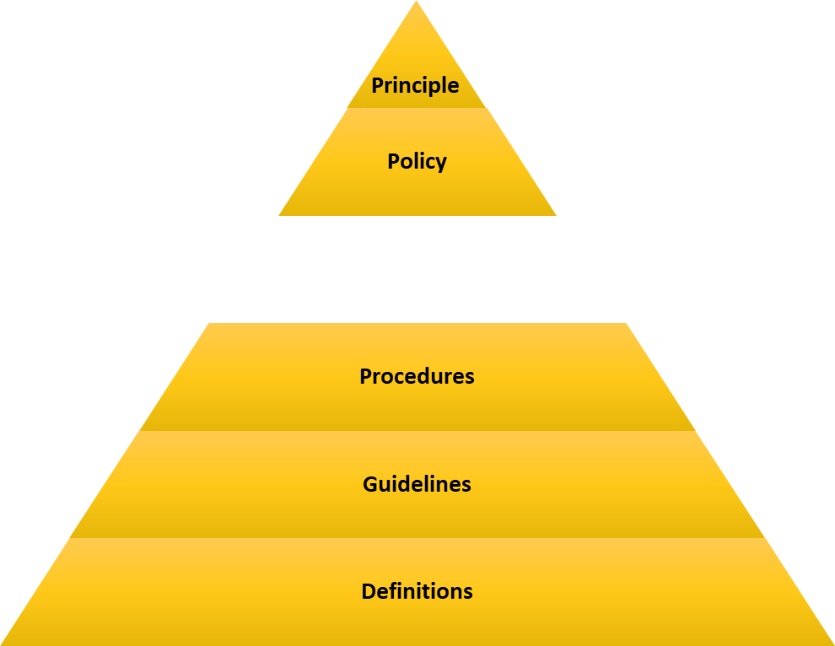

Internal versus External Documents
Internal versus external documents.

Slide 40
How Policies Differ from Programs and Procedures
How Policies and Procedures Differ
Policies are requirements placed on processes
  The why (justification)
Procedures: (business units)
  Are the technical steps taken to achieve policy goals
  Can contain step-by-step instructions on the performance of a task
  Can identify how to respond to an incident
How Policies and Programs Differ
Policies: (DG Committee)
  implement controls on a system to make it compliant to a standard
Programs: (Ent Risk Mgmt.)
  Influence the creation of policies
  Often determine a minimum requirement but can be very detailed in nature
  Often start with industry norms
Policy
Policy
Programs
(standards)
Programs
(Standards)
Procedures
Procedures

Slide 41
Data Lifecycle & Retention
Data Lifecycle Phases
  Creation (classification, labeling, access addressed now)
  Storage
  Sharing and usage (version control, access control)
  Retention (when, how, who, documentation)
  Destruction (when, how, who, documentation)

Slide 42
Joe Thomas
Associate Professor
Computer Information Systems & Analytics Department
University of Central Arkansas
joethomas@uca.edu
405-714-4693
Questions?

