Slide 1
UCA
2024 Continuing Professional Education in Accounting
Arkansas State Board Ethics:
2024 Board Update
December 6, 2024
Notes:
Code name: ETA – Arkansas Ethics
The Board wants to make sure that Arkansas CPAs know and understand the laws and rules that affect them in their role as a CPA.
◆ The ethics hours requirement does not go into effect for new CPAs until their first full calendar year of licensure.
◆ Note regarding upgrades: will have to get 4 hrs Ethics within 3 years before upgrade and 4 additional hrs 1st full year after upgrade

Slide 2
Proposed Board Rule and Statute Changes and Other Board Announcements
(in no particular order)
(well, maybe)

Slide 3
# 1
Reduced Sitting Requirements

Slide 4
CPA Exam Sitting Requirements
Board Rule 3 – Examinations (current)
Bachelor’s degree
30 hours upper-level accounting courses
Must cover 6 core subjects
30 hours business courses
Board Rule 3 – Examinations, Education and Experience (proposed)
18 hours upper-level accounting courses
Notes:
financial accounting
management accounting
governmental and not-for-profit accounting
federal taxation
auditing and attestation
accounting information systems

Slide 5
Education Requirements to License
Bachelor’s degree
30 hours upper-level accounting courses
Must cover 5 core subjects
Removes governmental and not-for-profit accounting
30 hours business courses
Notes:
The core education requirements remain the same as before with the exception of the 150 hour requirement. We will cover the other changes in the additional pathway proposal.

Slide 6
Other Notes Regarding Examinations
Test section credit window increased to 30 months
Window begins on the score release date of the 1st test section
339 sections valid on 1/1/2024 automatically extended to June 30, 2025
26 applicants (28%) were granted credit relief for 39 sections
Notes:
We will cover the other changes in the additional pathway proposal.

Slide 7
# 2
Additional Pathway to Licensure

Slide 8
Licensure Requirements (current)
Board Rule 3.11 – Education Requirement for Licensure
Bachelor’s degree
150 semester credit hours
30 hours upper-level accounting courses
Must cover 6 core subjects
30 hours business courses

Slide 9
Licensure Requirements (proposed)
Board Rule 3.11 – Education and Experience Requirements for Licensure
Education Requirements
Bachelor’s degree
30 hours upper-level accounting courses
Must cover 5 core subjects
30 hours business courses
Internship and Independent Study rules unchanged

Slide 10
Licensure Requirements (proposed)
Board Rule 3.11 – Education and Experience Requirements for Licensure
Experience Requirements
One year of experience is defined as full or part-time employment that includes no fewer than 2,000 hours of performance of services extending over a period of no less than one year and no more than three years.
Experience must be verified by both direct supervisor and CPA. Two notarized forms.

Slide 11
Licensure Requirements (proposed)
Board Rule 3.11 – Education and Experience Requirements for Licensure
Licensure Pathways
150 + 1: remains the same
Bachelor’s + 2: Bachelor’s degree plus 2 years of experience obtained within 6 years preceding the date of licensure application.

Slide 12
Licensure Requirements (proposed)
Board Rule 3.11
Any other pathway included in the Uniform Accountancy Act will also be accepted through substantial equivalency.
Until such time that Section 3.11(c)(1)(B) is adopted into the AICPA/NASBA Uniform Accountancy Act, an applicant licensed under this pathway will not be deemed substantially equivalent to the CPA licensure requirements of the UAA by NASBA’s National Qualification Appraisal Service and, therefore, may not be deemed to be substantially equivalent to practice in other states.

Slide 13
May 2024
Notes:
Automatic Mobility (4): NV, NE, NC, AL
Moving forward with changes (2): AR, OR
States talking about change (9): CA, WA, MN, IA, OH, SC, NH, UT, IN
Total = 15

Slide 14
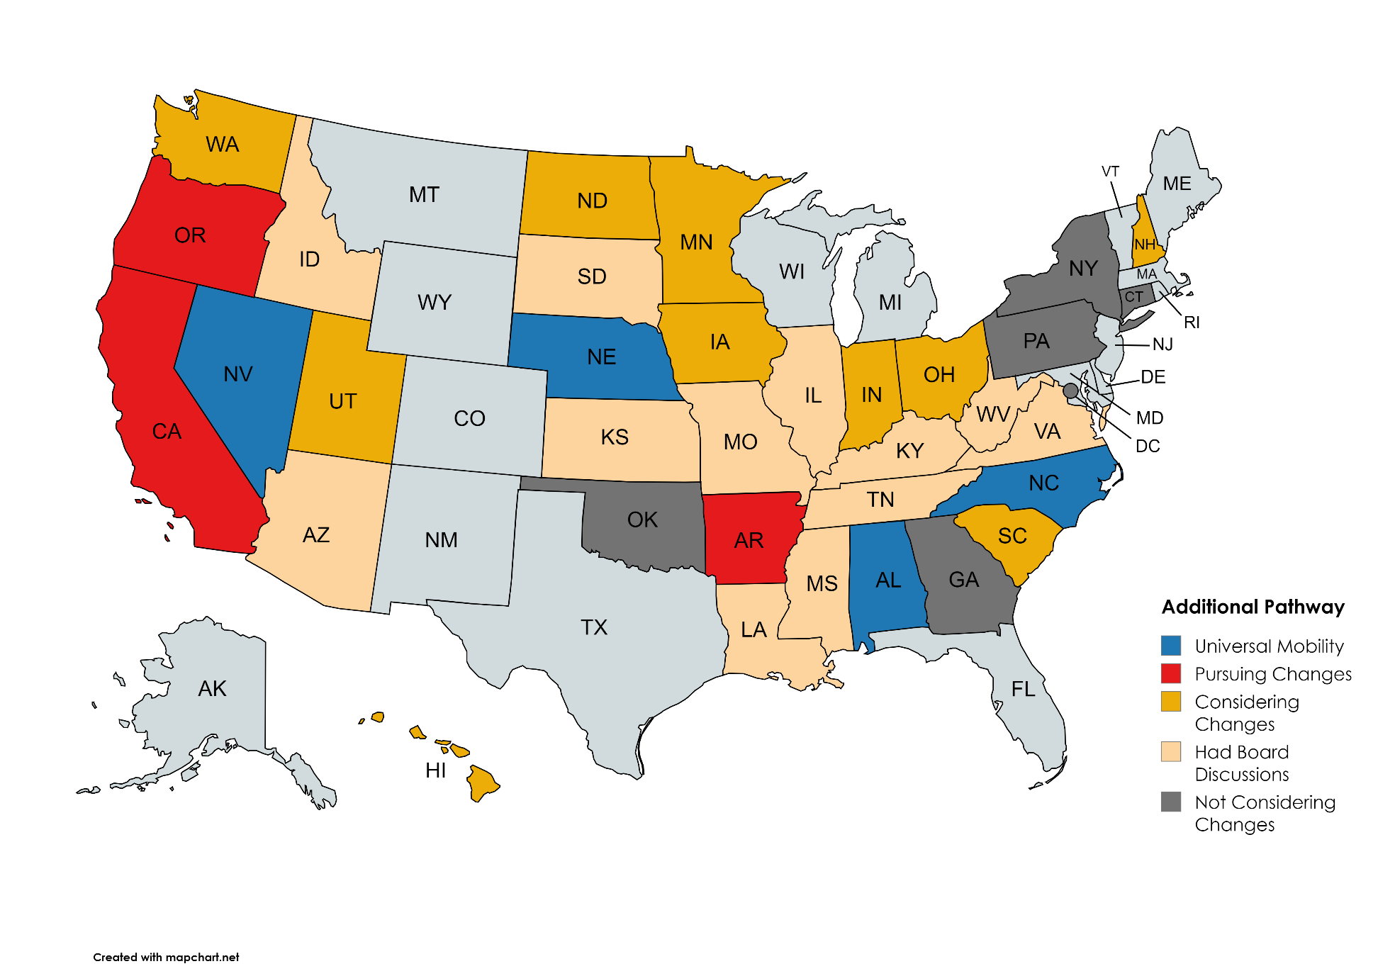
Additional Pathway August 2024
Notes:
Automatic Mobility (4): NV, NE, NC, AL
Moving forward with changes (3): AR, OR, CA
States talking about change (11): WA, MN, IA, OH, SC, NH, ND, NV, HI, UT, IN
Whispers (7): OK, MO, IL, LA, WV, NY, MS
Total = 25

Slide 15
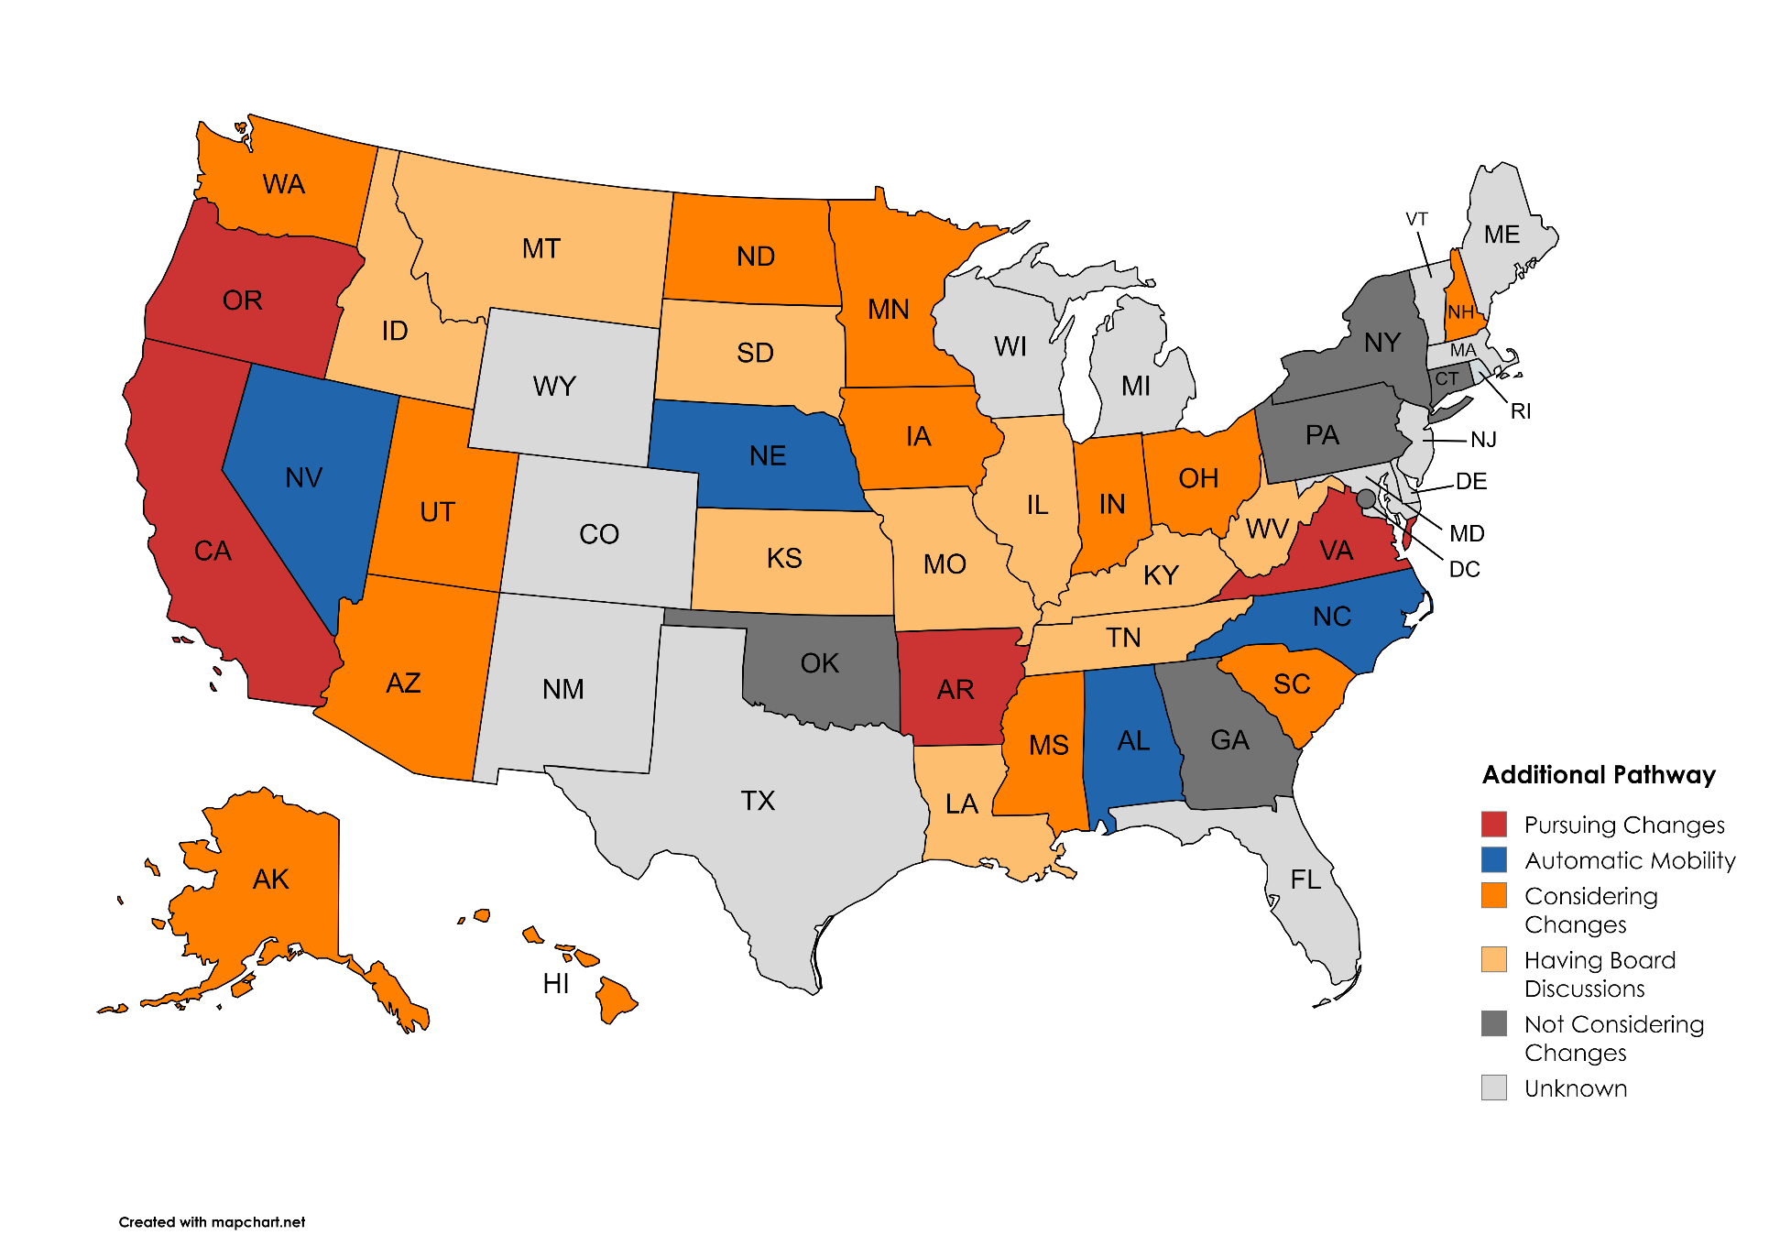
Additional Pathway October 2024
Notes:
Automatic Mobility (4): NV, NE, NC, AL
Moving forward with changes (4): AR, OR, CA, VA
States talking about change (13): WA, UT, AZ, ND, MN, IA, MS, IN, OH, SC, NH, HI, AK
Whispers (10): ID, MT, SD, KS, MO, IL, LA, KY, TN, WV
Total = 31

Slide 16
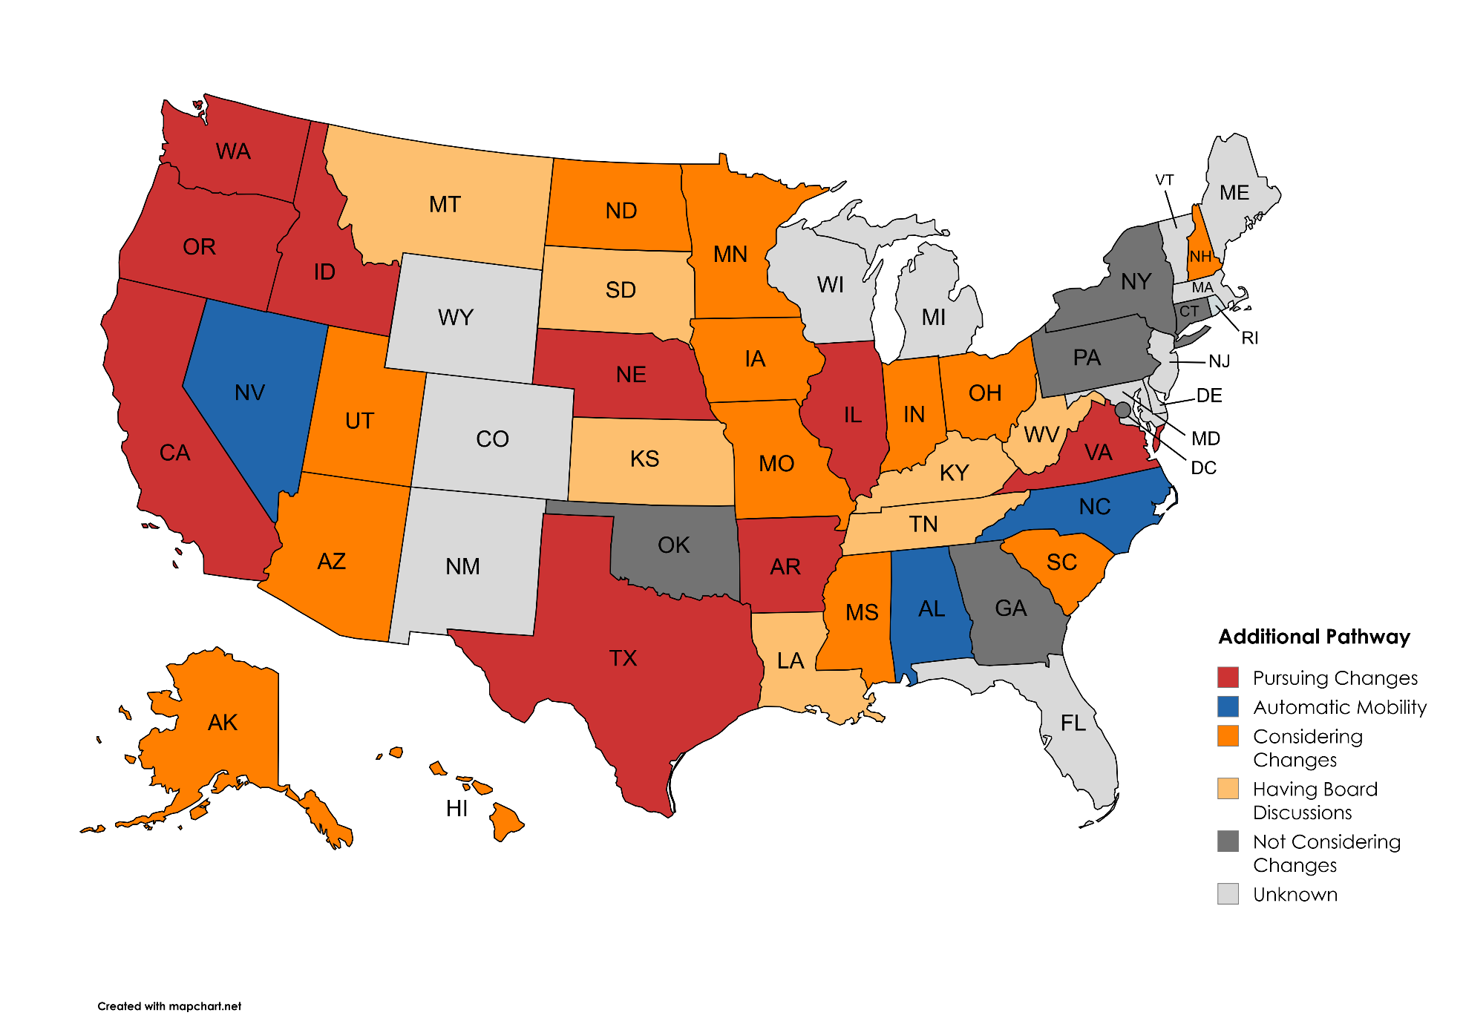
Additional Pathway November 2024
Notes:
Automatic Mobility (3): NV, NC, AL
Moving forward with changes (9): CA, OR, WA, ID, NE, TX, AR, IL, VA
States talking about change (13): UT, AZ, ND, MN, IA, MO, MS, IN, OH, SC, NH, HI, AK
Whispers (7): MT, SD, KS, LA, KY, TN, WV
Total = 32

Slide 17
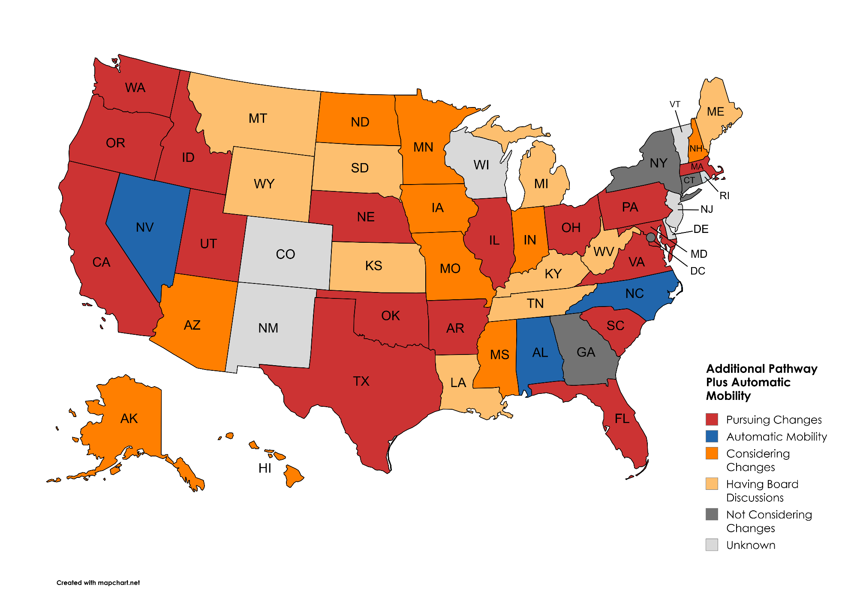
Additional Pathway Plus Automatic Mobility Nov 2024
Notes:
Automatic Mobility (3): NV, NC, AL
Moving forward with changes (17): CA, OR, WA, ID, UT, NE, OK, TX, AR, IL, OH, PA, VA, SC, FL, MD, MA
States talking about change (10): AZ, ND, MN, IA, MO, MS, IN, NH, HI, AK
Whispers (10): MT, WY, SD, KS, LA, MI, KY, TN, WV, ME
Total = 40
Unknown or Not pursuing (10) NM, CO, WI, DE, NJ, RI, VT, GA, DC, NY

Slide 18
NASBA’s Exposure Draft

Slide 19
Competency-Based Experience Pathway

Slide 20
Competency-based Experience

Slide 21
Competency-based Experience Certification Form

Slide 23
# 3
Substantial Equivalency

Slide 24
Automatic Mobility
(may be proposed)
Moving substantial equivalency out of statute to Board Rule
To accommodate moving target of Substantial Equivalency and Mobility
Automatic Mobility
Separating substantial equivalency and mobility
Retaining substantial equivalency with reciprocity

Slide 25
# 4
Arkansas Resident Initial Exam Support Program
ARIES

Slide 26
3 year, $250,000 pilot program
Reimburses Exam section fees for initial exam (currently $254.80)
Jurisdiction must be Arkansas
Must be Arkansas Resident:
Arkansas driver’s license
Employment offer letter from AR based company
20 requests received

Slide 27
# 5
Fees

Slide 28
Board Rule 12
Removes non-refundable status
Removes PA application fees
Removes Grade Transfer fees
Adds the following verbiage regarding exam section fees:
The Board may, by resolution, waive exam section fees (e.g. AICPA, NASBA and Prometric) for some or all applicants.

Slide 29
A.C.A. 17-12-306(d)
The applicable fees payable pursuant to this section shall be paid by the applicant at the time he or she applies for examination or reexamination unless the applicant is eligible for any Board program whereby any or all applicable fees are waived or assumed by the Board.

Slide 30
# 6
Other Changes

Slide 31
Board Rule 14 – Quality Review
Renames rule to Practice Review
Changes verbiage to match current practice
Corresponding changes in A.C.A. 17-12-507
Board Rule 16 – Experience Required
Repealed (incorporated into Board Rule 3)

Slide 32
Board Rule 19 – Service Members
Changes verbiage to match new law
A.C.A. 17-12-504 – Renewals and Renewal Fees
Sets July 1st as day that license is revoked if not renewed, retired or surrendered.

Slide 33
3 Proposals to Address the Accounting Pipeline and Barriers to Entry
Presented to Arkansas Secretary of Labor Daryl Bassett
Presented by
Tim Montgomery, Executive Director of ASBPA
Stephanie Watson, on behalf of We Are Accounting

Slide 34
Alternate Path to Certification
Acct Majors
Accounting Pipeline (FT College Studies)
Education
CPAs Elig Accts
Experience
Year 1
Year 2
Year 3
Year 4
Year 5
+ 1 yr Experience
Proposal 1

Slide 35
Filling the Pipeline
Acct Majors
Acct Majors
Accounting Pipeline (FT College Studies)
Education
CPAs Elig Accts
Experience
Year 1
Year 2
Year 3
Year 4
Year 5
+ 1 yr Experience
Proposal 2

Slide 36
Proposal 3: Filling the Pipeline
aka Introducing Accounting Career Awareness
Step 1: Develop a 2-week Accounting Exploration Curriculum
Suitable for Arkansas students in grades 8–12 grades
To be delivered jointly by accountants and 8–12 grade teachers
We Are Accounting has just begun planning this curriculum

Slide 37
Proposal 3: Filling the Pipeline
Step 2: Staff and Training for Delivery
Current young accountants
Trained for delivery and marketing the profession
Need commitments from accounting employers
Step 3: Delivery Annually
Beginning in academic year 2025–2026
Need commitment from schools and teachers

Slide 38
Proposal 3: Benefits
More pre-college students learn about accounting as a career
And the 2-yr employment opportunity (proposal 2)
More accounting majors
More practicing accountants

Slide 39
Proposal 3: Ask the State of Arkansas
Coordination from Arkansas Department Education to get the program in every middle and high school
Financial assistance for We Are Accounting
Financial and Personnel Support from Arkansas State Board of Public Accountancy
Personnel Support from Arkansas Society of CPAs and their Emerging CPAs Committee

Slide 40
Mid-Pipeline Work Opportunity
Acct Majors
Accounting Pipeline (FT College Studies)
Education
CPAs Elig Accts
Experience
Year 1
Year 2
Year 3
Year 4
Year 5
+ 1 yr Experience
Proposal 3

Slide 41
Proposal 2: Mid-Pipeline Work Opportunity
aka Accounting Jobs after 2 years of education
Step 1: Meet with Accounting Employers around the state
Develop a set of requirements to earn in 2 years of education (e.g., courses, skills)
Commit to hiring students meeting these requirements with parameters (e.g., duration, pay, encouragement for continuing education in accounting)
Step 2: Meet with 2- and 4-year institutions
Identify existing curriculum that meets requirements
Or Develop that curriculum

Slide 42
Proposal 2: Mid-Pipeline Work Opportunity
Step 3: Develop an application process
Website to apply
Mechanism to match with employers
Media and publicity

Slide 43
Investigation Difficulties

Slide 44
Questions???
Board staff members are always available to answer any questions about this course or any accountancy statutes or Board rules.
www.arkansas.gov/asbpa
tim.montgomery@arkansas.gov
The Board is here to help every Arkansas CPA licensee

