Slide 1
An Introduction to the UCA Core The UCA Experience Explore. Enrich. Empower
This presentation is intended to assist you in navigating and getting the most out of your Core experience as you progress towards your degree at UCA.
This presentation is not a substitute for the advice or guidance of your advisor.

Slide 2
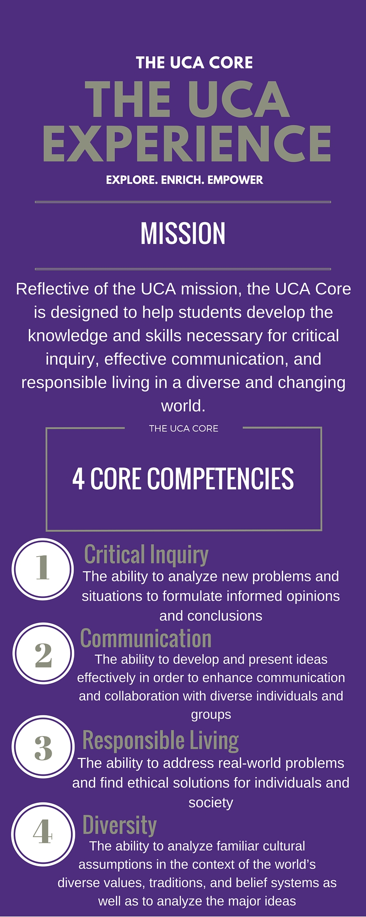
What is the UCA Core?
The UCA Core is a comprehensive course of study comprised of a lower (LD) and upper (UD) core curriuclum, and carried through the student’s entire undergraduate career. The Core introduces, develops, and applies fundamental competencies around four knowledge and skill areas:
Critical Inquiry (I) – The ability to analyze new problems and situations to formulate informed opinions and conclusions;
Effective Communication (C) – The ability to develop and present ideas logically and effectively in order to enhance communication and collaboration with diverse individuals and groups;
Responsible Living (R) – The ability to address real-world problems and find ethical solutions for individuals and society;
Diversity (D) – The ability to analyze familiar cultural assumptions in the context of the world’s diverse values, traditions, and belief systems as well as to analyze the major ideas, techniques, and processes that inform creative works within different cultural and historical contexts.

Slide 3
Why is there a UCA Core?
The Core, as a general education program, is the foundation of a liberal education at UCA.
“A liberal education helps you achieve broad knowledge and a set of skills and capacities that you need for all kinds of careers and for the rest of your life as well.” (from Robert Schoenberg, What Will I Learn in College?, 6)
A good liberal education prepares students to be successful in their careers as well as engaged, responsible members of their communities.

Slide 4
What is a Liberal Education?
A Liberal Education provides:
1) Knowledge of Cultures and the Physical and Natural World.
2) Intellectual and Practical Skills, including:
- Critical Thinking and Inquiry
- Written and Oral Communication
- Quantitative literacy
- Teamwork and Problem solving
3) Development of Personal and Social Responsibilities.
- Anchored through involvement with diverse communities and
real-world challenges. (from Robert Schoenberg, What Will I Learn in College?)

Slide 5
The Core as Liberal Education
The UCA Core is designed to:
Help students develop the knowledge and skills recognized as fundamental to a broad liberal education and necessary for success in a diverse and ever-changing world.
Develop and build knowledge and skill areas across the curriculum from introductory, lower division courses to junior and senior level, upper division course work.
Apply what the student has learned in a culminating, capstone experience.
Complement the knowledge and skills particular to any field of study or career path.

Slide 6
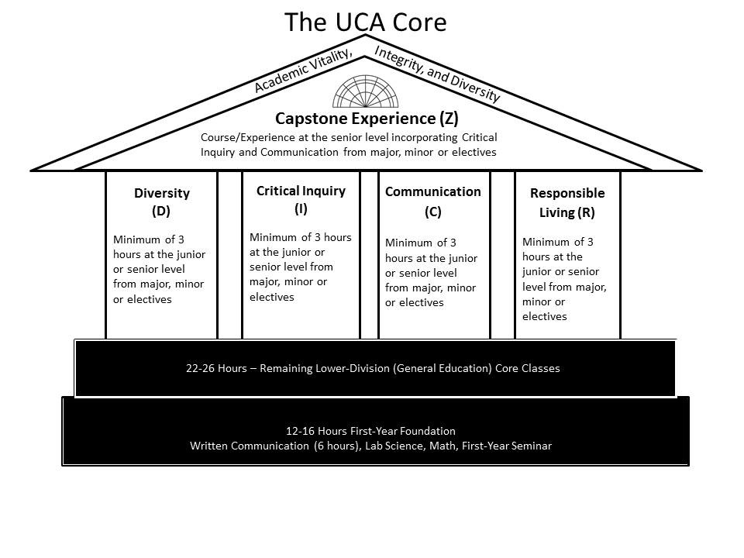
The Lower Division (LD) Core
In the Lower Division (LD) Core, courses introduce and develop the four competencies of Critical Inquiry, Effective Communication, Responsible Living, and Diversity.
The LD Core is comprised of 38 credits spread across these four competencies.
In these courses, foundational skills are introduced and the groundwork laid for further development.

Slide 7
The Checksheet
The LD Core provides great opportunities to explore during your educational journey. Don’t just check boxes. Use your LD Core requirements as a chance to learn something new, something different, and learn about yourself.
Find the LD Core Checksheet here:
http://uca.edu/academicbulletins/ld-uca-core/

Slide 8
Breadth Requirements
What are Breadth Requirements?
At UCA, in addition to your LD Core area requirements you also have to satisfy breadth requirements.
As you move through the LD Core and take your 38 credits of lower division credit you need to:
1) Take at least one course designated a Fine Arts (FA)
2) Take at least one course designated a Humanities (HUM)
3) Take an additional Social Science (SS) outside of the Social Sciences category.
These course designations are indicated on the checksheet.
Why are there Breadth Requirements?
In order for UCA’s Core to be consistent with Arkansas’s state minimum core students must meet these particular educational requirements. For more information on the state minimum core see: http://uca.edu/academicbulletins/files/2015/09/state-minimum-core.pdf
The value of breadth requirements is to be found in introducing a student to the intellectual life of the university and in providing students exposure to multiple perspectives.

Slide 9
First-Year Seminars (FYS)
First-Year Seminar courses provide a highly interactive, small-class learning environment for first-year students. Students work together in small groups to develop skills in team work and written communication as well as knowledge in one other Core area (Diversity, Critical Inquiry, or Responsible Living) as it applies to the subject matter of the course. Students also learn about the importance of general education and its place at UCA. In addition, these courses offer support for the unique needs of first-year students, providing discussions about issues such as effective study skills and exam preparation as well as orientation information about the services UCA provides to support students.

Slide 10
First-Year Seminars (FYS)
In addition to your breadth requirements noted previously, during your first year, one course must be designated a First-Year Seminar (FYS). See the online class schedule to find sections designated as FYS.
At UCA we know your first year is crucial to your future success which is why we developed and require FYS courses for all first-time students.
FYS courses offer a unique first experience with academic life at UCA.
FYS courses provide a valuable opportunity to learn about college, UCA, and build connections to campus.

Slide 11
The Lower Division (LD) Core Take Control of Your Education. Maximize Your UCA Experience.
Work through the LD Core Checksheet. Meet all area requirements. Explore your educational opportunities!
Meet your breadth requirements (FA, HUM, and SS)
Take a First-Year Seminar (FYS)
Note: many courses meet several requirements. A single course may meet your Fine Arts/Humanties LD Core requirement, your (HUM) breadth requirement, and be an FYS. Some LD Core courses may also meet major or minor requirements. If you have questions please contact your advisor, the advising center at: AdvisingCenter@uca.edu, 450-5149, or the Director fo the UCA Core at: jmheld@uca.edu, 450-3634.

Slide 12
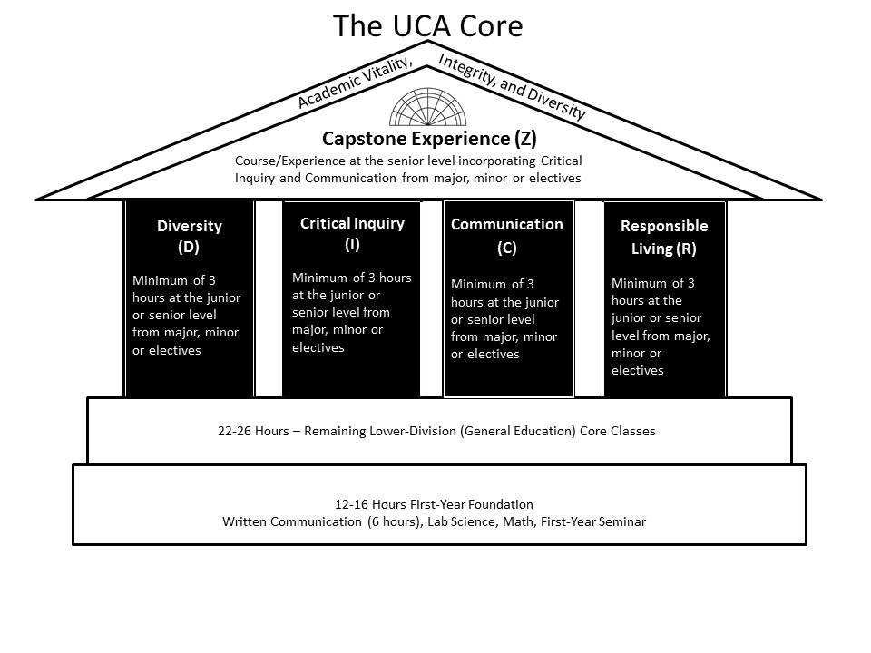
The Upper Division (UD) Core
In the Upper Division (UD) Core, courses are intended to further develop, and afford opportunities to apply, skills in Critical Inquiry, Effective Communication, Responsible Living, and Diversity.
The UCA Core is about foundational skills and competencies, not career or degree specific knowledge or skills.
These competencies are fundamental for any well-developed human being and in all facets of life.

Slide 13
Critical Inquiry (I), Effective Communication (C), Diversity (D), and Responsible Living (R)
Resources:
For a list of UD Core courses that don’t have any pre-requisites or only pre-requisites in the LD Core see: http://uca.edu/academicbulletins/upper-division-uca-core/
For a complete listing of all courses designated in the UD Core see the uBulletin at: http://uca.edu/ubulletin/
Questions? Contact your advisor or the Director of the UCA Core (Dr. Held) at jmheld@uca.edu, 450-3634
Courses in the UD Core (3000, 4000 level) are designated as Critical Inquiry (I), Effective Communication (C), Diversity (D), Responsible Living (R), or Capstone (Z).
All students must take at least one course designated in each of the UD Core areas.
A single course may be designated as meeting up to two areas, except capstone courses. For example, a course may meet C and I, or D and R.
Many major or minor specific courses are designated in the UD Core.

Slide 14
Capstone Experience (Z)
The UCA Experience
Explore. Enrich. Empower.
Courses in the UD Core at UCA offer opportunities for students to hone those skills developed at the Lower Division and provide summative experiences where students demonstrate how far they’ve come along their educational journey at UCA. The UD Core culminates in a Capstone Experience (Z) that integrates communication and critical inquiry alongside one’s chosen field of study. Capstones are opportunities for students to engage in an integrative educational experience drawing from their comprehensive education.

Slide 15
The Upper Division (UD) Core Take Control of Your Education. Maximize Your UCA Experience.
The LD and UD core work together to provide a comprehensive, developmental experience across your entire education at UCA.
Take courses designated: I, C, D, R, and Z
Note that some courses meet two UD Core areas, and many major or minor requirements also meet UD Core requirements.
If you have questions please contact your advisor, the advising center at: AdvisingCenter@uca.edu, 450-5149, or the Director of the UCA Core at: jmheld@uca.edu, 450-3634.

Slide 16
Resources
If you have questions please contact your advisor, the advising center at: AdvisingCenter@uca.edu , 450-5149, or the Director of the UCA Core at: jmheld@uca.edu , 450-3634.
The UCA Core website is located at: www.uca.edu/core
Find us on Facebook or Twitter, “University of Central Arkansas Core”
Monitor your Degreeworks worksheet. For a helpful “How to” presentation on Degreeworks and the UCA Core see the UCA Core website.

