Slide 1
Electronic Budget Transfer Information

Slide 2
The Electronic Budget Transfer :
Will only allow temporary transfers (BD04)
Only process whole dollars (do not use cents)
Will only allow transfers between maintenance and operation (M&O) lines
Will not process budget transfers if it involves:
        Salary Lines
        Expense Transfers
        Research or Matching Index (R or M as part of the index)
        Grants/Restricted Funds
        Account Code beginning with a “5” or “8”
        ***If the transfer involves these lines, a paper budget transfer will need to be completed.

Slide 3
Types of Electronic Budget Transfers
Budget Transfer (Maximum of 2 lines)
Multiple Line Budget Transfer (Maximum of 5 lines)

Slide 4
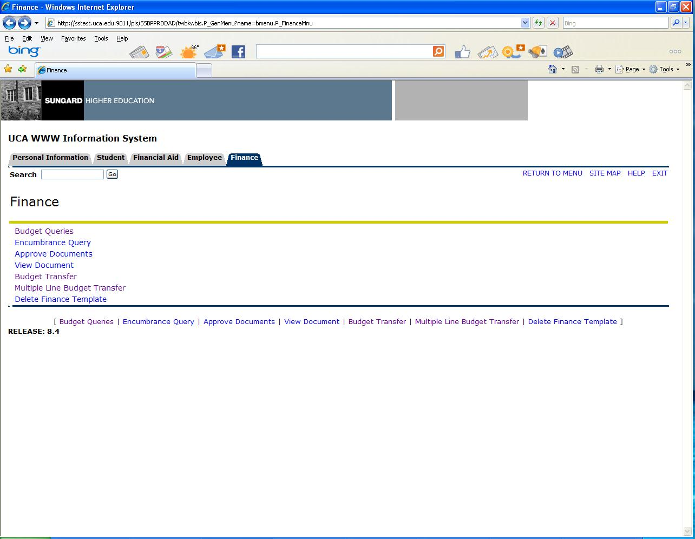

Slide 5
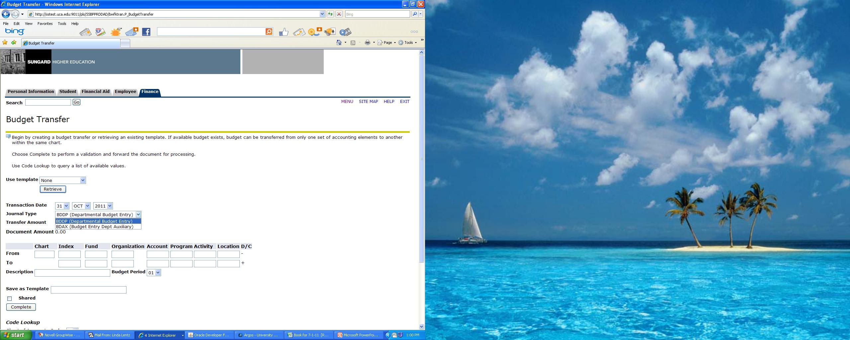

Slide 6
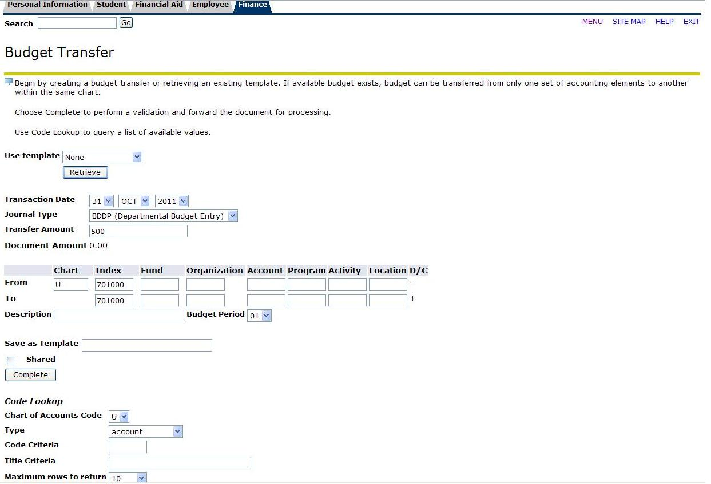

Slide 7
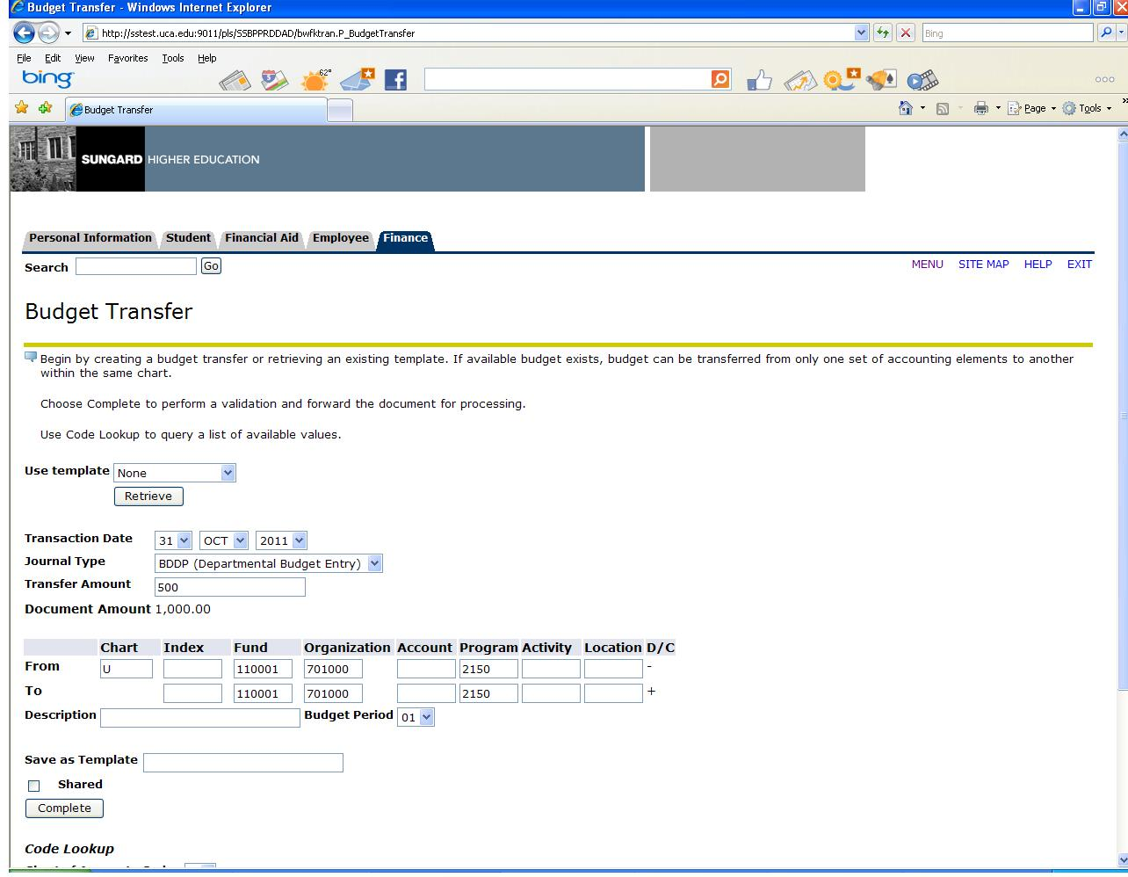

Slide 8
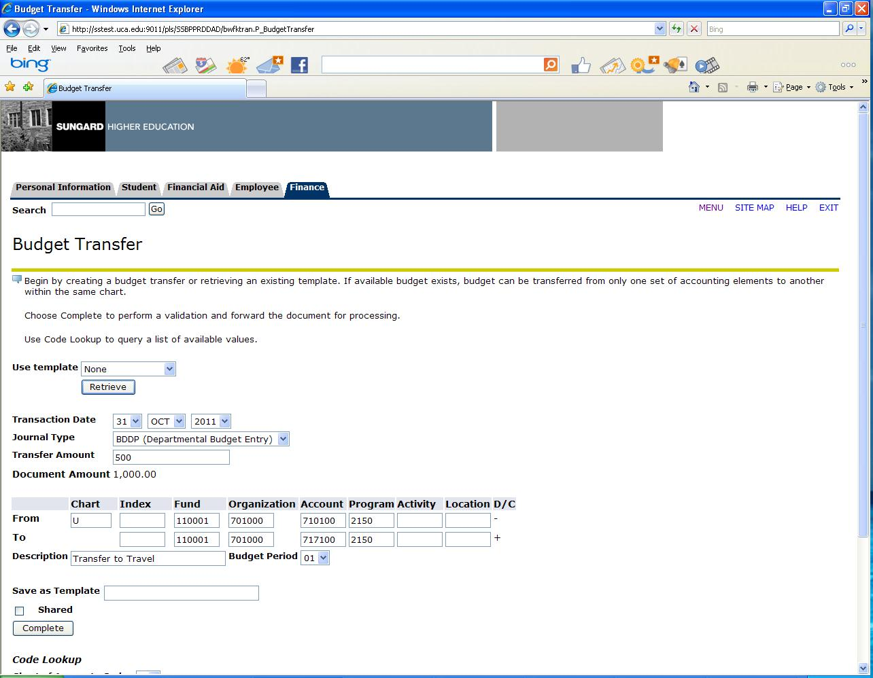

Slide 9
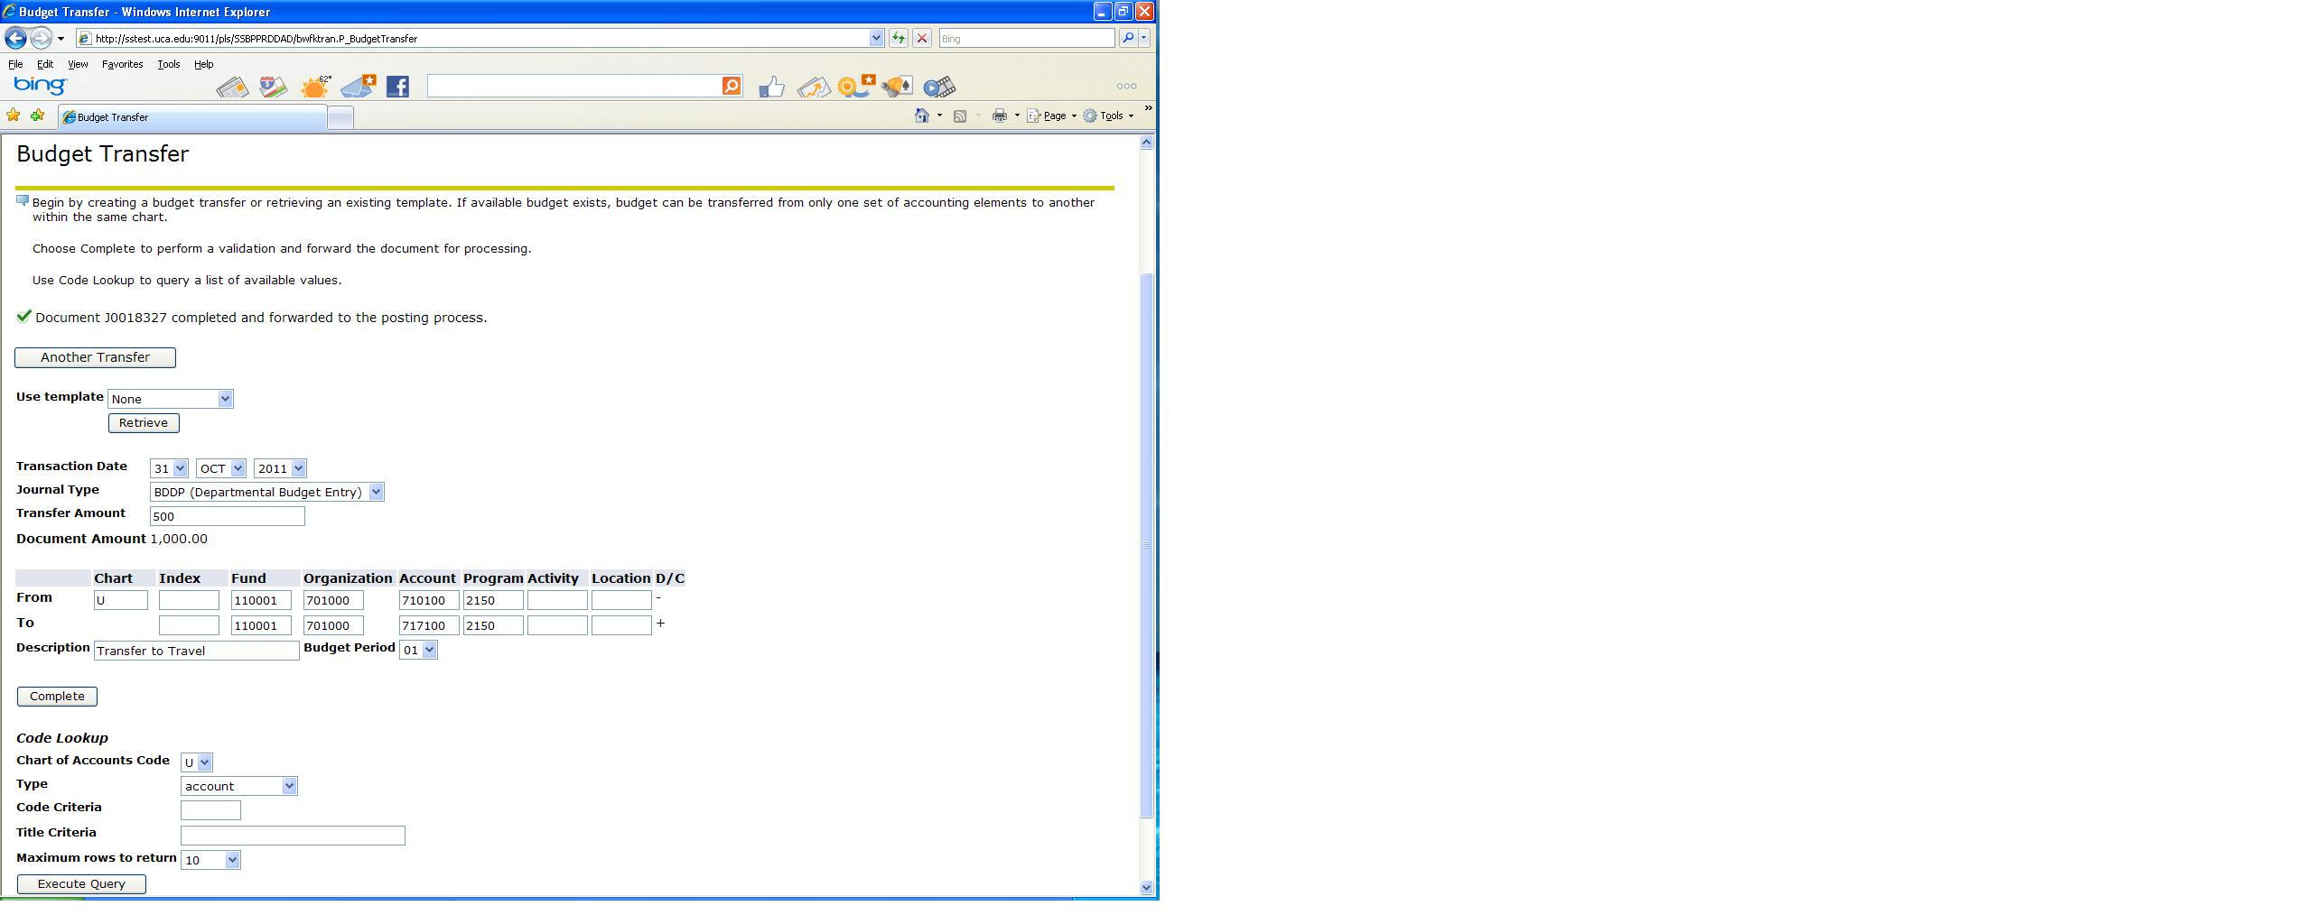

Slide 10
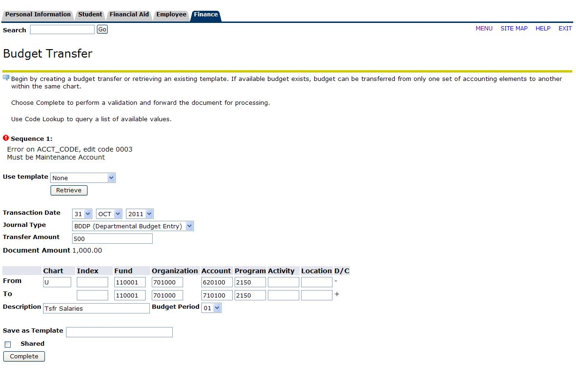

Slide 11
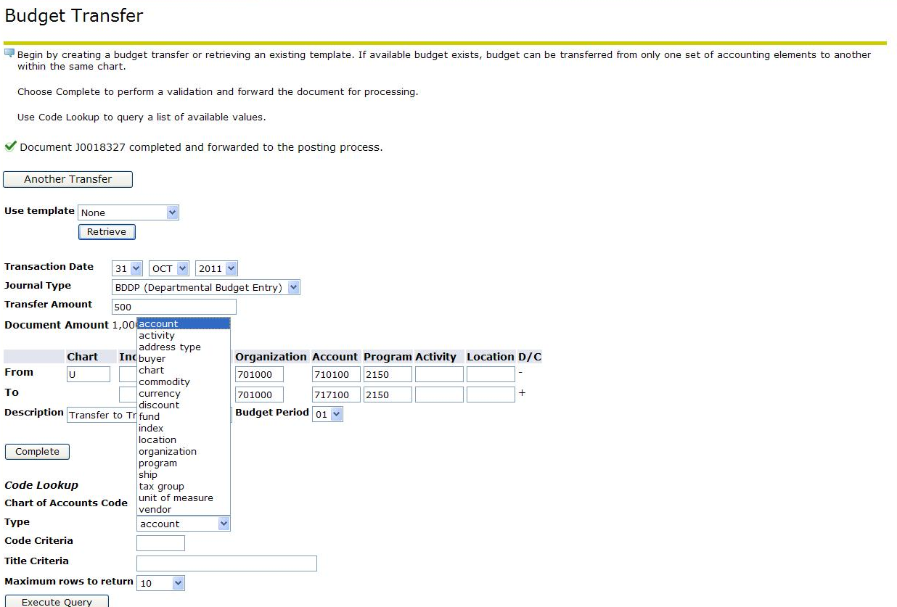

Slide 13
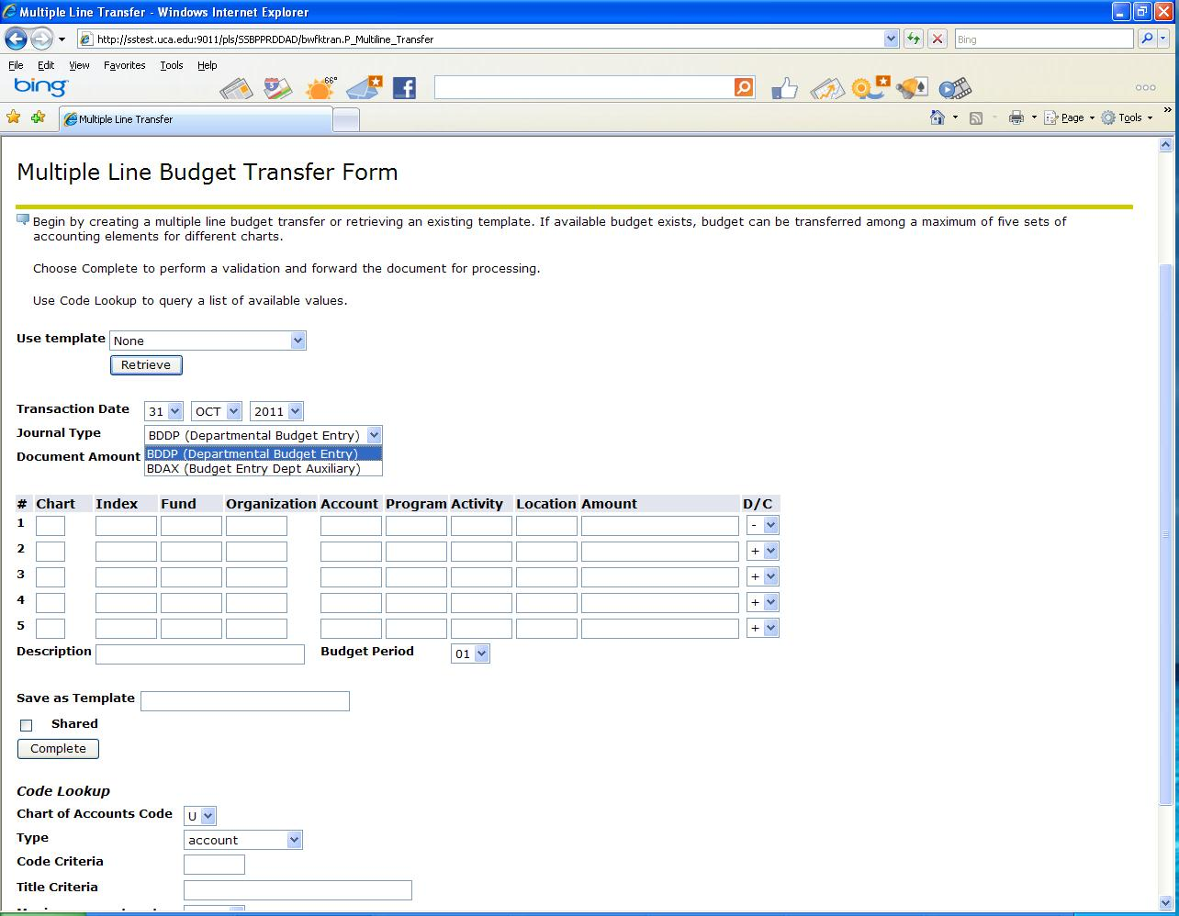

Slide 14
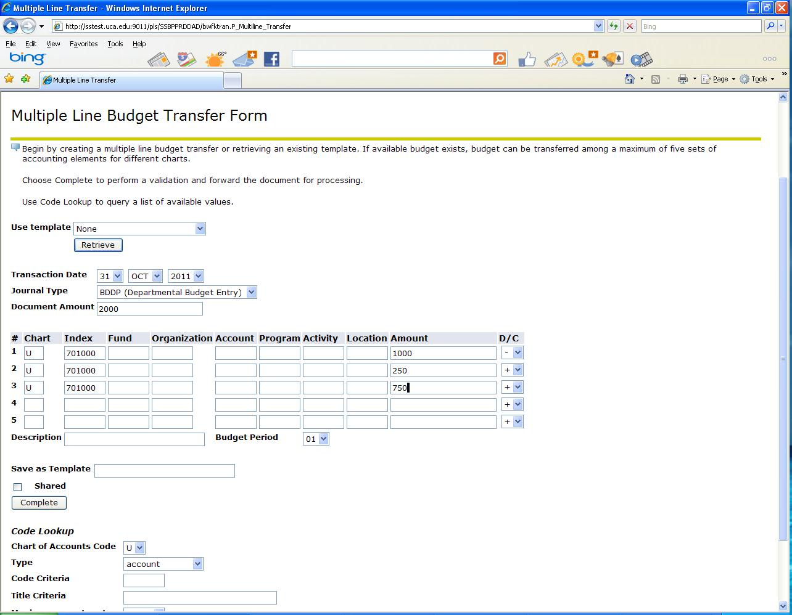

Slide 15
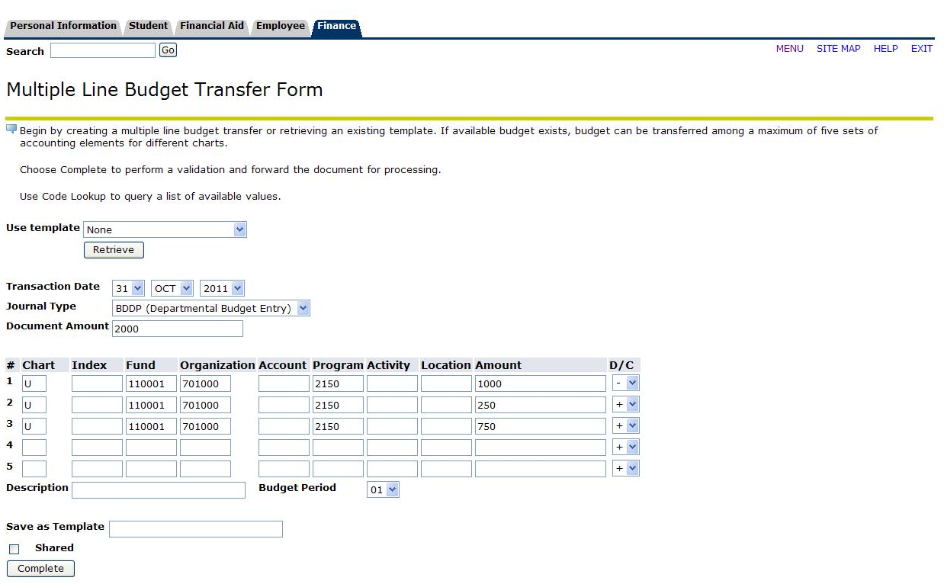

Slide 16
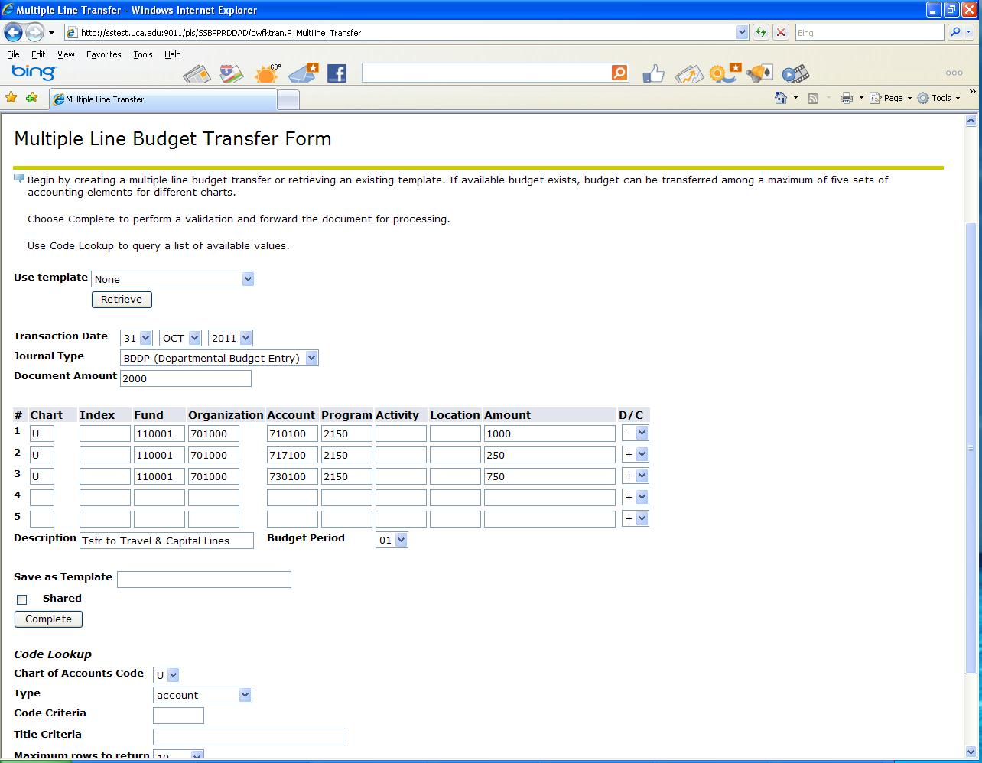

Slide 17
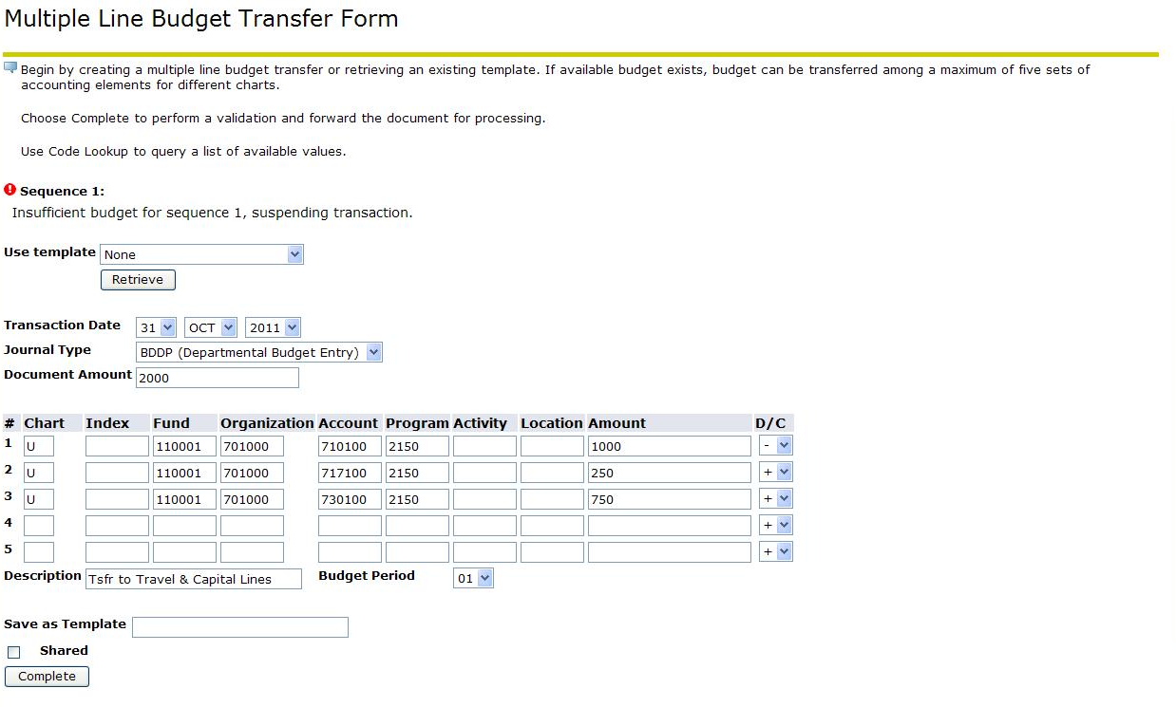

Slide 18
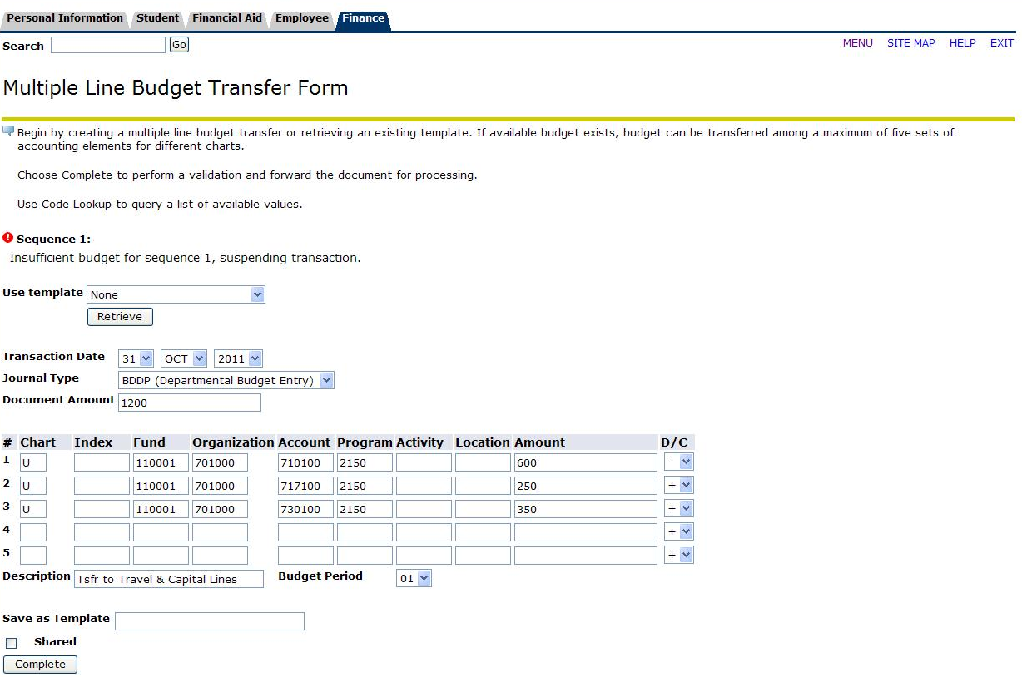

Slide 19
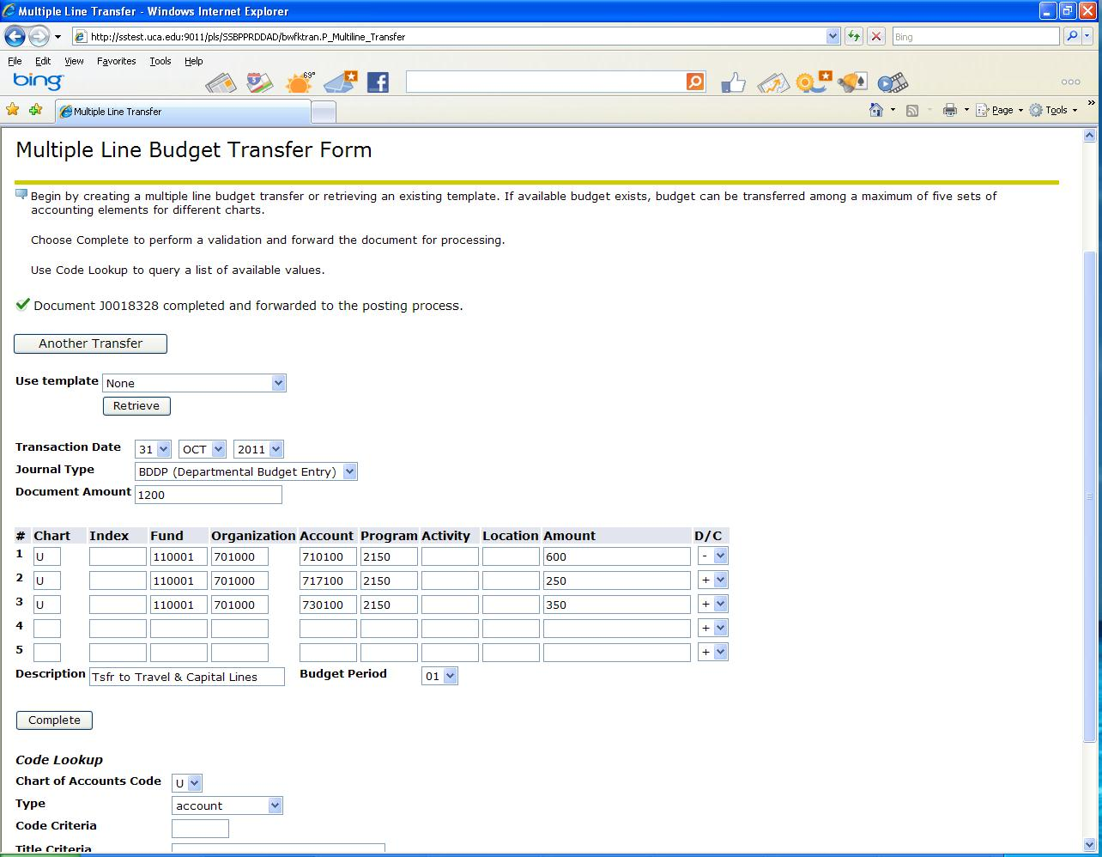

Slide 20
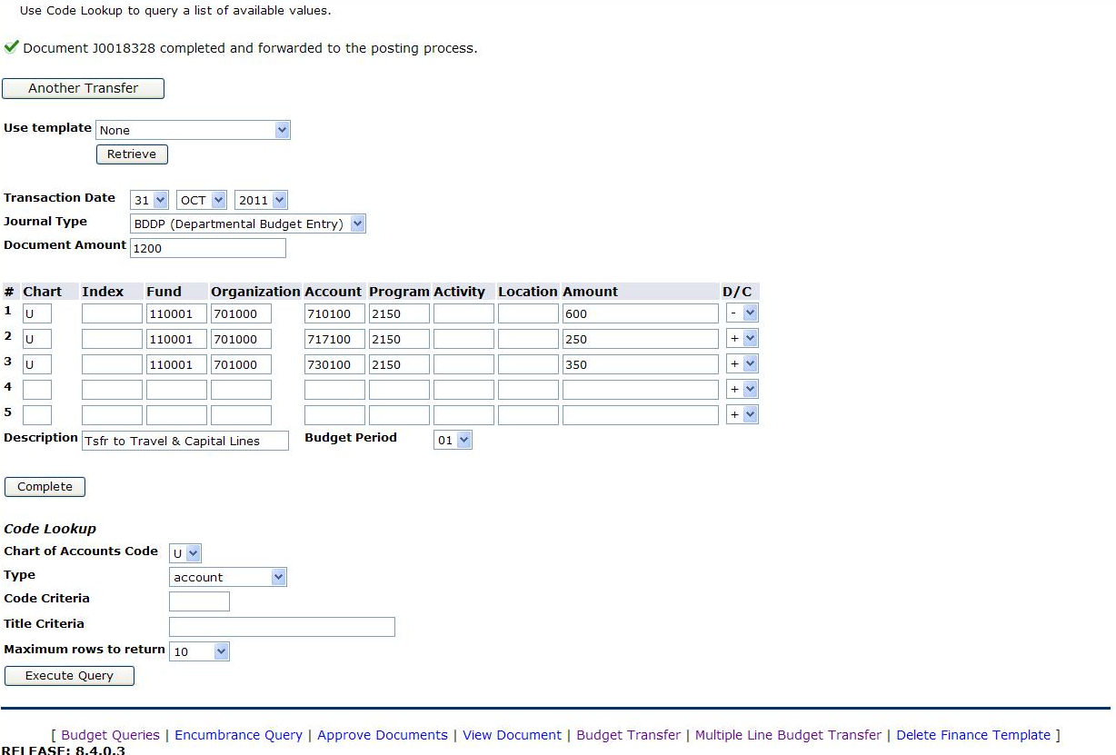

Slide 21
Electronic Budget Transfer Access
Access will be designated by:
  Vice President
  Dean
  Department Chair or Director
  ***Department Chair or Director can only process transfers within their department
  Access only to prior banner finance index(es)
  Access Forms located on the Budget Office webpage

Slide 22
Submit Access Form

